Slide 1
HeineOS Assignment Material: Coroutines
Prof. Dr. Michael Schöttner
Dr. Fabian Ruhland

Slide 2
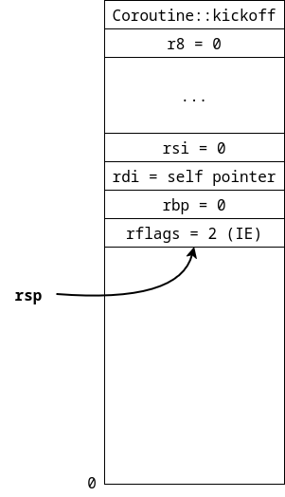
Coroutine::prepare_stack()
This function prepares the stack for starting a coroutine
Every register is manually pushed onto the stack (most general purpose registers are set to 0)
Coroutine::kickoff() is used as return address at the top of the stack → starting point for all coroutines
Coroutine::kickoff() expects a &mut self reference
→ first parameter of a function is expected to be in RDI register
rsp is stored in stored in Coroutine::stack_ptr

Slide 3
Starting the first coroutine
Call Coroutine::start() on a Coroutine object
This calls coroutine::coroutine_start(),an assembly function
Switches to the prepared stack
Pops the values from the stack into the designated CPU registers
Returns into Coroutine::kickoff()
The parameter for Coroutine::kickoff() must be loaded into rdi stehen (prepared on the stack)
unsafe extern "C" fn coroutine_start(stack_ptr: usize) { … }
pub fn start(&mut self) { unsafe { coroutine_start(self.stack_ptr); } }

Slide 4
Switching Coroutines
A switch between coroutines is initiated by calling Coroutine::switch()
This way, the active coroutine can switch to next one
Every coroutine stores a next pointer
The switch itself is performed in coroutine::coroutine_switch()
unsafe extern "C" fn coroutine_switch(current_stack_ptr: *mut usize, next_stack: usize) { … }
pub fn switch(&mut self) { unsafe { coroutine_switch(&mut self.stack_ptr, (*self.next).stack_ptr); } }

Slide 5
Switching Coroutines
coroutine::coroutine_switch(current_stack_ptr: *mut usize, next_stack: usize) is an assembly function :
Pushes the CPU register contents onto the stack and stores the current stack pointer (rsp)in current_stack_ptr afterward
Then, switches the stack pointer (rsp) to next_stack
Now, the CPU registers are popped from the new stack
Finally, return using ret → Resumes the coroutine
If a coroutine is switched to for the first time, coroutine::coroutine_switch() returns into Coroutine::kickoff() (similar to starting the first coroutine with Coroutine::start())
Otherwise, ret returns into coroutine::coroutine_switch() and from there to where the coroutine left, when it initiated the switch.

