Slide 1
HeineOS Assignment Material: Assembly
Prof. Dr. Michael Schöttner
Dr. Fabian Ruhland

Slide 2
What is an Assembler?
A simple compiler, that translates assembly code into machine language
Assembly code = human-readable CPU instructions
Machine language = Binary representation of CPU instructions
Assembly language is more comfortable than machine language
Instead of 000001011110100000000011 the programmer can write add ax,1000
Assembly instructions are uniquely mapped to binary machine instructions
Every CPU architecture has its own assembler
Assembly language | Machine language
add ax | 00000101
1000 (decimal) | 0000001111101000

Slide 3
What is an Assembler?
Contrary to real (higher level language) compilers, an assembler cannot translate many complex expressions
Assembly language
Assembly code = human-readable CPU instructions
Higher level constructs are broken down into simpler instruction by a compiler
No complex instructions
No convenient loops (mostly just goto equivalents)
No structured datatypes
No subroutines with parameter passing

Slide 4
Example
The expressions sum = a + b + c + d is too complex for an assembler and needs to be split into multiple instructions
The x86 assembler can only add two numbers at a time and store the result in one of the used variables (accumulator register)
The above expressions corresponds to these instruction in an assembly program:
sum = a; sum = sum + b; sum = sum + c; sum = sum + d;

Slide 5
Example
This program:
sum = a; sum = sum + b; sum = sum + c; sum = sum + d;
would look like this in x86 assembly language:
mov rax, [a] add rax, [b] add rax, [c] add rax, [d]
Assemblers only support primitive operations
Most assembler work line-oriented
One line matches one machine instruction
No semicolon necessary at the end of a line

Slide 6
Branch instruction if
Simple if-then-else constructs are too complex for an assembler
if (a== 4711) {
... } else { ... }
In x86 assembly language, this would look like the following:
cmp rax, 4711 ; compare eax to 4711 jne unequal ; if rax != 4711 → jump to unequal equal: ... ; otherwise, continue here (if-branch) jmp after ; jump over else-branch unequal: ... ; else-branch after: ... ; continue with the rest of the program

Slide 7
A simple for loop
Simple counting loops are supported by the x86 instruction set
The following loop...
for (i = 0; i < 100; i++) { sum = sum + a; }
...looks like this in assembly language:
mov rcx, 100 loop_start: add rax, [a] loop loop_start
The loop instruction implicitly decrements the rcx register and only jumps to the specified label, if rcx is not 0.

Slide 8
CPU Register
Assembly language does not support arbitrary variables → Parameter values or computation results are stored in CPU registers
A CPU register is an extremely fast, but very small, temporary storage inside the CPU, that can store 64 bits in x86_64 CPUs (extensions like SSE or AVX introduce larger registers with up to 512 bits for vector operations)
The actual variables of a high level language are translated to memory addresses inside the data segment of an object file
To perform calculations using a variable, its value must first be loaded into a CPU register from the corresponding memory address
Only a limited amount of variables fit into the few available registers
The mapping variable <=> register changes over time

Slide 9
Memory
Oftentimes, a problem cannot be solved using register alone
Accessing main memory is necessary
The main memory acts like a giant array of registers, that may be 8, 16, 32 or 64 bit wide
A byte is the smallest addressable unit
Memory cells are enumerated (index)
Access times are much slower (~70 ns) compare to CPU registers (~1 ns)
To access a value in main memory, the programmer must know its index inside the memory → This is called the value’s address
Main memory indexed in bytes, ascending from 0

Slide 10
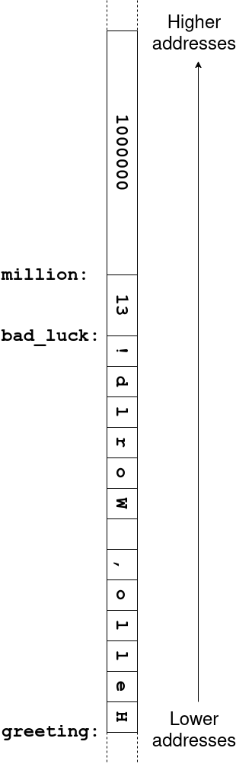
Memory: Example
[SECTION .data] greeting: db ‘Hello, World!‘ bad_luck: dw 13 million: dq 1000000 [SECTION .text] mov rax, [million] db: define byte dw: define word (2 byte) dd: define double word (4 byte) dq: define quad word (8 byte)

Slide 11
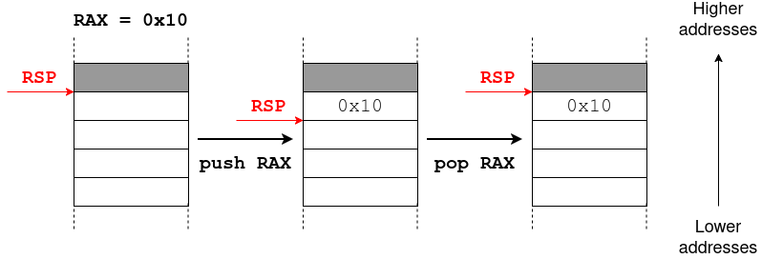
Stack
The push instruction puts values on top of the stack, while pop removes the topmost value from the stack
The current memory address for push/pop is stored in a special registers called Stack Pointer (RSP register in x86_64) → Always points to the last used entry
Programmers do not need to worry about the concrete stack pointer value, only about the order in which values were pushed onto the stack
push and pop always use 32 or 64 bit values (depending on the CPU mode)

Slide 12
Addressing modes
Most x86 instructions can take operands either out ouf registers, the main memory or immediate constants
The mov instruction works with the following addressing modes, where the first operand ist always the target and the second operand is always the source (NASM-syntax)
Register addressing: The value of one register is transferred into another one mov rbx, rdi
Immediate addressing: A constant value is loaded into a register mov rbx, 1000
Absolute addressing: The value stored at a given memory address is transferred into a register mov rbx, [1000]
Register indirect addressing: The value stored at the memory address, pointed to by the second register, is loaded into the first register mov rbx, [rax]
Base register addressing: The value stored at the memory address, pointed to by the sum of the second register’s content and a constant value, is loaded into the first register mov rax, [10+rsi]

Slide 13
Functions
Higher level languages introduce the concept of functions or procedures
In contrast to a simple goto, procedures may be called from anywhere in the program and after it returns, the program continues automatically with next instruction after the procedure call
The procedure does not need to know from where it was called where the program continues afterward, as this automatically handled using the stack
Not only its data, but the program itself (code) resides in main memory → Every machine language instruction is uniquely addressable in memory
To let the processor execute a program, its instruction pointer needs to point to the address of the program’s first machine language instruction
The instruction pointer itself is a special register (rip for x86_64 CPUs)
The processor executes the instruction pointet to by rip and then automatically increases rip by the length of the executed instruction

Slide 14
Functions
A jump instruction (e.g. jmp, jne, je, …) does not increase the rip by its length, but …
… either sets the rip directly to the given address (absolute jump)
… or increases/decreases the rip by a relative offset
Calling a function/procedure behaves similar to a jump instruction, but also pushes the old rip value (+ instruction length) beforehand (this is called the return address)
When returning from a function, the return address is popped from the stack and the CPU jumps to it.
In the x86 instruction set, call implicitly stores the return address on the stack and jumps to a function, while ret returns from a function to the return address on the stack:
; ------- Main program ------- main: ... call f1 xyz: ... ; ------- Function f1 ------- f1: ... ret

Slide 15
Application Binary Interface (ABI)
If a function should take parameters, these are passed in CPU registers or on the stack
How this works exactly is specified by the ABI
Size and byte order of primitive data types
Calling conventions: Where are parameters and return values stored (Register/Stack)
In general, the ABI describes an interface between two binary parts of a program
We use the System V ABI for AMD64
https://www.uclibc.org/docs/psABI-x86_64.pdf

Slide 16
Functions with parameters
If a function takes parameters, the first six parameters are passed in registered, and any additional ones on the stack (x86_64 with System V ABI)
Naturally, this has to be prepared before executing the call instruction
Afterward, the parameters need to be cleaned up, either by using multiple pop instructions, or by directly updating the stack pointer (rip).
Needs to be done after the call instruction, or when returning from the function (e.g. ret 16)
Parameter number | Register/Stack
1 | rdi
2 | rsi
3 | rdx
4 | rcx
5 | r9
6 | r9
>6 | stack

Slide 17
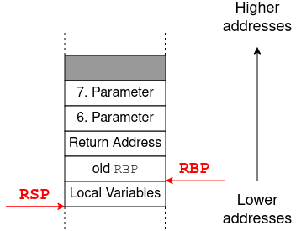
Typical Stackframe
Addressing of parameters on the stack via rbp register with a positive offset
Addressing of local variables on the stack via rbp register with a negative offset
In 64-bit mode, each stack entry is 64 bit wide

Slide 18
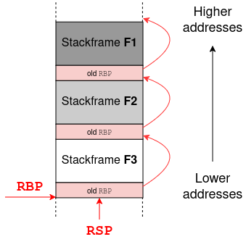
Chaining Function Calls
Example: Calling order F1 → F2 → F3
Stack frames are chained via the RBP entries of each frame

Slide 19
Integrating Assembly Code in Rust
For our coroutine implementation, we use naked functions that may only contain assembly code
#[unsafe(naked)]
unsafe extern "C" fn coroutine_start(stack_ptr: usize) {
unsafe {
naked_asm!(
"...", // 1. ASM instruction
"...", // 2. ASM instruction
"...", // 3. ASM instruction
...
)
}
}
The first parameter stack_ptr is passed via the rdi register
More informationo on inline assembly in Rust:
https://doc.rust-lang.org/reference/inline-assembly.html

