Slide 1
HeineOS Assignment material: Memory
Prof. Dr. Michael Schöttner
Dr. Fabian Ruhland

Slide 2
Aspects of Memory Management
Wasted memory (internal and external fragmentation)
Managing free/occupied memory
Reintegration of unused (freed) memory

Slide 3
Internal Fragmentation
If more memory is supplied than was requested, unused memory is wasted
On the other hand, sparing very small chunks of memory makes no sense → These small heap-chunks need to be managed and are almost unusable
This is especially critical, if many small chunks of memory are allocated
Example: 28 Byte are allocated, 32 Byte are supplied → 4 Byte are wasted
If this happens 1 billion times, we lose 4 GB of main memory
Chunk of memory on the heap
Used Data
Internal Fragmentation

Slide 4
Internal Fragmentation
Over time, allocations and deallocations result in many small chunks of free memory scattered throughout the heap
The heap may not be able to serve a large allocation request, although in theory enough free memory is available (but not coherent)
?
Heap
used
free

Slide 5
Internal Fragmentation
Compacting the heap solves this problem
This is time-consuming for many blocks and may require hardware support
Heap
belegt
frei

Slide 6
Managing free memory in a table
Free chunks of memory are managed in a separate table
Example (f=free, u=used, Unit: KB): 1f, 5u, 4f, 9u, 6f, 3u, 5f
0 1 6 10 19 25 28 33
Size | Adress
1 | 0
4 | 16
5 | 28
6 | 19

Slide 7
Managing free memory in a table
Advantages:
Easy to implement
Table can be stored in a separate memory area, protecting it from unintentionally being overwritten by the program
Disadvantages:
Memory demand for the table is unclear
Depends on the amount of free memory chunks → Unkown at compile time
An allocation of a free memory chunk results in a gap in the table → The table memory also needs to be managed

Slide 8
Managing free memory in a list
Link free chunks of memory through pointers
Example (f=free, u=used, Unit KB): 1f, 5u, 4f, 9u, 6f, 3u, 5f
End
0 1 6 10 19 25 28 33
Entry point of the free list

Slide 9
Managing free memory in a list
Advantages:
Does not require additional memory, as the free heap memory itself is used for storing the pointers and size information
Disadvantages:
If a program writes beyond the boundary of an allocated chunk, it may corrupt the list
Sequential search for a fitting block is slow
Optimization
Use multiple lists for different magnitudes of chunk sizes
Each list requires its own entry point

Slide 10
Managing free memory in a list
End of Heap
Detail-Ansicht mit Meta-Daten
Free
frei
Header
User Data
Pointer
(Returned by malloc)
Header
Free
Header
Entry point of free list
User Data
Pointer
(Returned by malloc)
Beginning of Heap
Header

Slide 11
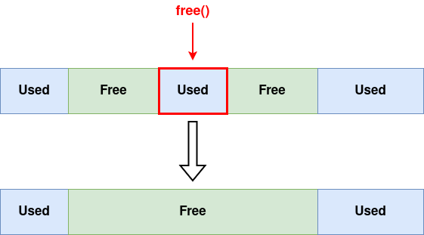
Reintegration of freed memory
When a chunk of memory is freed, check if other free chunks are immediately adjacent → If so, merge adjacent chunks
This prevents fragmentation of the heap into many small chunks

Slide 12
Memory Management in Rust
We create the heap directly after the kernel code/data (see consts.rs)
This is technically unsafe, as the physical memory at this location may be occupied by devices, the UEFI BIOS or bootloader data → A sophisticated allocator for physical memory is implemented in the second course
Our memory manager needs to implement the GlobalAlloc trait:
unsafe fn alloc(&self, layout: Layout) -> *mut u8
unsafe fn dealloc(&self, ptr: *mut u8, layout: Layout)
More information is provided in the code; Philipp Oppermann has written a nice article around mememory management in Rust: https://os.phil-opp.com/heap-allocation/

