Slide 1
PyB Status Update
Versions:
Python-PyB
Python-PyB (symbolic)
C-PyB
https://github.com/hhu-stups/pyB
20.08.2015 by John Witulski

Slide 2
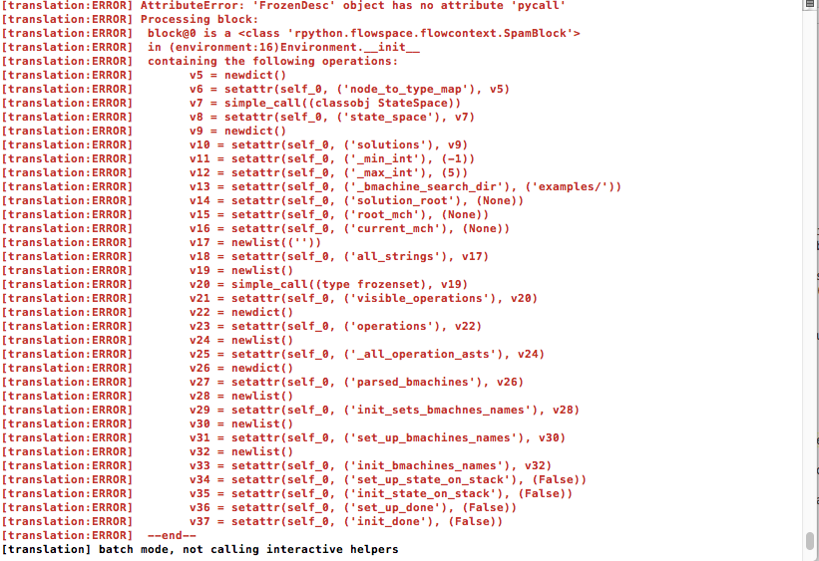
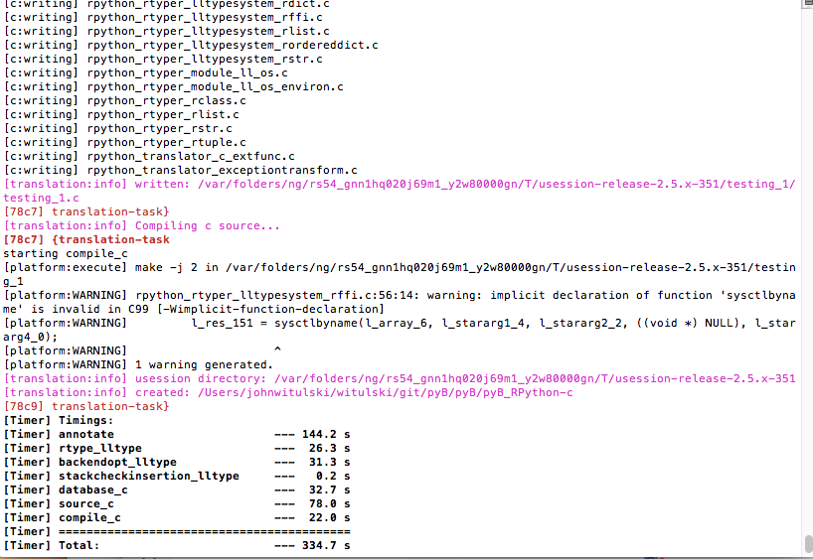
PyB Status Update
Manual and Rpython C – Executable
  1. Rpython Flags in config.py to True
  2. python ../pypy/rpython/translator/goal/translate.py --batch pyB_RPython.py
  No Flags /
  Wrong PYTHONPATH
  Flags:

Slide 3
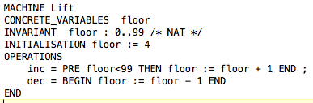
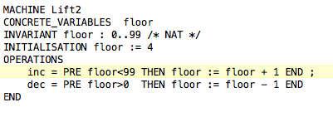
PyB Status Update

Slide 4
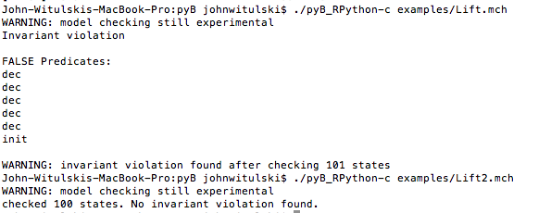
PyB Status Update
https://github.com/hhu-stups/pyB/blob/master/manual.pdf

Slide 5
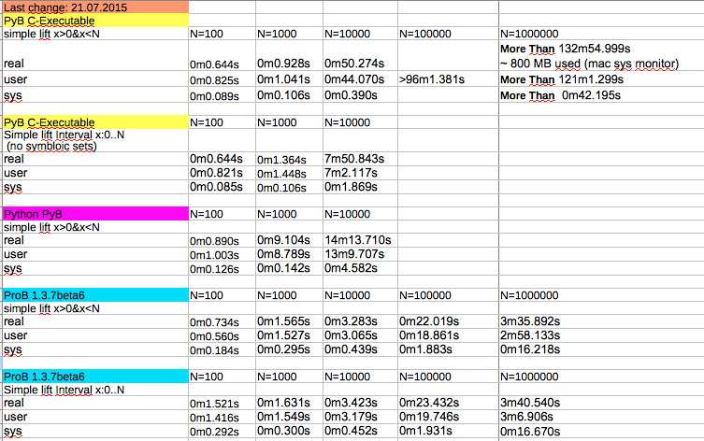
PyB Status Update
Model Checking

Slide 6
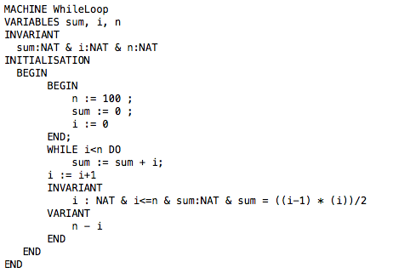
PyB Status Update
While loop: (TODO)

Slide 7
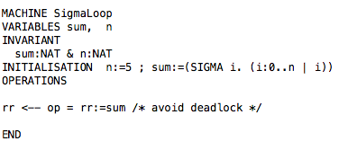
PyB Status Update
Quantifierts: (TODO)

Slide 8
PyB Status Update
NEXT:
  WhileLoop / Sigma Loop
  JIT
  C-PyB: State hashing
  C-PyB: add enumeration / symbolic sets

