Slide 1
PyB - Features
B interpreter in python
- Evaluates B-Predicates, B-Expressions, B-Machines
(Invariants/Properties/Constraints/Assertions/Operations)
- Reads and checks ProB Solutions Files
- animates B machines (still under development)
Written in Python, TDD (>600 tests), Uses a Java-B-Parser
Uses Constraint-solving (still under development)
Contact: John.Witulski@hhu.de
Checkout: https://github.com/hhu-stups/pyB

Slide 2
PyB - usage
Repl:
  Python pyB.py -repl
Eval Predicates, Expressions or Eval/Animate B-machines
  Python pyB.py B.mch
Use/Check ProB Solutions
  ./probcli -init -sptxt -animate <Number> solution_values.txt B.mch
  Prepend “#PREDICATE ” to solution_values.txt
  Python pyB.py -c B.mch solution_values.txt

Slide 3
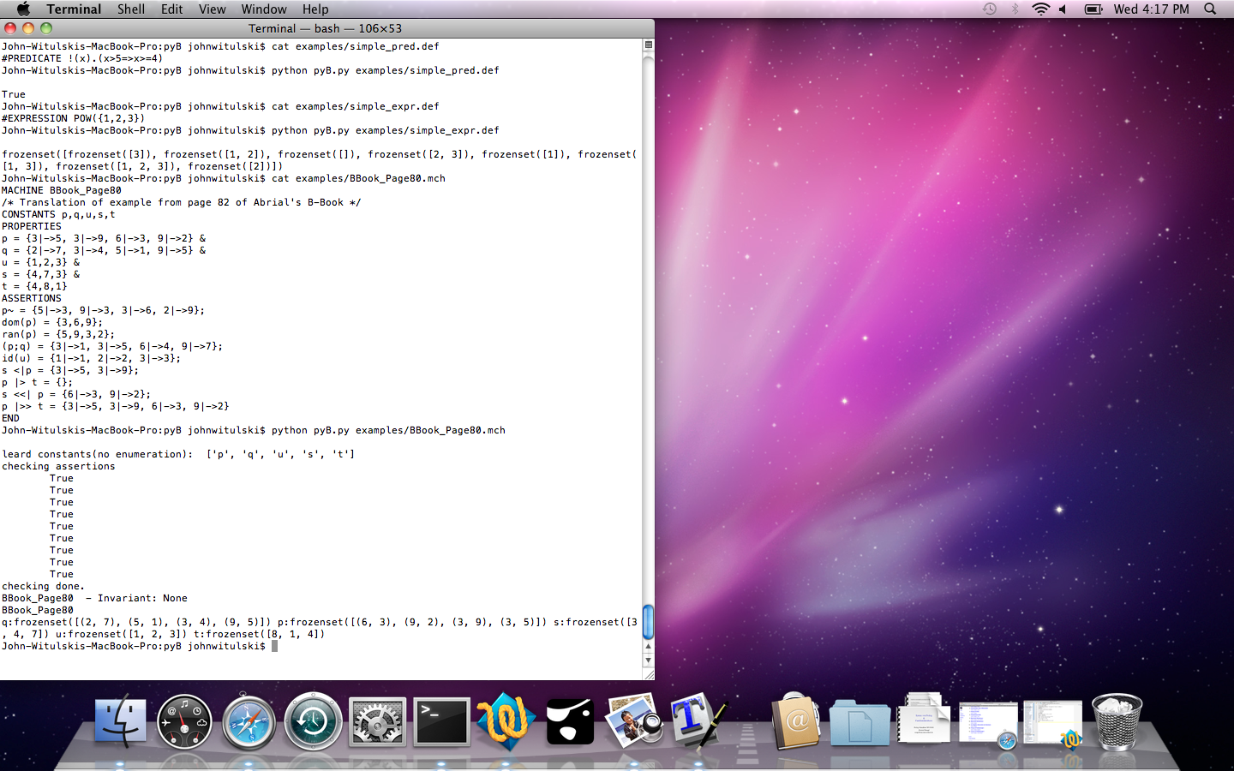
PyB - repl

Slide 4
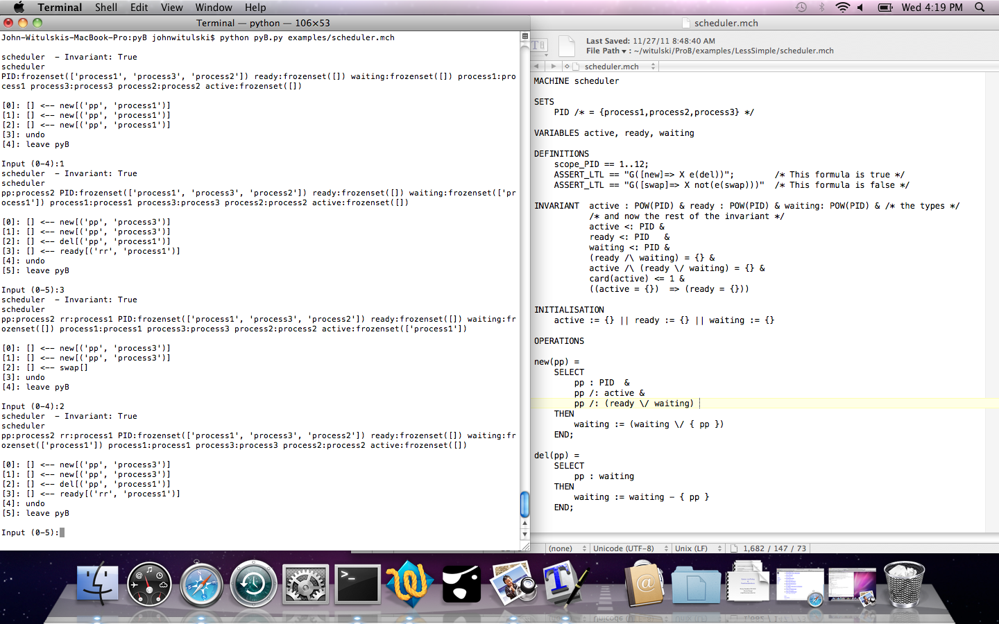
PyB -animation

