Slide 1

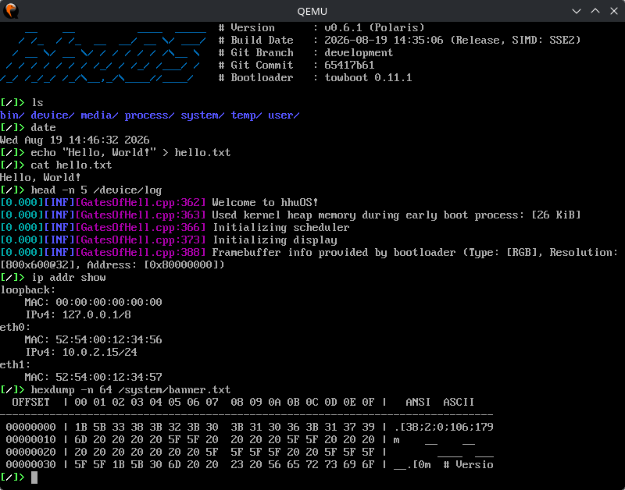
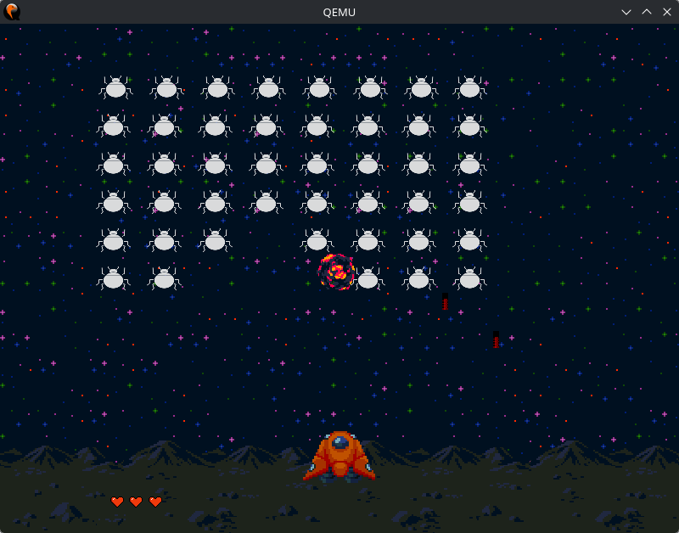
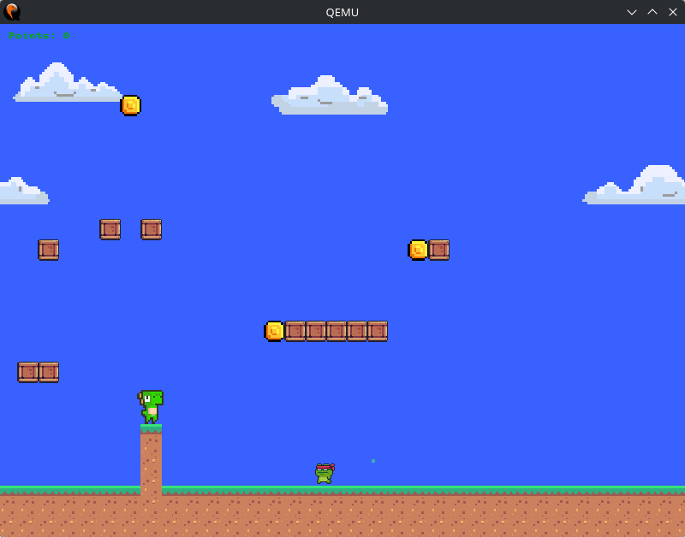
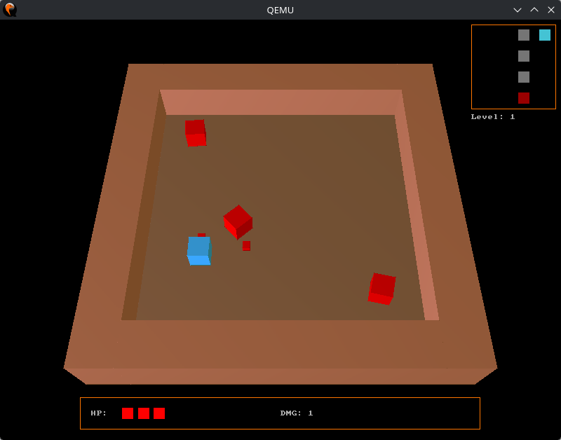
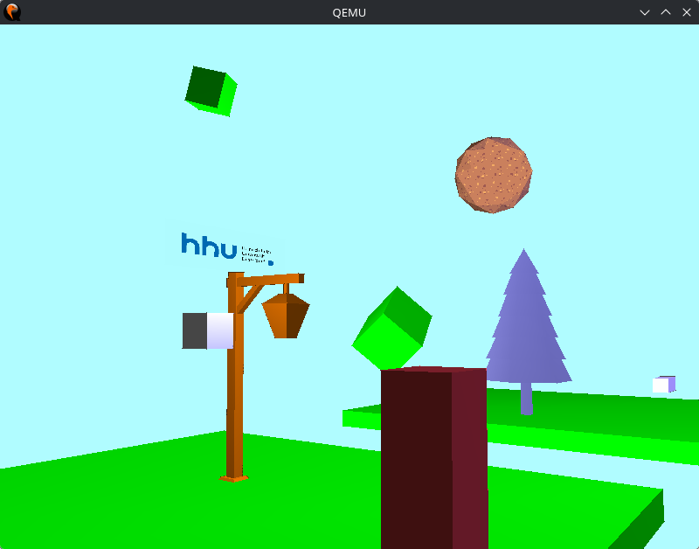
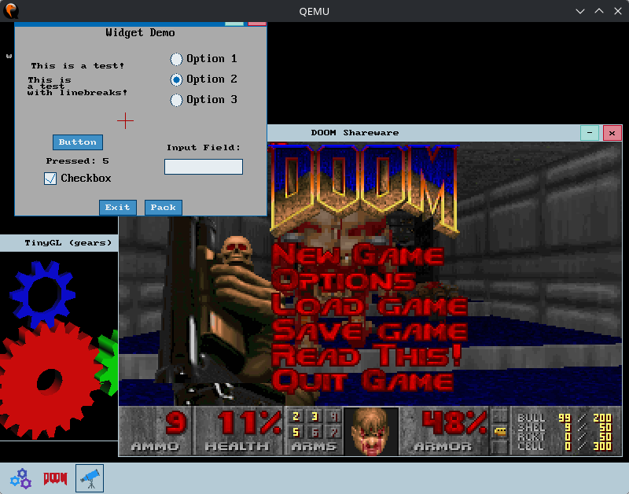
hhuOS
10 years of developing a teaching operating system
Dr. Fabian Ruhland (fabian.ruhland@hhu.de), Dr. Christian Gesse (christian.gesse@hhu.de)
Overview
Timeline
32-bit operating system for the x86-architecture (written in C++)
Open source: https://github.com/hhuOS/hhuOS/
Goal: Serve as a basis for students to explore OS principles
Many features were implemented by students during a thesis (https://github.com/hhuOS/hhuOS/wiki/Student-theses)
2017
Development started by four students (Burak Akguel, Christian Gesse, Filip Krakowski, Fabian Ruhland)
2018
First bachelor’s thesis (E1000 network card driver)
More than 30 thesis followed during the years
2019
Rudimentary audio support via SoundBlaster 16
2021
UDP/IP network stack
UEFI support using own bootloader Towboot
2022
Hard disk drive support
Driver for Realtek RTL8139 network card
2023
Separation between kernel and user space
2D/3D game engine for user space games
Support interrupt handling via APIC
2025
Audio mixer enabling sound in user space
Widget library for GUI applications
2026
Inter-process communication (Pipes, Shared Memory)
Development of a desktop environment started
2027
10th anniversary
Development still ongoing
Features
Game Engine
Processes & Threads:
  Round-Robin based preemptive scheduling
  Binary files are executed as processes
  Each process has its own address space
  Kernel offers functionality to user space via system calls
Address Spaces & Memory Management:
  Using x86-paging mechanism (virtual/physical memory)
  Page frames are mapped on-demand using a page fault handler
  Kernel is mapped in low 128 MiB (inaccessible from user space)
  User heaps are managed by a free list algorithm
Filesystem:
  Virtual filesystem using abstract Node class (similar to Inodes)
  Interface for physical filesystem drivers (can be mounted anywhere in the virtual filesystem)
Network stack:
  Supports Ethernet, ARP, ICMP, IPV4 and UDP protocols
  Sockets are used to send/receive data via the network stack
Unified Library:
  Single codebase for user- and kernel-space library
  Functions requiring kernel access are outsourced into an interface
  Offers high-level abstractions over system calls
  Provides data structures similar to JDK
    Collections: ArrayList, ArrayQueue, HashMap, etc.
    Streams: InputStream, FileInputStream, PrintStream, etc.
  Network: Create sockets and send/receive data
  File: Create/remove files and read/write them using streams
  Sound: Create sound channels and play audio
  Graphic: Draw to the screen and manipulate the terminal
  Async: Create threads and processes and provide synchronization and IPC mechanisms
C Standard Library:
  Full ANSI C compatible standard library available in user space
  Implemented on top of the hhuOS unified library
  Ported software (i.a.) : Doom, Quake, Peanut-GB, ClassiCube
User space game engine for 2D/3D games
Supports basic physics (e.g., linear/accelerated movement, gravity)
2D games have a scrolling background, animations and particles
3D games are based on TinyGL (OpenGL 1.1 software rendering)
Future Work
Current projects:
  Desktop environment
Future projects:
  Better scheduling
  Enhance network stack (e.g, DHCP, TCP, HTTP)
  Multicore support
  64-bit support
  More device drivers

