Slide 1
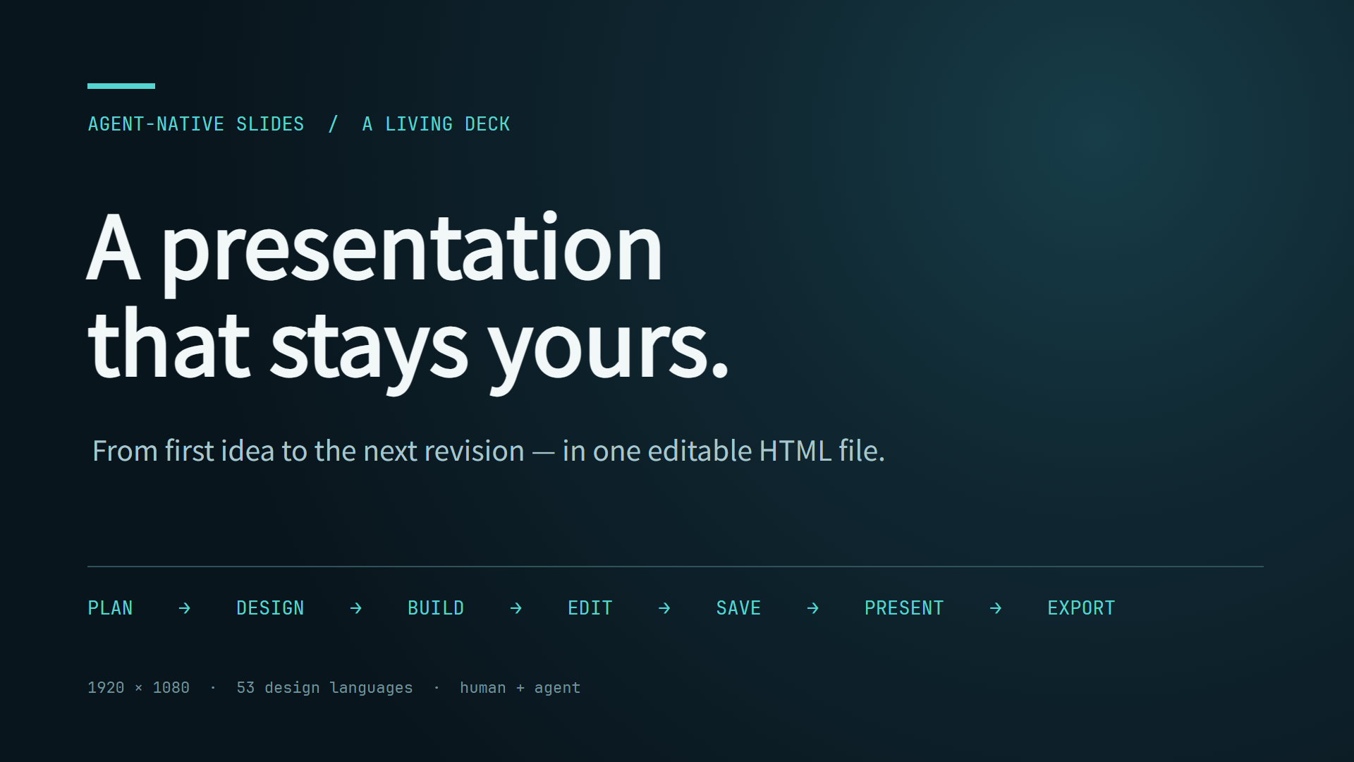
Notes:
[Assertion]
A presentation that stays yours
[Key Points]
1. Open with the full loop: an agent plans and designs, then the human keeps ownership of the editable file.

Slide 2
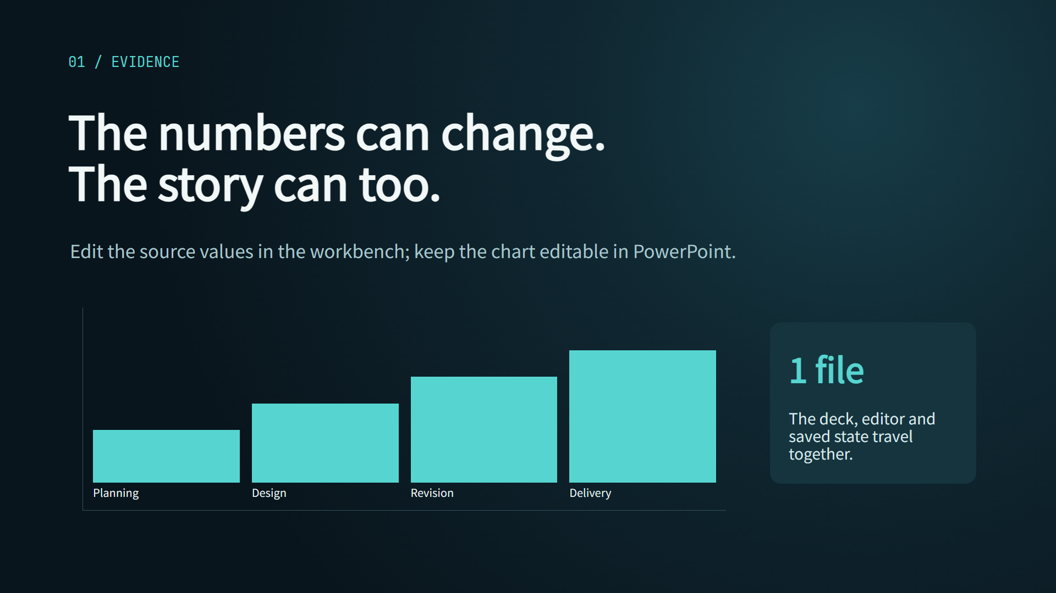
Notes:
[Assertion]
Evidence remains editable
[Key Points]
1. The chart is sourced from structured values, and exports as a native PowerPoint chart with an embedded workbook.

Slide 3
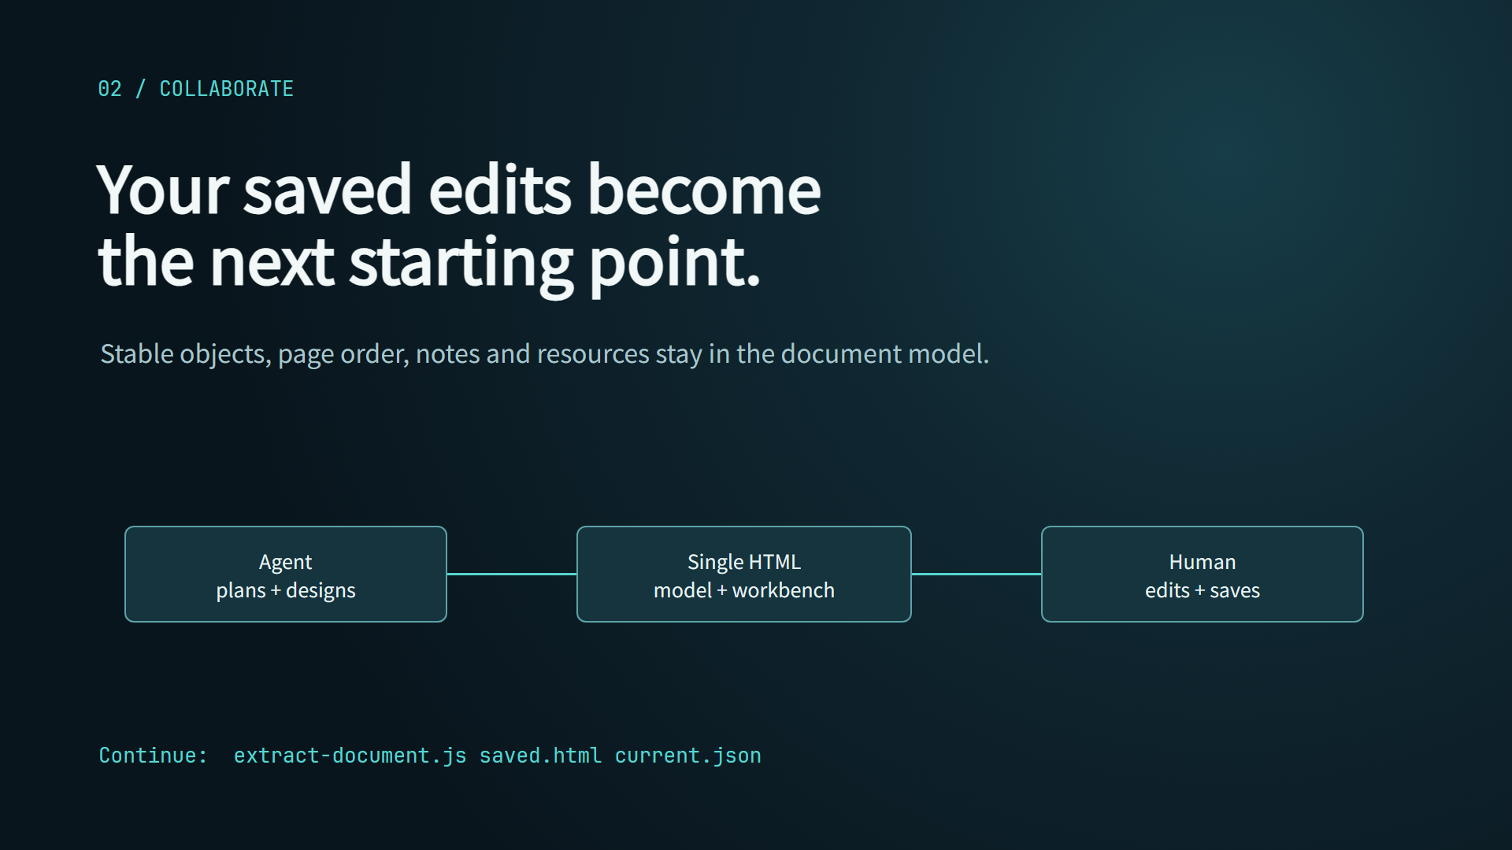
Notes:
[Assertion]
The saved file is the next starting point
[Key Points]
1. Continue AI work from the saved HTML. Extract its current document model rather than returning to the first generated plan.

