Slide 1
What Do Vision Transformers Read?
Executable Attention Reading Sets
under Centre-Bias Control
Author Name · HKUST(GZ)
DSAA 2012 Deep Learning · Course project · Fall 2026
Notes:
Hi, I'm [name]. This talk asks a simple question: when a Vision Transformer looks at an image, which parts does it actually read? I'll show a way to read this from an unmodified model, a way to check that the reading is real, and what it tells us about three ViTs.

Slide 2
Attention maps are easy to draw and hard to trust
1
A map is a picture, not a computation
2
Photos put objects in the middle
Nothing guarantees the model relies on the highlighted tokens
“Attention is not explanation” debate (Jain & Wallace 2019; Wiegreffe & Pinter 2019)
We want a reading we can run and check
0.41
Spearman of a fixed centred Gaussian with ClickMe human maps, higher than our top-k probe on every model
0.10–0.14
deletion faithfulness (SRG) of the same centre map on ImageNet-S; it beats Rollout on DeiT-B
Notes:
Attention maps are the default view into ViTs, but they have two problems. First, a map is just a picture. Nothing guarantees the model uses the highlighted tokens. Second, photos put objects in the middle, so a map that always lights up the centre already looks good. A fixed Gaussian in the centre correlates 0.41 with human maps, and even scores 0.10 to 0.14 on a deletion test. So every test in this work subtracts the centre.

Slide 3
Attention is a fast-weight MLP: every token is a neuron
Attn(q_{i}) = Σ_{j} softmax(q_{i}·k_{j} / √d) · v_{j}
Two-layer MLP | One attention head
input x | query qᵢ
hidden neuron j: first-layer weights | key kⱼ of token j
activation | softmax
hidden neuron j: second-layer weights | value vⱼ of token j
Neuron j = image patch j
So “which neurons does this region use?” is a set of patches we can draw on the image.
Schlag et al. 2021; MiTA (Wen et al. 2026). The weights come from the image itself, hence “fast weights”.
Notes:
One attention head computes exactly what a two-layer MLP computes: keys are the first-layer weights, softmax is the activation, values are the second-layer weights. So every token is a hidden neuron, and that neuron sits at a fixed image patch. This view is not ours; it comes from fast-weight work and from MiTA. What we add is using it to read and test a pretrained model.

Slide 4
Reading sets: read top-k from an unmodified ViT, then execute
1
2
3
4
Split the 14×14 patches into 16 regions
Score every key with the region's mean query
Keep the top k = 16 keys
Execute and compare
4 × 4 grid, per layer and head
one ordinary forward pass, no training
every query in the region reads only this set; CLS gets its own
restrict layers to the sets; does the top-1 prediction survive?
Three readouts from the same forward pass (layers 9–12):
Top-k probe: attention received inside the sets
Dense attention: attention received from all tokens (token-pruning score)
CLS attention: attention of the CLS query only
Notes:
Here is the probe. For each layer and head, we split the patch grid into 16 regions, score all keys with the region's mean query, and keep the top 16. Every query in the region may read only that set. Because this is a restriction of the model's own computation, we can run it and see whether the prediction survives. From the same forward pass we get three readouts: attention inside the sets, plain attention received from all tokens, and CLS attention.

Slide 5
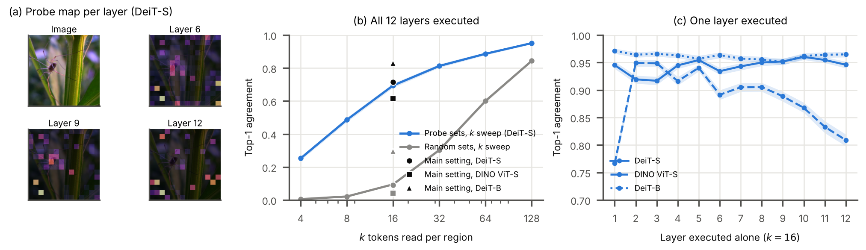
The reading sets are what the model computes with
72% vs 9%
0.1%
83%
DeiT-S predictions kept when all 12 layers read only their sets vs random sets
kept with no attention at all: the 72% is not the FFNs alone
for the larger DeiT-B (random: 30%)
Notes:
Does the model really compute with these sets? The test is the whole network. Restricting all twelve layers at once keeps 72 percent of DeiT-S predictions, against 9 percent for random sets of the same size and 0.1 percent with no attention at all; the larger DeiT-B keeps 83 percent. One layer at a time is not a test: deleting a single layer's attention outright already keeps 93 to 97 percent, so panel c only shows which layers are harder to replace. So we can treat attention reading as a measured quantity.

Slide 6
Every test controls for centre bias
1
Same-ring enrichment
2
Image-specific human alignment
Compare only patches at the same distance from the centre; a centre prior scores 0
ρ with this image's ClickMe map minus ρ with another image's map
3
Centre-matched removal
4
Part removal
Remove object tokens vs. as many tokens at matched distances from the centre
Remove 4 head or 4 body patches; how much does the prediction drop?
Models DeiT-S, DeiT-B (supervised) · DINO ViT-S (self-supervised)
Data ImageNet-S · Hard ImageNet · Oxford Pet · ClickMe · PartImageNet
Statistics paired bootstrap over images · all predictions registered before the runs
Notes:
To take the centre out, we use four tests. Same-ring enrichment compares only patches equally far from the centre. Human alignment subtracts the score against another image's human map. For the model side, we remove object tokens and compare with tokens at matched distances, and we remove head or body patches. We test three ViTs on five datasets, with bootstrap intervals, and we wrote every prediction down before running.

Slide 7
As saliency maps, attention readouts trail gradient methods
−0.10 to −0.14
the best attention readout vs GAE, per model
Dense attention is the best attention map on DeiT-S and DeiT-B; CLS attention on DINO
Same ranking on Hard ImageNet, Pet and an ImageNet subset
Probe, CLS attention and Rollout pass the weight-randomisation sanity check; Integrated Gradients fails
Notes:
First, the honest part. Used as a saliency map, every attention readout is clearly less faithful than GAE, which uses gradients of the predicted class. The best attention readout is 0.10 to 0.14 SRG behind. Among attention readouts, dense attention wins on the supervised models and CLS attention on DINO, whose classifier reads the CLS token. The attention readouts do pass the sanity check, while Integrated Gradients does not.

Slide 8
Top-k selection does not improve the map
ρ = 0.90
median per-image correlation between the probe map and dense attention
Dense attention is as good or better on faithfulness (10/10 pairs), object focus and human alignment
The probe's stronger head preference comes from truncation
It does not name the part the model relies on more often: 46.7% vs 46.4% (chance 40%)
So: draw the map with dense attention, verify it with the top-k sets
Notes:
We also asked whether the top-k step itself helps. It doesn't. The probe map and plain attention received correlate at 0.90 per image, and plain attention is equal or slightly better on every map-quality test. The probe favours animal heads much more, but that is the truncation sharpening the map; it does not pick the part the model relies on any more often. So we draw maps with dense attention and use the top-k sets to verify them.

Slide 9
Beyond the centre: models read objects and rely on heads
> 0
63–79%
2–3.4×
same-ring enrichment for every readout and model: objects win even among patches equally far from the centre
of the object effect survives when removed tokens are matched for distance to the centre (DeiT-S, DINO)
larger drop when 4 head patches are removed than 4 body patches (quadrupeds and bipeds)
Objects moved off-centre: when the crop window shifts 48 px towards a corner, the probe's object mass drops less than a centre prior's on all three models
→
Notes:
Now what the models read. Every readout prefers object patches even among patches at the same distance from the centre. When we shift the object to a corner, the reading follows it. On the model side, removing object tokens hurts much more than removing tokens at matched distances: 63 to 79 percent of the effect survives the matching. And the models rely on animal heads: removing four head patches hurts two to three times more than removing four body patches.

Slide 10
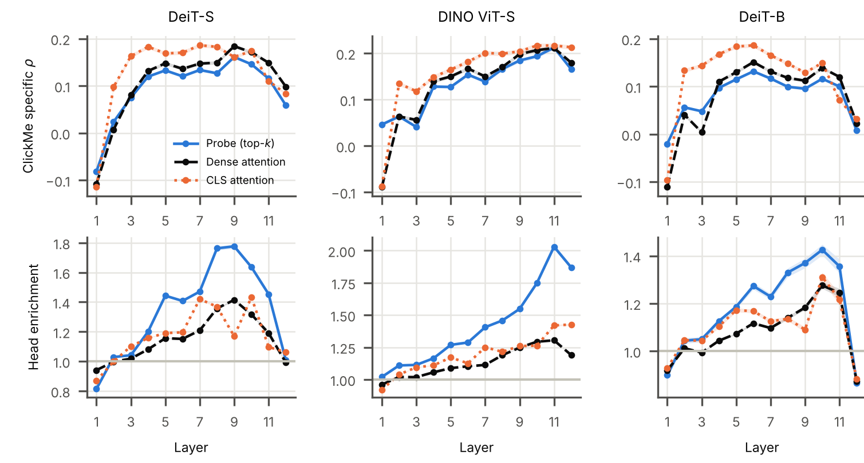
Layer by layer: reading is most human-like in mid-to-late layers
Peaks: DeiT-S layer 9, DINO layer 11, DeiT-B layers 6–10
Supervised last layer drifts off the object (dense attention, layer 12 vs best of 8–11: −0.09 DeiT-S, −0.12 DeiT-B)
DINO barely drops (−0.03)
Same curves for all three readouts (r = 0.77–0.99): a property of the model, not of the probe
Notes:
Reading layer by layer, human alignment and head preference rise and peak in mid-to-late layers. In the two supervised models, the last layer drops sharply and moves off the object. DINO barely drops. Importantly, the curves are the same for all three readouts, so this is a property of the models' attention, not an artefact of our probe.

Slide 11
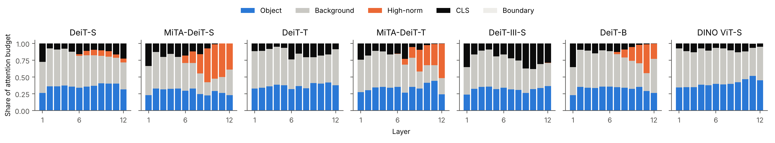
High-norm tokens take up to half of deep attention
43%
0.052
≈ 0
of DeiT-B layer-11 attention lands on 3% of patches (MiTA-DeiT-S: 50%)
nats lost when no query reads them in DeiT-B, more than for the top ordinary patches (0.037)
lost when their values are replaced by a fixed mean: they act like a constant
Notes:
Every query spends a budget of one over the tokens. In a registered follow-up we traced this budget in seven ViTs on twelve thousand ImageNet-S images. In DeiT-B and in both MiTA models, a handful of high-norm tokens take thirty to fifty percent of deep attention; DeiT-T, DeiT-III and DINO have none. In DeiT-B this budget is used: blocking these tokens hurts more than blocking as many of the most-attended ordinary patches. Yet a fixed mean value works just as well, so they behave like a constant term rather than carrying image content.

Slide 12
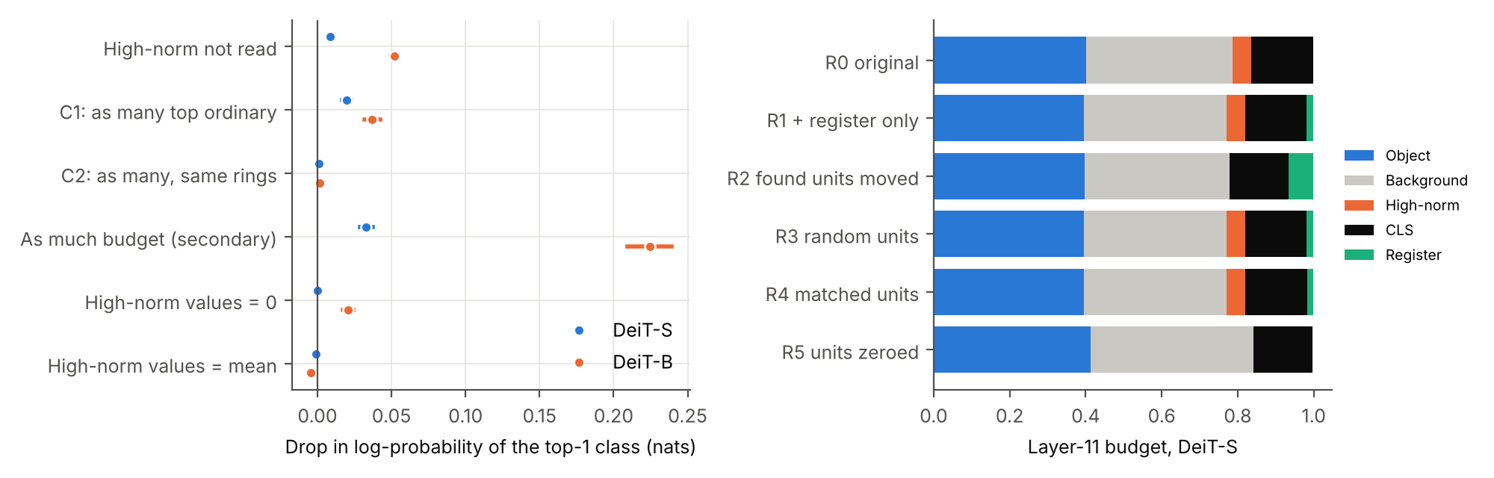
Neither sparsity nor registers moves attention to objects
Top-k training (MiTA vs DeiT): object enrichment lower at both sizes as maps are drawn (−0.039, −0.020); without high-norm patches −0.011 (Small), +0.037 (Tiny)
Test-time register (DeiT-S, 8 FFN units): 92% of high-norm patches gone, accuracy unchanged, but the freed budget goes to the register; enrichment +0.006
The last-layer drift stays in all seven models, also with the register
−92%
+0.006
high-norm patches after moving 8 FFN units to a test-time register (accuracy 79.83% → 79.83%)
object enrichment: the freed budget goes to the register (+5.9 points), not the object (+0.5)
Notes:
Two levers are said to make attention maps cleaner. Top-k training, as in MiTA, does not focus maps on objects as they are usually drawn; it creates more high-norm tokens. Only after removing those does the Tiny model look more focused, so the effect depends on scale. Moving the eight FFN units that make high-norm tokens in DeiT-S to a test-time register removes them at no cost in accuracy, but the freed attention goes to the register, not to the object. And these tokens do not explain why the last layer leaves the object.

Slide 13
Takeaways
1
Top-k reading sets make attention checkable: run the model through them and the prediction survives
2
Under centre control, ViTs read objects and animal heads, and rely on them
3
Reading is most human-like in mid-to-late layers; supervised ViTs lose this at the last layer
4
A cleaner-looking map is not more object focus: sparsity and registers only move the sink
5
Honest limits: attention maps trail GAE, and top-k does not beat dense attention as a map
Registered before the runs: of 32 directional predictions, 20 held, 7 held partly, 5 failed. Questions?
Notes:
To sum up. Top-k reading sets make attention checkable. Under centre control, ViTs read objects and animal heads and rely on them. Reading is most human-like in mid-to-late layers, and supervised models drift at the last layer. A cleaner-looking map, from sparsity or from registers, is not more object focus: the attention just moves to a new sink. And the limits: attention maps trail gradient methods, and top-k selection does not beat plain attention as a map. We registered every prediction in advance; most held, and we report the ones that failed. Thank you, I'm happy to take questions.

