Slide 1
Weather Mobile Application
Group 3:

Slide 2
Main contents
Overview
UI
Features

Slide 3
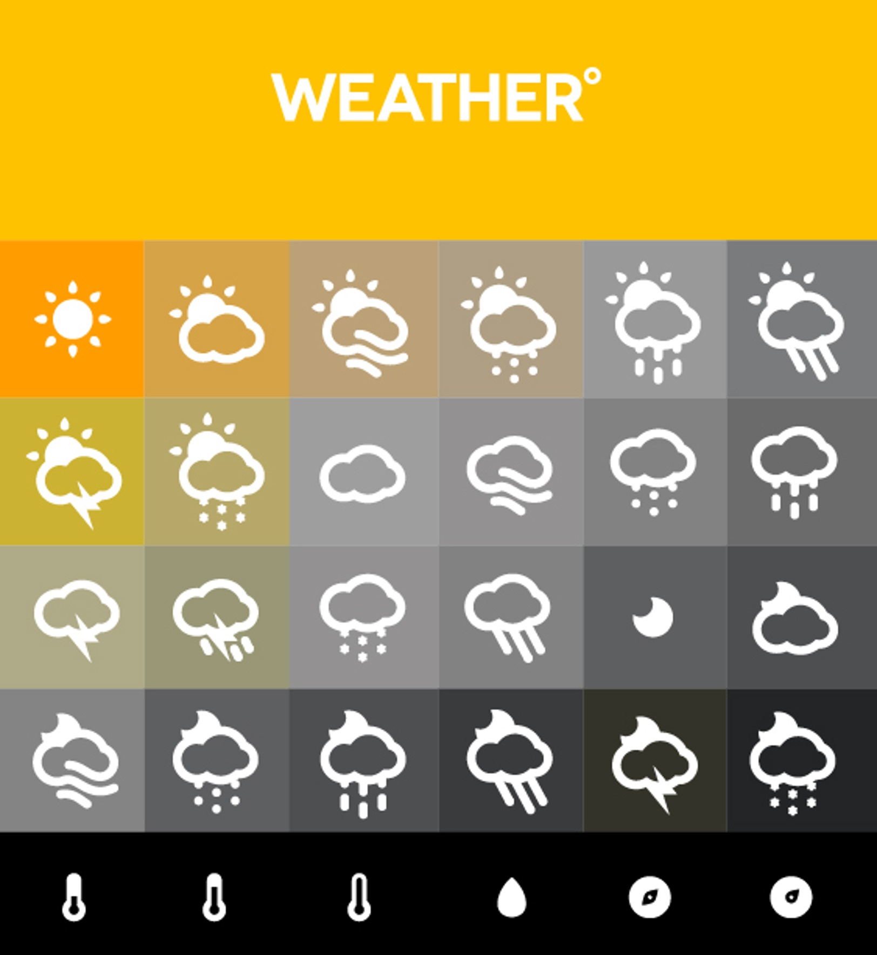
Overview
The objective of this weather application is to provide users with a comprehensive and user-friendly tool for accessing accurate and up-to-date weather information on the Android platform

Slide 4


Overview
Programming languages and environments

Slide 5
UI
Home page
Register
Login
Dashboard
Map
Chart
Settings

Slide 6
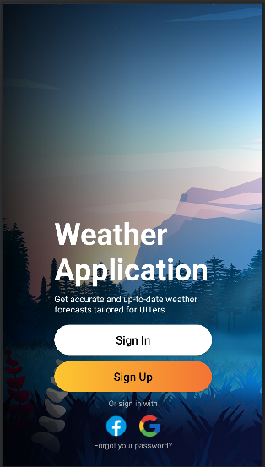
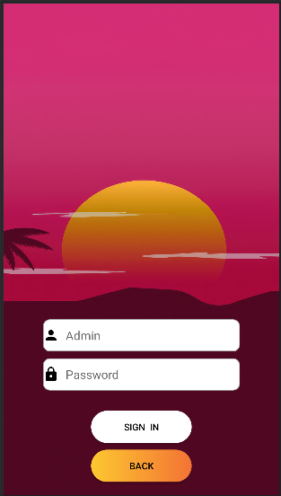
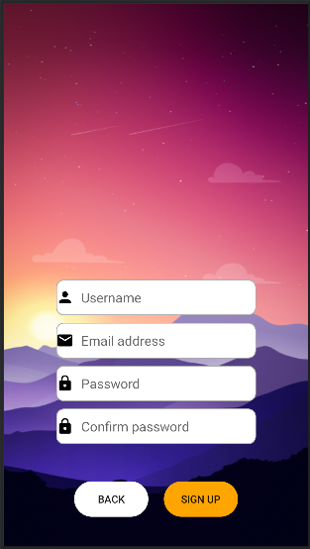
UI
Three main screens to facilitate login and registration
Homepage
Login
Register

Slide 7
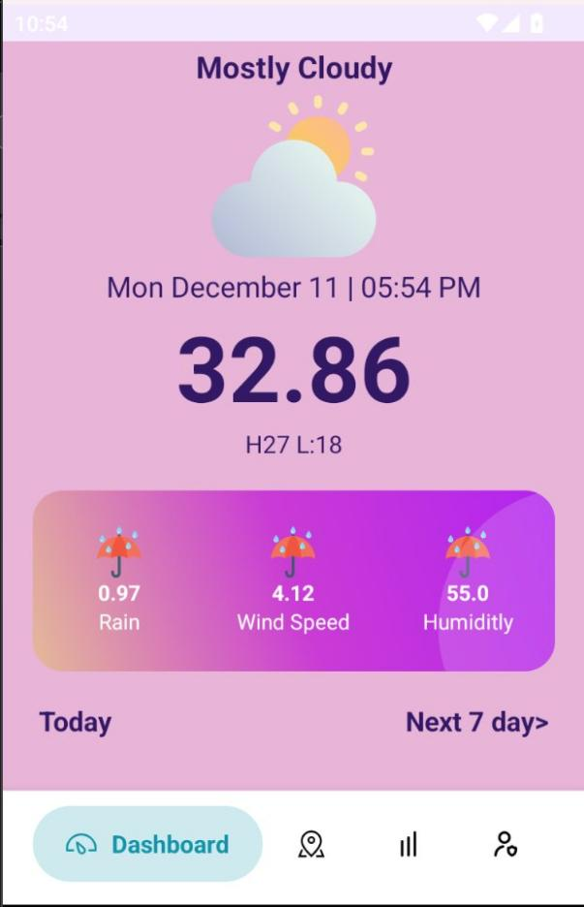
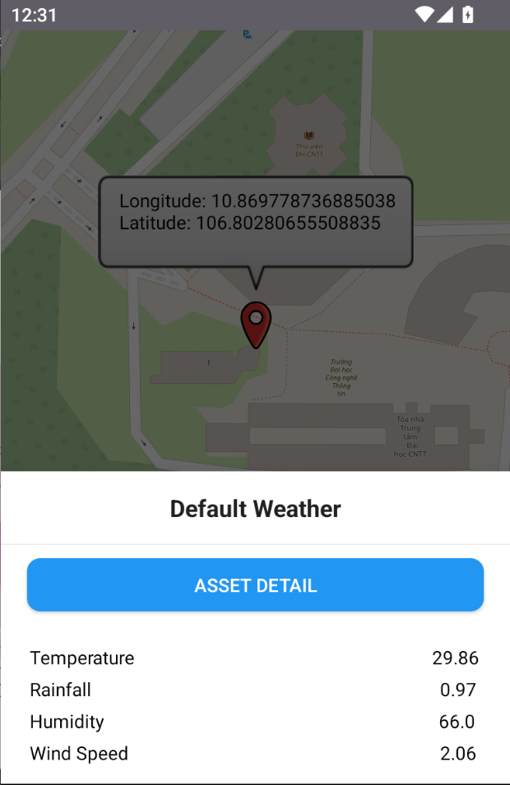
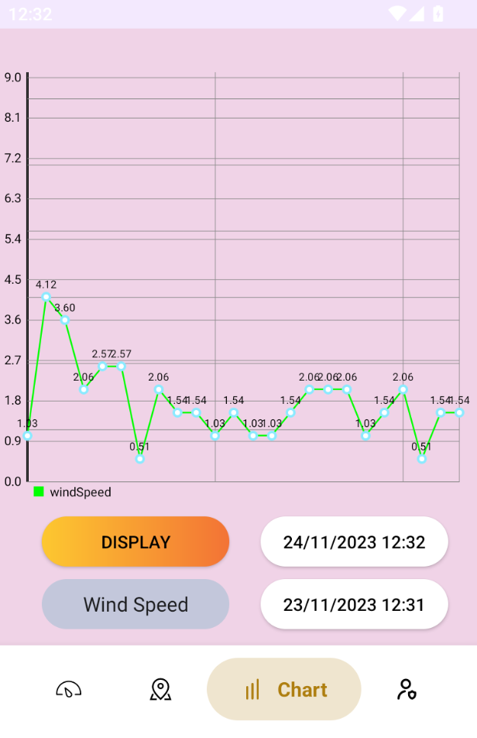
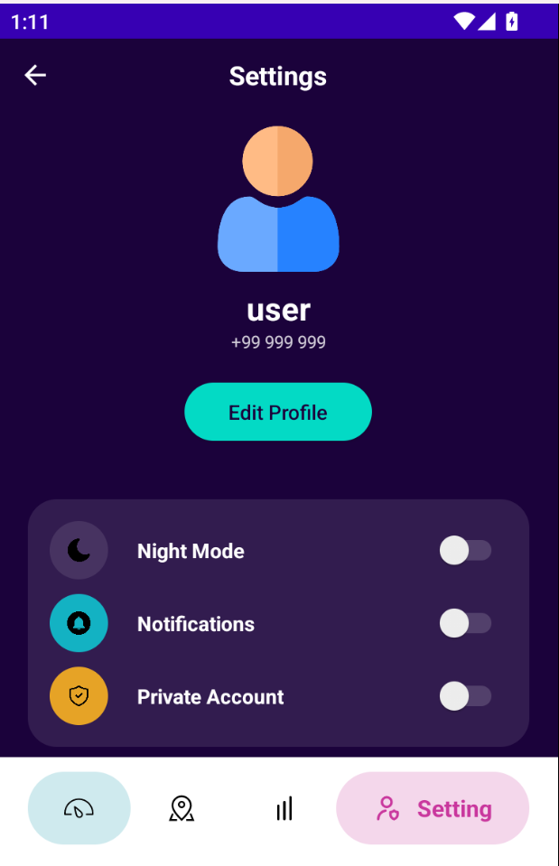
UI
These are the main interfaces after successful login
Dashboard
Map
Chart
Settings

Slide 8
D
M
C
S
Dashboard
Map
Chart
Settings
Monitor every change in the current weather
Displays the coordinates of weather data collection devices. In addition, it has a bottom sheet to display overall features
Chart displaying temperature levels over a period of time
View User Information and App Customizations

Slide 9
Thank you
for waching !

