Slide 1

BakuML
Where might
Baku grow next?
Mapping urban potential through
12- and 24-month real estate
price scenarios.
Holberton School · Group 3
Notes:
The project connects asking prices, geography, infrastructure and time to explore future urban market potential. This is the purpose, not a claim of a validated urban-expansion model. Cover is an AI-generated conceptual Baku illustration, not a geographic map or photograph. Sources: README.md; bakuml/pipeline.py; bakuml/config.py.
Evidence: fresh full synthetic pipeline run, seed 20243, 18 September 2026. Artifacts in .presentation-build/research-kdtree unless stated otherwise. No live-market forecast accuracy is established.

Slide 2
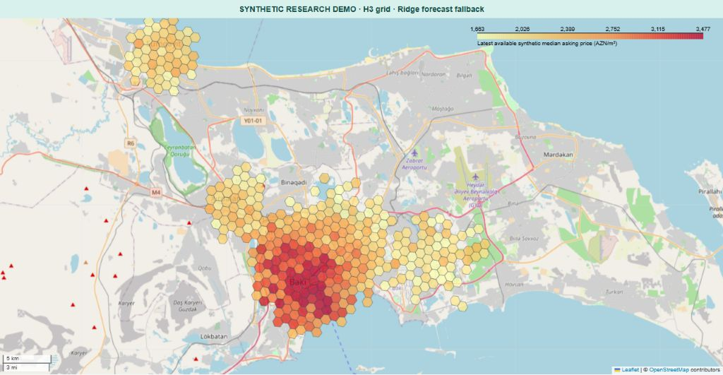
A city of different price patterns
Baku & Absheron · latest available synthetic median asking prices, AZN/m²
H3 resolution 8 · cells with usable data · cell observation dates can differ
Notes:
Map generated from the project’s hex_layer_geojson helper and the fresh H3 artifacts. Each cell uses its latest available observed synthetic median asking price; this is not a simultaneous real-market snapshot. Colour limits use the 5th and 95th percentiles, with outliers saturated. Basemap attribution remains visible. Sources: research-h3/panel.parquet, predictions.parquet, cell_geometry.geojson; bakuml/viz.py.
Evidence: fresh full synthetic pipeline run, seed 20243, 18 September 2026. Artifacts in .presentation-build/research-kdtree unless stated otherwise. No live-market forecast accuracy is established.

Slide 3
44 months turn listings into a research panel
January 2023 – August 2026 · controlled synthetic experiment
37,312
2,117
generated listing records
duplicate reposts removed
256 spatial cells
6,799 observed cell-months
KD-tree research run · known synthetic truth lets us test the method
Notes:
Dataset counts are fresh run metrics, not README estimates. 35,195 deduplicated records remain; the minimum cell-month count is three. The feature matrix contains 3,953 rows after history availability constraints. Source: research-kdtree/metrics.json dataset.
Evidence: fresh full synthetic pipeline run, seed 20243, 18 September 2026. Artifacts in .presentation-build/research-kdtree unless stated otherwise. No live-market forecast accuracy is established.

Slide 4
The model improves on “last month again”
Mean absolute error in AZN/m² · lower is better
19.8%
lower temporal error
18.0% lower
across held-out regions
Fresh synthetic KD-tree run · these tests measure monthly price estimates
Notes:
Temporal: {"mae":211.9352308491179,"mape":8.118925352259827,"r2":0.8073786194554667} versus persistence {"mae":264.27424507658645,"mape":10.170313926776107,"r2":0.7038476938521243} across 25 splits. Spatial: {"mae":207.55560670520217,"mape":8.397496197872881,"r2":0.8113765353645102} versus {"mae":253.2630913230458,"mape":10.111507490561355,"r2":0.716211851639923} across 5 folds. Percent improvement uses unrounded MAE. Spatial evaluation omits neighbour encoding but retains own-cell price history, so this is not prediction in locations with no history. These metrics do not validate the 12/24-month forecast. Sources: metrics.json; bakuml/models/baseline.py.
Evidence: fresh full synthetic pipeline run, seed 20243, 18 September 2026. Artifacts in .presentation-build/research-kdtree unless stated otherwise. No live-market forecast accuracy is established.

Slide 5
Location is the strongest fitted price signal
Mean absolute TreeSHAP contribution · AZN/m²
Global importance explains this fitted synthetic model; it does not establish causality
Notes:
The five largest mean absolute TreeSHAP contributions come directly from shap_summary.json. City-centre distance dominates, followed by neighbour prices and time. This is consistent with the synthetic generator’s planted spatial gradient, not independent proof of a real-world mechanism. Source: research-kdtree/shap_summary.json; bakuml/models/baseline.py; bakuml/data/synthetic.py.
Evidence: fresh full synthetic pipeline run, seed 20243, 18 September 2026. Artifacts in .presentation-build/research-kdtree unless stated otherwise. No live-market forecast accuracy is established.

Slide 6
Can we recover a simulated metro effect?
Spatial difference-in-differences · a test against planted truth
0.067
≈0.075
estimated average effect
(log-price units)
planted ramp-average effect
(log-price units)
The experiment recovers a positive effect.
Synthetic station-opening experiment · not an observed causal effect in Baku
Notes:
Fresh ATT 0.06749224093078372; 95% CI [0.057763749390372834, 0.07722073247119461] log units. Do not confuse the planted fully ramped .08 with the approximate average post-opening .075 effect. Treated listings within 1 km, controls 2–6 km away. Cell and month fixed effects; clustered errors. Planted ramp lasts three months; see synthetic_truth.json. Source: research-kdtree/did_results.json; bakuml/causal/did.py. No real station causal conclusion is being made.
Evidence: fresh full synthetic pipeline run, seed 20243, 18 September 2026. Artifacts in .presentation-build/research-kdtree unless stated otherwise. No live-market forecast accuracy is established.

Slide 7
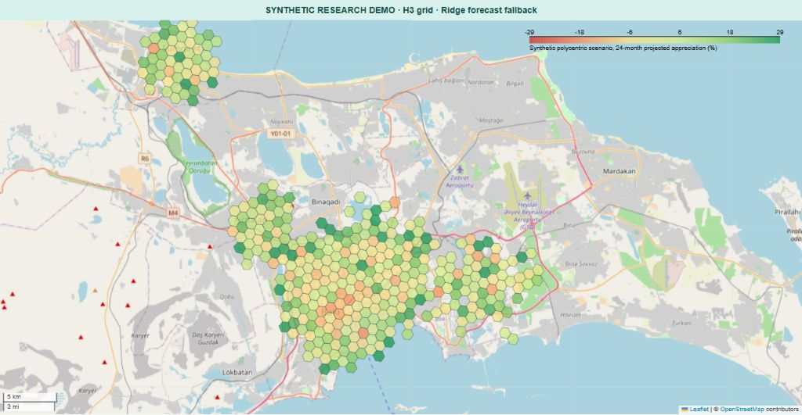
Future potential is a scenario, with assumptions
Polycentric scenario · projected 24-month appreciation (%) · synthetic H3 run
Ridge forecast fallback + estimated node adjustment · conditional research output
Notes:
This map is generated from actual H3 scenario predictions, not a hand-painted map. The polycentric scenario doubles the estimated historical node-gravity appreciation slope. The pipeline here used SpatialLagRidgeForecaster because torch is not installed. These are conditional projections, not validated future market outcomes or a forecast of physical city expansion. Source: research-h3/predictions.parquet and metrics.json; bakuml/pipeline.py.
Evidence: fresh full synthetic pipeline run, seed 20243, 18 September 2026. Artifacts in .presentation-build/research-kdtree unless stated otherwise. No live-market forecast accuracy is established.

Slide 8
This central cell projects a lower price
Three conditional scenarios · cell selected by location and sufficient history
3,813
AZN/m²
last observed median
Synthetic cell example · forecast endpoints, not observed future prices
Notes:
Cell kd:10010011, centroid 40.37937125, 49.849948999999995, latest observed month 2026-08. Chosen as nearest eligible cell to the configured centre, not by forecast growth. Last observed 3813.2. All six q50 endpoints plotted directly from predictions.parquet. Ridge fallback, no new claim of STGCN performance. Forecast intervals scale one-month relative conformal widths by square root of horizon; long-horizon coverage is not established. Source: evidence.json example; bakuml/pipeline.py.
Evidence: fresh full synthetic pipeline run, seed 20243, 18 September 2026. Artifacts in .presentation-build/research-kdtree unless stated otherwise. No live-market forecast accuracy is established.

Slide 9
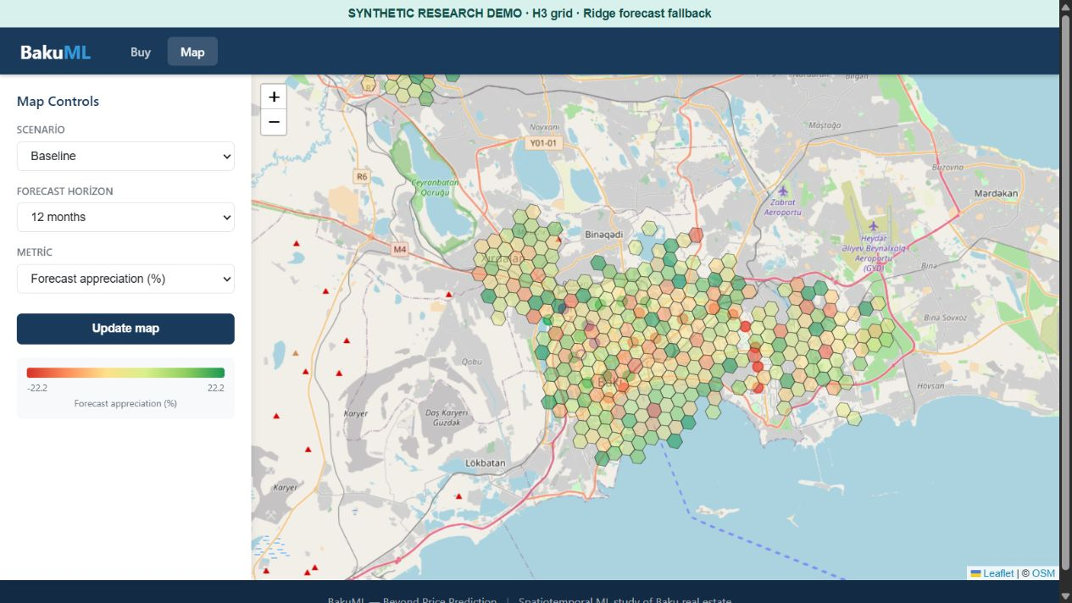
The research is explorable in the software
Actual local application · scenario and horizon controls · cell-level map
Captured with synthetic H3 artifacts and a visible research-demo label
Notes:
Actual Flask application screenshot. A local capture wrapper serves research-h3 artifacts, adds a visible synthetic-demo banner, and converts the API’s RGBA palette arrays to CSS hex colours so the map renders. No production app source was changed. The screenshot illustrates current interaction, not a live deployed real-data product. Sources: app/flask_app.py; app/static/js/map.js; .presentation-build/demo_server.py.
Evidence: fresh full synthetic pipeline run, seed 20243, 18 September 2026. Artifacts in .presentation-build/research-kdtree unless stated otherwise. No live-market forecast accuracy is established.

Slide 10
Uncertainty still needs improvement
Observed interval coverage on three unseen months
5.4 pp
below the target
Long-horizon coverage
is not yet established.
Fresh synthetic KD-tree run · holdout: June–August 2026
Notes:
Coverage 74.64285714285714% versus80%, gap 5.357142857142861 percentage points. Six preceding calibration months and three held-out months. This updates the old README figure rather than repeating it. One-month interval coverage and long-horizon heuristic widths must not be conflated. Sources: metrics.json conformal; bakuml/models/conformal.py; bakuml/pipeline.py.
Evidence: fresh full synthetic pipeline run, seed 20243, 18 September 2026. Artifacts in .presentation-build/research-kdtree unless stated otherwise. No live-market forecast accuracy is established.

Slide 11
What our work establishes
Geography matters.
The monthly model beats persistence.
Scenarios make future assumptions visible.
Next: longitudinal real data and 12/24-month backtests.
Notes:
Conclusions are scoped to this synthetic research run: geography is a major fitted signal, XGBoost outperforms persistence in time and spatial tests, and the scenario engine produces explicit conditional futures. The real snapshot pipeline is separate and uses heuristic appreciation. To make credible real-market forecasting claims, collect repeated snapshots, compute neighbour features within folds, separate calibration and evaluation, and test each long horizon. Sources: pipeline.py; scripts/run_real_pipeline.py; metrics.json.
Evidence: fresh full synthetic pipeline run, seed 20243, 18 September 2026. Artifacts in .presentation-build/research-kdtree unless stated otherwise. No live-market forecast accuracy is established.

Slide 12
BakuML
Holberton School · Group 3
We connect place, time and infrastructure
to explore Baku’s future real estate potential.
Hüseyn Hüseynli · Nihad Süleymanov · Eldəniz Arifzadə
Zeynəb Mirzəzadə · Vüqar Dünyamalıyev
Questions?
Notes:
Team names reproduced from README.md. The central contribution is a spatial research pipeline, scenario outputs and an interface to explore them. Avoid describing this as a validated prediction of city land growth or investment returns.
Evidence: fresh full synthetic pipeline run, seed 20243, 18 September 2026. Artifacts in .presentation-build/research-kdtree unless stated otherwise. No live-market forecast accuracy is established.

