Slide 1
AR Child English Vocabulary Teaching Based on Handwritten Letter Recognition
Group Member：Huang Hongyi，Zhou Shuo,
Chen Yuming, Yu Chuan, Yang Xueya

Slide 2
Presentation Outline
1
Introduction
2
Feature Extraction
CONTENTS
3
Algorithm
4
Demo Presentation
5
Summary

Slide 3
Introduction --Application of handwritten letter recognition
Digitalize
previous documents
Transform from handwritten to digital media.

Slide 4
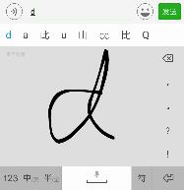
Introduction --Application of handwritten letter recognition
Digitalize
previous documents
Handwriting Input
Transform from handwritten to digital media
Handwriting Input allows you to handwrite text on your phone or tablet

Slide 5
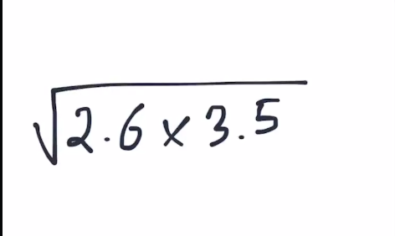
Introduction --Application of handwritten letter recognition
Digitalize
previous documents
Handwriting Input
Handwriting Calculator
Transform from handwritten to digital media
Handwriting Input allows you to handwrite text on your phone or tablet
Perform mathematical operations naturally using your handwriting

Slide 6
Introduction --Related research
Algorithms
Back Propagation Neural Network
Convolutional Neural Network
Multilayer perceptron
SVM
…
Notes:
convolutional neural network

Slide 7

Introduction --Related research
Algorithms
Back Propagation Neural Network
Convolutional Neural Network
Multilayer perceptron
SVM
…
Notes:
convolutional neural network

Slide 8
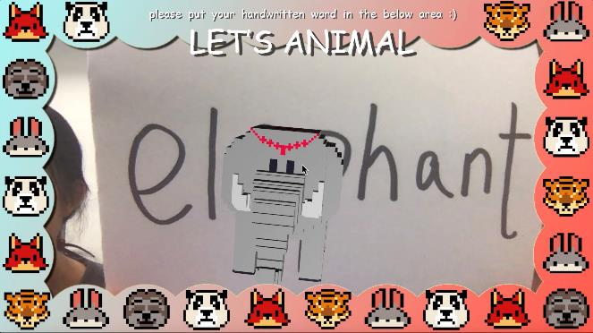
Introduction --Our Application

Slide 9
Presentation Outline
1
Introduction
2
Feature Extraction
CONTENTS
3
Algorithm
4
Demo Presentation
5
Summary

Slide 10
2.1 Word Segmentation
/02
To recognize a word, we consider extracting the letters from the word, and recognizing these letters one by one.

Slide 11
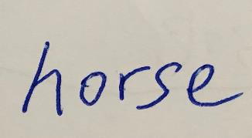
Word Segmentation
Image Binarization
Look at the picture on the left, it is the word “horse”.
We want to extract the letters ‘h’, ‘o’, ‘r’, ‘s’, ‘e’ respectively. In order to reduce the data size and highlight the features of the handwritten letters, we use Image Binarization to process these pictures.

Slide 12
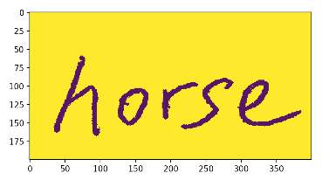
Word Segmentation
Image Binarization
Look at the picture on the left, it is the word “horse”.
We want to extract the letters ‘h’, ‘o’, ‘r’, ‘s’, ‘e’ respectively. In order to reduce the data size and highlight the features of the handwritten letters, we use Image Binarization to process these pictures.
After processing, the deeper parts of the original image become deeper, and the lighter parts of the image become lighter.

Slide 13
Word Segmentation
Connected Components Extraction and Analysis
Connected Component refers to the region in the image formed by the adjacent pixel points that share the same pixel values with one another.
The Connected Components of the word pictures are these single letters.
Using Connected Components Analysis, we obtain the images of the single letters.

Slide 14
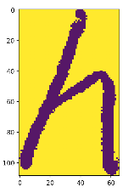
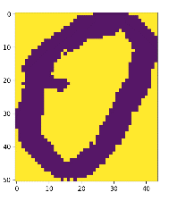
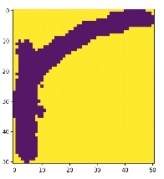
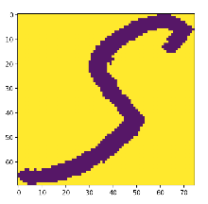
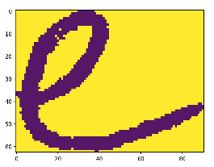
Word Segmentation
Segmentation Results
Example: the segmentation of word “horse”

Slide 15
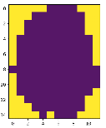


Word Segmentation
Some Exceptions
The result of last slide seems good, however, there exists some exceptions that we need to pay attention to.
For example, the letters ‘i’ and ‘j’ are not connected components or connected graph since there exists a “dot” on the top of these two letters.
Hence, we need to consider the relative height of the dot compared to the whole letter in order to recognize the letter ‘i’ and ‘j’.

Slide 16
2.2 Letter Partition
/02
After obtaining a single letter, we can formally extract features from the letters.

Slide 17

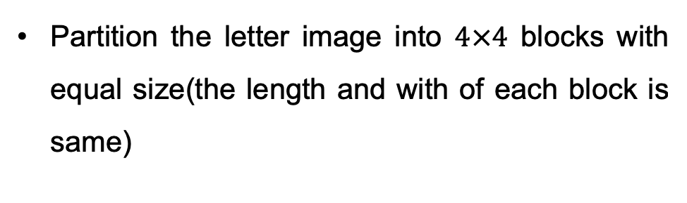
Letter Partition
Partition and Feature Extraction
Partition the letter image into $4×4$ blocks with equal size(the length and with of each block is same)

Slide 18
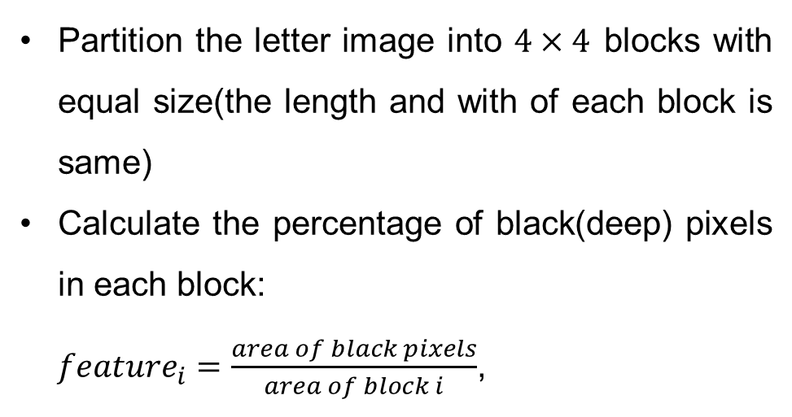
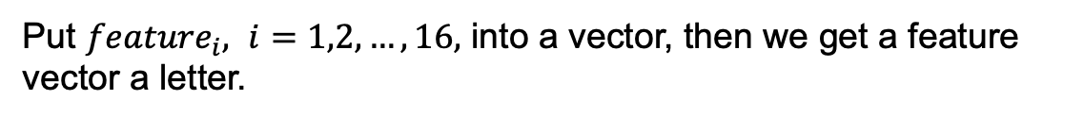
Letter Partition
Partition and Feature Extraction
Partition the letter image into $4×4$ blocks with equal size(the length and with of each block is same)
Calculate the percentage of black(deep) pixels in each block:
${feature}_{i}=\frac{area of black pixels}{area of block i}$,
Put ${feature}_{i}, i=1,2,…,16,$ into a vector, then we get a feature vector a letter.

Slide 19
Presentation Outline
1
Introduction
2
Feature Extraction
CONTENTS
3
Algorithm
4
Demo Presentation
5
Summary

Slide 20
Algorithm
/03

Slide 21
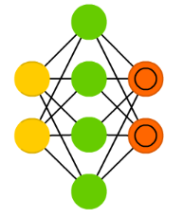
Neural network
Multi-class classification
Training set:
X: 1300 * 16
Y: 1300 * 1 a-z ->0-25
Architecture:
Input layer: 16 nodes
One hidden layer: 26 nodes
Output layer: 26 nodes
S1= 16
S2= 26
S3= 26

Slide 22
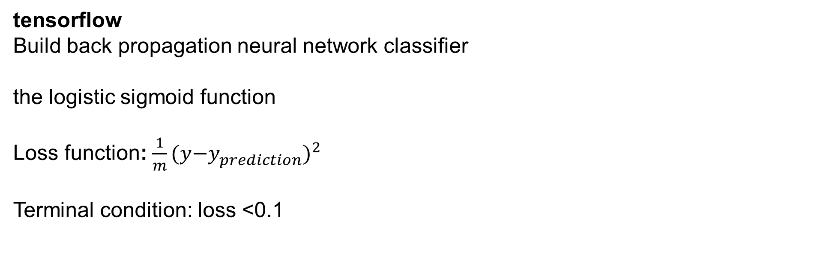
Neural network
tensorflow
Build back propagation neural network classifier
the logistic sigmoid function
Loss function: $\frac{1}{m}{(y{−y}_{prediction}^{})}^{2}$
Terminal condition: loss <0.1

Slide 23
Neural network
scikit-learn: sklearn.neural_network.MLPClassifier
Multi-layer Perceptron classifier
This model optimizes the log-loss function using LBFGS or stochastic gradient descent.
Activation = ‘logistic’
the logistic sigmoid function
hidden_layer_sizes=(26,))

Slide 24
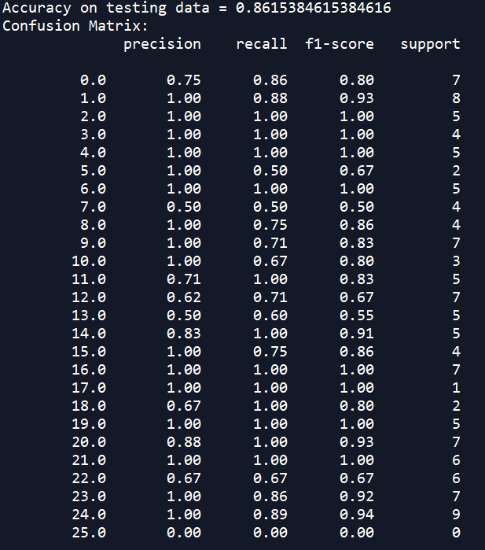
Neural network
Test set:
X: 130 * 16
Y: 130 * 1
0 | 1 | 2 | 3 | 4 | 5 | 6 | 7 | 8 | 9
a | b | c | d | e | f | g | h | i | j
10 | 11 | 12 | 13 | 14 | 15 | 16 | 17 | 18 | 19
k | l | m | n | o | p | q | r | s | t
20 | 21 | 22 | 23 | 24 | 25
u | v | w | x | y | z

Slide 25
Neural network
Test set:
X: 130 * 16
Y: 130 * 1
0 | 1 | 2 | 3 | 4 | 5 | 6 | 7 | 8 | 9
a | b | c | d | e | f | g | h | i | j
10 | 11 | 12 | 13 | 14 | 15 | 16 | 17 | 18 | 19
k | l | m | n | o | p | q | r | s | t
20 | 21 | 22 | 23 | 24 | 25
u | v | w | x | y | z

Slide 26
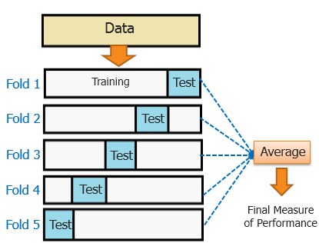
Evaluation of our Model
random_state =1
Cross validation:
the seed used by the random number generator
 | 1 | 2 | 3 | 4 | 5
accuracy | 81.12% | 78.32% | 75.87% | 79.02% | 79.72%
Average accuracy: 78.81%
Training set is not large. Only around 1300 instances
One hidden layer
26 Classes

Slide 27
Presentation Outline
1
Introduction
2
Feature Extraction
CONTENTS
3
Algorithm
4
Demo Presentation
5
Summary

Slide 28
Demo Presentation
/04

Slide 29
Demo
The Function of Identification Image
The Python program will identify the word in the image
The camera will recognize the feature points in the image

Slide 30
Demo
unity
Inform file
image
Response file
python
Value file

Slide 31
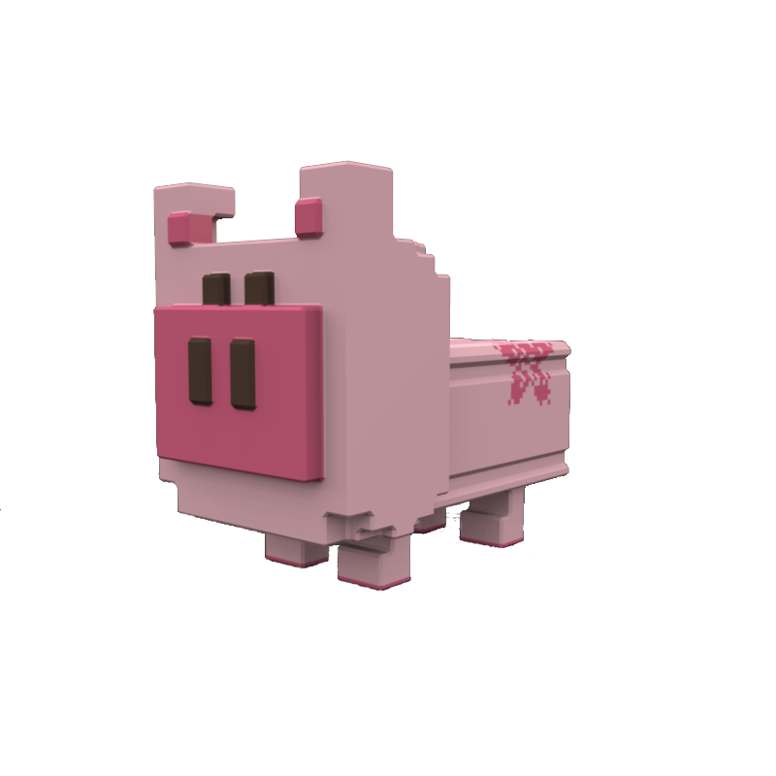
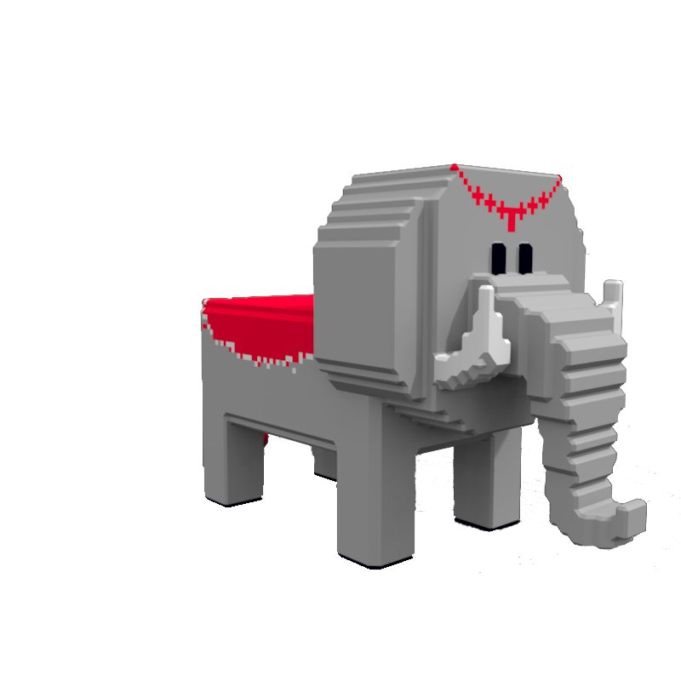


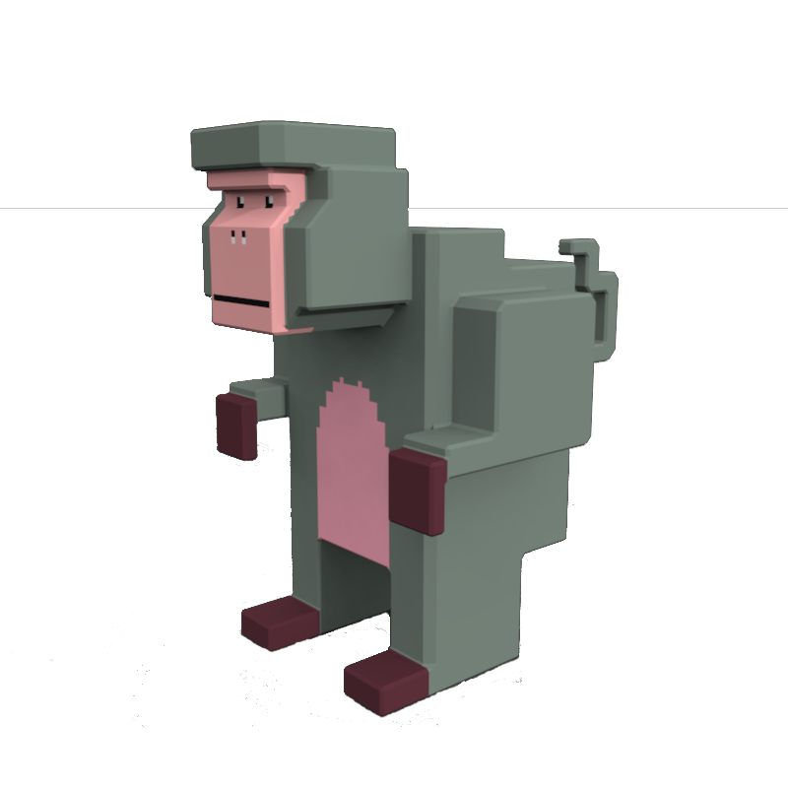

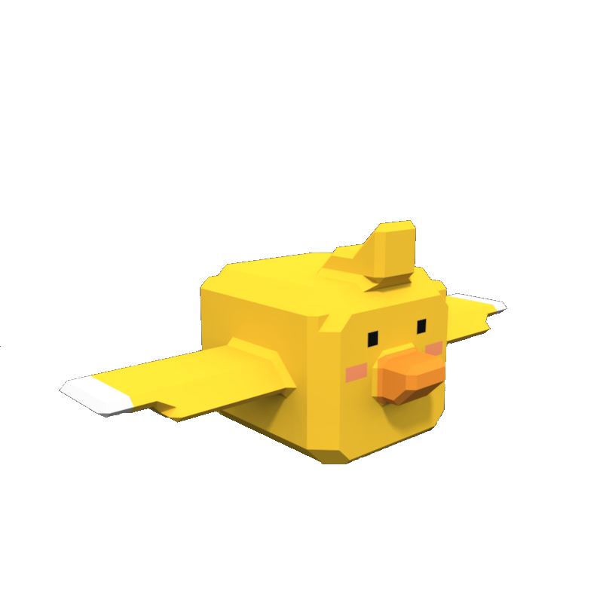

Slide 32
Demo
Demo

Slide 33
Presentation Outline
1
Introduction
2
Feature Extraction
CONTENTS
3
Algorithm
4
Demo Presentation
5
Summary

Slide 34
Summary
/05

Slide 35
Summary
05
03
Feature Extraction
Demo
02
04
Algorithm
01
Summarys
introduction

Slide 36
Summary
Advantages and Disadvantages
Advantage: Using machine learning algorithm in AR compared to traditional AR
Advantage: Applying machine learning to daily life.
Because of time limitation:
Disadvantage: The accuracy of words recognition is not satisfying;
Disadvantage: Requirement for proper placement of images in front of the camera is strict.

Slide 37
Summary
Outlook
Improve the accuracy of model: increase the dataset size by putting capitalized English letters, more handwritten letters with different styles
Optimize the codes and complete this app

Slide 38
References
1. Yadav P, Yadav N. Handwriting recognition system-a review[J]. Analysis, 2015, 114(19): 36-40.
2. Cohen G, Afshar S, Tapson J, et al. EMNIST: an extension of MNIST to handwritten letters[J]. arXiv preprint arXiv:1702.05373, 2017.
3. LeCun Y, Boser B, Denker J S, et al. Backpropagation applied to handwritten zip code recognition[J]. Neural computation, 1989, 1(4): 541-551.
4. Gupta O P, Bailey J F, Bulatek D E. Machine recognition of handwritten character strings such as postal zip codes or dollar amount on bank checks: U.S. Patent 5,307,423[P]. 1994-4-26.

Slide 39
Thank You!

