Slide 1


5-year Treasury Strategy
Based on Fed Speech Sentiment
Hanyuan Hu, Binlin Chi
10/17/2019

Slide 2

News Analytics and Machine Learning
Contents:
Quick Refresh
Model Improvements:
Using Clustering
Doc2Vec and Pooling
Comparison and Summary

Slide 3
Quick Refresh
Model Summary For the First Stage
Feature Engineering
1. Using word bags
2. Treat words in title and in body differently
Learning Algorithms
1. Tree/Gaussian Naïve Bayes + Bagging
Cross Validation
1. Rolling normalization, training and testing
2. Hyper parameter tuning: grid search + aggregation
Trading Signal Metrics
1. Cumulative returns
2. Alpha decay

Slide 4
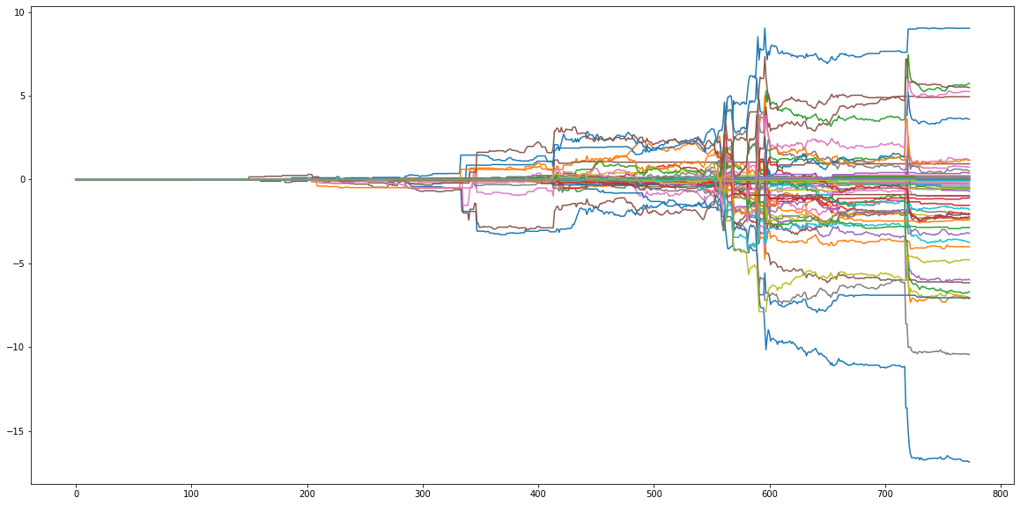
A Quick Refresh - Strategy Performance Overview
Strategy Performance Overview

Slide 5
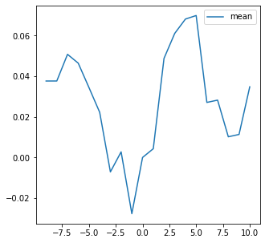
A Quick Refresh - Strategy Performance Overview
Ranking | Learning Algorithm | Percentage of Labeling | Holding Period | Sample Size
1 | ExtraTree | 20 | 1 | 200
2 | ExtraTree | 30 | 1 | 300
3 | ExtraTree | 10 | 2 | 100
4 | ExtraTree | 20 | 2 | 100
5 | ExtraTree | 30 | 2 | 200
6 | ExtraTree | 20 | 5 | 100
7 | ExtraTree | 30 | 5 | 100
8 | ExtraTree | 30 | 5 | 200
9 | ExtraTree | 30 | 10 | 100
10 | ExtraTree | 30 | 10 | 200

Slide 6


Model Improvements – Using Clustering
Motivation:
1. For different topics, the important words/features are not the same.
2. There is evidence the Fed speeches fall into several groups.
3. One way to model inter-sample relationships:
provide prior information by feature engineering.
$$f\left(x_{i}\right)→y_{i}$$
$f\left(x_{i}, g(x_{i}, X\right))→$ $y_{i}$

Slide 7
Model Improvements – Using Clustering
Evidence:
1. Using Birch algorithm to cluster all samples based on all features.
2. We first assume there are two clusters.
3. Top 10 discriminant features reported as follow:
ranking | y | 0 | 1
1 | inflation | 2.253635 | 34.64516
2 | policy | 5.442649 | 28.53548
3 | rate | 3.486268 | 21.02581
4 | monetary | 2.980614 | 17.30968
5 | federal | 8.453958 | 19.28387
6 | prices | 2.187399 | 12.27097
7 | rates | 2.801292 | 12.05161
8 | economic | 5.73021 | 14.90968
9 | economy | 3.875606 | 11.74194
10 | central | 2.468498 | 10.12258
Cluster 0:
Progress on the Transition to Risk-Free Rates (4/10/2019)
Fostering Closer Supervisory Communication (4/2/2019
Cluster 1:
Navigating the Different Signals from Inflation and Unemployment (5/30/2017)
Sustaining Maximum Employment and Price Stability (5/30/2019)

Slide 8
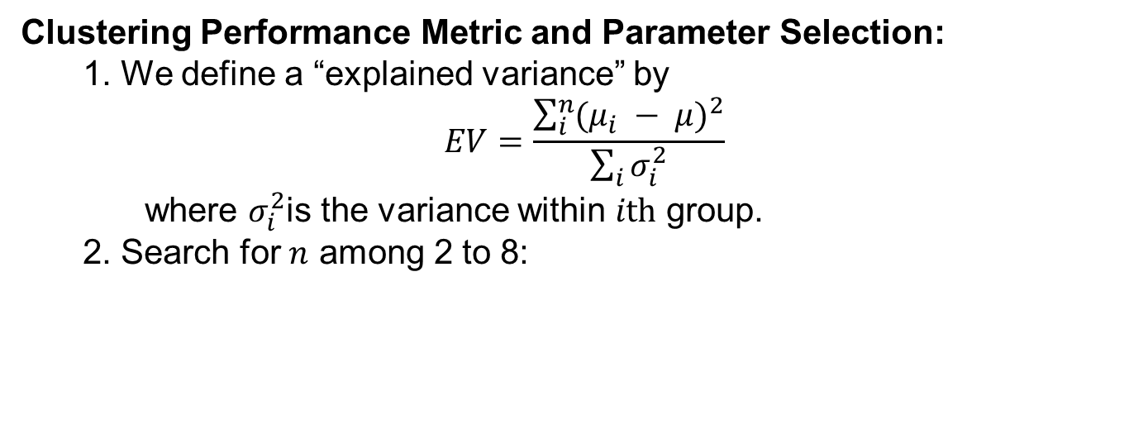
Model Improvements – Using Clustering
Clustering Performance Metric and Parameter Selection:
1. We define a “explained variance” by
$$EV=\frac{\sum_{i}^{n}{{(μ_{i} − μ)}^{2}}}{\sum_{i}{σ_{i}^{2}}}$$
where $σ_{i}^{2}$is the variance within $ith$ group.
2. Search for $n$ among 2 to 8:

Slide 9
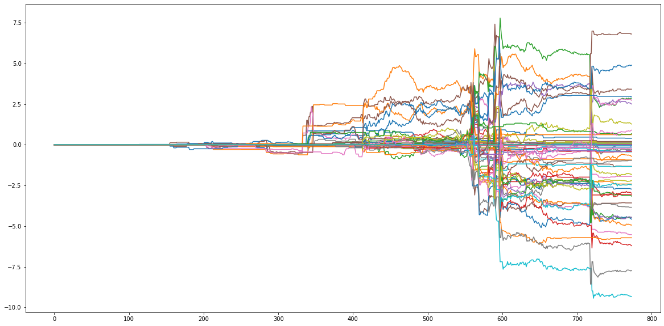
Model Improvements – Using Clustering
Performance

Slide 10
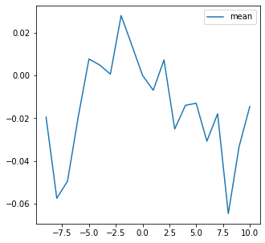
Model Improvements – Using Clustering
Performance
Ranking | Learning Algorithm | Percentage of Labeling | Holding Period | Sample Size
1 | ExtraTree | 30 | 1 | 300
2 | ExtraTree | 30 | 1 | 500
3 | ExtraTree | 30 | 2 | 100
4 | ExtraTree | 30 | 2 | 200
5 | ExtraTree | 30 | 2 | 400
6 | ExtraTree | 30 | 5 | 100
7 | ExtraTree | 20 | 10 | 100
8 | ExtraTree | 20 | 10 | 300
9 | ExtraTree | 30 | 10 | 100
10 | ExtraTree | 30 | 10 | 200

Slide 11
Model Improvements - Doc2Vec and Pooling
Motivation:
1. Word bag may not be the best way in feature extraction.
2. Understanding an article vs. understanding a word.
3. Assuming one speech has only one main idea:
the vector representation of an article is the mean of its sentences.
4. Given the computation power limit, instead of doing daily rolling back testing, we separate the total sample into 8 training/testing sets.

Slide 12
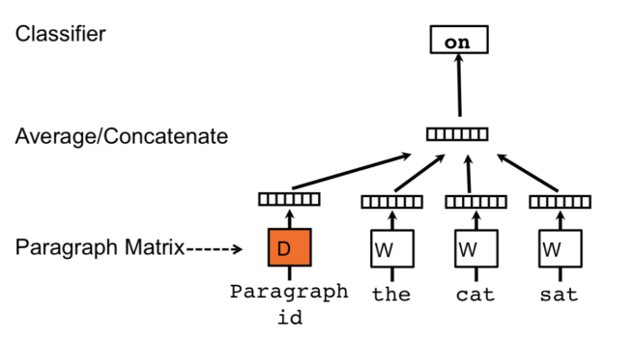
Model Improvements - Doc2Vec and Pooling
Model Intuition
From: https://blog.acolyer.org/2016/06/01/distributed-representations-of-sentences-and-documents/

Slide 13
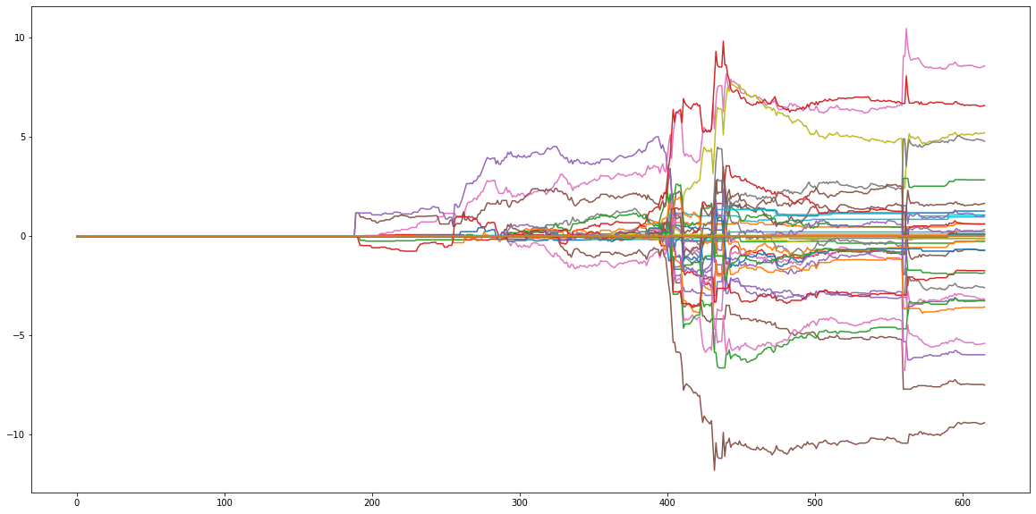
Model Improvements - Doc2Vec and Pooling
Performance

Slide 14
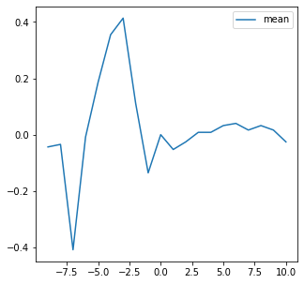
Model Improvements - Doc2Vec and Pooling
Performance
Ranking | Learning Algorithm | Percentage of Labeling | Holding Period | Sample Size
1 | ExtraTree | 10 | 1 | 100
2 | ExtraTree | 30 | 1 | 100
3 | ExtraTree | 30 | 1 | 300
4 | ExtraTree | 10 | 2 | 100
5 | ExtraTree | 20 | 2 | 300
6 | ExtraTree | 30 | 2 | 200
7 | ExtraTree | 10 | 5 | 100
8 | ExtraTree | 30 | 5 | 100
9 | ExtraTree | 30 | 10 | 100
10 | ExtraTree | 30 | 10 | 300

Slide 15
Comparison and Summary
Conclusions:
1. Doc2Vec embedding alpha has smoother profile, i.e. easier for portfolio implementation.
2. Adding intra-sample information by clustering may not be helpful in this problem and dataset.
3. Several Fed speeches contribute significantly large to the total PnL, which we may be interested in determine what those are.

