Slide 1


5-year Treasury Yield Prediction
Based on Fed Speech Sentiments
Hanyuan Hu, Binlin Chi
10/17/2019

Slide 2

News Analytics and Machine Learning
Contents:
Quick Refresh
Model Summary
Performance
Model Improvements:
Using Clustering
Doc2Vec and Pooling
Comparison and Summary

Slide 3
Quick Refresh – Model Summary
Model Summary For the First Stage
Feature Engineering
1. Using Bag-of-words
2. Treat words in title and in body differently
Learning Algorithms
1. Tree/Gaussian Naïve Bayes + Bagging
Cross Validation
1. Rolling training and testing
2. Hyper parameter tuning: grid search + aggregation
Trading Signal Metrics
1. Cumulative returns + maximum drawdown
2. Alpha decay

Slide 4
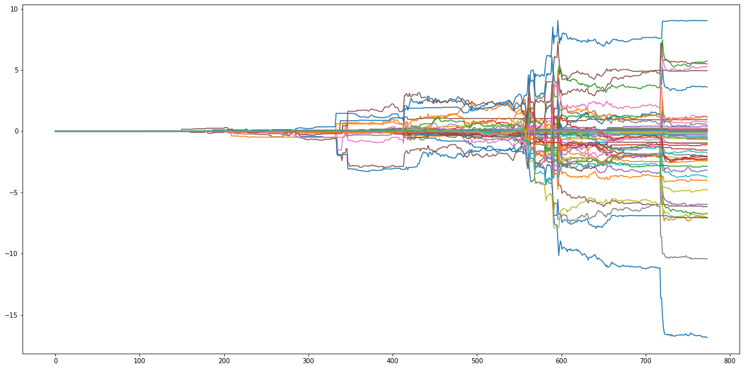
A Quick Refresh – Performance
Strategy Performance Overview

Slide 5
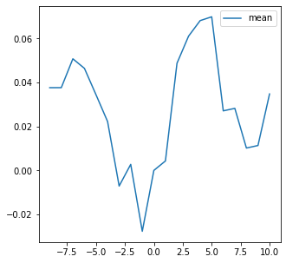
A Quick Refresh - Performance
Ranking | Learning Algorithm | Percentage of Labeling | Holding Period | Sample Size
1 | ExtraTree | 20 | 1 | 200
2 | ExtraTree | 30 | 1 | 300
3 | ExtraTree | 10 | 2 | 100
4 | ExtraTree | 20 | 2 | 100
5 | ExtraTree | 30 | 2 | 200
6 | ExtraTree | 20 | 5 | 100
7 | ExtraTree | 30 | 5 | 100
8 | ExtraTree | 30 | 5 | 200
9 | ExtraTree | 30 | 10 | 100
10 | ExtraTree | 30 | 10 | 200

Slide 6
A Quick Refresh - Performance
Performance
Strategy ID | Sharp Ratio | Maximum Drawdown | Cumulative Return
20 | 1.117799277 | 2.128294673 | 9.025915
35 | 0.811062124 | 3.19641783 | 4.94178
12 | 0.609563784 | 2.217124259 | 5.740266
54 | 0.569434943 | 0.295962135 | 0.38338
56 | 0.566517857 | 2.782303302 | 5.254754
55 | 0.565095573 | 3.301107805 | 5.491214
15 | 0.51284976 | 0.325011571 | 0.937775
46 | 0.488450989 | 0.0588405 | 0.211837
2 | 0.409534789 | 0.072085727 | 0.132422
40 | 0.375522125 | 5.976538897 | 3.606798

Slide 7


Model Improvements – Using Clustering
Motivation:
1. For different topics, the important words/features are not the same.
2. There is evidence the Fed speeches fall into several groups.
3. One way to model inter-sample relationships:
provide prior information by feature engineering.
$$f\left(x_{i}\right)→y_{i}$$
$f\left(x_{i}, g(x_{i}, X\right))→$ $y_{i}$

Slide 8
Model Improvements – Using Clustering
Evidence:
1. Using Birch algorithm to cluster all samples based on all features.
2. We first assume there are two clusters.
3. Top 10 discriminant features reported as follows:
ranking | y | 0 | 1
1 | inflation | 2.253635 | 34.64516
2 | policy | 5.442649 | 28.53548
3 | rate | 3.486268 | 21.02581
4 | monetary | 2.980614 | 17.30968
5 | federal | 8.453958 | 19.28387
6 | prices | 2.187399 | 12.27097
7 | rates | 2.801292 | 12.05161
8 | economic | 5.73021 | 14.90968
9 | economy | 3.875606 | 11.74194
10 | central | 2.468498 | 10.12258
Cluster 0:
Progress on the Transition to Risk-Free Rates (4/10/2019)
Fostering Closer Supervisory Communication (4/2/2019
Cluster 1:
Navigating the Different Signals from Inflation and Unemployment (5/30/2017)
Sustaining Maximum Employment and Price Stability (5/30/2019)
Notes:
Balanced Iterative Reducing and Clustering Using Hierarchies
在设计之初就考虑到了大规模数据集上聚类的精确性（充分利用有限内存保证好的聚类效果）和最小化I/O代价（减少数据库的读写，保证效率）之间的均衡。BIRCH能够识别出数据集中数据分布的不均衡性，将分布在稠密区域中的点聚类，将分布在稀疏区域中的点视作异常点而移除。此外，BIRCH是一种增量聚类方法，针对每一个点的聚类决策都是基于当前已经处理过的数据点，而不是全局的数据点。

Slide 9
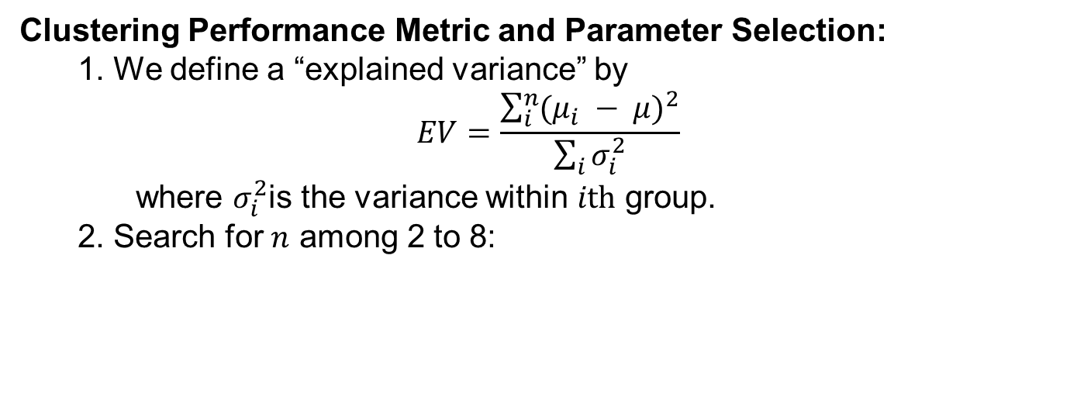
Model Improvements – Using Clustering
Clustering Performance Metric and Parameter Selection:
1. We define a “explained variance” by
$$EV=\frac{\sum_{i}^{n}{{(μ_{i} − μ)}^{2}}}{\sum_{i}{σ_{i}^{2}}}$$
where $σ_{i}^{2}$is the variance within $ith$ group.
2. Search for $n$ among 2 to 8:

Slide 10
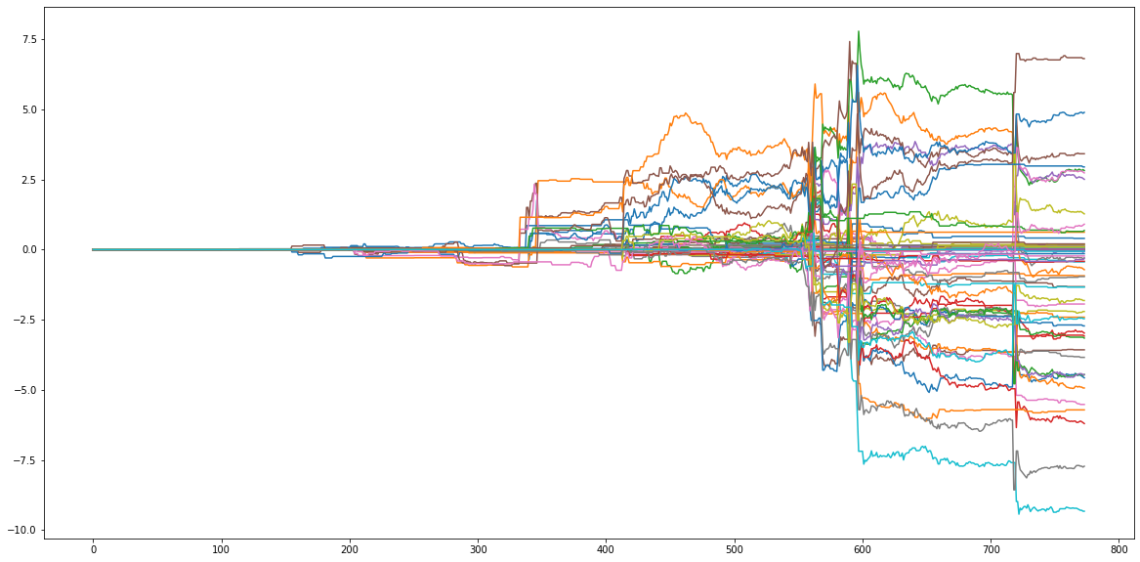
Model Improvements – Using Clustering
Performance

Slide 11
Model Improvements – Using Clustering
Performance
Strategy ID | Information Ratio | Maximum Drawdown | Cumulative Return
55 | 0.701122 | 4.490692 | 6.808737
40 | 0.57091 | 3.480486 | 4.8916
31 | 0.509244 | 0.039221 | 0.620025
50 | 0.445645 | 4.695299 | 2.946374
45 | 0.387308 | 0.111226 | 0.201752
25 | 0.364599 | 4.491992 | 3.416569
47 | 0.339173 | 0.058841 | 0.101502
48 | 0.329672 | 0.058841 | 0.09531
12 | 0.326528 | 5.489241 | 2.818283
14 | 0.30177 | 2.60515 | 2.504622
Strategy ID | Information Ratio | Maximum Drawdown | Cumulative Return
20 | 1.117799277 | 2.128294673 | 9.025915
35 | 0.811062124 | 3.19641783 | 4.94178
12 | 0.609563784 | 2.217124259 | 5.740266
54 | 0.569434943 | 0.295962135 | 0.38338
56 | 0.566517857 | 2.782303302 | 5.254754
55 | 0.565095573 | 3.301107805 | 5.491214
15 | 0.51284976 | 0.325011571 | 0.937775
46 | 0.488450989 | 0.0588405 | 0.211837
2 | 0.409534789 | 0.072085727 | 0.132422
40 | 0.375522125 | 5.976538897 | 3.606798

Slide 12
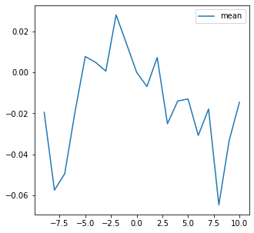
Model Improvements – Using Clustering
Performance
Ranking | Learning Algorithm | Percentage of Labeling | Holding Period | Sample Size
1 | ExtraTree | 30 | 1 | 300
2 | ExtraTree | 30 | 1 | 500
3 | ExtraTree | 30 | 2 | 100
4 | ExtraTree | 30 | 2 | 200
5 | ExtraTree | 30 | 2 | 400
6 | ExtraTree | 30 | 5 | 100
7 | ExtraTree | 20 | 10 | 100
8 | ExtraTree | 20 | 10 | 300
9 | ExtraTree | 30 | 10 | 100
10 | ExtraTree | 30 | 10 | 200

Slide 13
Model Improvements - Doc2Vec and Pooling
Motivation:
1. Bag-of-Words may not be the best way in feature extraction.
2. Understanding an article vs. understanding a word.
3. Assuming one speech has only one main idea:
the vector representation of an article is the mean of its sentences.
4. Given the computation power limit, instead of doing daily rolling back testing, we separate the total sample into 8 training/testing sets.

Slide 14
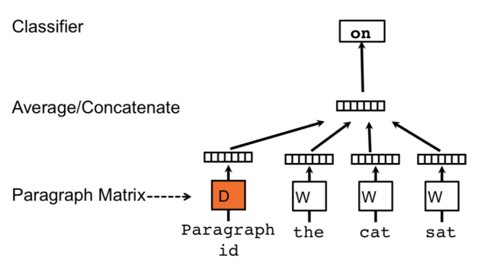
Model Improvements - Doc2Vec and Pooling
Model Intuition
From: https://blog.acolyer.org/2016/06/01/distributed-representations-of-sentences-and-documents/

Slide 15
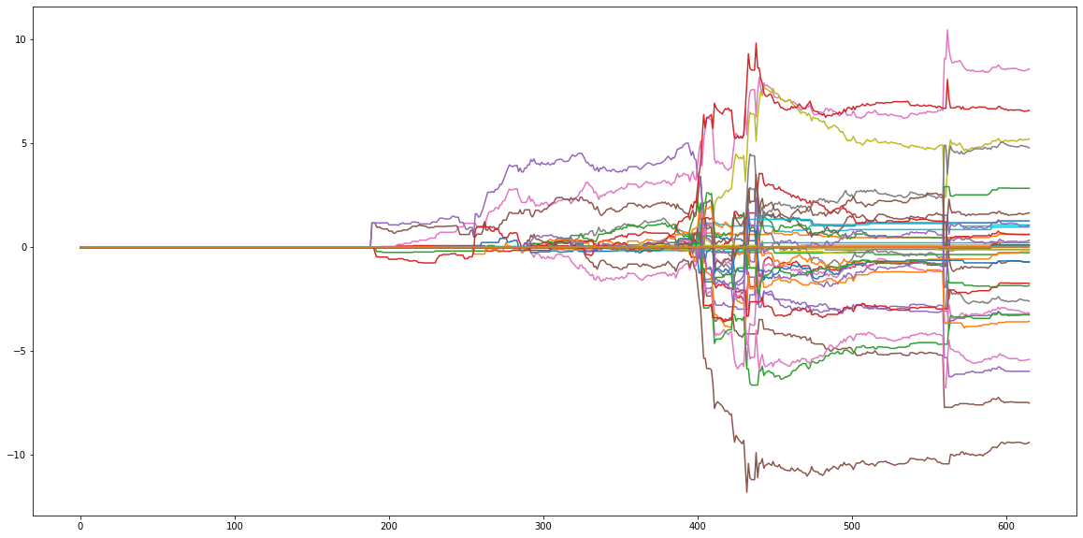
Model Improvements - Doc2Vec and Pooling
Performance

Slide 16
Model Improvements - Doc2Vec and Pooling
Performance
Version | Strategy ID | Information Ratio | Maximum Drawdown | Cumulative Return
Original | 20 | 1.117799 | 2.128295 | 9.025915
Doc2Vec | 6 | 1.013236 | 2.565984 | 8.594213
Doc2Vec | 33 | 0.872234 | 3.577525 | 6.603261
Original | 35 | 0.811062 | 3.196418 | 4.94178
With Clustering | 55 | 0.701122 | 4.490692 | 6.808737
Doc2Vec | 9 | 0.676622 | 0.433335 | 0.981856
Doc2Vec | 8 | 0.632118 | 5.338426 | 5.227318
Original | 12 | 0.609564 | 2.217124 | 5.740266
Doc2Vec | 17 | 0.591079 | 3.283414 | 4.795537
With Clustering | 40 | 0.57091 | 3.480486 | 4.8916
Original | 54 | 0.569435 | 0.295962 | 0.38338
Original | 56 | 0.566518 | 2.782303 | 5.254754
Original | 55 | 0.565096 | 3.301108 | 5.491214
Doc2Vec | 0 | 0.559261 | 0.526377 | 1.278248
Doc2Vec | 1 | 0.519884 | 0.396033 | 0.633132

Slide 17
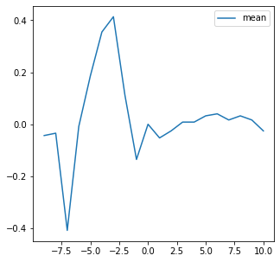
Model Improvements - Doc2Vec and Pooling
Performance
Ranking | Learning Algorithm | Percentage of Labeling | Holding Period | Sample Size
1 | ExtraTree | 10 | 1 | 100
2 | ExtraTree | 30 | 1 | 100
3 | ExtraTree | 30 | 1 | 300
4 | ExtraTree | 10 | 2 | 100
5 | ExtraTree | 20 | 2 | 300
6 | ExtraTree | 30 | 2 | 200
7 | ExtraTree | 10 | 5 | 100
8 | ExtraTree | 30 | 5 | 100
9 | ExtraTree | 30 | 10 | 100
10 | ExtraTree | 30 | 10 | 300

Slide 18
Comparison and Summary
Comments:
1. Doc2Vec embedding alpha has smoother profile, i.e. easier for portfolio implementation.
2. Adding intra-sample information by clustering may not be helpful in this problem and dataset.
3. Several Fed speeches contribute significantly large to the total PnL, which we may be interested in determine what those are.

