Slide 1

Computer Graphics
< 3D Maze Hunting _ Horror>
201634951 유동섭
201835489 이소라
201835505 이하영

Slide 2
01
02
03
04
Brief
description
Key
features
Implementation Details
Members
Info & Duty

Slide 3



01
BRIEF DESCRIPTION
It's a 3D maze-hunting horror game,
where dark and obstacles exist, but it's a game where you get out of the way
“
”

Slide 4


02
KEY FEATURES
Walls that make up the maze & characters that escape
Solve the problem that pass the wall
When you Escape safely, you win
1
MAZE
2
Unlike the existing maze, Depth is added
Feeling in a real maze
3D

Slide 5


02
KEY FEATURES
3
Use MTL & OBJ loader to place obstacles
If you encounter obstacles, you die
Create tension with a time limit
OBSTACLE
1) Darken surroundings area to create panic mood
2) Place colored lights from place to place
4
LIGHT

Slide 6
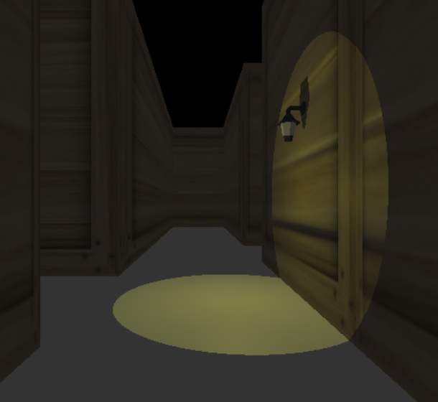
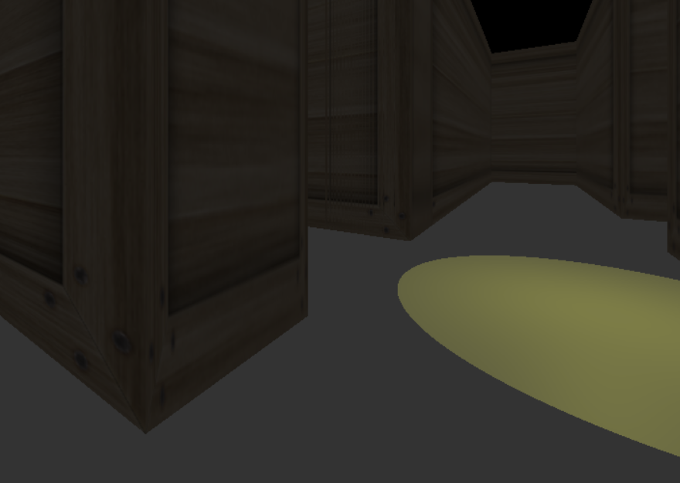
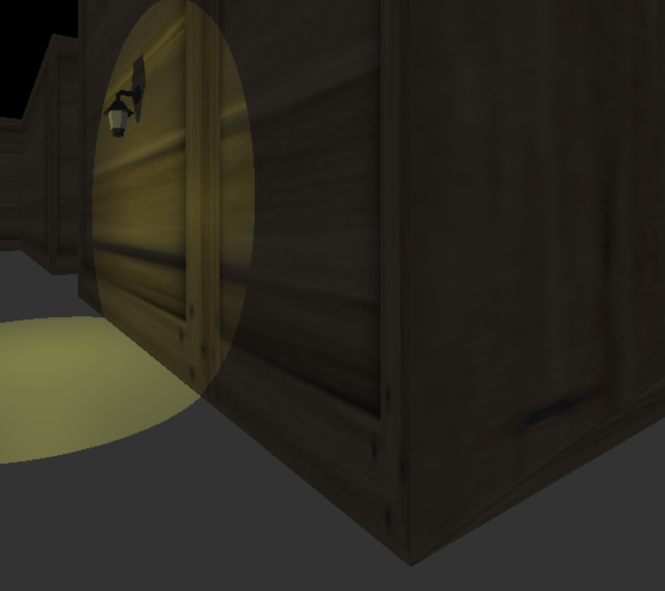
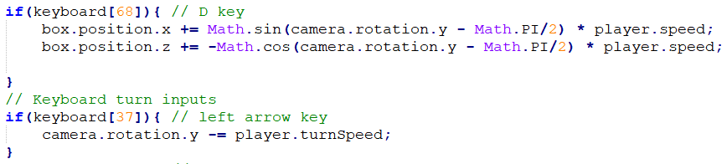
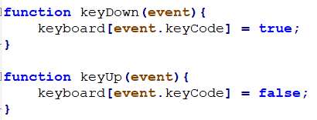
03
IMPLEMENTATION DETAILS
MOVE
<-
->
W
A
D
S

Slide 7
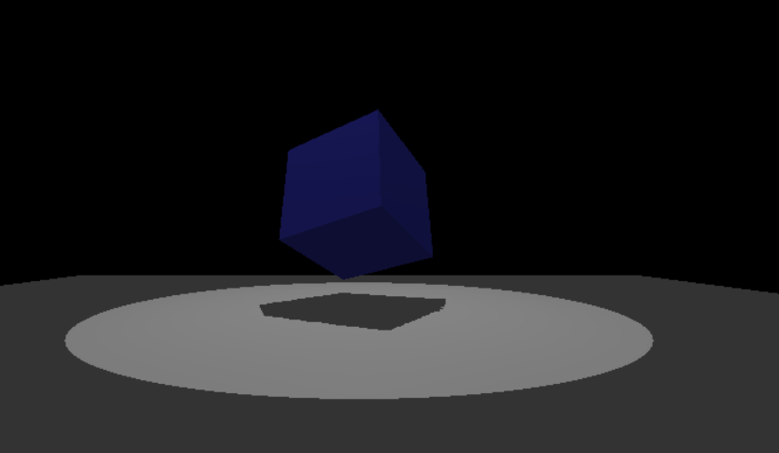

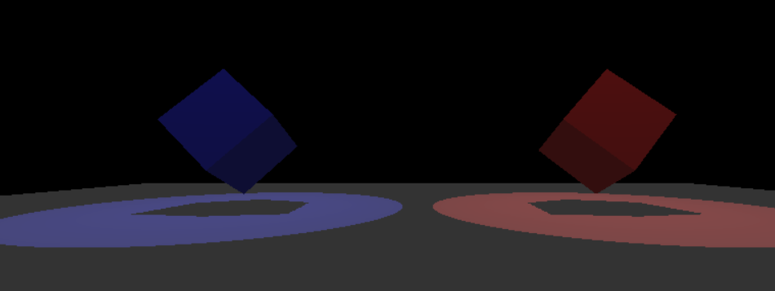
03
IMPLEMENTATION DETAILS
LOADING SCREEN
X3
Die
First Screen
Loading
Loading
Last Screen
Game
Start again
Go to the blue cube
& start the game
3 seconds
loading
Show the game
with start point
3 seconds
loading
Blue : Start again
Red : Window Close

Slide 8
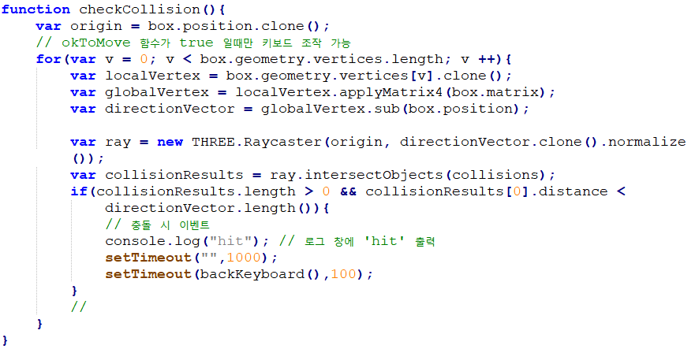
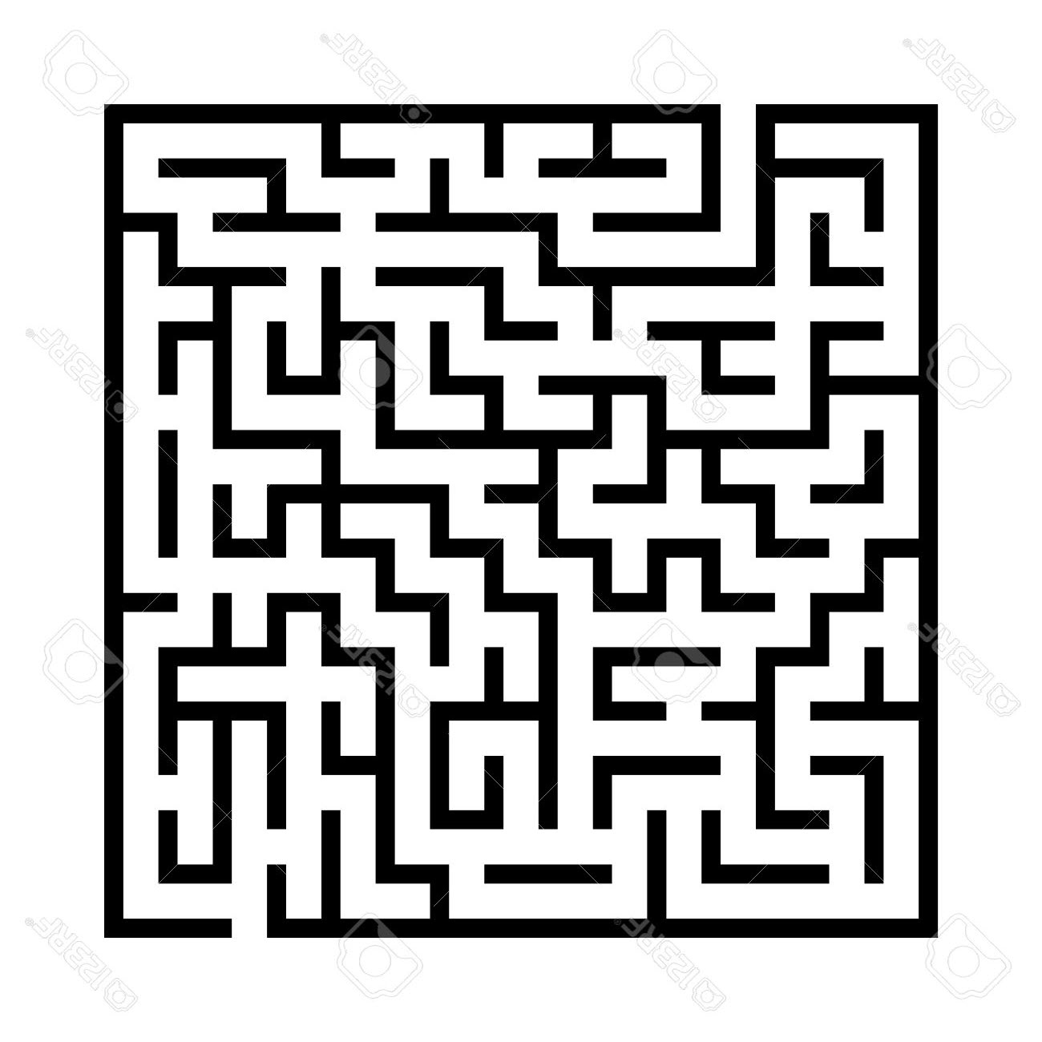
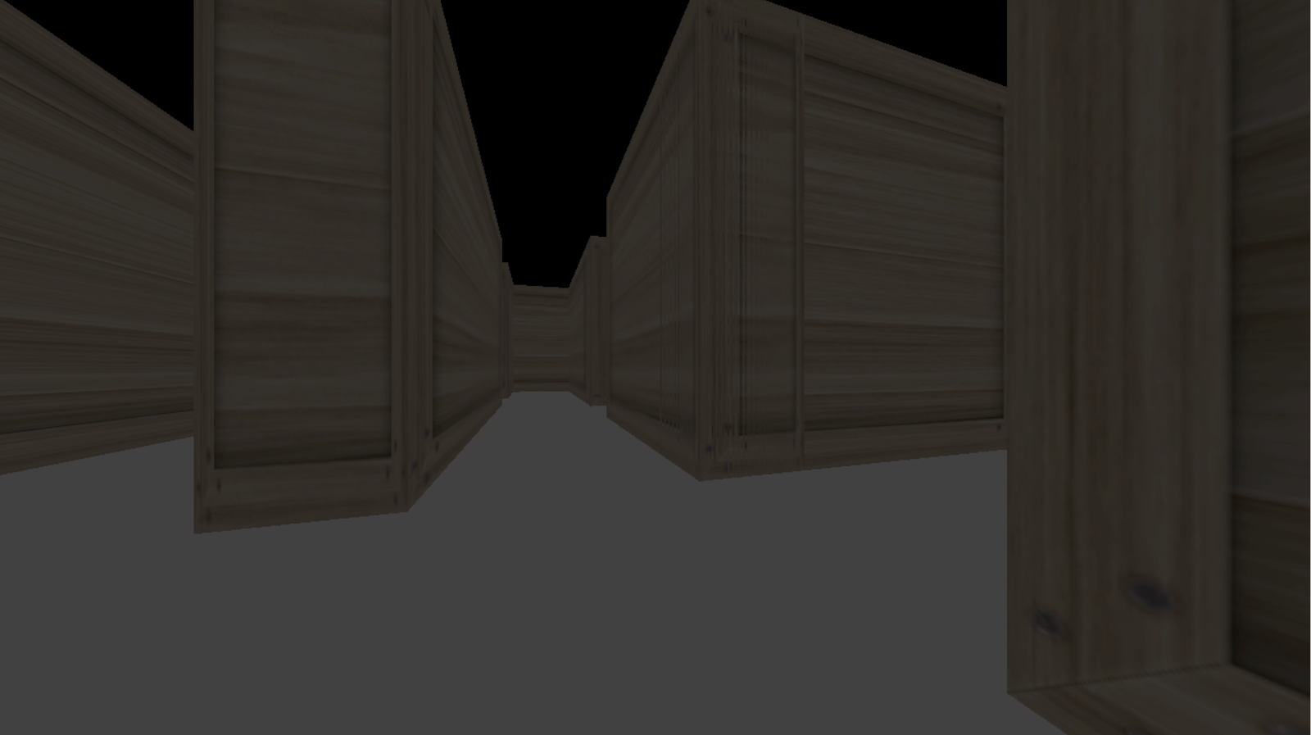
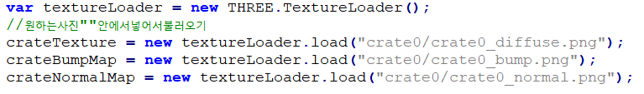
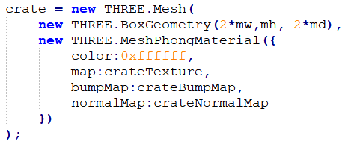
03
IMPLEMENTATION DETAILS
MAZE
1) Solve problem that camera pass the wall
2) Texture
Made 50 * 50 size
maze in 3D

Slide 9
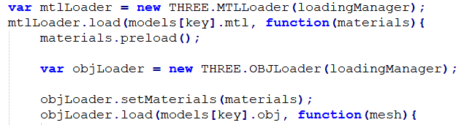
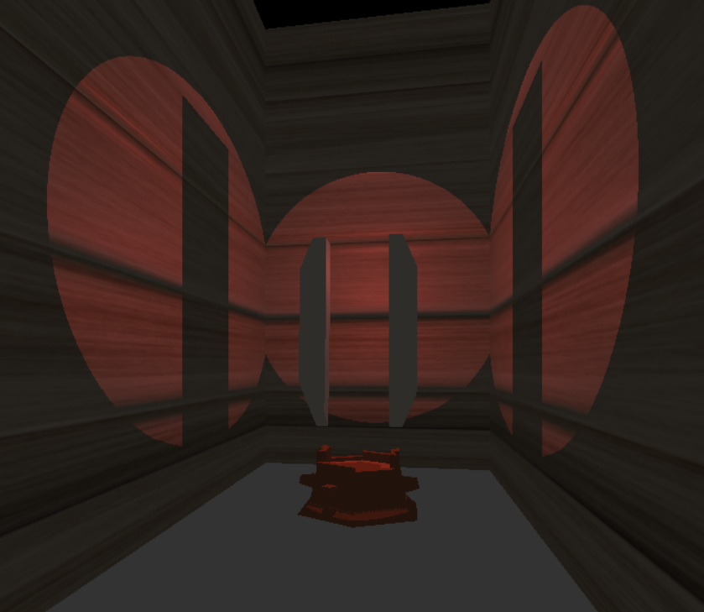
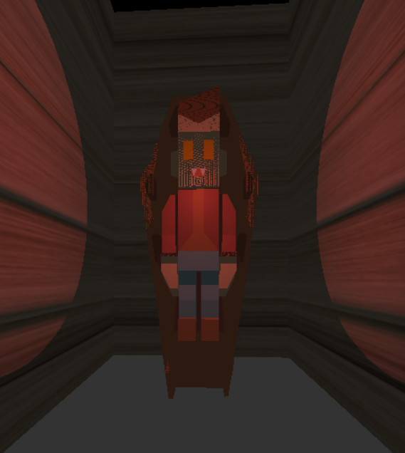
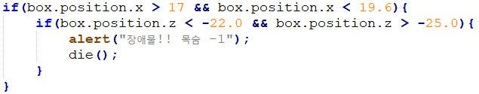
03
IMPLEMENTATION DETAILS
OBSTACLES
Use MTL & OBJ loader to place obstacles
2) Set obstacles they meet to death & assume the position of barrier into cube
-> If you die, reduce one life & start again

Slide 10
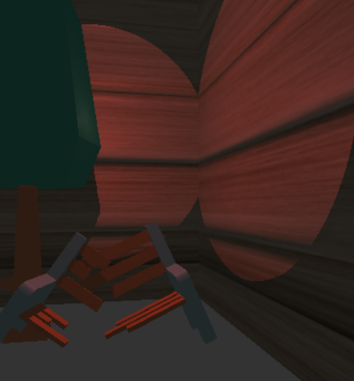
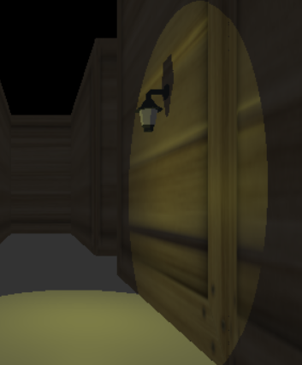
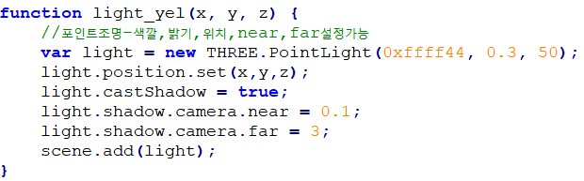

03
IMPLEMENTATION DETAILS
LIGHT
1) Darken surroundings area
2) Place colored lights from place to place

Slide 11
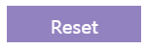

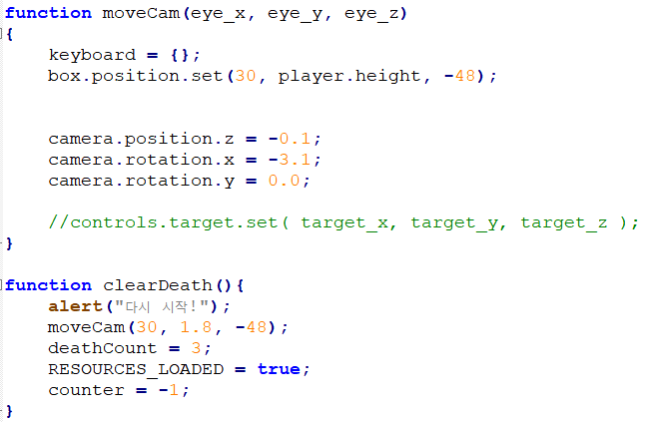
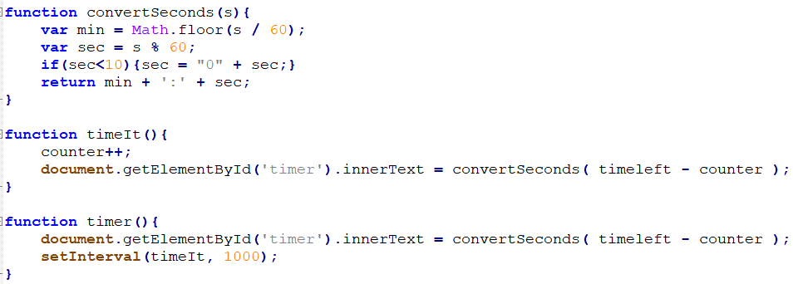


03
IMPLEMENTATION DETAILS
OTHER
Button
Timer
-> Add to html to move camera to start point
-> Add to html to death after some period of time
Sound
-> Play music to create horror atmosphere

Slide 12
03
IMPLEMENTATION DETAILS
DEMO VIDEO
DEMO VIDEO

Slide 13


04
MEMBER INFO & DUTY
유동섭
kidyoo14@naver.com
Proposal Presentation
Demo Video
Develop Code - Collision Problem, View-Point, Demo Video
이소라
ehrqor39@naver.com
Proposal PPT
Final Presentation
Develop Code - Maze, Components, Light, Loading screen
이하영
hyl980911@naver.com
Assignment #2
Final PPT
Develop Code - Obstacles, Timer, Button, Action & Event Activity

Slide 14
THANK YOU

