Slide 1
CONTENT
Abstract
Introduction
Problem statement
Objectives of the work
Methodology
Implementation of project Execution
Experimental Setup, Expected Results & Analysis
Project Status, Conclusion
Publication
References(IEEE format)

Slide 2
ABSTRACT
Context: Manual evaluation of handwritten exam answer sheets is slow, inconsistent across evaluators, and does not scale to large classes.
Problem Identified: Existing OCR / auto-grading tools handle printed or MCQ answers well, but real handwritten, annotated descriptive answers — with strikethroughs, underlines, margin insertions and diagrams — remain largely unaddressed.
Objective: To build an end-to-end system that reads a photographed handwritten answer sheet, correctly interprets hand-drawn annotations, and scores each answer against concepts extracted automatically from the teacher's own model answer.
Methods: A computer-vision pipeline (preprocessing, segmentation, Hough-transform annotation detection with VLM adjudication, adaptive OCR routing) feeds a RAG-based scoring pipeline (chunk retrieval, triple-pass LLM coverage voting, embedding similarity) that produces a mark, a confidence score, and structured feedback per concept.
Results: The system correctly transcribes real handwritten answers, detects genuine annotations while rejecting printed page furniture misread as marks, computes concept-level scores consistent with answer quality, and exposes a confidence band so teachers know which sheets need a manual look.
Keywords: OCR, Computer Vision, Retrieval-Augmented Generation, Large Language Models, Vision-Language Models, Automated Grading, Django, Celery, pgvector.

Slide 3
INTRODUCTION
Manual grading of handwritten answer sheets is repetitive and time-consuming, and evaluator fatigue makes concept-level feedback inconsistent across a large class.
Existing automated grading tools largely assume typed or MCQ input — very little tooling handles real handwriting with corrections (strikethroughs), emphasis (underlines) and margin insertions the way a human evaluator naturally reads them.
Scope: build a pipeline from a photographed/scanned answer sheet all the way to a teacher-reviewable, per-concept mark — not just an OCR demo, and not just an LLM asked to "grade this."
Related work reviewed: classical OCR engines (Tesseract), Retrieval-Augmented Generation for grounding LLM judgements in the actual answer text, and vision-language models as a fallback for content classical CV/OCR cannot read reliably.

Slide 4
PROBLEM STATEMENT
Evaluators spend significant time per handwritten sheet, and cannot always give consistent, concept-by-concept feedback across a full class.
A single LLM call asked to "grade this answer" gives no auditable reasoning, no per-concept breakdown, and no reliable way for a teacher to trust or override the result.
Real answer sheets contain hand-drawn corrections and emphasis (strikethroughs, underlines, arrows to margin notes) that a plain OCR transcription silently gets wrong — either keeping deleted text or losing inserted text.
Gap addressed: a defensible, concept-by-concept, teacher-reviewable pipeline that works directly on photographed handwritten sheets, not on typed or pre-cleaned text.

Slide 5
OBJECTIVES OF THE WORK
Automatically decompose a teacher's model answer into independently gradable, weighted concepts.
Reliably segment a photographed answer sheet into per-question blocks, even when the student has not written a clear question-number label.
Detect and correctly interpret hand-drawn annotations — strikethrough as deletion, underline as emphasis, arrow as a margin-note insertion point — and escalate genuinely ambiguous marks to a vision-language model rather than guessing.
Score each concept from two independent signals (embedding similarity and a triple-pass LLM coverage vote), producing a mark, a measurable confidence, and structured feedback.
Give teachers a reviewable, override-able interface, and give students visibility only into their own approved results.

Slide 6
METHODOLOGY
Computer-vision pipeline (L1-L5):
  L1 Preprocessing — denoise, deskew, adaptive threshold, quality scoring
  L2 Segmentation — line/row detection; question-number reading via Tesseract with a vision-language-model fallback for handwritten or unlabelled numbers
  L3 / L3.5 Annotation detection — Hough-transform strike/underline/arrow/margin detection, with VLM adjudication for ambiguous marks
  L4 / L4.5 Adaptive OCR — Tesseract routed by scan quality, vision-language-model transcription for low-confidence or non-text (diagram/table/equation) content
  L5 Reconstruction — drop struck-out text, stitch margin notes in at arrow tips, assemble correct reading order
RAG + LLM scoring pipeline (L6-L8):
  L6 Chunking & retrieval — chunk the reconstructed answer, retrieve top-matching chunks per concept
  L7 Coverage voting — three independent LLM passes per concept, majority-voted verdict with a measurable agreement score
  L8 Scoring, confidence & feedback — combine similarity and LLM verdict into a mark; combine OCR quality, vote agreement and retrieval corroboration into a confidence band
Tech stack: Django REST Framework, Celery + Redis, PostgreSQL + pgvector, React + TypeScript, OpenCV, Tesseract OCR, hosted LLM/VLM/embedding models, pytest (265 automated tests).

Slide 7
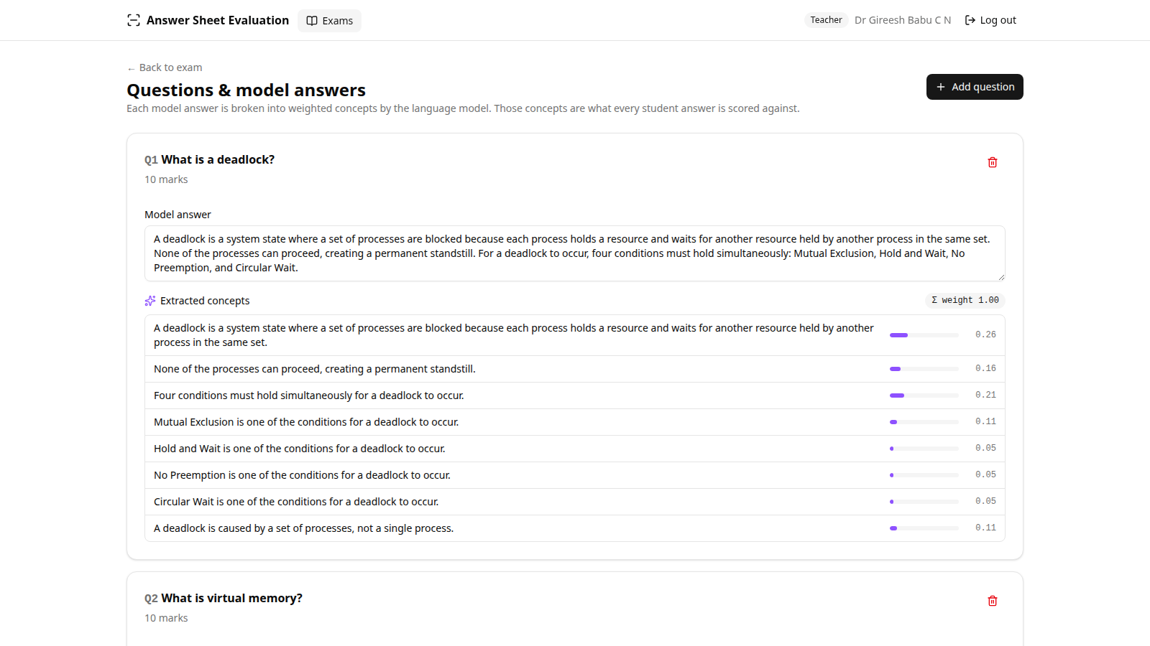
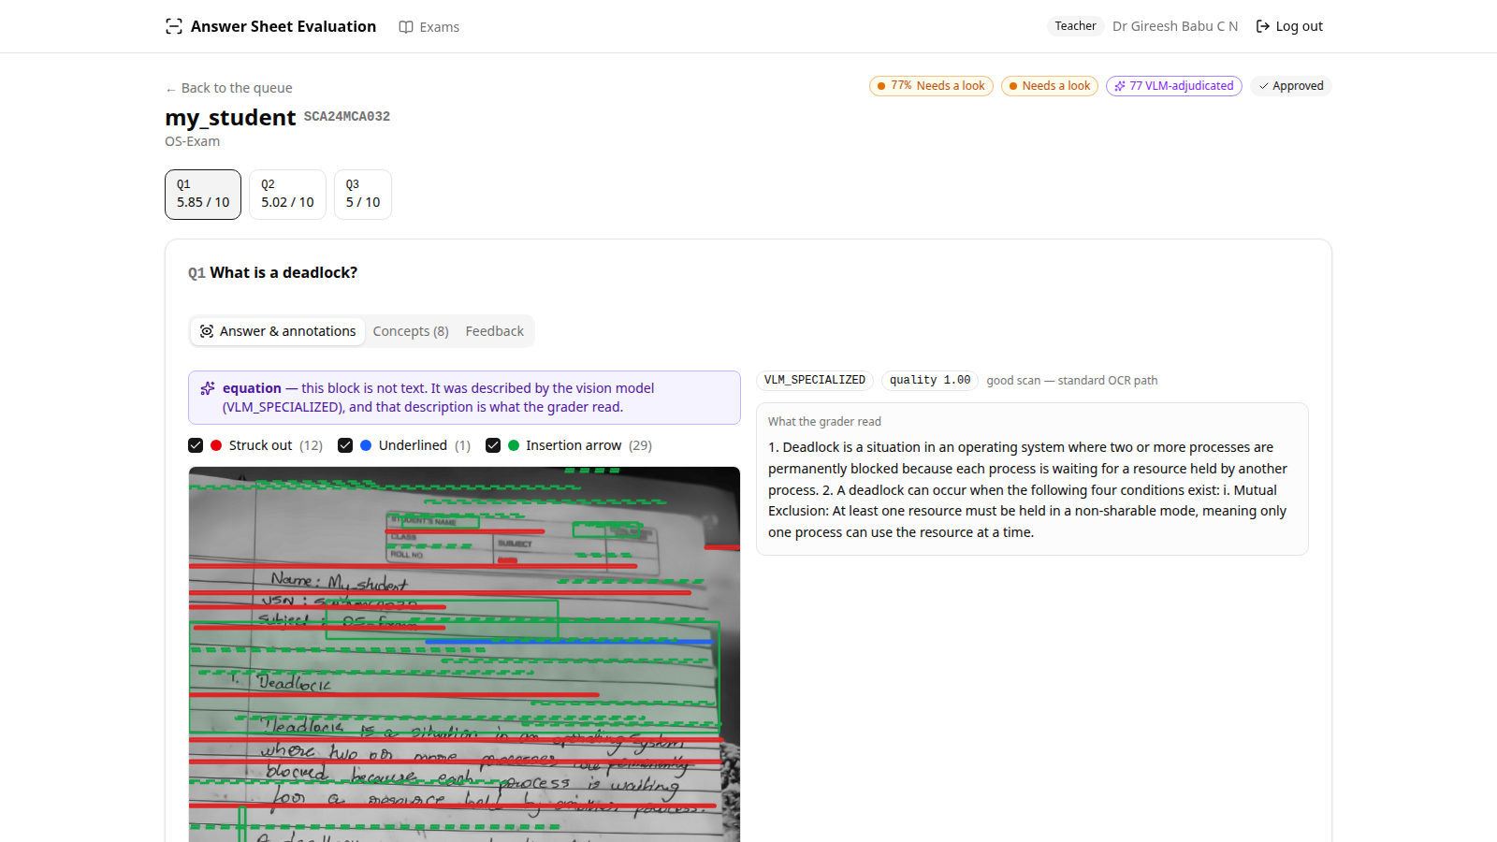
DEMONSTRATION OF PROJECT EXECUTION
Technologies: Django REST + Celery + PostgreSQL/pgvector backend, React frontend, hosted LLM / VLM / embedding models behind a swappable provider interface. No local GPU required.
Input: photographed or scanned handwritten answer sheets. Module-wise status — auth, exam/question/concept management, CSV import, real CV pipeline (L1-L5), real RAG+LLM scoring (L6-L8), teacher review/override/approve, student results: all done.
Model answer auto-decomposed into weighted concepts
Review screen: annotation overlay + real transcription

Slide 8
Experimental Setup, Results & Analysis
Experimental Setup
  Real photographed handwritten answer sheets across multiple Operating Systems / DBMS questions
  Evaluated end-to-end through the live running pipeline
  Evaluation metrics: per-concept status (Covered / Partial / Missing), auto marks vs. maximum marks, composite confidence score, VLM escalation rate
Testing Procedure
  265 automated tests: synthetic golden fixtures for every CV detector, plus regression tests built directly from real photographed answer sheets
  Live end-to-end verification against the running system
Results & Analysis
  Class-analytics dashboard correctly separates strong and weak answers
  Low-confidence sheets are automatically flagged for human review
  ~53% VLM escalation rate on real handwriting — ambiguous CV detections correctly get a second, human-quality opinion instead of a guess

Slide 9
PROJECT STATUS, CONCLUSION
Completed modules:
  Authentication & role management; exam, question and concept CRUD; CSV student import
  Real CV pipeline: preprocessing, segmentation, annotation detection & VLM adjudication, adaptive OCR, reconstruction
  Real RAG + LLM scoring pipeline: chunking & retrieval, triple-pass coverage voting, scoring, confidence, feedback
  Teacher review / override / approve workflow; student results; 265 automated tests
Pending work: threshold calibration against a labelled benchmark dataset, broader OCR robustness on cluttered real photographs, a formal correlation (Pearson r) benchmarking report.
Challenges faced: hosted-model churn (multiple third-party models were retired or degraded mid-project), handwriting OCR accuracy on cluttered real photographs, telling genuine hand-drawn marks apart from printed page furniture such as ruled lines.
Solutions adopted: a provider abstraction so a model swap is a one-line change; a vision-language-model adjudication step with an explicit "not a real mark" option; geometric detectors hardened against real, not just synthetic, photographs.
Conclusion: the core pipeline — from a photographed handwritten sheet to a concept-level, confidence-scored, teacher-reviewable mark — is built, tested and working end-to-end on real data. Remaining work is calibration and OCR robustness, not core architecture.

Slide 10
PUBLICATIONS
Instructions to the team :
Each team must publish their work in a reputed conference / journal indexed in Scopus / Web of Science. (exclusive marks are allotted for this parameter) or Patent
Project report must be prepared using LaTeX software.
The Project reports and research paper should be checked through Turnitin Plagiarism tool. (Must be less than 15%)

Slide 11
REFERENCES
[1] R. Smith, "An Overview of the Tesseract OCR Engine," in Proc. 9th Int. Conf. Document Analysis and Recognition (ICDAR), 2007, pp. 629-633.
[2] P. Lewis et al., "Retrieval-Augmented Generation for Knowledge-Intensive NLP Tasks," in Proc. NeurIPS, 2020.
[3] R. O. Duda and P. E. Hart, "Use of the Hough Transformation to Detect Lines and Curves in Pictures," Communications of the ACM, vol. 15, no. 1, pp. 11-15, 1972.
[4] A. Vaswani et al., "Attention Is All You Need," in Proc. NeurIPS, 2017.
[5] OpenAI, "GPT-4 Technical Report," arXiv:2303.08774, 2023.
[6] NVIDIA, "NVIDIA NIM: Optimized Inference Microservices," NVIDIA Developer Documentation, 2024. [Online]. Available: https://developer.nvidia.com/nim
[7] pgvector, "Open-source vector similarity search for Postgres," GitHub repository, 2024. [Online]. Available: https://github.com/pgvector/pgvector

