Slide 1
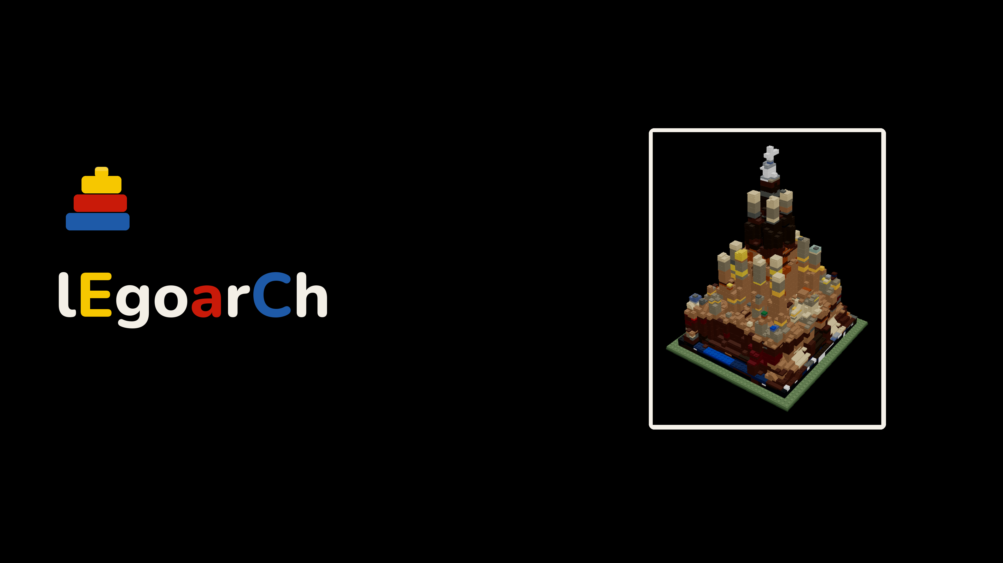
BEHIND THE SETS
Name a building → get a buildable LEGO set.
The engineering under the demo → how a sentence becomes real, orderable bricks.
Generative AI · Emilie El Chidiac & Charles Abi Chahine · 2026
Notes:
Title holds while the recorded demo plays. These slides are the 'behind the sets' — the engineering, not a re-walk of the demo.

Slide 2
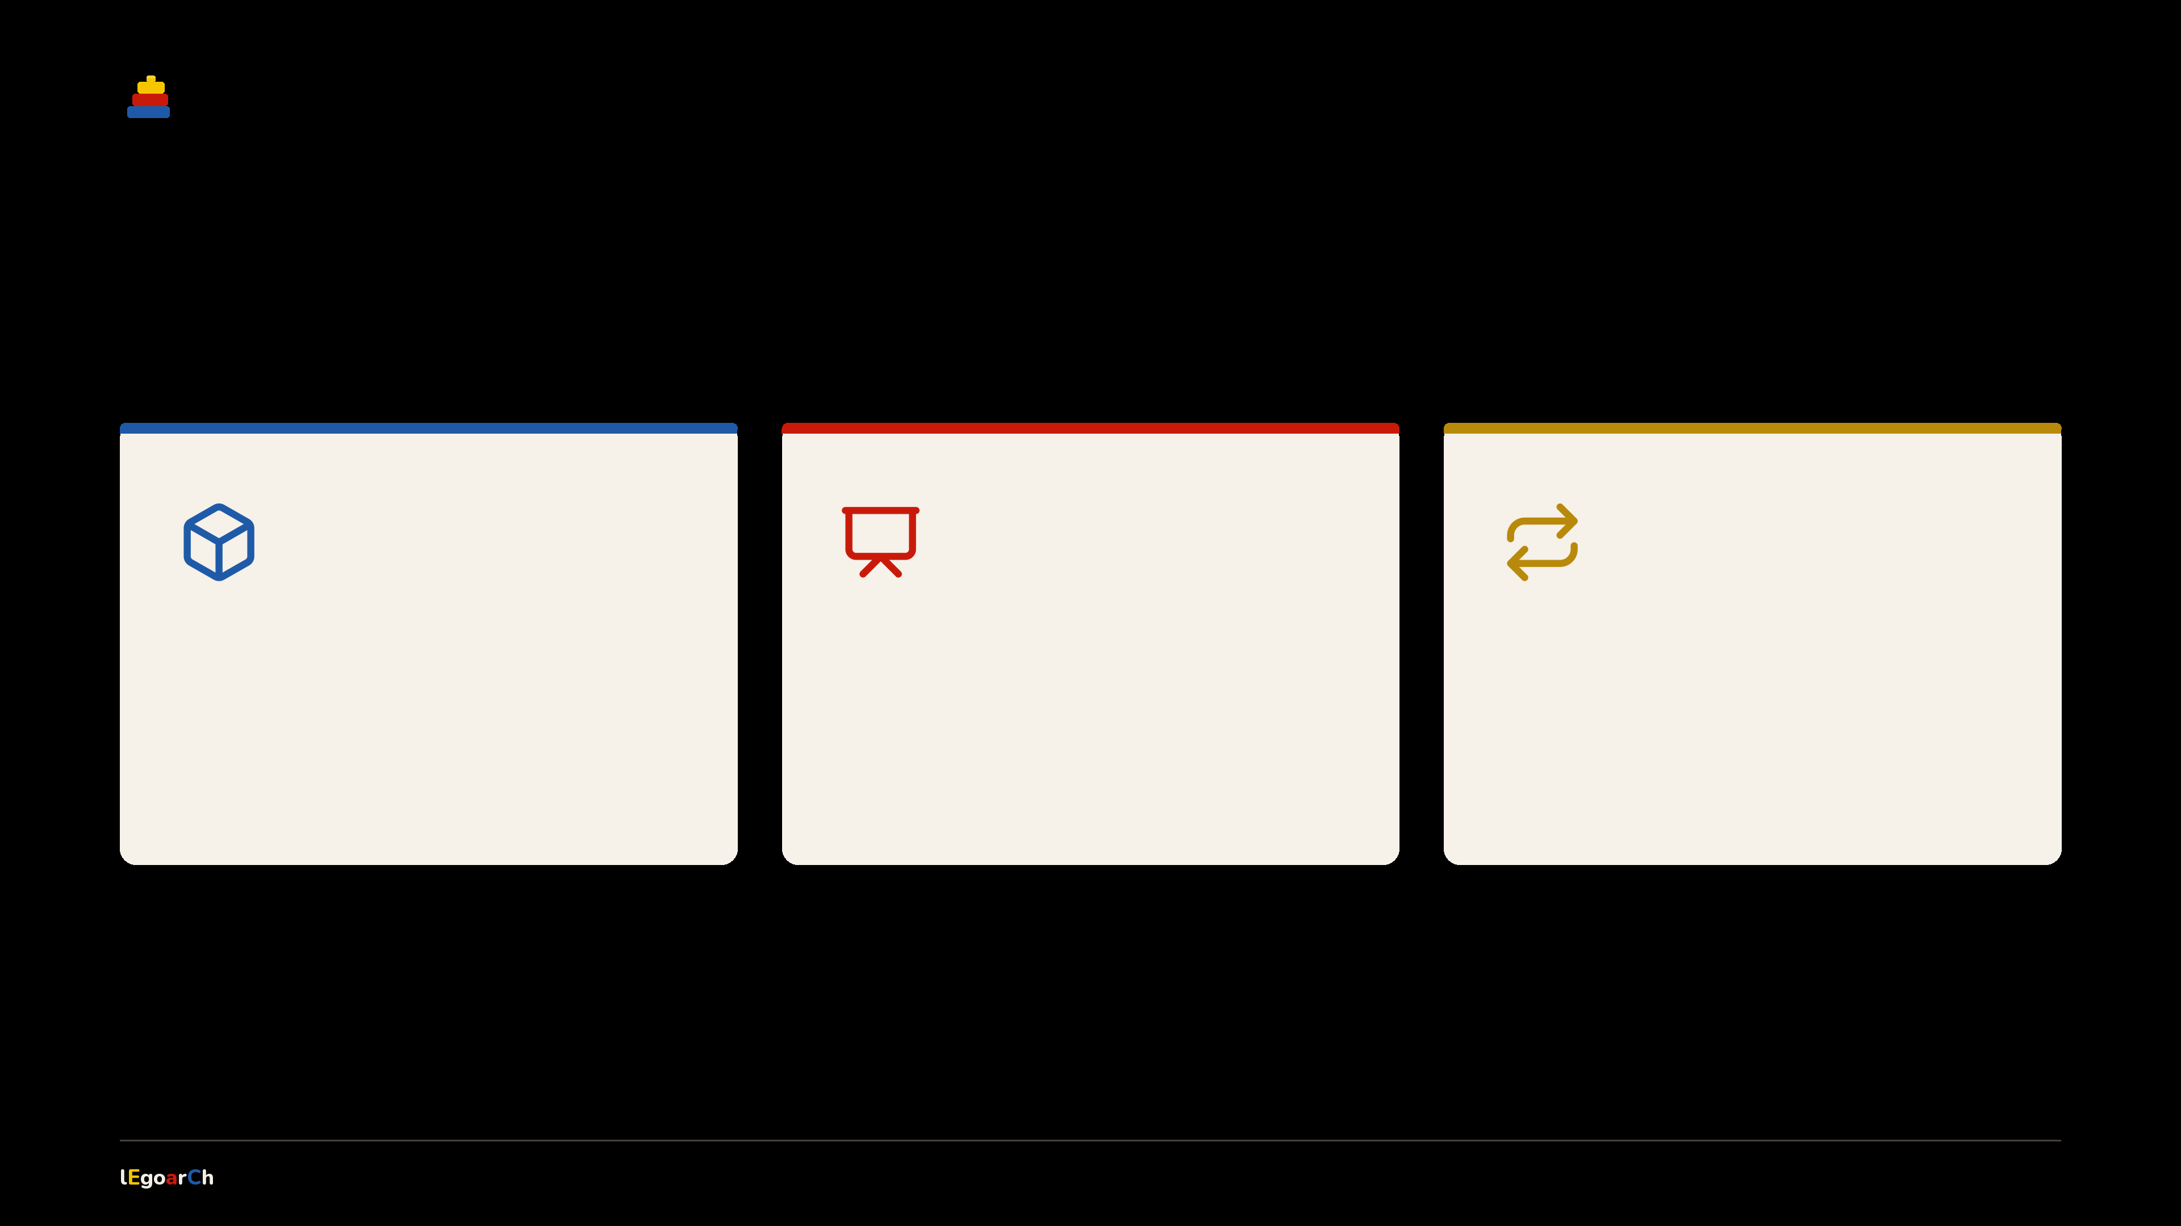
WHY IT MATTERS
Computation you can hold.
Three reasons a generated set beats a render.
Real, not rendered
Models, not mockups
Iterate in bricks
Generative form that snaps together in real bricks.
Hand a client a set they keep → not foam they bin.
Change the design → reorder only what changed.
FOR THE COMPUTATIONAL DESIGNER
FOR THE PRACTICING ARCHITECT
FOR THE STUDENT & MAKER
A form a machine dreamed up → that real bricks can actually build.
02 / 15
Notes:
Why this matters. Computation you can hold — generative form that's provably buildable, not a render. The architect's client model, and the iterate loop.

Slide 3
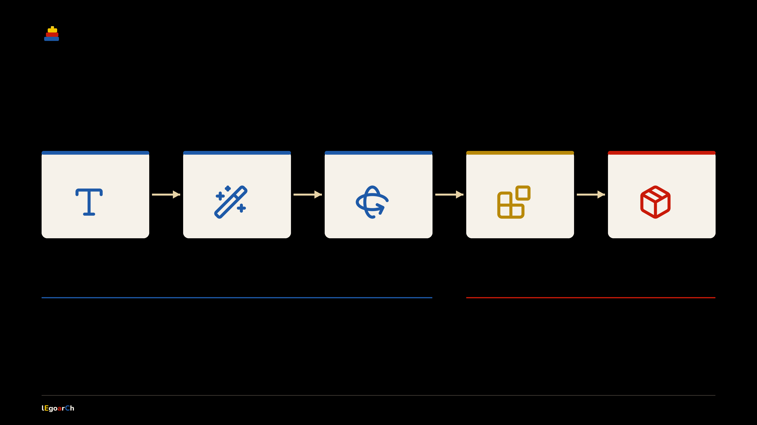
THE SYSTEM
One pipeline, end to end.
Five moves turn a sentence into an orderable set.
Prompt
FLUX.2 + LoRA
TRELLIS.2
Legolize
Catalog
a building name
→ a set-look render
→ a 3D mesh
→ real bricks
→ orderable parts
GENERATIVE AI · proposes the form
DETERMINISTIC CODE · proves & orders
Anyone can generate a picture → the back half, the code that proves it builds, is the work.
03 / 15
Notes:
The whole machine in one view. A sentence flows through FLUX+LoRA and TRELLIS (generative, blue), then plain deterministic code legolizes and maps to a real catalog (yellow then red). Generative proposes; code proves and orders.

Slide 4
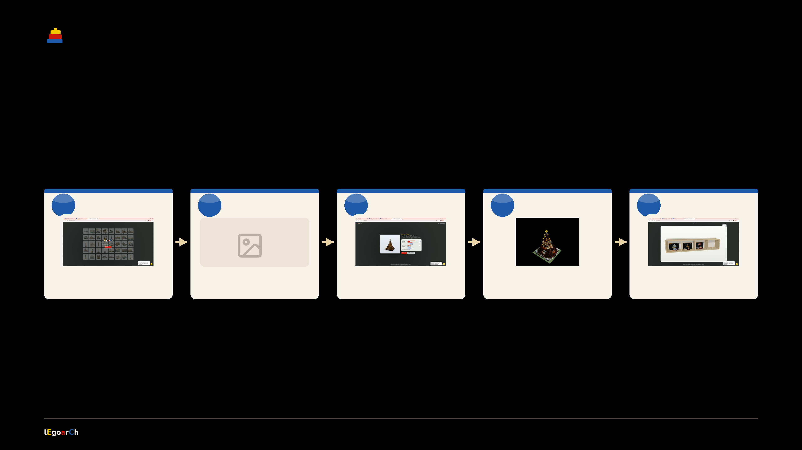
THE EXPERIENCE
What you actually do.
One sentence in → a real set on your shelf. Five moves, every one yours to redo.
1
Name it
2
Forge it
3
Carve it
4
Build it
5
Keep it
image
type any building
FLUX render · tune it
TRELLIS 3D mesh
course by course
box · booklet · parts · shelf
Every stop is editable → re-roll the render, re-tune the bricks, reopen any set from the shelf.
04 / 15
Notes:
What the user actually does: name a building, forge a render (and tune it), carve it to 3D, watch it build course by course, then keep the boxed set — booklet, priced parts, all on a persistent shelf.

Slide 5
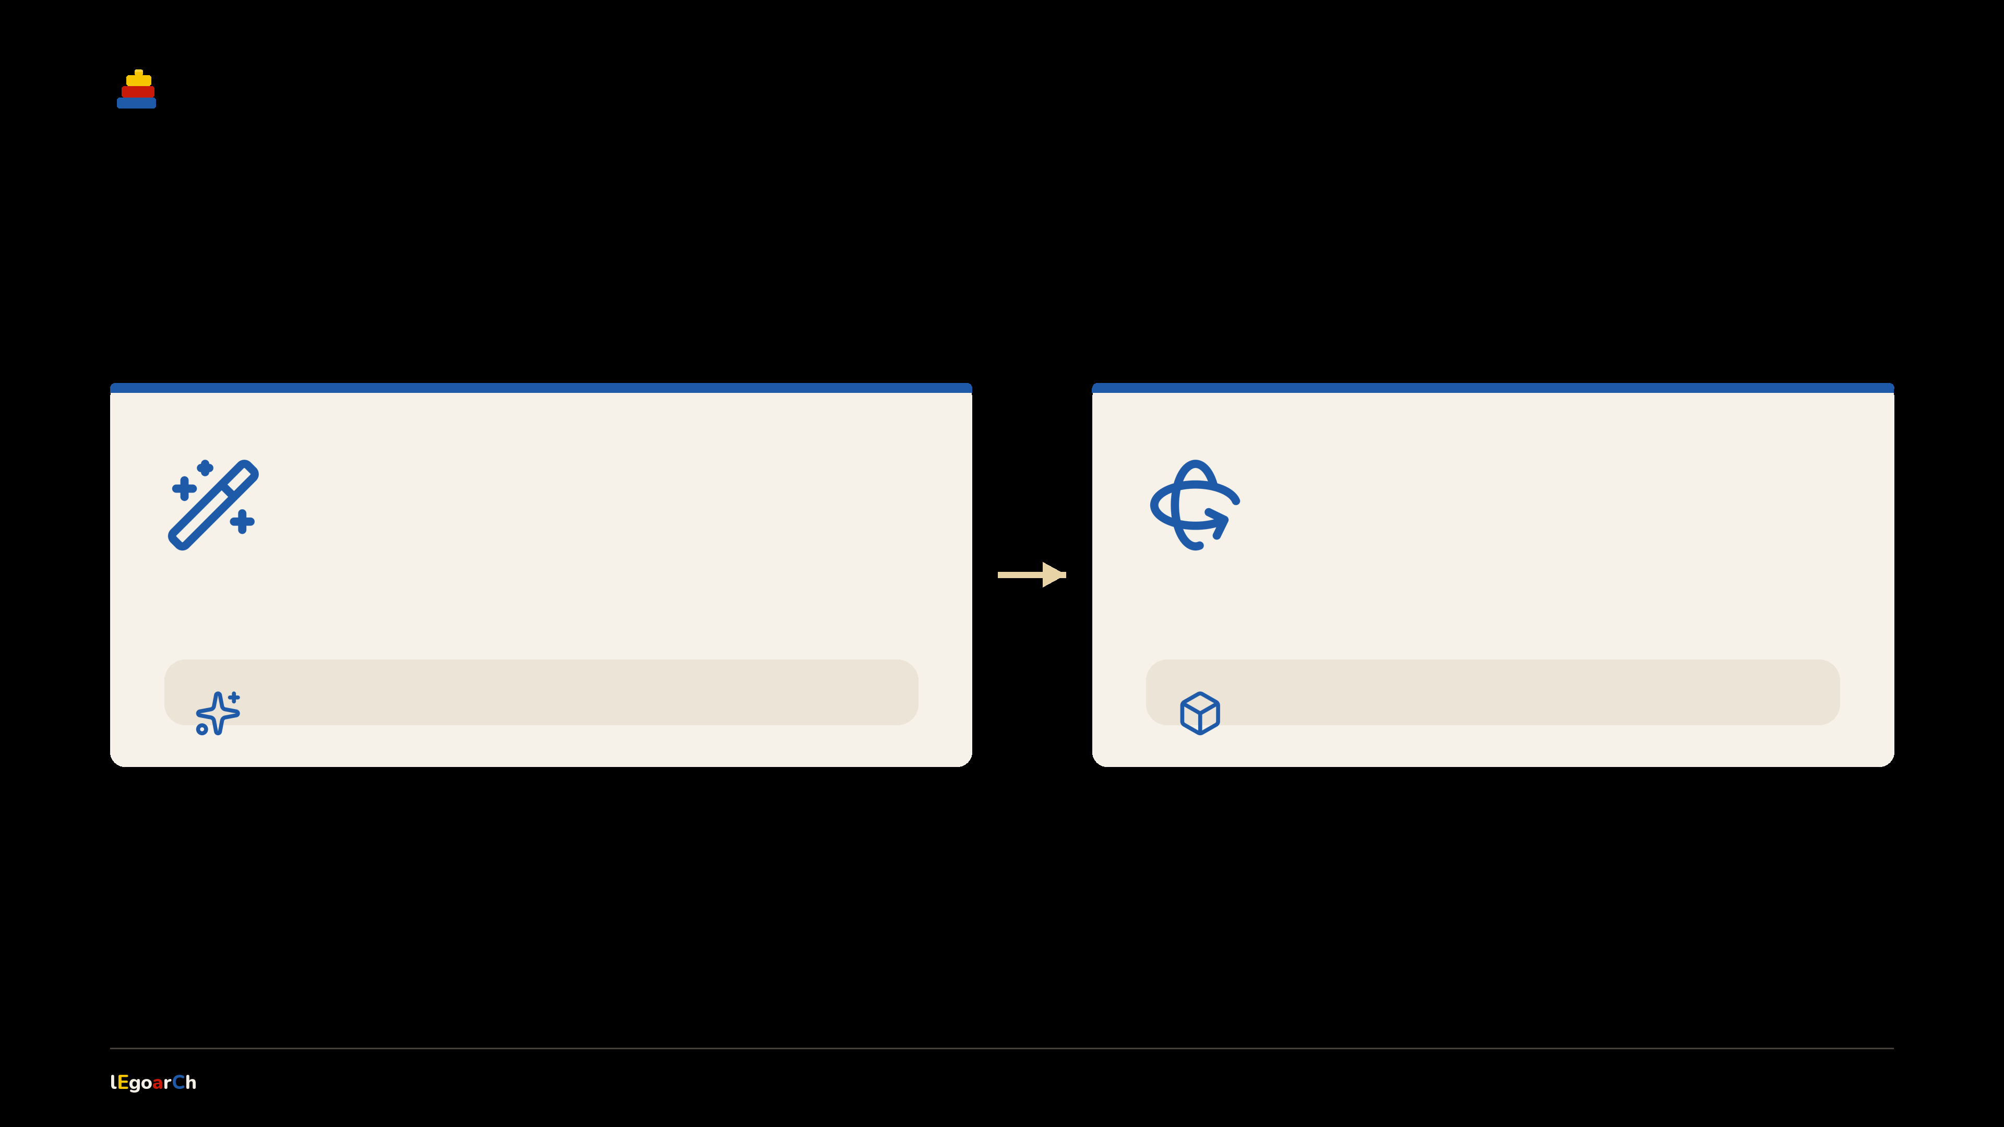
THE MODELS
One dreams → one carves.
Two AI models do all the imagining. Everything after is plain code.
FLUX.2 Klein 4B
TRELLIS.2-4B
base image model → dreams the picture
render → carves a textured 3D mesh
+ legoarch LoRA · 40 real Architecture sets
invents the faces the photo can't see
qwen3-4b encoder · flux2-vae · euler · 1024×1024
swept, then fixed → 28 steps · CFG 5.0 · LoRA 1.0 · negative prompt on
Two models dream → everything after them is plain, checkable code.
05 / 15
Notes:
Two models. FLUX.2 Klein dreams the picture, with a LoRA we trained on 40 real LEGO Architecture sets. TRELLIS carves it into 3D. After that, no AI.

Slide 6
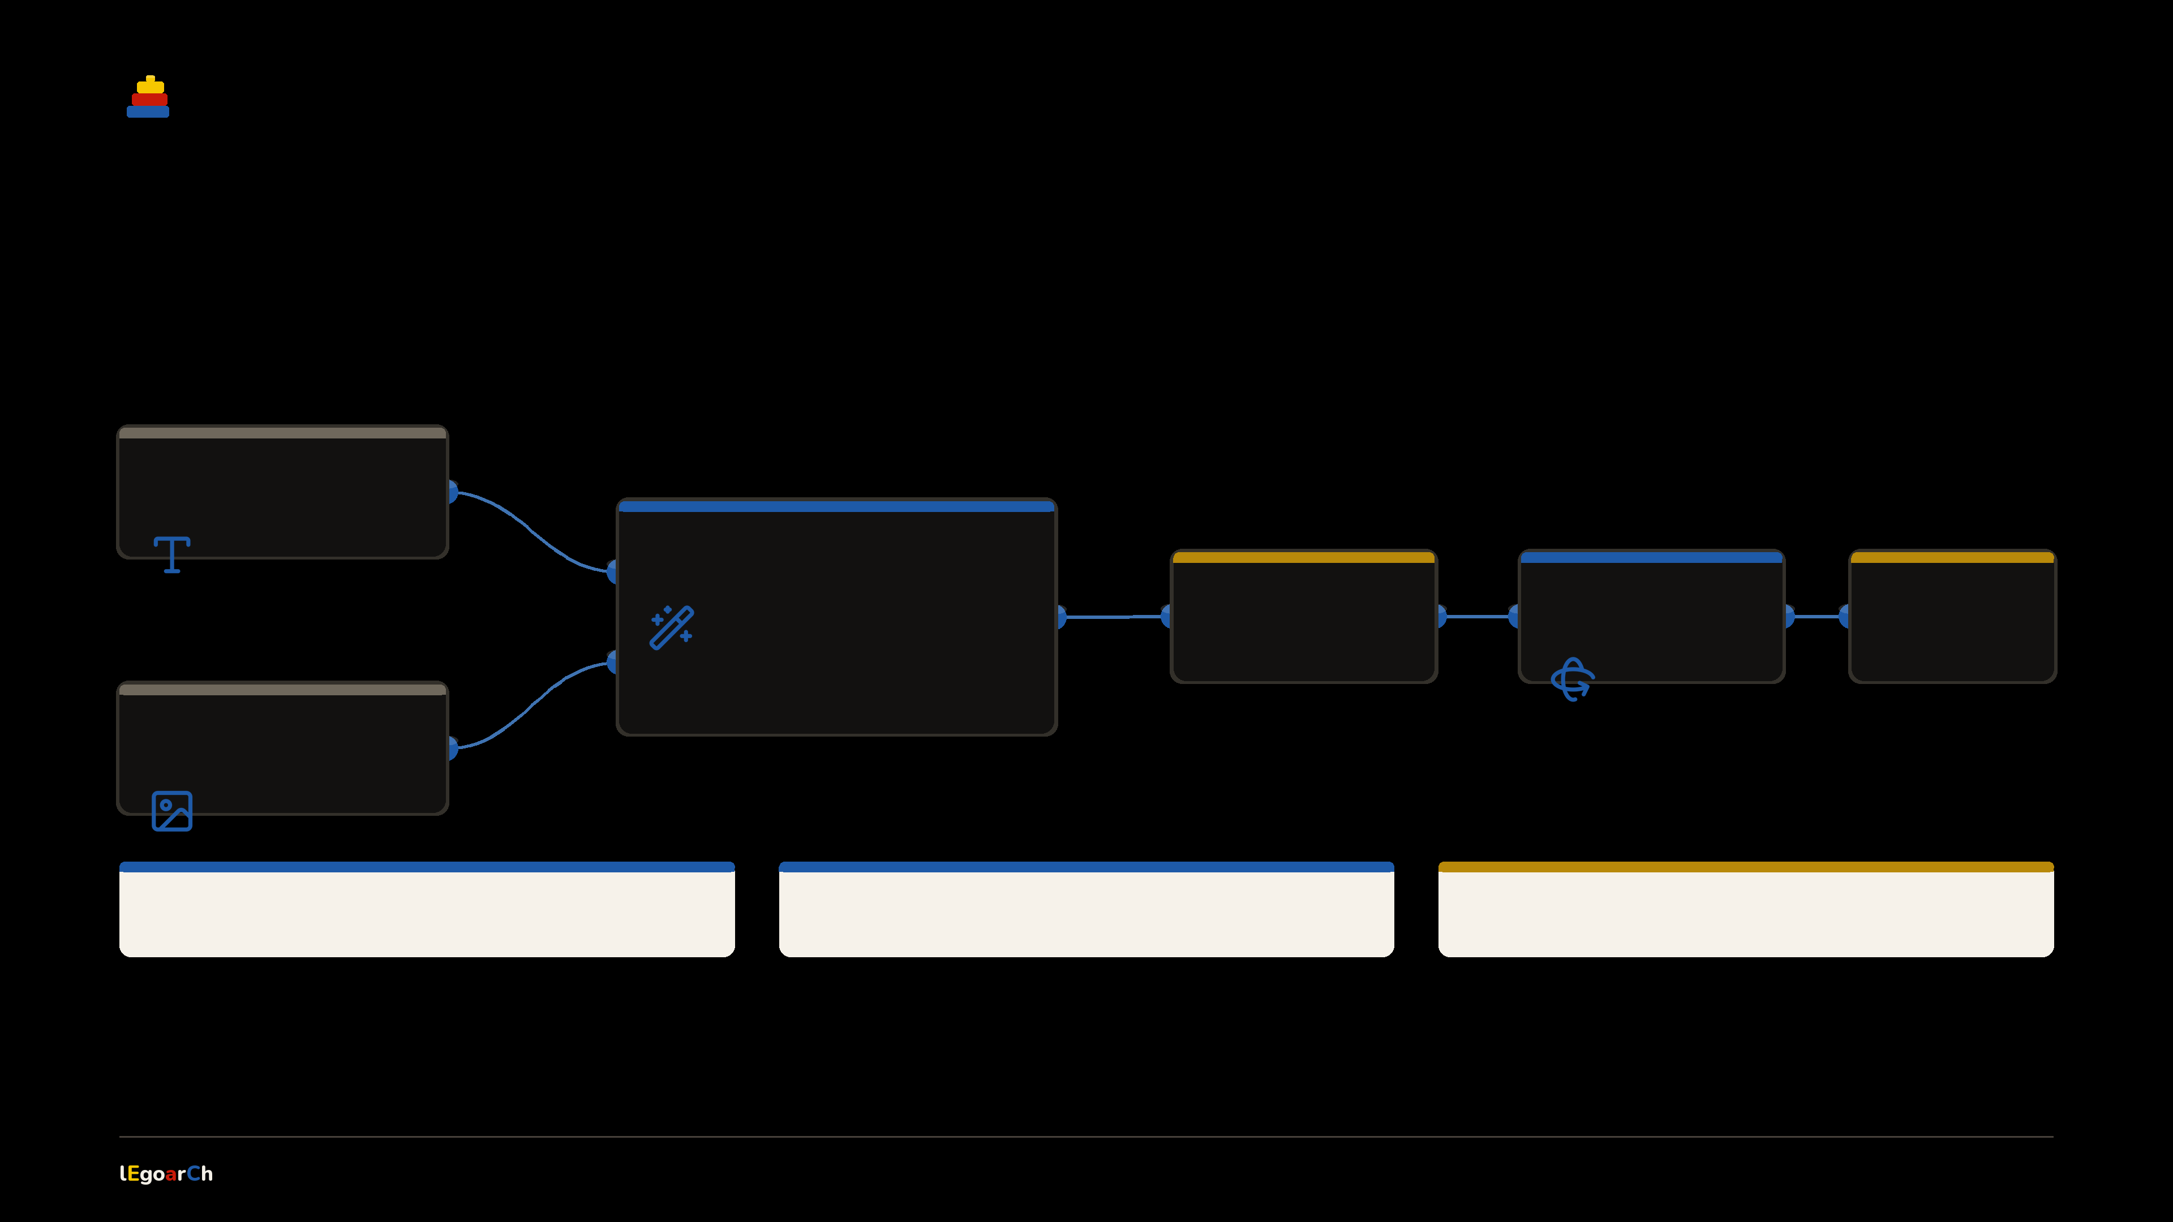
COMFYUI WORKFLOWS
Three graphs, one core.
Text or image in → the same FLUX.2 + legoarch LoRA core → then TRELLIS to 3D.
TEXT
a building name
FLUX.2 + LoRA
the shared core →
one LEGO look
RENDER
TRELLIS.2
3D MESH
set-look image
carves 3D
textured
IMAGE
a photo or sketch
txt → img
img → img
img → 3D
05_FLUX.2_LoRA.json
FLUX.2_image-to-image_LoRA.json
3D.json
06 / 15
Notes:
Three ComfyUI workflows are really one connected node graph. Text or image both feed the shared FLUX.2 + legoarch LoRA core; its render feeds TRELLIS to 3D. Same look out of every door — the three .json files are just three entry points.

Slide 7
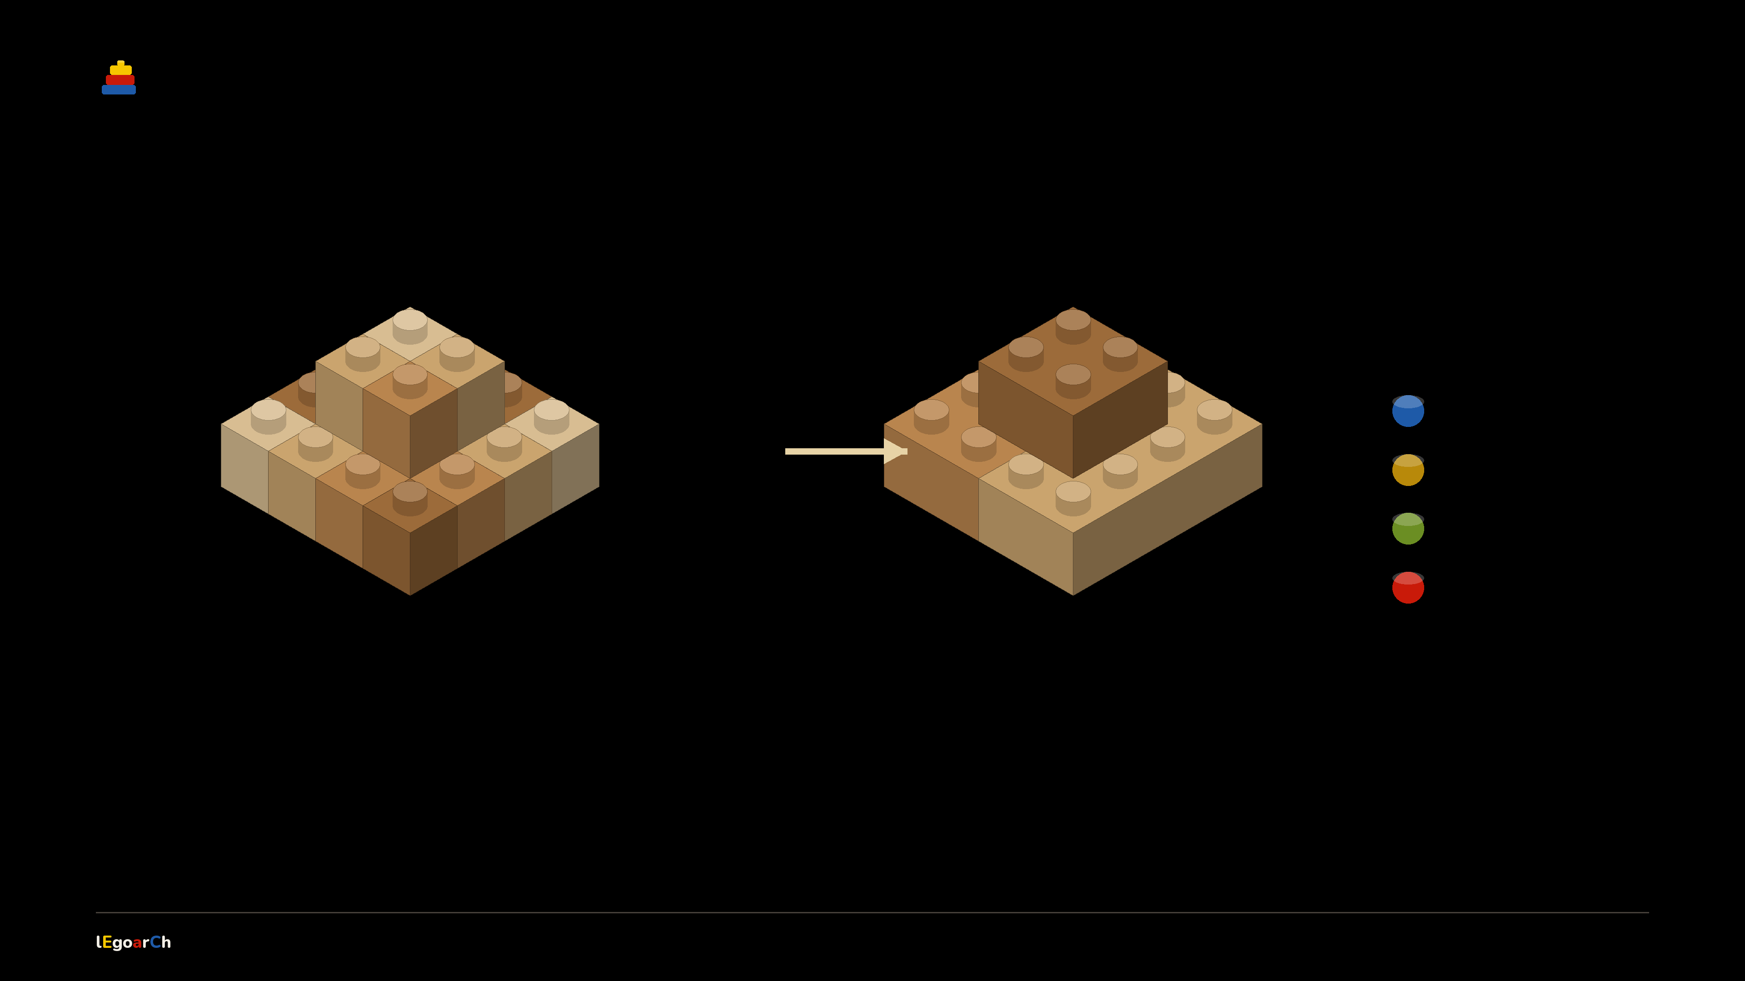
HOW LEGOLIZATION WORKS
Many 1×1s → a few real parts.
Split-and-merge packs the voxel grid into the largest legal bricks — fewer parts, same shape.
FOUR PASSES
slopes
bricks
plates
tiles
raw voxel grid
merged real parts
thousands of 1×1 cells
2×4 · 2×2 · slopes
Every brick is colour-uniform and seam-staggered → every footprint is one a real mould was made in.
07 / 15
Notes:
The brick solve. A split-and-merge pass (Luo 2015) packs the anisotropic voxel grid into the largest legal, colour-uniform bricks — four passes: slopes, bricks, plates, tiles — staggering seams like real masonry. Thousands of 1x1s collapse into a few real footprints, same shape.

Slide 8
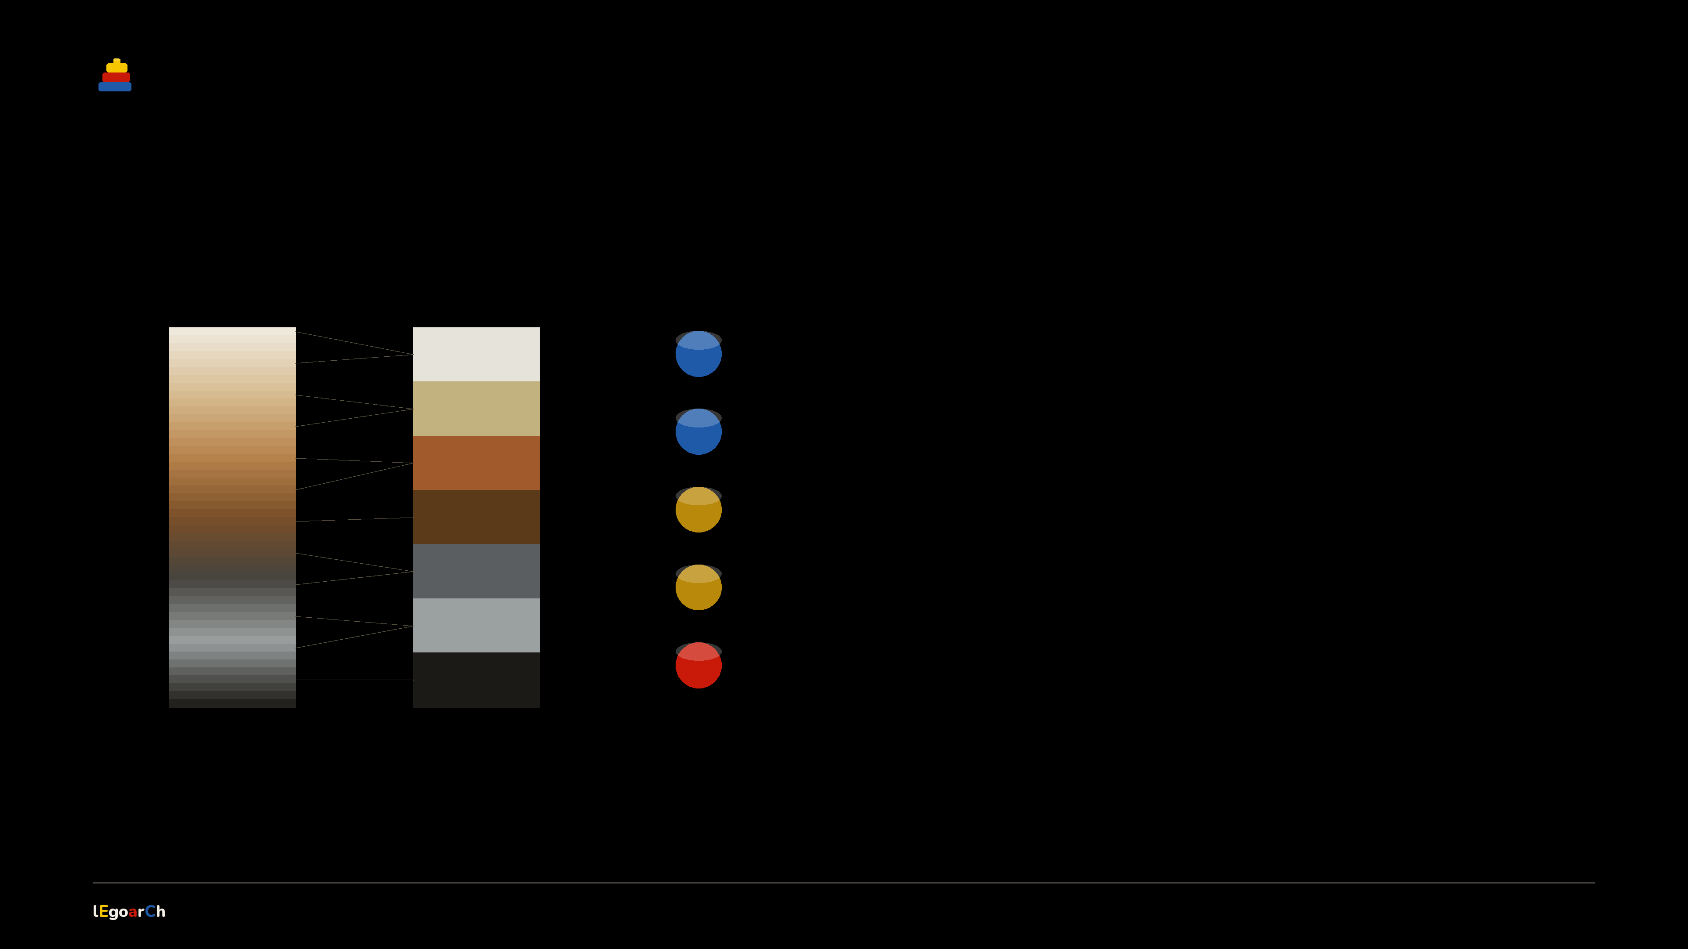
HOW COLOUR MATCHES
Every voxel → a real colour.
A continuous mesh colour is snapped to the nearest of 48 real LEGO colours by ΔE2000.
ΔE2000 → nearest
1
Sample
read each voxel's colour off the textured mesh
2
Match
rescale exposure to the FLUX render (per-channel quantile)
3
Convert
sRGB → CIE Lab (D65)
4
Snap
nearest of 48 real colours by CIEDE2000
5
Clamp
to a colour that part was really moulded in
mesh colour
48 real
Continuous mesh colour → a small set of real, orderable LEGO colours. No invented paint.
08 / 15
Notes:
How colour matches. We sample each voxel's colour off the textured mesh, rescale exposure to the render the user saw, convert to CIE Lab, snap to the nearest of 48 real LEGO colours by CIEDE2000, then clamp to a colour that exact part was really produced in. Continuous colour becomes a small, orderable palette.

Slide 9
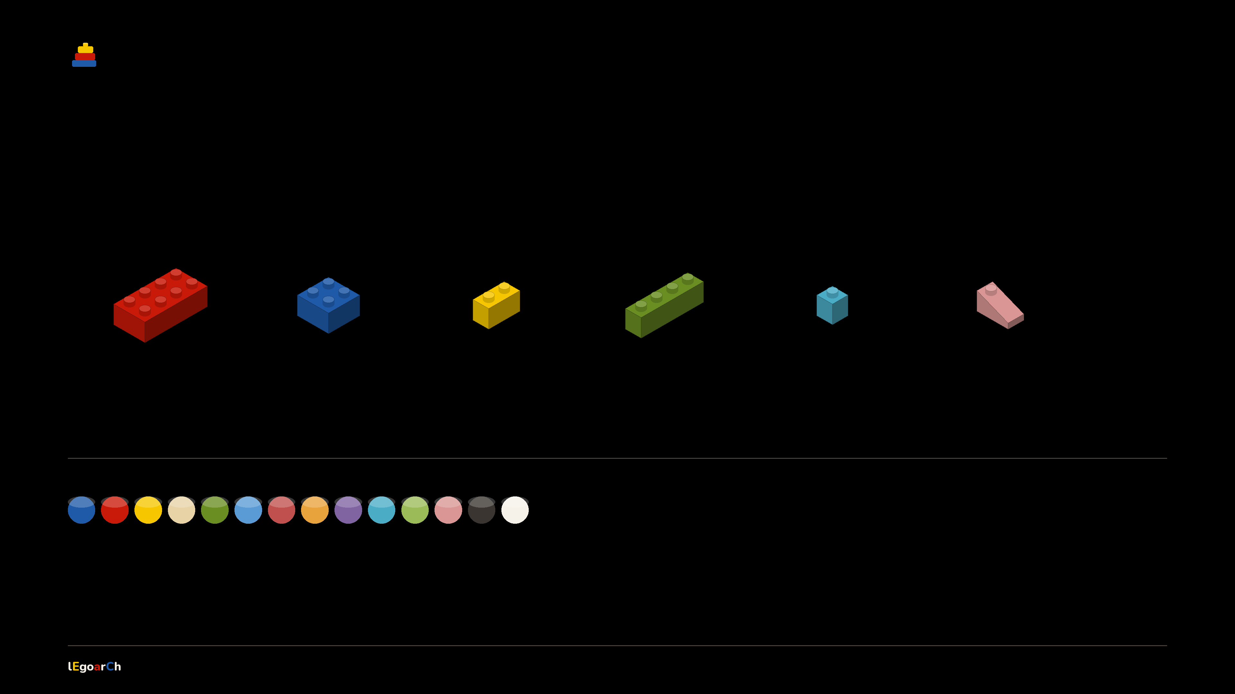
BUILDABLE MEANS ORDERABLE
Real parts. Real moulds.
A small vocabulary of actual BrickLink parts → snapped to real colours.
2×4
2×2
1×2
1×4
1×1
slope
3001
3003
3004
3010
3005
3040
44
1,598
48 real LEGO colours
real parts
validated combos
09 / 15
Notes:
It's all real. Actual BrickLink moulds — bricks, plates, a slope — snapped to 48 real colours and 1,598 validated combinations. Every piece is orderable, and one model scales from a 2k draft to a 22k flagship.

Slide 10
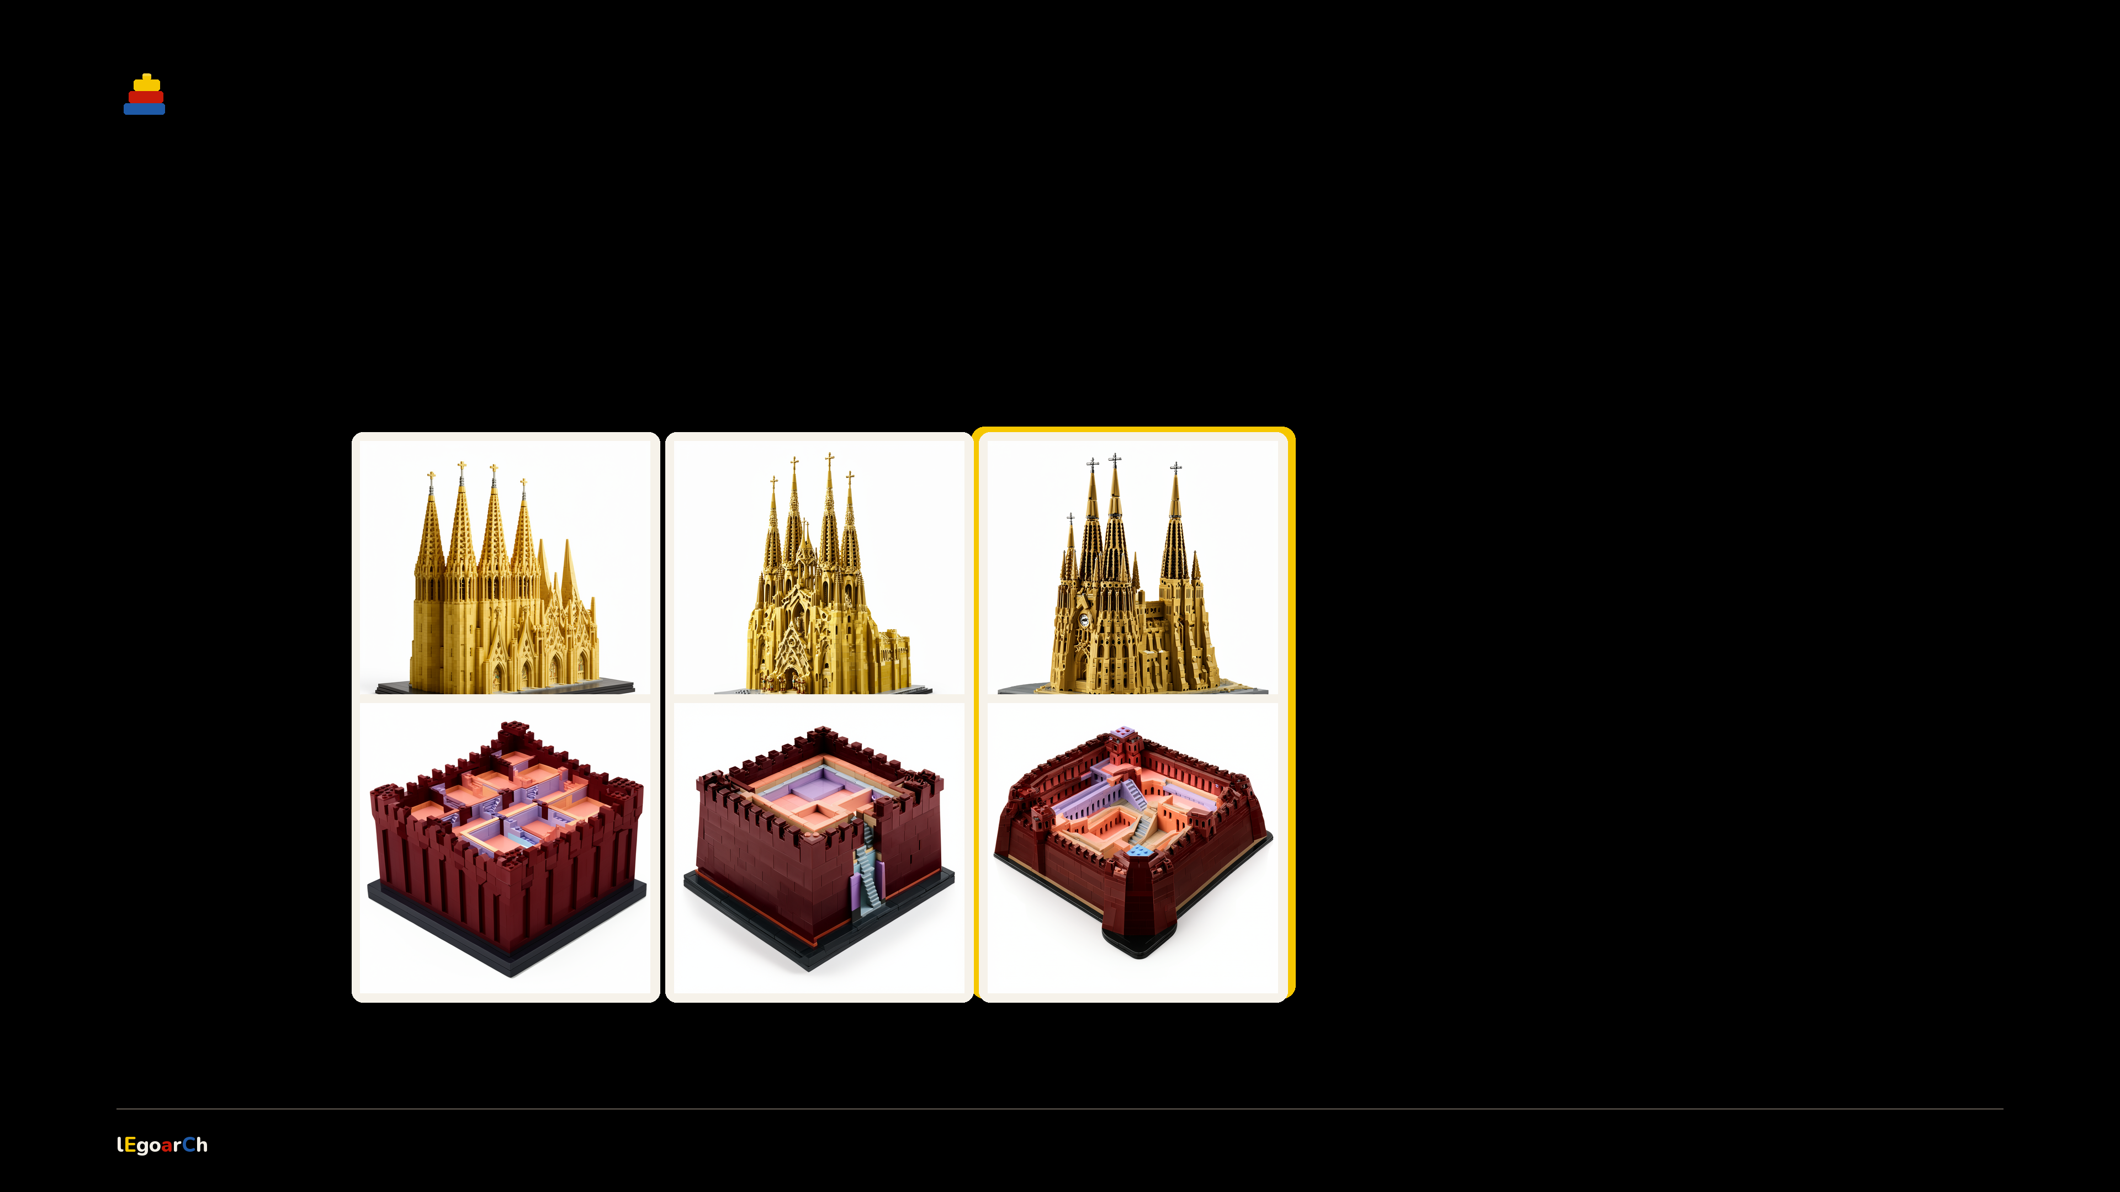
WE TESTED THIS
The look lives in the LoRA.
Same prompt, same seed → only the LoRA strength changes.
LoRA 0
LoRA 0.5
LoRA 1.0
0 → 0.5 → 1.0
At 0 it's a plain building. At 1 the studs and seams snap in → on a landmark and an obscure block alike.
Sagrada
The LEGO look isn't the prompt. It's the fine-tune.
La Muralla
swept 0 → 1.5 · winner 1.0
winner
10 / 15
Notes:
Of everything we tuned, this matters most. Only the LoRA strength changes across the grid. At zero, a normal building; at one, studs and seams appear. The LEGO-ness lives in the fine-tune.

Slide 11
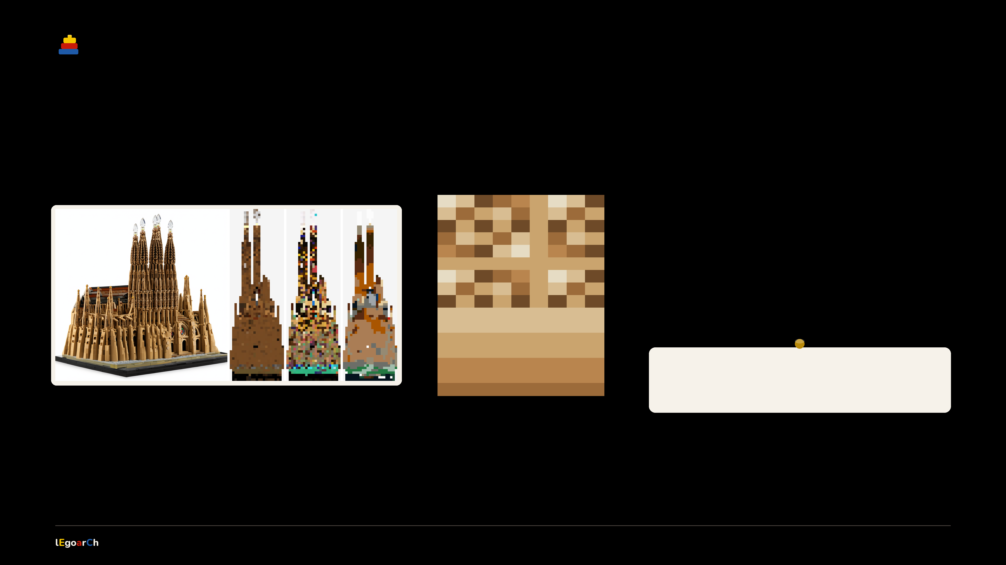
WE TESTED THIS
Same building, −46% bricks.
Raw mesh colour speckles into thousands of 1×1s → we merge it to the true colour first.
1×1 speckle
SAGRADA FAMÍLIA
−46%
8,627 → 4,682 pieces
WHY FEWER IS BETTER
cheaper · simpler to build · same stability
real build → raw colour grid → merged to true colour
merged regions
holds across buildings → −19% to −46%
11 / 15
Notes:
The 3D model bakes in colour speckle, and each speck forces its own 1x1 brick. Blur it onto the render's true colour first → up to 46 percent fewer pieces on Sagrada, 19 to 46 percent across buildings, no loss of stability. Real montage on the left, the merge concept on the right.

Slide 12
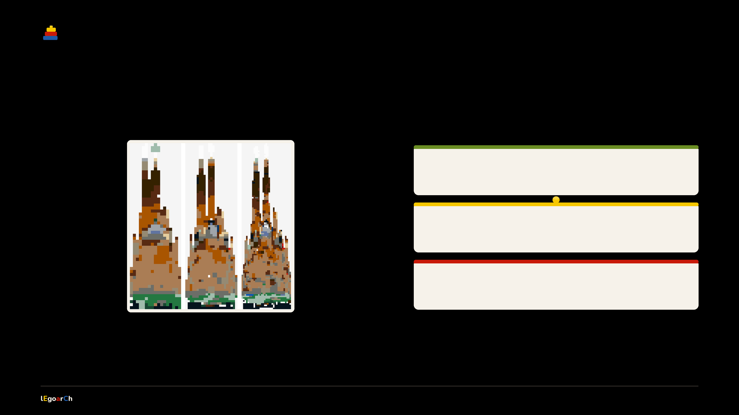
WE TESTED THIS
Draft to flagship — same set.
Pick the detail; the method holds. Pieces grow about quadratically.
detail 24
2,189
draft
pieces
detail 32
4,682
default · winner
pieces
detail 48
15,089
large
pieces
Sagrada Família at detail 24 · 32 · 48
16–64 studs available in-app · same connected set every time
12 / 15
Notes:
Scale is the user's call. The same Sagrada at detail 24, 32 and 48 gives 2.2k, 4.7k and 15k pieces — roughly quadratic. The default is 32; in-app you can dial 16 to 64. Same connected, recognizable set at every size.

Slide 13
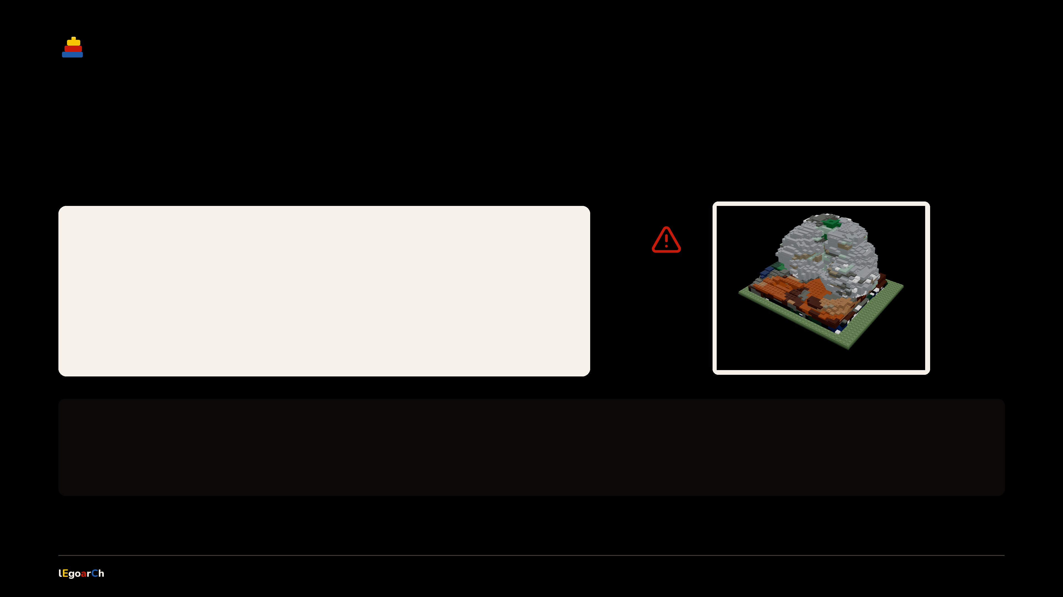
THE HONEST PART
It built Gehry, not the Guggenheim.
We named both. The model followed the curves — and voxels can't hold them.
THE PROMPT — VERBATIM
“Guggenheim Museum Bilbao Frank Gehry … interconnected swirling titanium-clad volumes … overlapping curved ship-like masses merging into one continuous sculptural body …”
voxelized Bilbao → a connected metallic blob
Smooth curves can't survive a voxel grid.
Connected and 93% supported → just not legible. Knowing exactly where the method ends is part of the work.
13 / 15
Notes:
The honest part. The prompt names the museum AND the architect — and the model latched onto Gehry's signature swirling curves, not the specific Guggenheim. Those smooth curves can't survive a voxel grid, so Bilbao builds as a connected, 93%-supported, but illegible blob. Knowing the edge is part of the work.

Slide 14
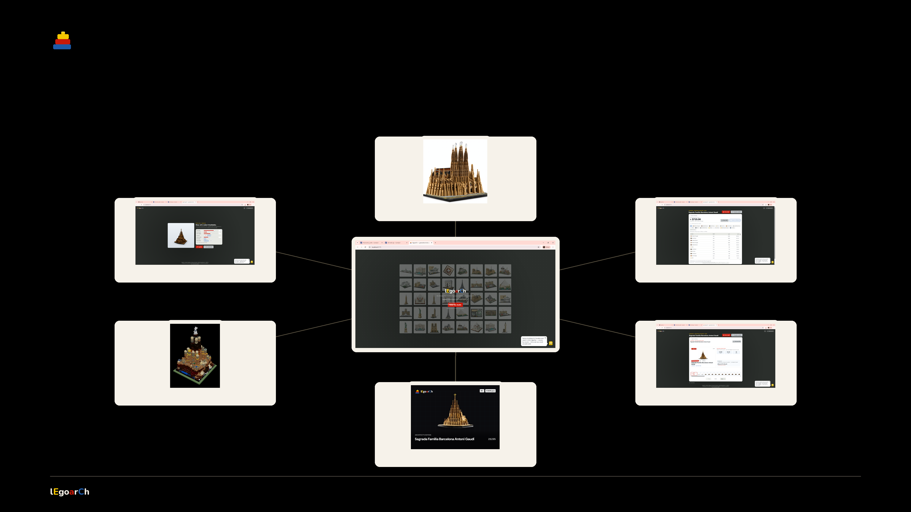
INPUTS → OUTPUTS
One sentence → everything you get.
the render
the 3D mesh
parts + price
NAME A BUILDING
the build
the booklet
the boxed set
14 / 15
Notes:
From one sentence, a whole set radiates out: the render, the 3D mesh, the legolized build, a boxed set, an instruction booklet, and a real parts list with a price.

Slide 15

From words to LEGO.
Generative AI proposes → code proves → the catalog ships.
Emilie El Chidiac & Charles Abi Chahine · 2026
Notes:
Close. From words to LEGO — every brick is real and orderable.

