Slide 1

local
COMS W4115
Programming Languages and Translators
Professor Alfred V. Aho
GROUP 13
Project Manager - Neeraja Ramanan (nr2404) Language and Tools Guru - Michael Costello (mc3401) System Architect - Yang Song (ys2592) System Integrator - Aayush Beri (ab3591) Verification and Validation - Julianna Eum (jme2134)

Slide 2
local’s Lineage
a lightweight location calculation language, designed to elegantly solve problems in a specific domain: those involving two-dimensional geospatial coordinates
Seamless mobile application design
Simplify ground navigation programming
Easily handle unit conversion
Can be used by programmers of any skill level
a simple, fast, safe, robust and extensible language

Slide 3


Motivating Example Programs
Calculate distance between two coordinates given different input formats
Find points within a given radius
Find the closest point that satisfies a given attribute
Find all points within a given radius that satisfy a given attribute

Slide 4


Solution
Existing techniques
MongoDB
PostGIS in PostgreSQL
Libraries in Java
Convenient?
No! Complex and unwieldy
No native support
local aims to bridge this gap
Native coordinate data types
“Python-esque”
Strong string manipulation

Slide 5
local Code Example: surprise.local
coords = [(8, 4), (1, 6), (7, 3)];
coords2 = [(3, 2), (2, 9), (5, 7), (6, 4)];
shortest = 0;
for coord in coords {
for c2 in coords2 {
d = dist(coord, c2);
if ((d < shortest) or (shortest == 0)) {
shortest = d;
closest = coord;
closest2 = c2;
}
}
}
print("%s and %s are the closest pair.", closest, closest2);

Slide 6
local Code Example: coffee.local
walk_speed = 3.0; // in miles per hour
try {
places = open("coffee.csv”);
} except Exception {
print ("Cannot open file”);
exit(1);
}
print("Where are you starting? ");
start = read();
print("How long do you have until your next event? ");
time = read();
for place in places {
''' Your CSV file has two times, wait time (time spent
standing in line) & make time (time it takes the
barista to make you a drink) '''
name, coord, wait_t, make_t, URL = split(place, ";");
d = dist(start, coord);
d_mile = convertdist(d, "mi", "m");
print ("Distance between you and %s is %s miles", name, d_mile);
time_at_shop = num(wait_t) + num(make_t);
try {
if can_you_get_coffee(d, time, time_at_shop)
print("You have time to go to %s\n", name);
else
print("You do not have time to go to %s\n", name);
} except Exception {
print ("Could not calculate time for %s\n", name);
}
}
''' tot_t is the total time you have,
make_t is the time it takes the baristas to
fix you a drink.'''
def can_you_get_coffee(d, tot_t, make_t){
transit_time = d / (walk_speed * 60);
print (”Time it will take you to get there: ”);
print (“%s mins", transit_time);
compare_time = transit_time + make_t;
print (”Total time to travel and get coffee”);
print (“there: %s mins", compare_time);
compare_time = num(compare_time);
tot_t = num(tot_t);
boo = (compare_time > tot_t);
if (boo)
return false;
else
return true;
}
Where are you starting?
(40.809343, -73.959811)
How long do you have until your next event?
8
Distance between you and Joe's is 0.126600820083 miles
The time it will take you to get there is 1.13188166533 mins
Total time to travel and get coffee there: 22.1318816653 mins
You do not have time to go to Joe’s

Slide 7





Project Development
Quasi – Agile development
Weekly deliverables
Continuous integration of components
Focus on modules completed
Not afraid to rework certain sections entirely
Move between roles
Timed meetings
Centralized code versioning & development

Slide 8
Architecture
.local file
PLY
local lex
get next token
tokens
local parse
fails
Course of Action (COA) for Now
AST
Error Message
COA for
Future
Semantic Analysis
fails
Code Generation
Error Message
AST
Code Generation
Native Python

Slide 9
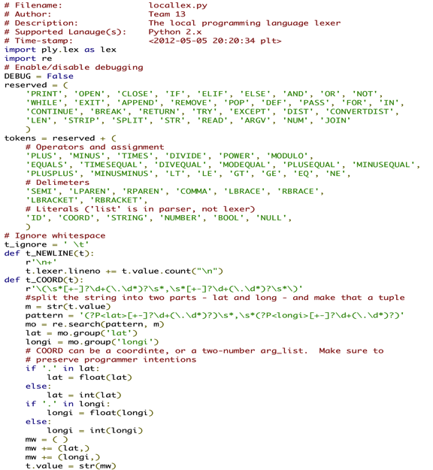
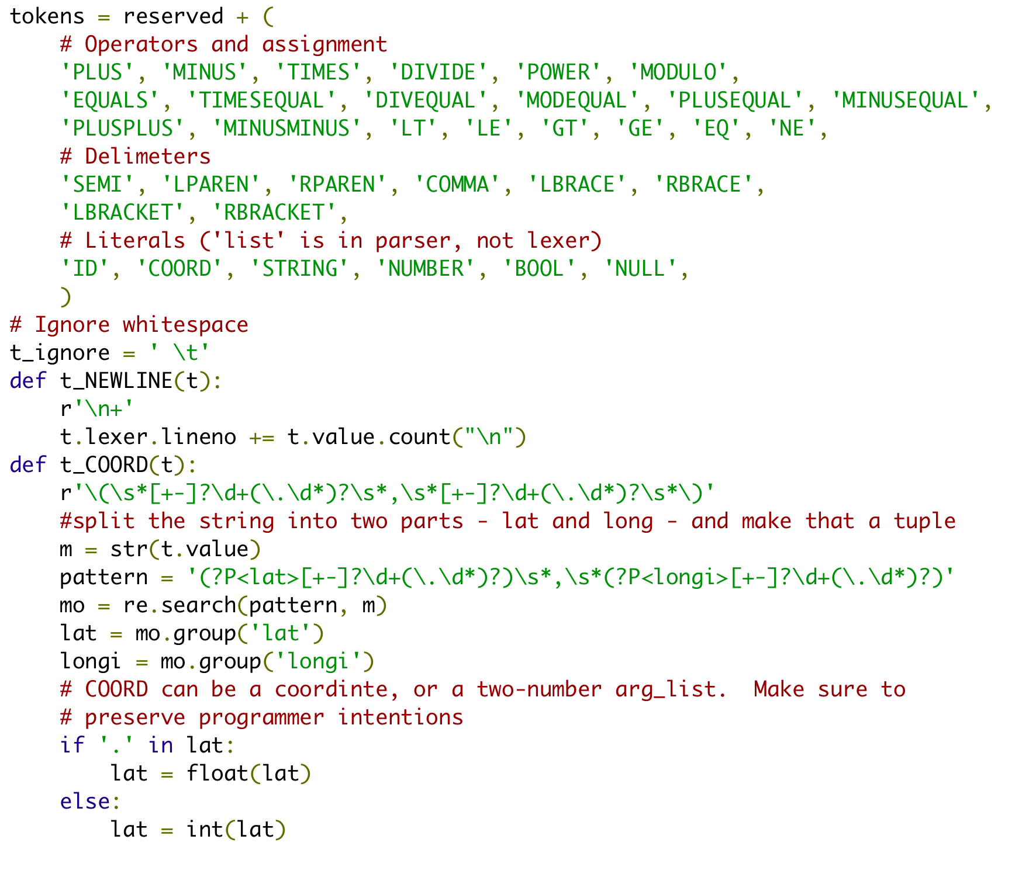
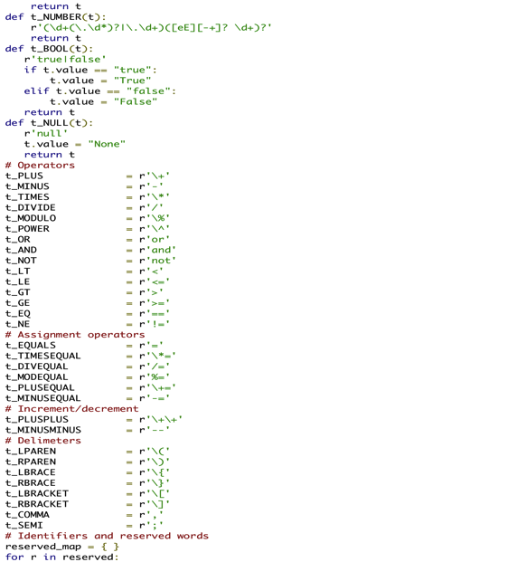
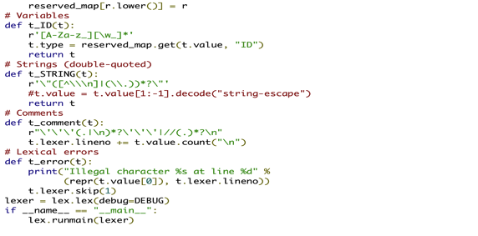
local Lexing

Slide 10
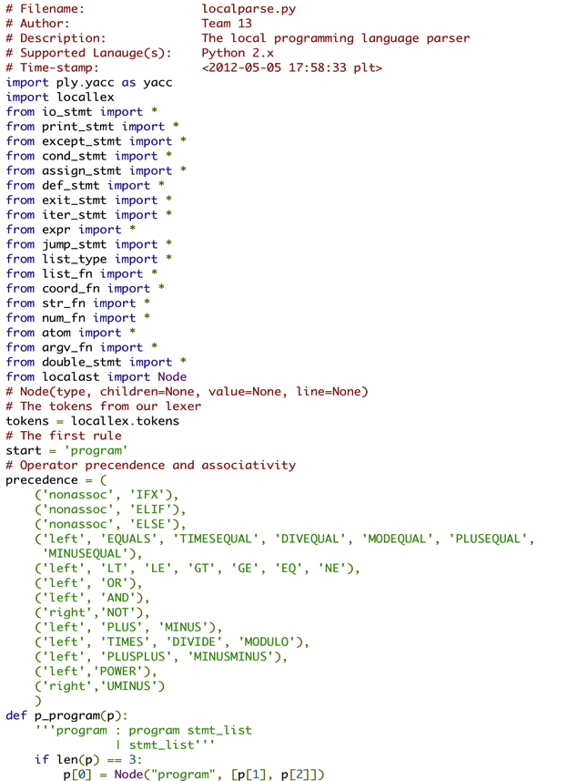
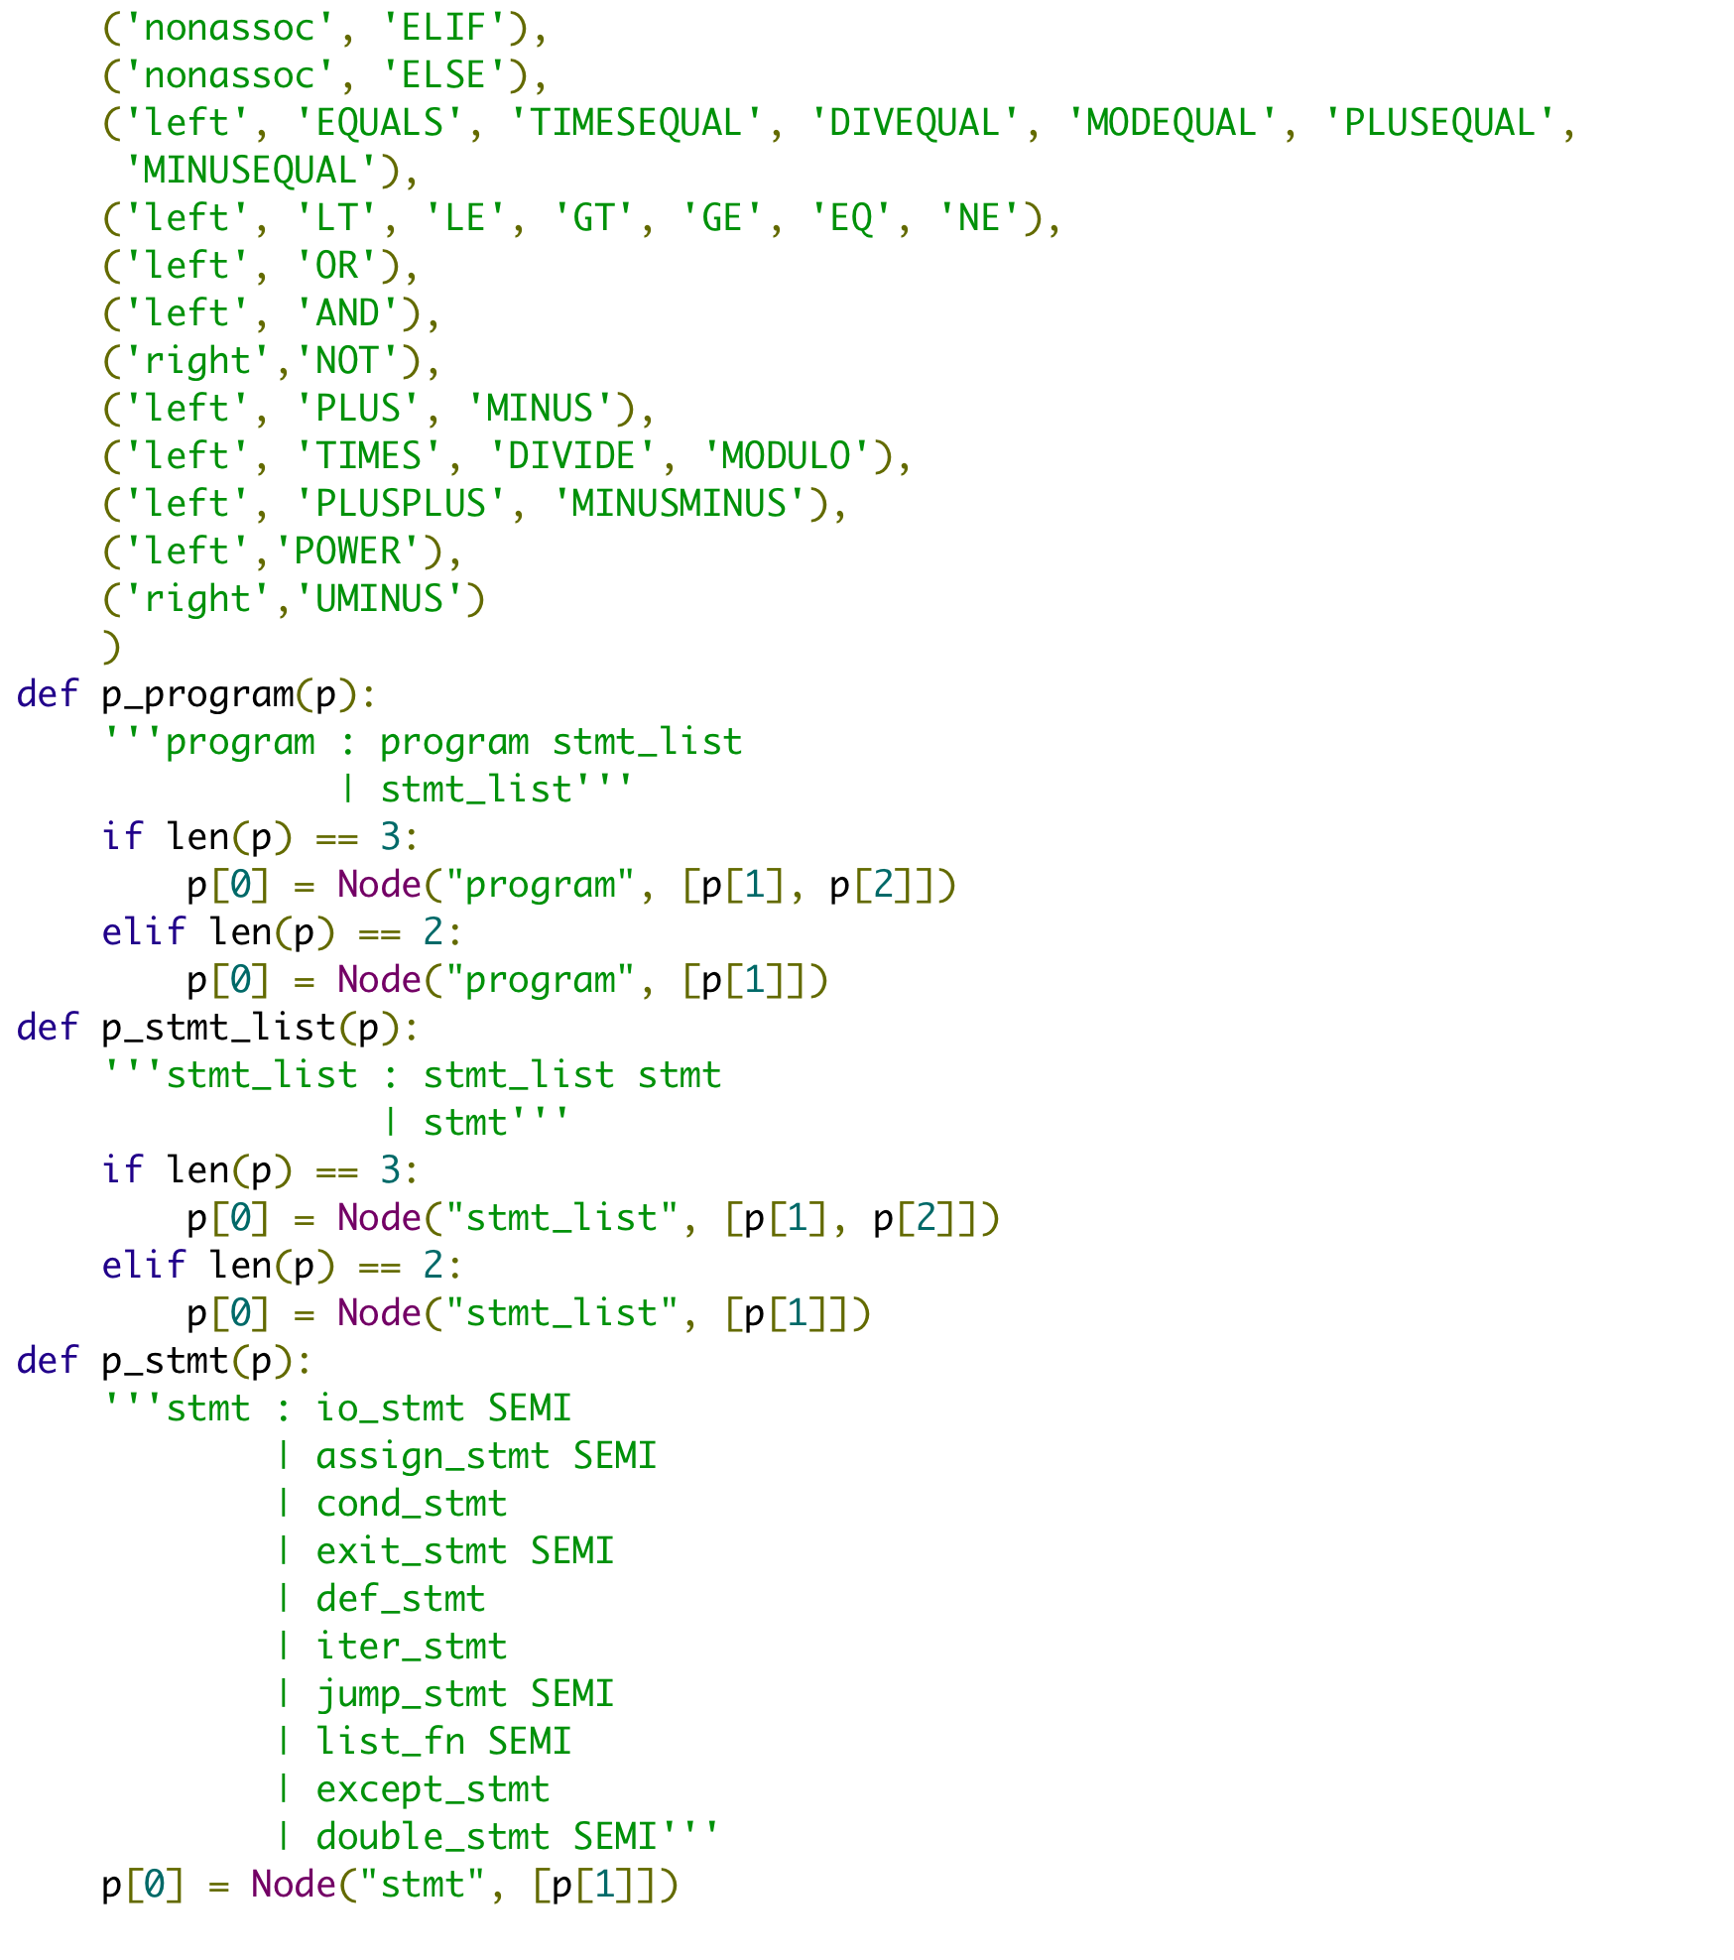
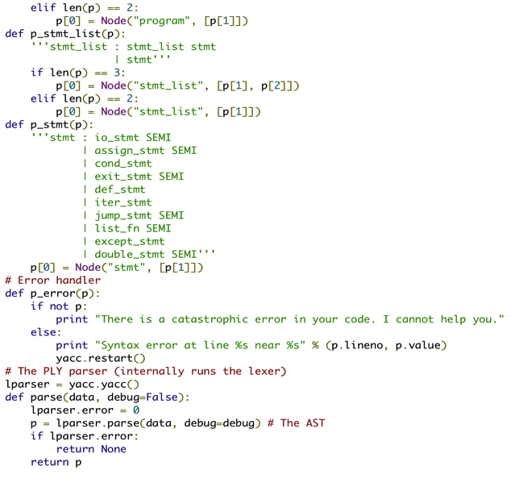
local Parsing

Slide 11


Run Time Environment
Python 2.7.2
Python 2.7 series: last major release in 2.X series
Most supported version of python
Contain features from the 3.X series to help with portability
Has faster IO module than its predecessors
New syntax for nested with statements

Slide 12




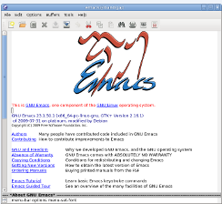

Software Development Environment

Slide 13
Verification/Test Plan
Individual Grammar Tests
Combined Grammar Tests
Simple Programs
Characteristic Programs
Incremental:
Handle expected & unexpected inputs
Bugs addressed through Google Code Issues Board & at Group Meetings
Simple Programs (Tutorial)
Characteristic Programs:
Determine whether you have time to (get coffee)
Solve the Traveling Salesman problem given a database of landmarks around Columbia University… !
Unexpected Inputs

Slide 14
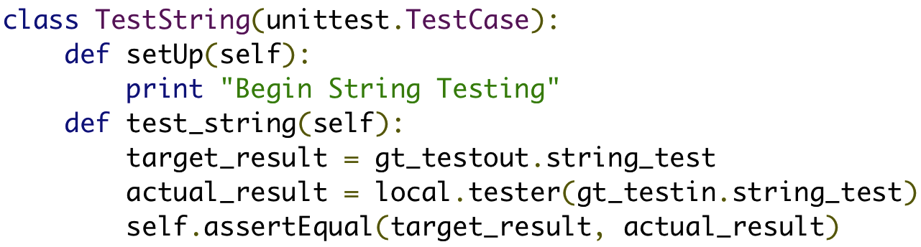
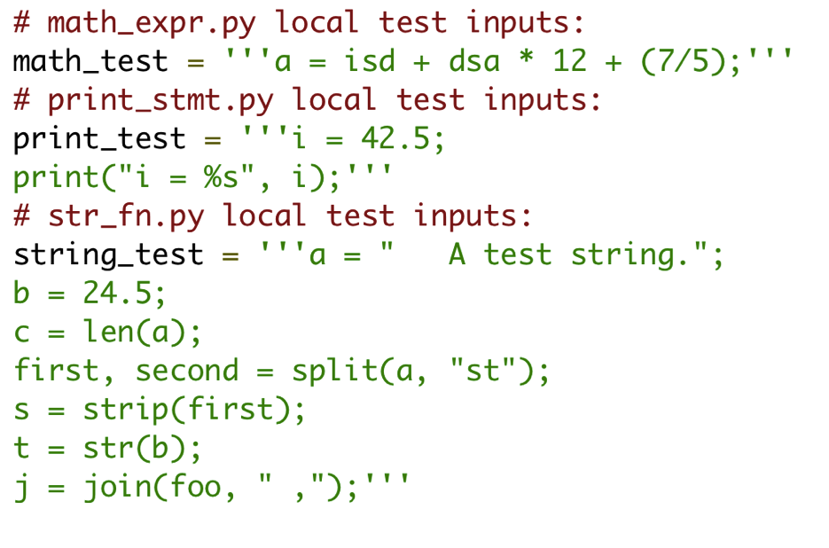
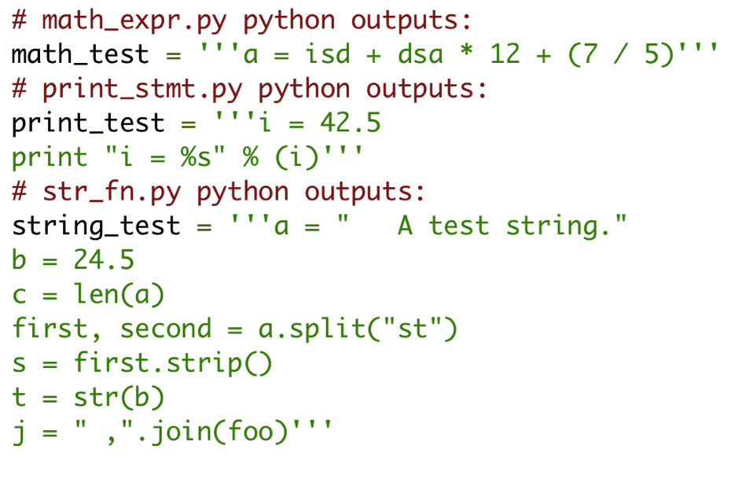

Python’s unittest
Compare source code to target code
Use definitions in python files for manageability

Slide 15


Lessons Learned
Grammar is powerful – so don’t spend too much time on it!
Don’t be afraid of building the AST
Conflicts are inevitable, handling them is an art
Paradigm shift: can’t take our favorite programming languages for granted anymore

Slide 16

The good. The bad
Wonderfully organized team!
Updated each other often
Mature about conflicts
Delightfully on schedule
Too much time spent on grammar
Less on AST
Didn’t get complex local programs up and running until the last week

Slide 17
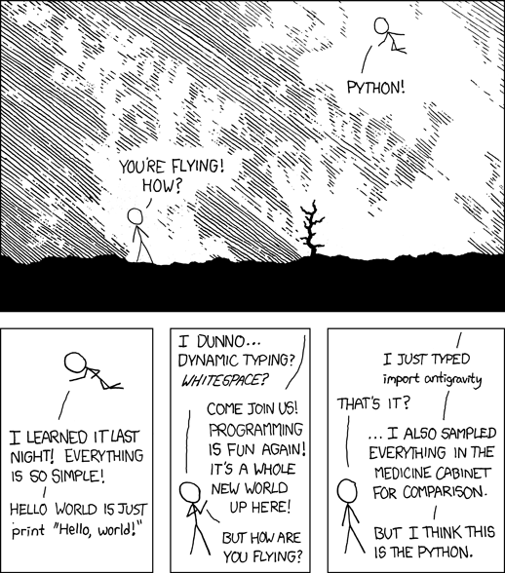
Use our language!
It’s so simple… No really it is!
Available at http://xkcd.com/353/

Slide 18

DEMO

Slide 19


Questions?

