Slide 1
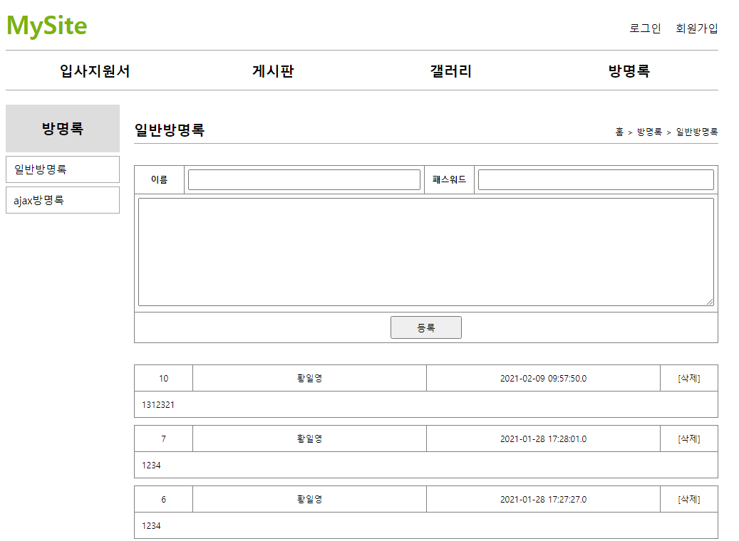
ㅁ
#guestbook(ajax)
Handler Mapping
■ajaxList: 등록폼 → 등록폼은 ajax형식이 아님(기존방식)
”/mysite5/guestbook/ajaxList get, post → GuestbookController.ajaxList( )
sqlSession.insert();
sqlSession.update();
sqlSession.delete();
sqlSession.selectOne();
sqlSession.selectList();
http://localhost:8088/mysite5/guestbook/ajaxList
GET mysite5/guestbook/ajaxList / HTTP/1.1
Host: www.javaex.com
Accept: deflate
Accept-Lantext/html, */*
Accept-Encoding: gzip, guage: ko-KR
User-Agent: Mozilla/5.0
파라미터
Tomcat (web+was)
mysite
applicateinContext.xml
com.javaex
@Repository
web.xml
spring-servlet.xml
controller 위치 com.javaex.controller
Handler Mapping
MyBatis
http 요청(request)
SqlSession (sqlSessionTemplate)
DB서버 →오라클
rquest
파라미터
어트리뷰트
1
2
3
Service 객체
Dao 객체
DB
Front Controller
DispatcherServlet
4
Controller
.
.
SqlSessionFactioryBean
Model and View
ajaxList()
configuration.xml
DataSource
response
5
Pool
http 응답(response)
<html>
방명록폼
View
View Resolver
phonebook.xml
namespace = guestbook
id=“."
Connection
HTTP/1.1 200 OK
Date: Mon, 25 Mar 2019 05:03:24 GMT
Accept-Ranges: bytes
Last-Modified: Mon, 25 Mar 2019 03:30:47 GMT
Content-Type: text/html
Content-Length: 459
ajaxList.jsp
Connection
Connection
Connection
<html>
방명록폼
mapper.xml
JDBC Driver
mapper.xml
http 요청(request)
mapper.xml
ajax
…
$("document").ready()에서 리스트 출력 요청이 들어간다.
→리스트 출력은 다음페이지에 설명
data
http 응답(response)
HTTP/1.1 200 OK
Date: Mon, 25 Mar 2019 05:03:24 GMT
Accept-Ranges: bytes
Last-Modified: Mon, 25 Mar 2019 03:30:47 GMT
Content-Type: text/html
Content-Length: 459
[{"no":18,"name":"황일영","content":"방명록 입니다.","regDate":"2021-02-09“}
, {"no":18,"name":"황일영","content":"방명록 입니다.","regDate":"2021-02-09“}
, {"no":18,"name":"황일영","content":"방명록 입니다.","regDate":"2021-02-09“}
]
ㅁ
var guestbooVo ={
no:18,
name:"황일영",
content:"방명록 입니다.",
regDate:"2021-02-09“
}
JSON
ㅁ
var guestbooVo ={
no:18,
name:"황일영",
content:"방명록 입니다.",
regDate:"2021-02-09“
}
deleteForm.jsp

Slide 2
ㅁ
#guestbook(ajax)
Handler Mapping
sqlSession.selectList(“guestbook.selectList”);
■list: 리스트
”/mysite5/guestbook/ajaxList get, post → GuestbookController.ajaxList( )
”/mysite5/api/guestbook/write get, post → ApiGuestbookController.write( )
”/mysite5/api/guestbook/list get, post → ApiGuestbookController.list( )
http://localhost:8088/mysite5/guestbook/ajaxList
http 요청(request)
Tomcat (web+was)
http 응답(response)
이전페이지 내용
web.xml
spring-servlet.xml
controller 위치 com.javaex.controller
mysite5
applicateinContext.xml
com.javaex
@Repository
MyBatis
Handler Mapping
SqlSession (sqlSessionTemplate)
DB서버 →오라클
http://localhost:8088/mysite5/api/guestbook/list
http 요청(request)
rquest
파라미터
어트리뷰트
1
2
3
Service
Dao
DB
ajax
Front Controller
DispatcherServlet
4
Model and View
Controller
selectList()
0x001
SqlSessionFactioryBean
list(GuestbookVo vo)
getList()
configuration.xml
DataSource
response
[{"no":18,"name":"황일영","content":"방명록 입니다.","regDate":"2021-02-09“}
, {"no":18,"name":"황일영","content":"방명록 입니다.","regDate":"2021-02-09“}
, {"no":18,"name":"황일영","content":"방명록 입니다.","regDate":"2021-02-09“}
]
5
0x001
0x001
Pool
data
http 응답(response)
View
View Resolver
List<GuestbookVo>
List<GuestbookVo>
phonebook.xml
namespace = guestbook
id=“insertSelectKey”
Connection
seq_guestbook_no
=18
0x333
Connection
Connection
jQuery로 그린다.
HTTP/1.1 200 OK
Date: Mon, 25 Mar 2019 05:03:24 GMT
Accept-Ranges: bytes
Last-Modified: Mon, 25 Mar 2019 03:30:47 GMT
Content-Type: text/html
Content-Length: 459
[{"no":18,"name":"황일영","content":"방명록 입니다.","regDate":"2021-02-09“}
, {"no":18,"name":"황일영","content":"방명록 입니다.","regDate":"2021-02-09“}
, {"no":18,"name":"황일영","content":"방명록 입니다.","regDate":"2021-02-09“}
]
Connection
javaScript
mapper.xml
JDBC Driver
guestbookList= [
var guestbooVo ={
no:18,
name:"황일영",
content:"방명록 입니다.",
regDate:"2021-02-09“
},
var guestbooVo ={
no:18,
name:"황일영",
content:"방명록 입니다.",
regDate:"2021-02-09“
},
var guestbooVo ={
no:18,
name:"황일영",
content:"방명록 입니다.",
regDate:"2021-02-09“
}
]
JSON
mapper.xml
mapper.xml
…
0x001
0x991
0x992
0x993
0x991
GuesbookVo
0x992
GuesbookVo
0x993
GuesbookVo
GuestbookVo{
private int no; 18
private String name; 황일영
private String password;
private String content; 방명록입니다.
private String regDate; 2021-02-09
메소드 생략
}
GuestbookVo{
private int no; 18
private String name; 황일영
private String password;
private String content; 방명록입니다.
private String regDate; 2021-02-09
메소드 생략
}
GuestbookVo{
private int no; 18
private String name; 황일영
private String password;
private String content; 방명록입니다.
private String regDate; 2021-02-09
메소드 생략
}
ㅁ
JAVA
ㅁ
deleteForm.jsp

Slide 3
#guestbook(ajax)
Handler Mapping
sqlSession.insert(“guestbook.insertSelectKey", guestbookVo);
sqlSession.update();
sqlSession.delete();
sqlSession.selectOne(“guestbook.select“, no);
sqlSession.selectList();
■write: 등록
”/mysite5/guestbook/ajaxList get, post → GuestbookController.ajaxList( )
”/mysite5/api/guestbook/write get, post → ApiGuestbookController.write( )
0x333
http://localhost:8088/mysite5/guestbook/ajaxList
GET mysite5/guestbook/ajaxList / HTTP/1.1
Host: www.javaex.com
Accept: deflate
Accept-Lantext/html, */*
Accept-Encoding: gzip, guage: ko-KR
User-Agent: Mozilla/5.0
파라미터
name=황일영
password=1234
content=방명록글
Tomcat (web+was)
mysite5
applicateinContext.xml
com.javaex
@Repository
http://localhost:8088/mysite5/api/guestbook/write?name=황일영&password=1234&content=방명록
web.xml
spring-servlet.xml
controller 위치 com.javaex.controller
ajax
http 요청(request)
Handler Mapping
MyBatis
버튼클릭시 요청됨
rquest
파라미터
name=황일영
password=1234
content=방명록글
어트리뷰트
2
@ResponseBody
SqlSession (sqlSessionTemplate)
DB서버 →오라클
data
1
3
Controller
Service
Dao
DB
HTTP/1.1 200 OK
Date: Mon, 25 Mar 2019 05:03:24 GMT
Accept-Ranges: bytes
Last-Modified: Mon, 25 Mar 2019 03:30:47 GMT
Content-Type: text/html
Content-Length: 459
{"no":18,"name":"황일영","content":"방명록 입니다.","regDate":"2021-02-09"}
Front Controller
DispatcherServlet
4
Model and View
0x333
SqlSessionFactioryBean
write(GuestbookVo vo)
writeResultVo(GuestbookVo vo)
insertSelectKey(GuestbookVo vo)
selectOne(int no)
DataSource
jQuery로 그린다.
http 응답(response)
response
{"no":18,"name":"황일영","content":"방명록 입니다.","regDate":"2021-02-09"}
5
0x999
0x333
0x333
configuration.xml
Pool
JavaScript
JSON
View
View Resolver
insert() → vo.getNo →no
selectOne(18)
0x999
phonebook.xml
namespace = guestbook
id=“insertSelectKey”
Connection
seq_guestbook_no
=18
var guestbooVo ={
no:18,
name:"황일영",
content:"방명록 입니다.",
regDate:"2021-02-09“
}
0x333
Connection
0x333
Connection
Connection
mapper.xml
JDBC Driver
mapper.xml
mapper.xml
GuesbookVo
…
0x333
0x999
GuesbookVo
GuestbookVo{
private int no; 18
private String name; 황일영
private String password; 1234
private String content; 방명록입니다.
private String regDate;
메소드 생략
}
GuestbookVo{
private int no; 18
private String name; 황일영
private String password;
private String content; 방명록입니다.
private String regDate; 2021-02-09
메소드 생략
}
JAVA
ㅁ
deleteForm.jsp

