Slide 1
Forecasting Bike Usage with TransformerModel
EIND 558 Comp Project
Gage Halverson

Slide 2
Executive Summary
Updated goal: Use Transformer model to predict bike rental demand
Demand can then be used to determine bike rental rate
Many factors affect bike rental demand
Feels like temperature and season have the strongest effects on demand
By adjusting rental rates depending on weather and time of year, XYZ company can increase profits and rental fleet utilization
This project is an introduction to the possibilities of using machine learning in the future to optimize profits
Future model can be used to determine daily demand using weather forecasts and other public information.
Thus, reducing the risk of public scrutiny

Slide 3
Approach
Use Neural Network Forecaster: the Transformer model to predict bike rental demand
Data Source: Kaggle Bike Count Prediction Multivariate Data Set
Included weather related features
Examined the impact of non-time-series features on rental demand
Used Python and Darts to create model
Export Tensor Model to be deployed if applicable

Slide 4
Model Description
Overview of basic methodology: Predict the number of rides during the day using probabilistic forecast which wraps the central point between uncertainty bands (0.01, 0.05, 0.50, 0.95, 0.99)
Model: TransformerModel
Dependent variable: Bike rental count (daily)
Scope:
Bike rental company in unknown city with over 4,500+ daily rides
Sampling
training
start: 2011-01-01
end: 2012-08-21
duration: 598 days
test
start: 2012-08-22
end: 2012-10-27
duration: 66 days
The model takes 5+ minutes to train

Slide 5
Model Details
Candidate variables:
feels like temp
temp
season weather wind speed
working day humidity holiday
Feature selection
Drop features based on correlation to target feature
Additional covariates added:
Day of the week
Month
Model Parameters
EPOCHS = 200
likelihood=QuantileRegression()
Reduce computation usage

Slide 6
Challenges
Transformer Model is very complex and is not typically used for multivariate time series
Difficulty finding research using this technique
Difficulty finding help on stack overflow using this technique
Most explanations of Transformer Model were related to Natural Language Processing
I was not able to get the model to work using hourly data points
Feels like temp and temp are not independent but were both included

Slide 7
Recommendations and Future Research
Begin using model to predict daily bike demand without changing price, tracking accuracy
Compare this model to models currently used at the company to determine accuracy
Use forecast in conjunction with revenue forecast to determine if variable pricing is the correct choice
Tune parameters to allow for hourly forecasts
Use PCA for dimension reduction
Compare model with other multivariate forecasting models such as Neural Basis Expansion Analysis for interpretable Time Series (N-BEATS), Temporal Fusion Transformer or SARIMAX

Slide 8
Data Wrangling
Never trust data integrity
Find and correct missing values
Transformer Model requires particular data types
All data must be scaled prior to model generation
Cleaned Data Set
Testing Training Split
Scaling
Training
Testing
Actual
Values
Features
Covariates
Predictor
Features
Covariates
Covariates
Transformer Model
Model
Predicted
Values
Evaluation

Slide 9
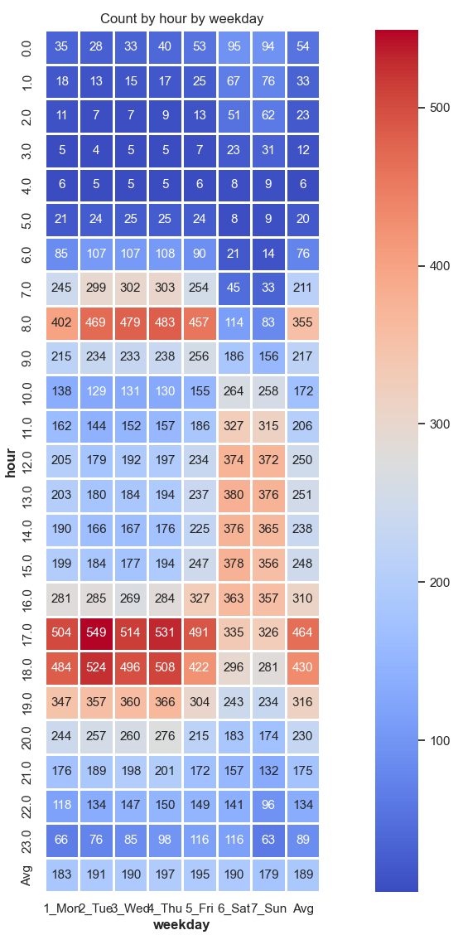
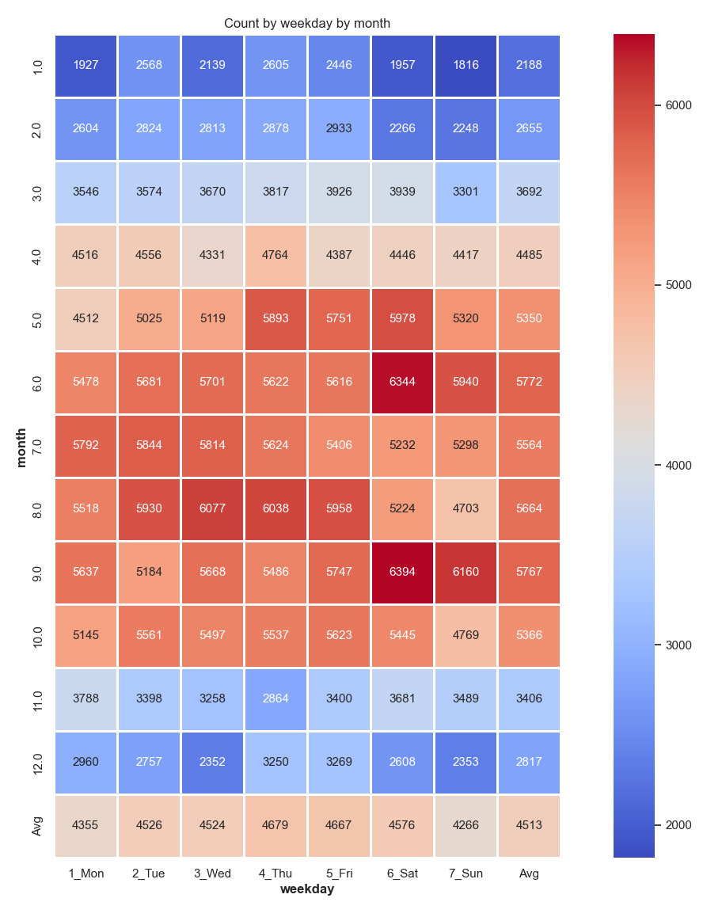
Covariates Selection

Slide 10
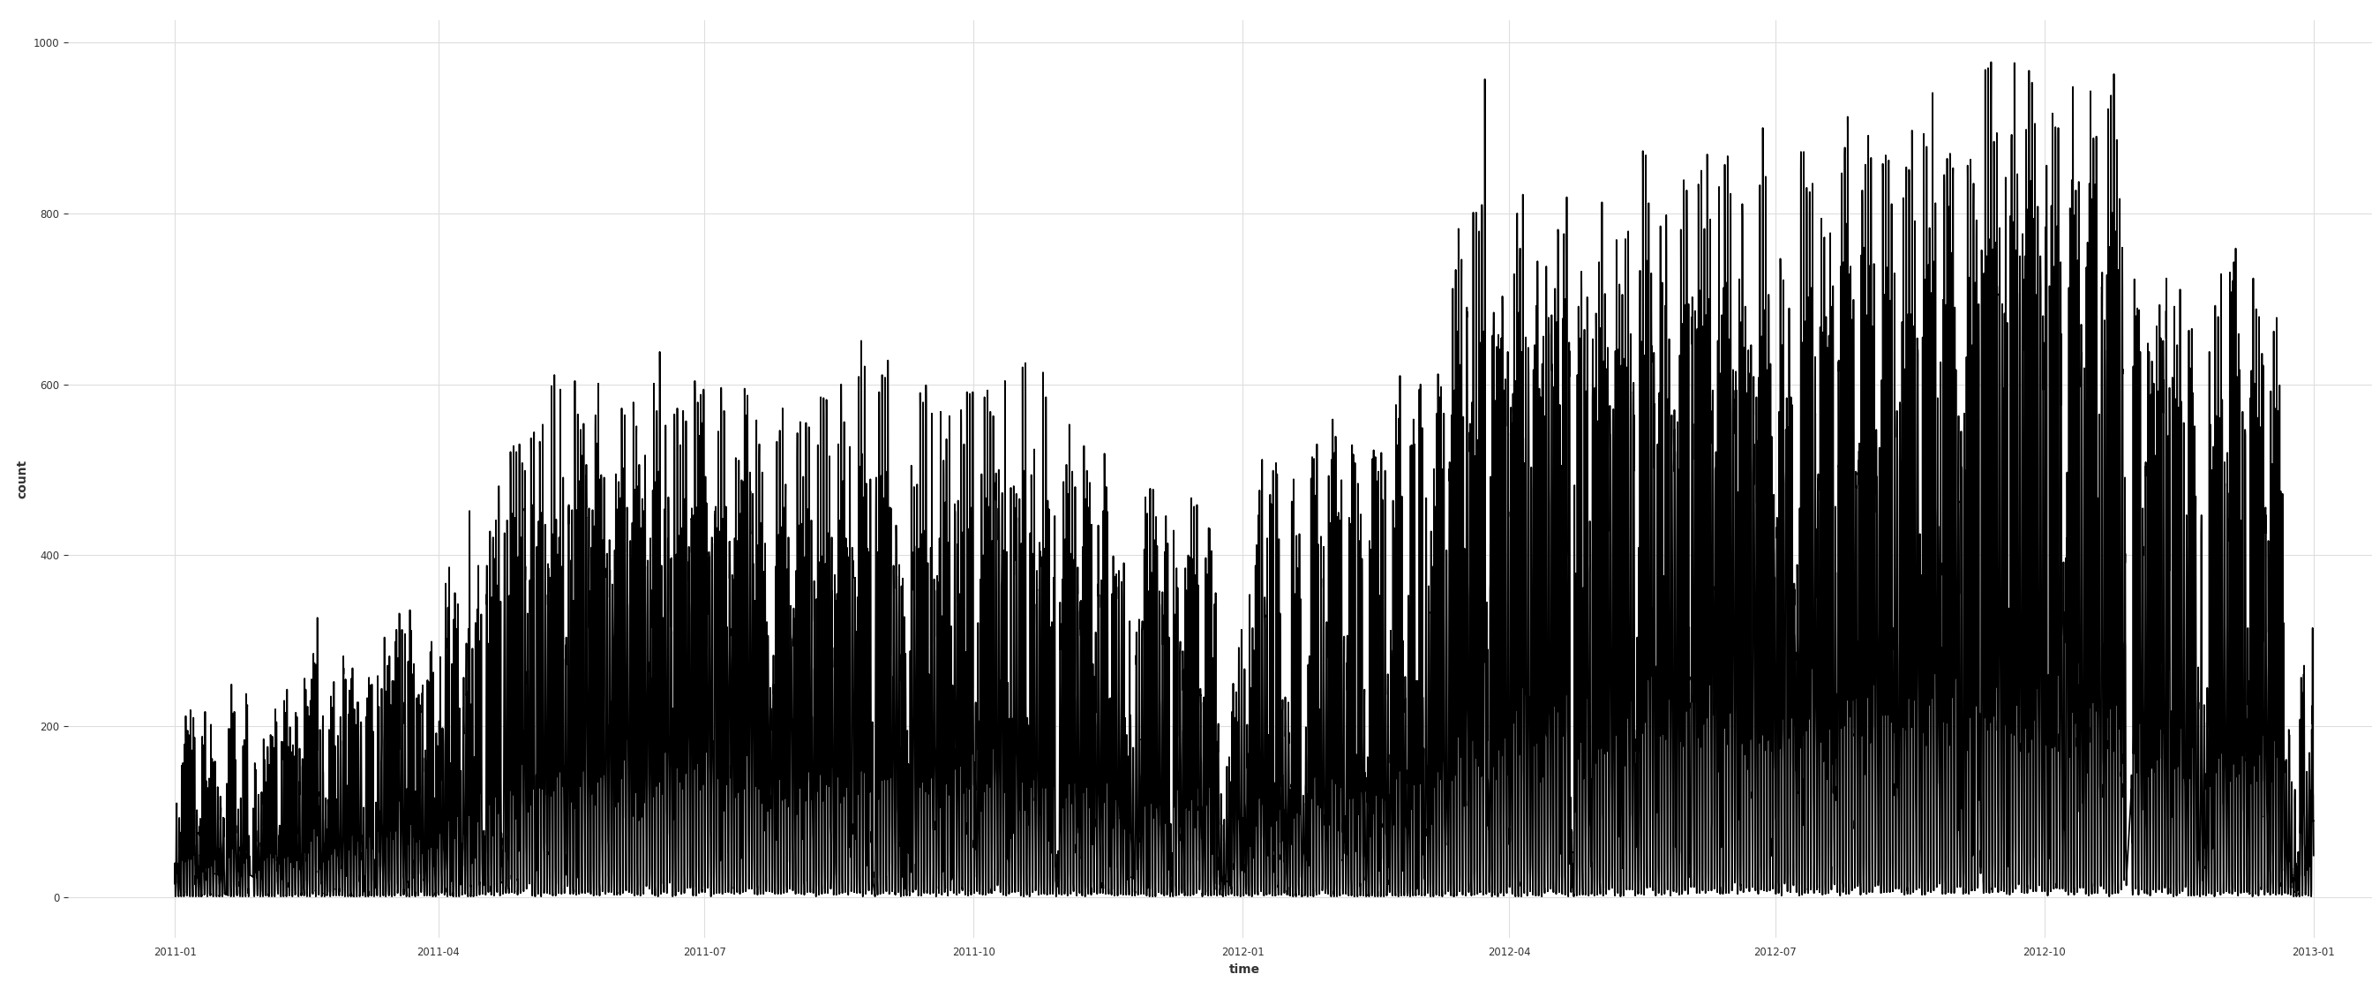
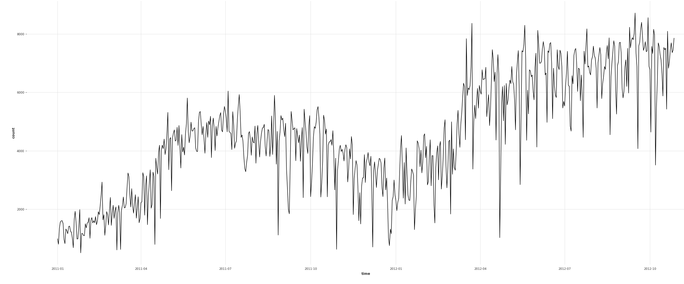
Data Before and After

Slide 11
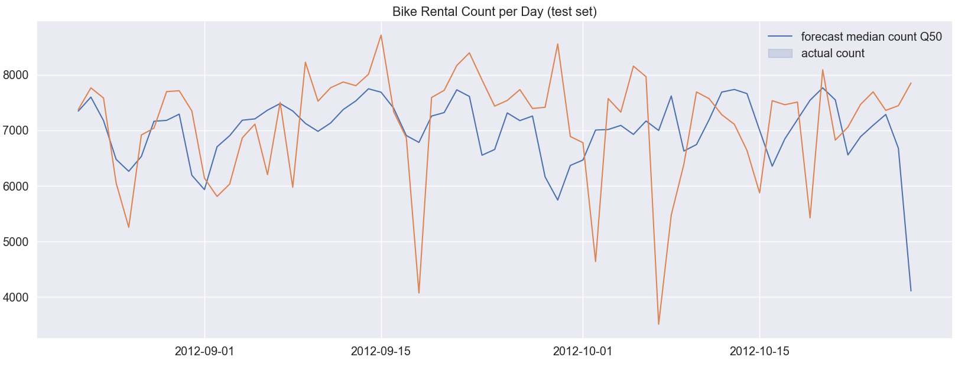
Prediction
MAPE: 12.14
RSME: 1120.16

Slide 12
Thank you

Slide 13
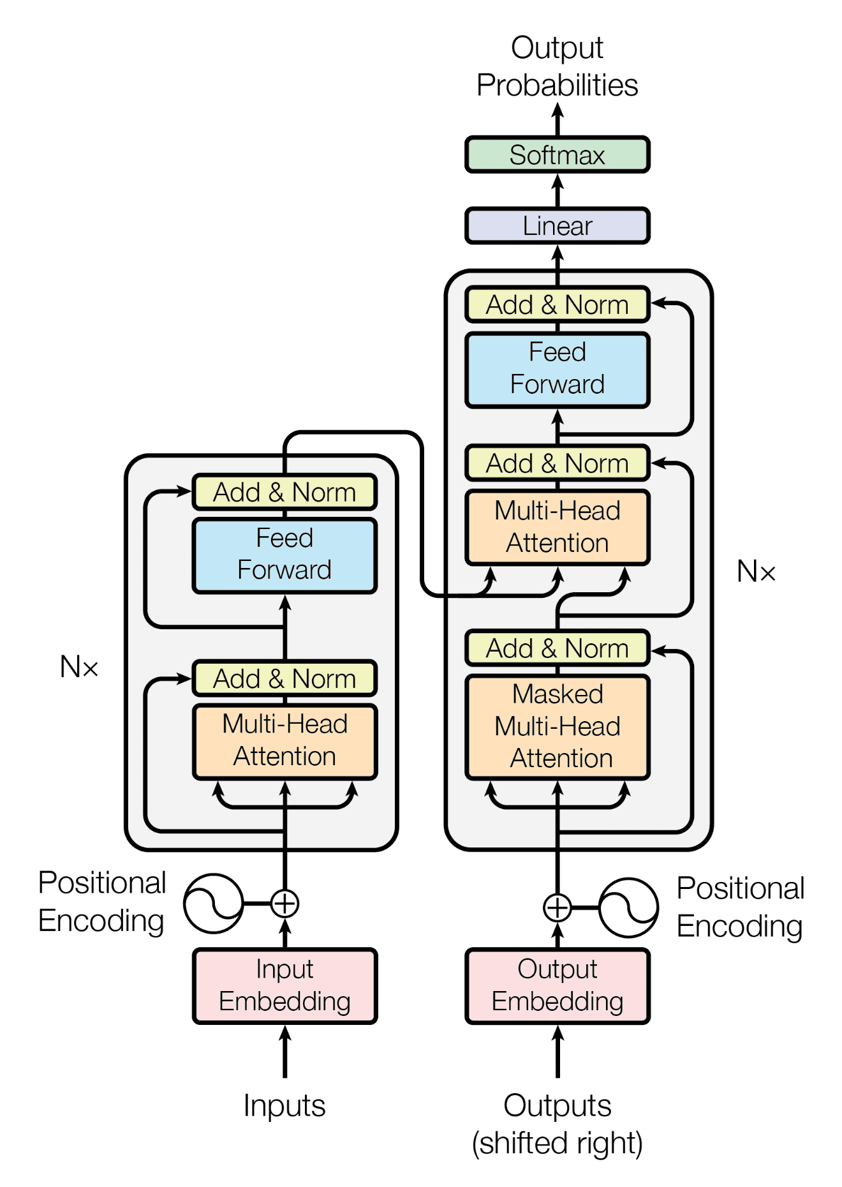
Transformer Architecture
Training Inputs are encoded
Training Outputs are encoded

