Slide 1
Forecasting Bike Usage with TransformerModel
EIND 558 Comp Project
Gage Halverson

Slide 2
Executive Summary
Running

Slide 3
Approach
Data Source: Kaggle Bike Count Prediction Multivariate Data Set
Included weather related features
Neural Network Forecaster: the Transformer model to predict bike rental demand
Examined the impact of non-time-series features on rental demand
Used Python and Darts to create model

Slide 4
Model Description
Overview of basic methodology:
Model: TransformerModel
Dependent variable: Bike rental count (daily)
Scope:
Bike rental company in unknown city with over 4,500+ daily rides
Sampling
training
start: 2011-01-01
end: 2012-08-21
duration: 598 days
test
start: 2012-08-22
end: 2012-10-27
duration: 66 days
The model developed has the predictive power

Slide 5
Model Details
Candidate variables:
season
holiday working day weather temp atemp humidity wind speed
Feature selection
Drop features based on correlation to target feature
Candidate variables:
season
holiday working day weather temp atemp humidity wind speed

Slide 6
Recommendations

Slide 7
Data Wrangling
Find and correct missing values

Slide 8
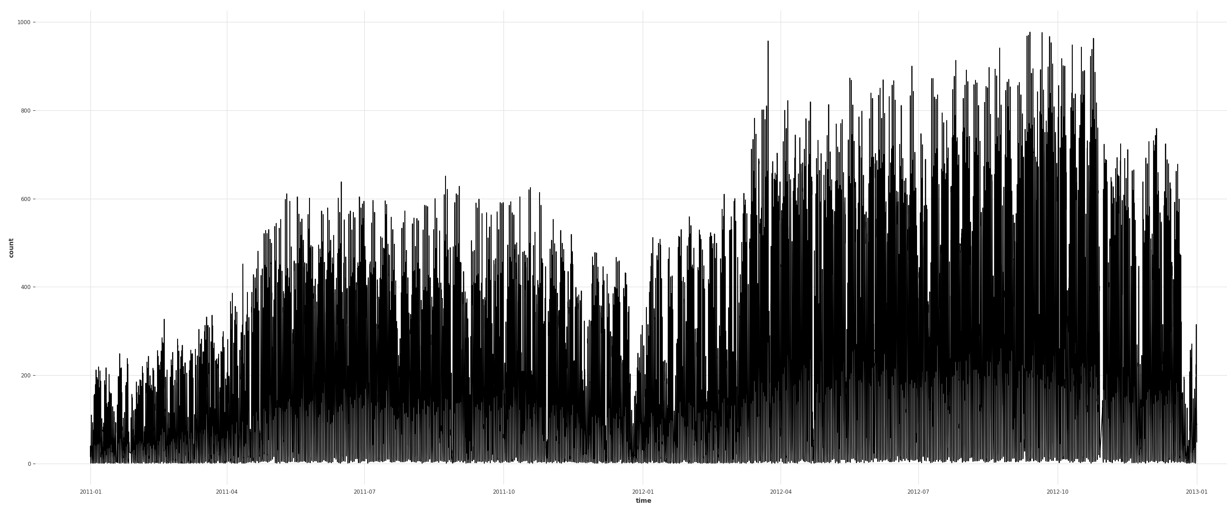
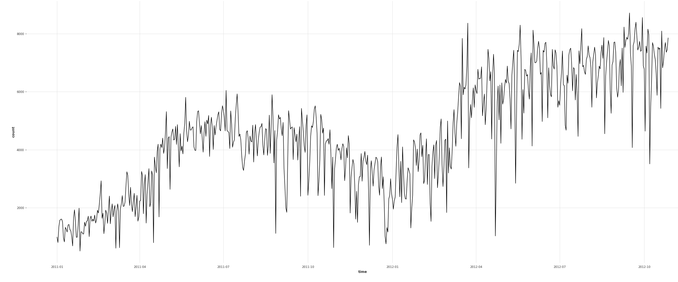
Data Before and After

