Slide 1
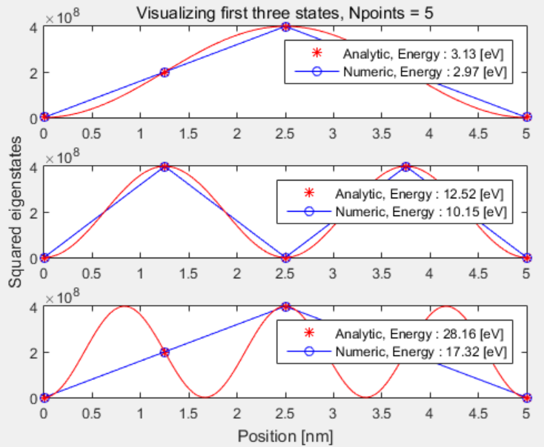
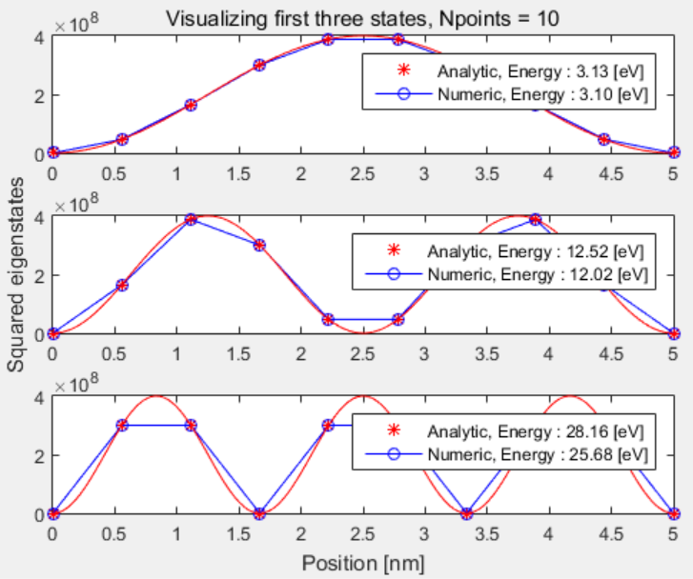
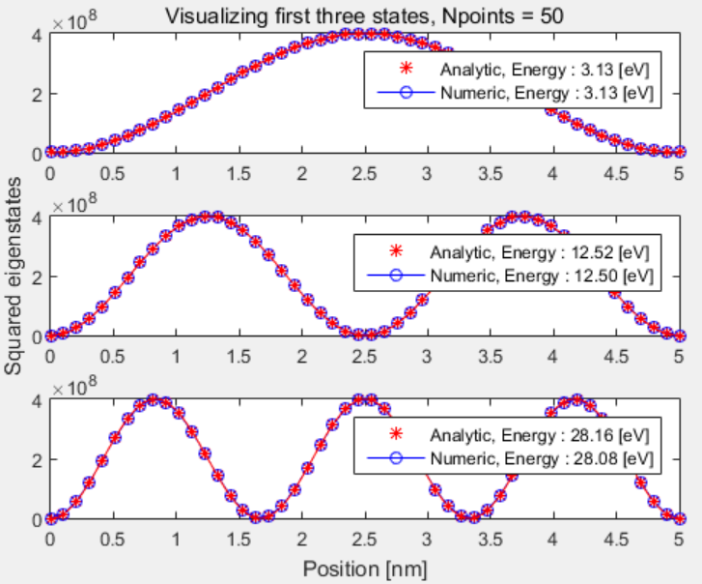
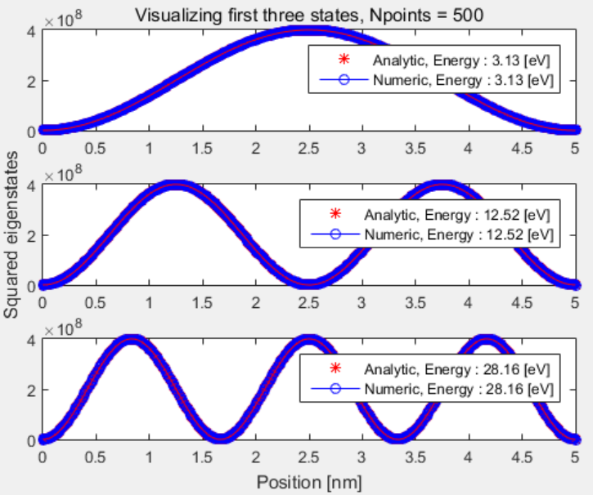
Less numerical sampling generates more spreader eigenfunctions than analytical one.
More spreader eigenfunctions have lower eigenvalues (energies) than analytical one.
Higher excited states need more numerical sapling to get correct eigenvalue due to theirs faster varying nature.

