Slide 1
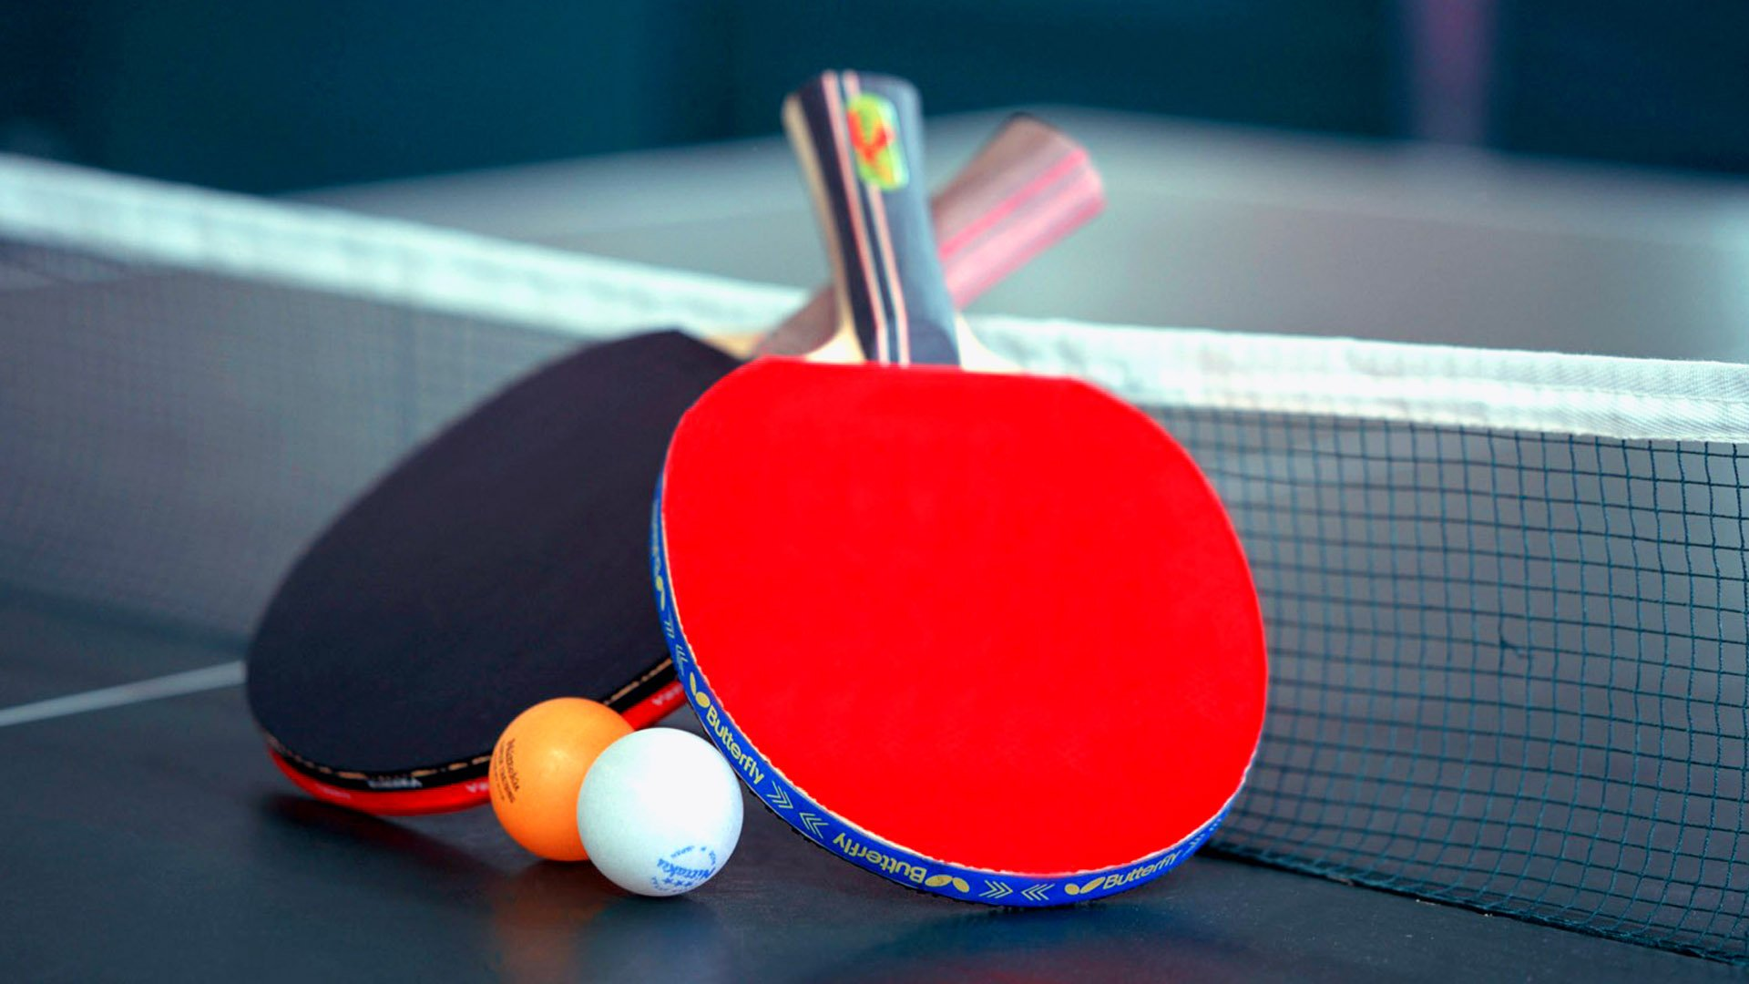
Table Tennis game
WITH PYTHON
財金三 王聖揚
財金三 郭 昕
財金三 李荐濂
財金三 劉庭華

Slide 2
Table Tennis Game
Menu
Play
Information
Quit
Instruction
Hard
Easy
Moderate
Game Mode
Developers

Slide 3

Modules
pygame
os
random

Slide 4
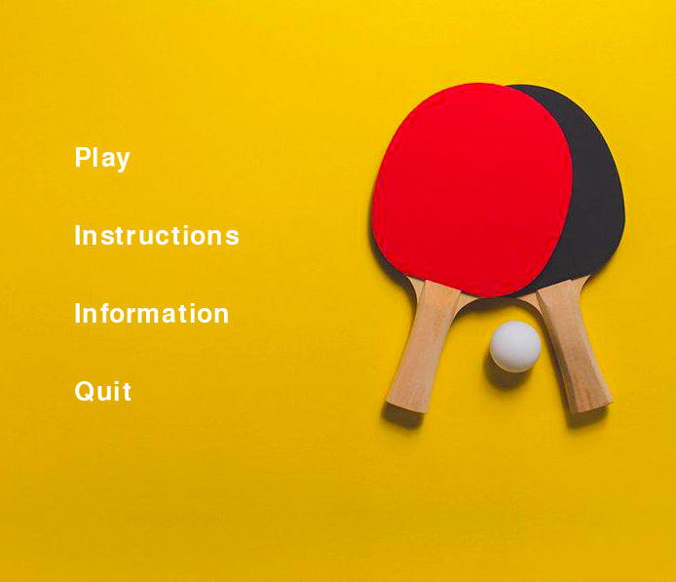
Menu

Slide 5
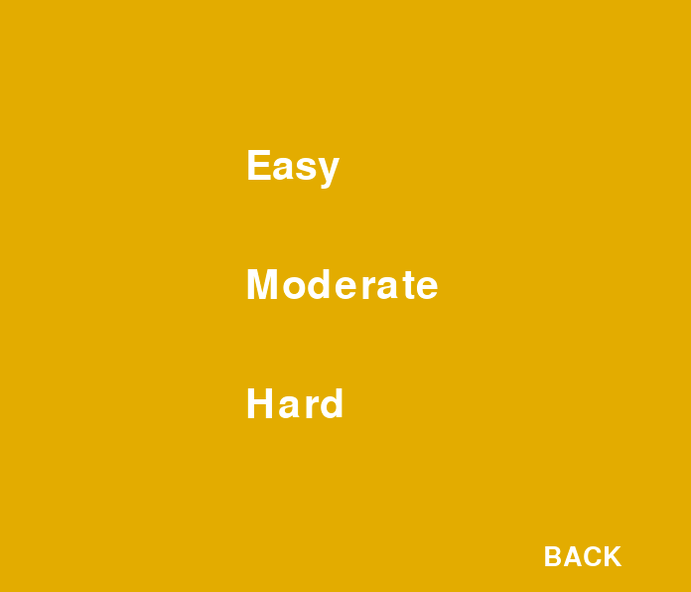
Game Modes

Slide 6
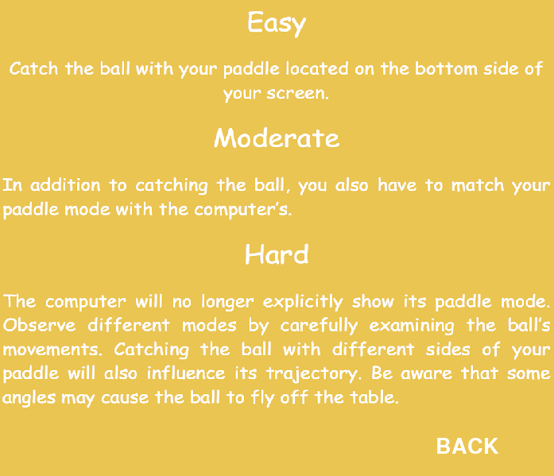
Instructions

Slide 7
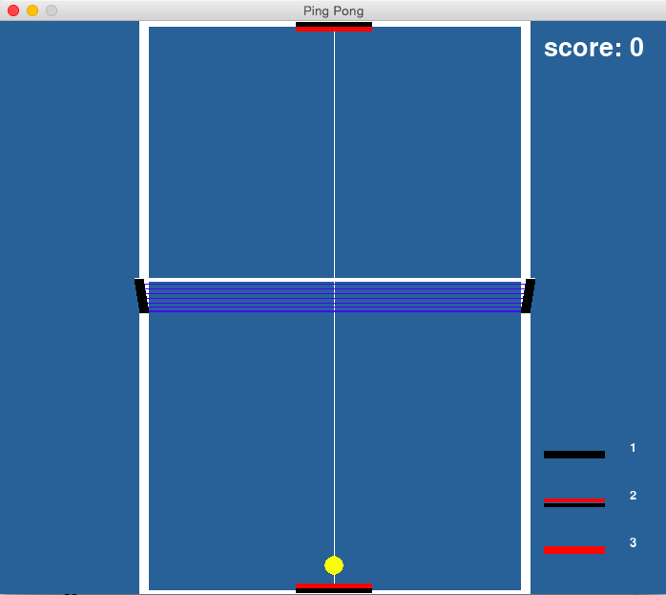
Easy
Player does not need to serve
Return the ball as many times as possible

Slide 8
Easy
Direction of the hit will be random, but will always be inbound

Slide 9
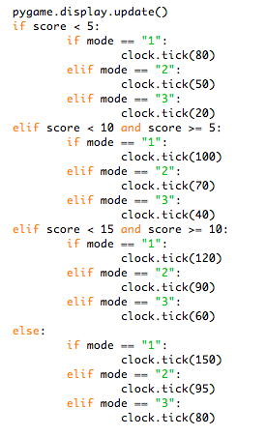
Speed Increases with every 5 hits

Slide 10
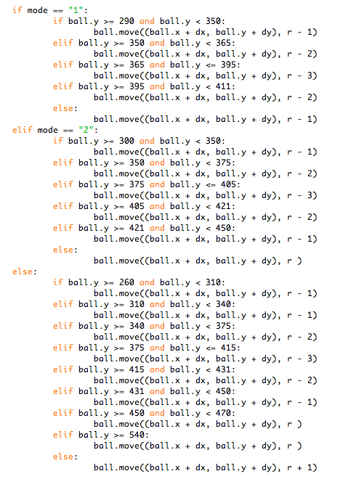
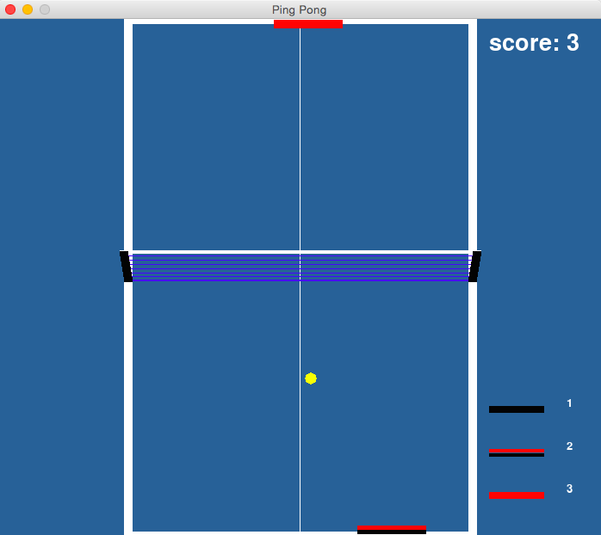
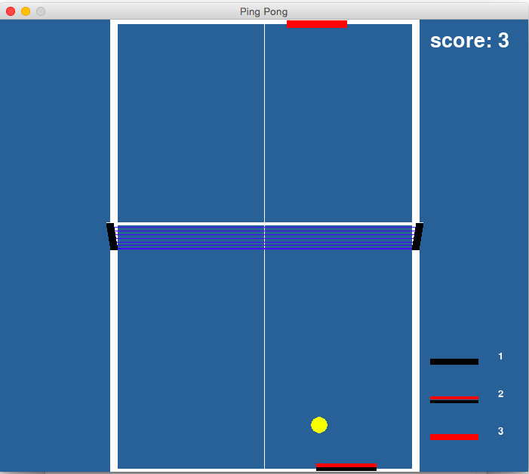
Bouncing motion is shown by size of the ball

Slide 11
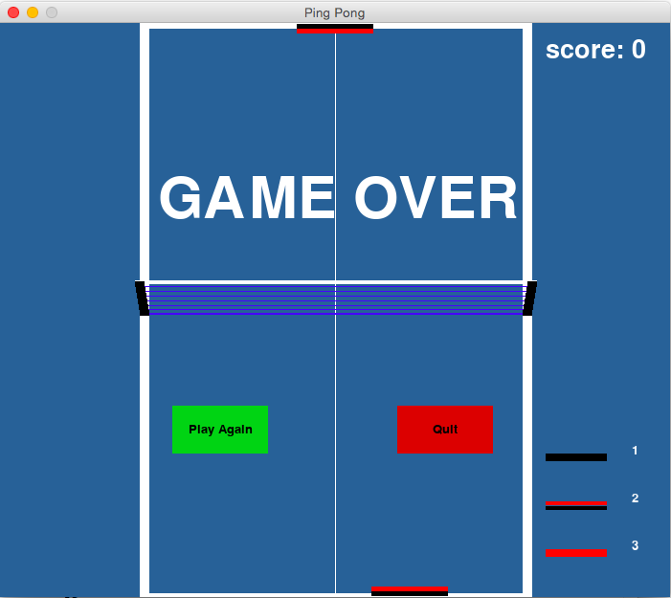
Easy
Option 1:
Play again in the same game mode
Failing to hit the ball
Option 2:
Return to main menu

Slide 12
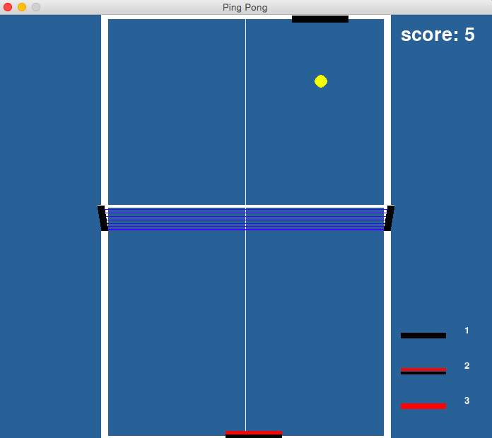
Moderate
Computer returns the ball with a spin
Player must observe the color of the paddle or the motion of the ball
Top spin
No spin
Back spin

Slide 13
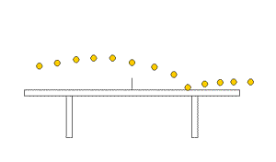
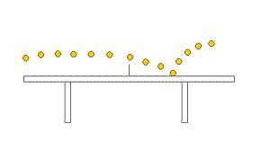
Top Spin:
Ball travels faster and speeds up after contacting the table
Back Spin:
Ball travels slower, slows down and bounces higher after contacting the table

Slide 14
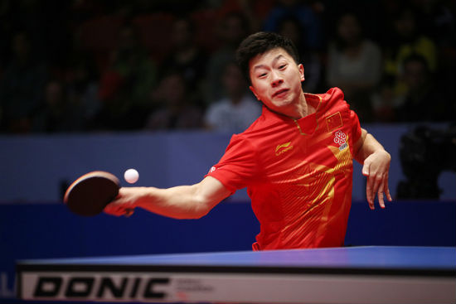
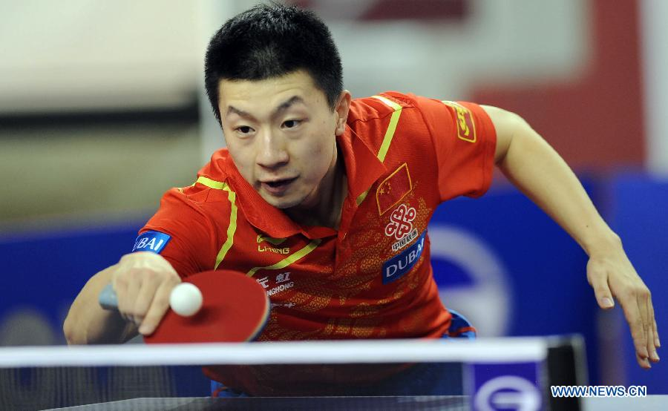
Can you tell which one is which?

Slide 15
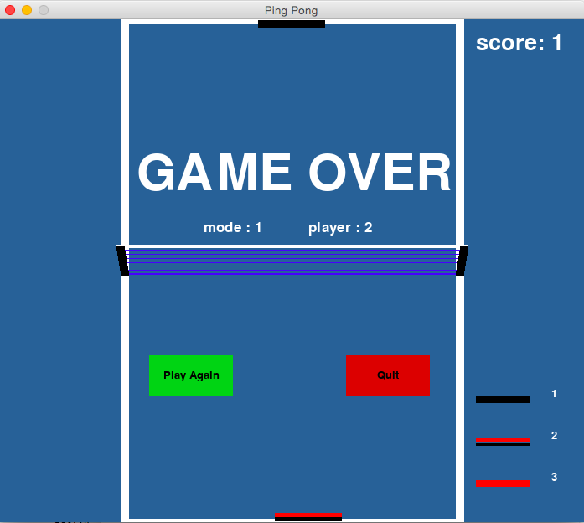
Notice that the computer hits a top spin(1) but the player returns with no spin(2)
Failing to return with the correct mode

Slide 16
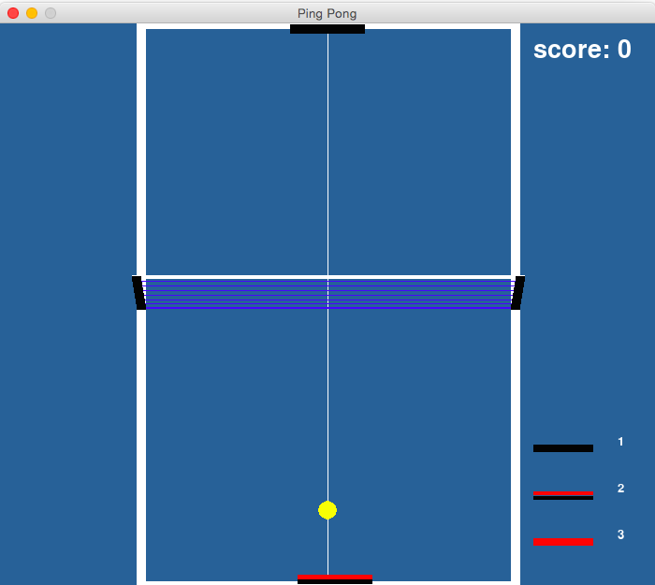
Hard
Computer no longer shows its spin mode with its paddle

Slide 17
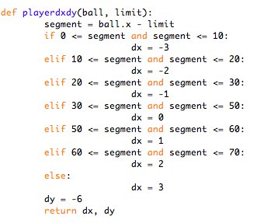
Hard
Player must also decide the direction of the return

Slide 18
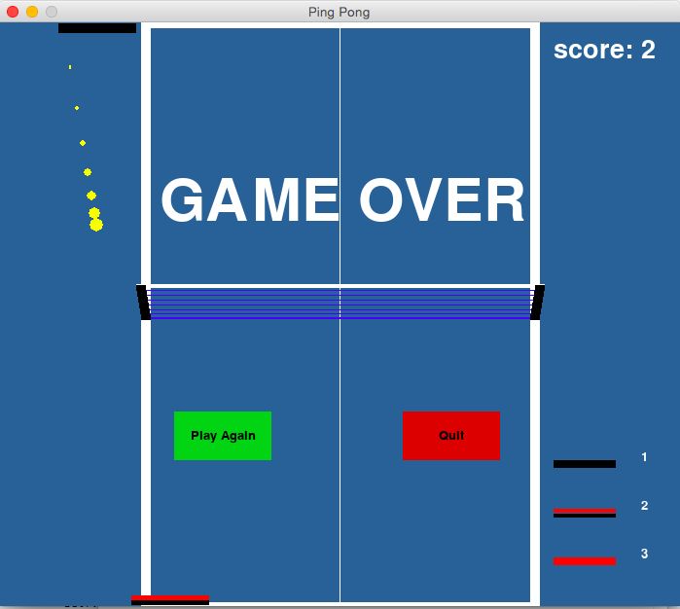
Hard

Slide 19
Demo

Slide 20
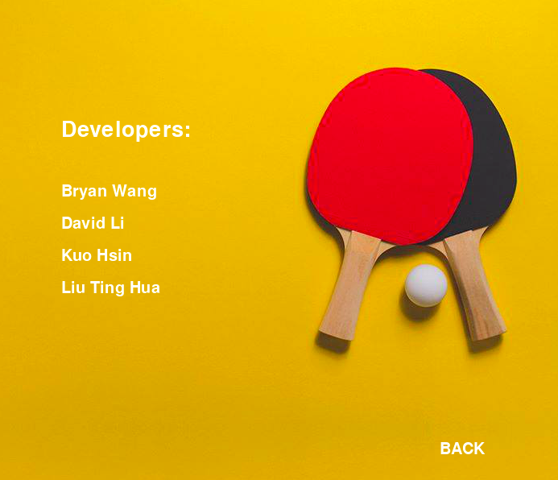

Slide 21
Thank your for listening!

