Slide 1
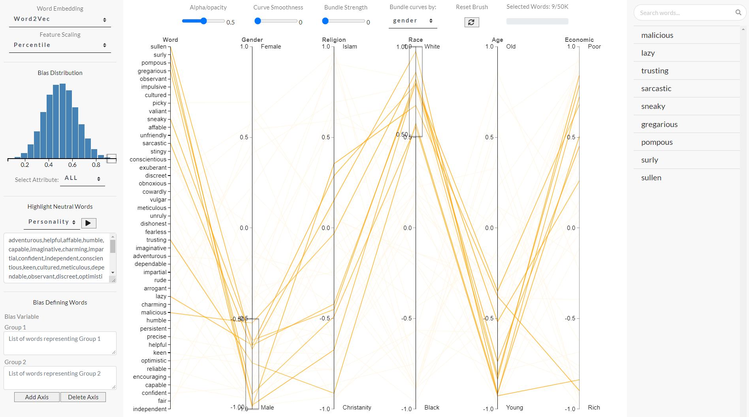
B
A
C

Slide 2
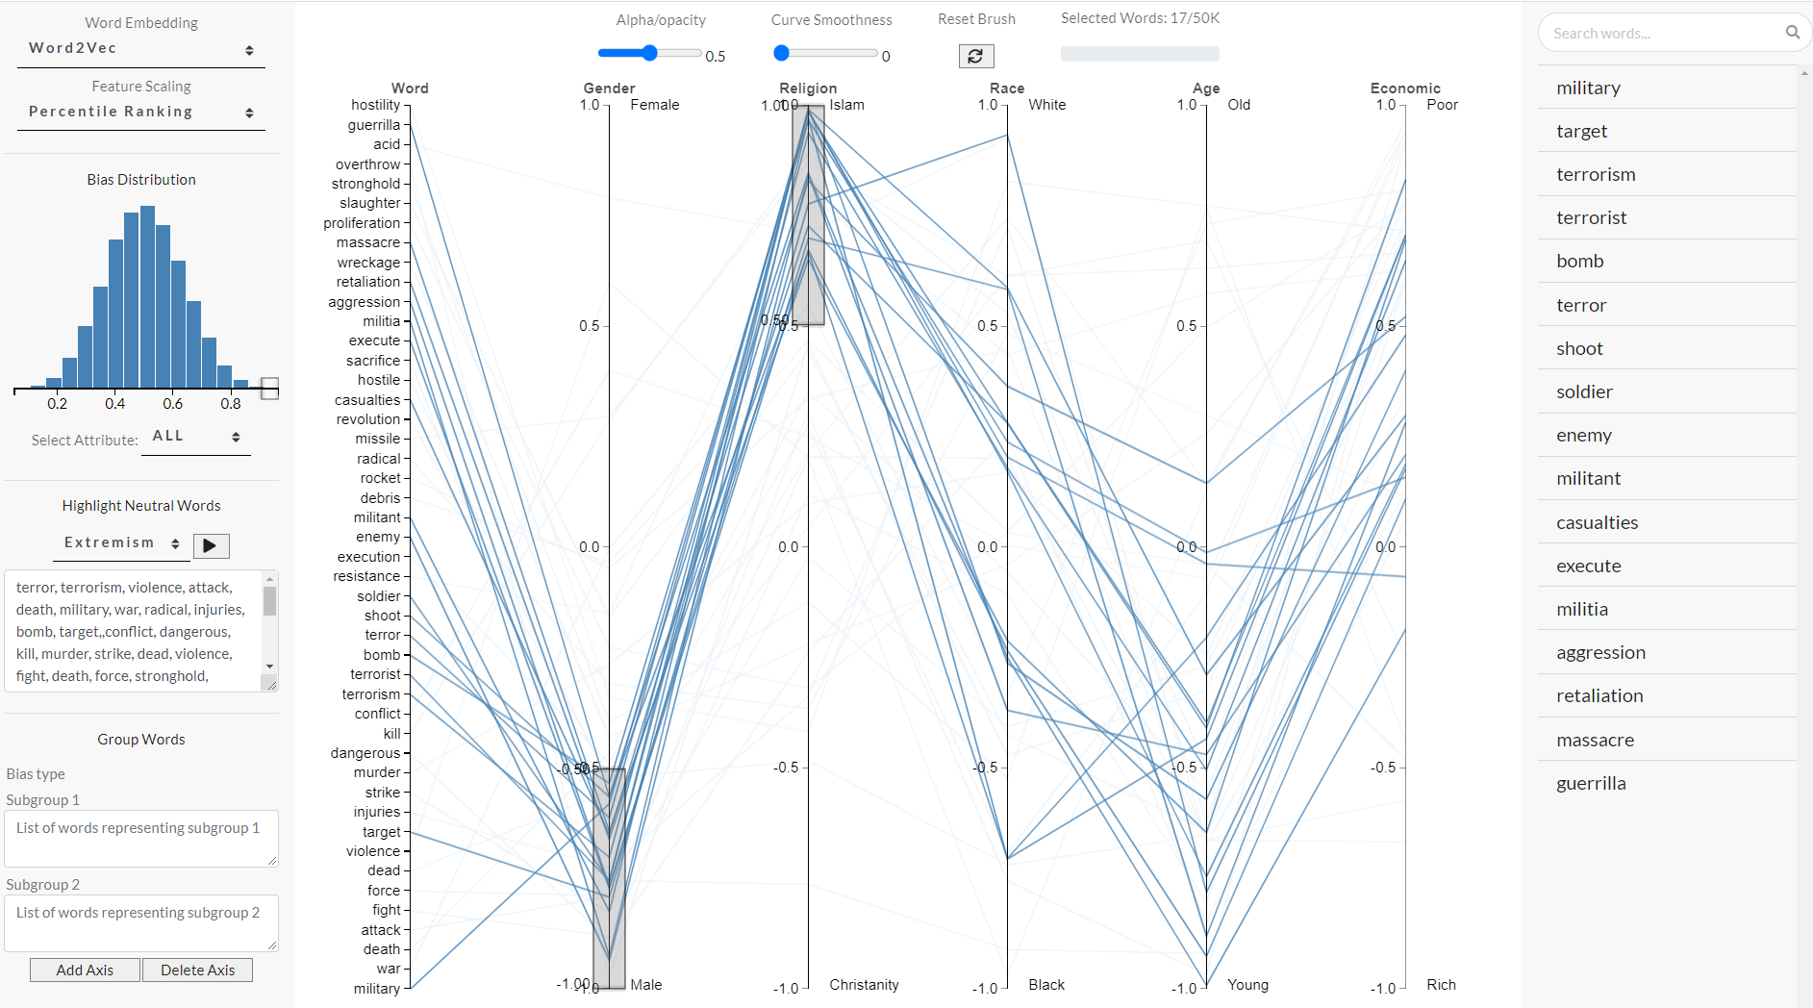
B
C
A

Slide 3
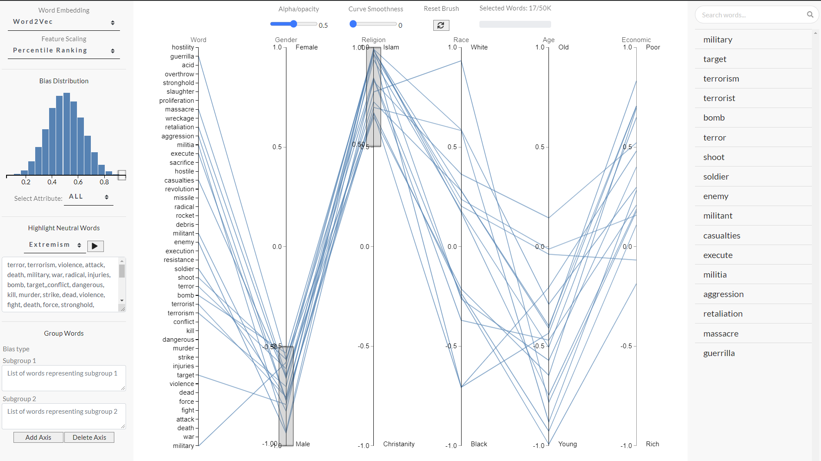

WordBias
An Interactive Visual Tool for Discovering Intersectional Biases Encoded in Word Embeddings
Bhavya Ghai, Md Naimul Hoque, Klaus Mueller
Stony Brook University

Slide 4
Thanks for Watching!
Check out github.com/bhavyaghai/WordBias for more

