Slide 1
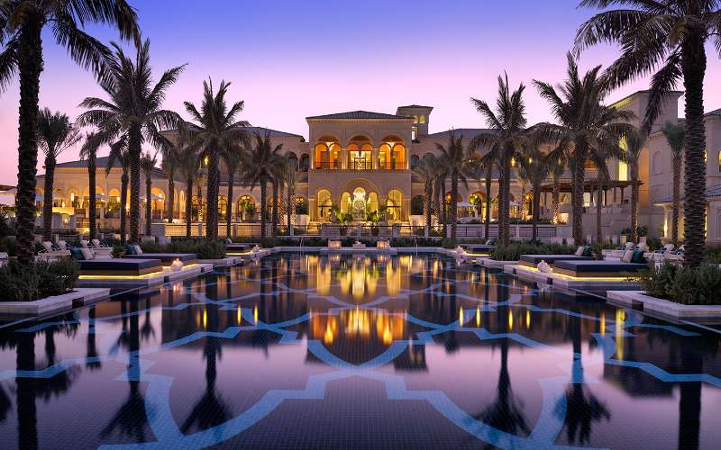
2017
Granville Hotel Online Booking System
Feng Zheng
Qian Xu
Zili Ma
Team 15

Slide 2
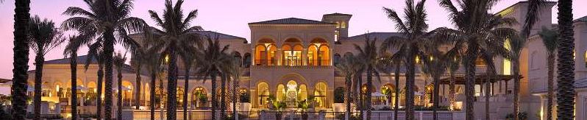
01
THE PART
Motivation

Slide 3
Motivation
Design Goals
Business Goals
Design Opportunity
Design Goals
Business Goals
Comfortable
Attractive
Convenient
Profitable
Notes:
The gap between the business goal and design goal is our design opportunity.
We build a bridge to connect the hotels and the customers and to benefit both parties.

Slide 4
02
THE PART
Introduction

Slide 5
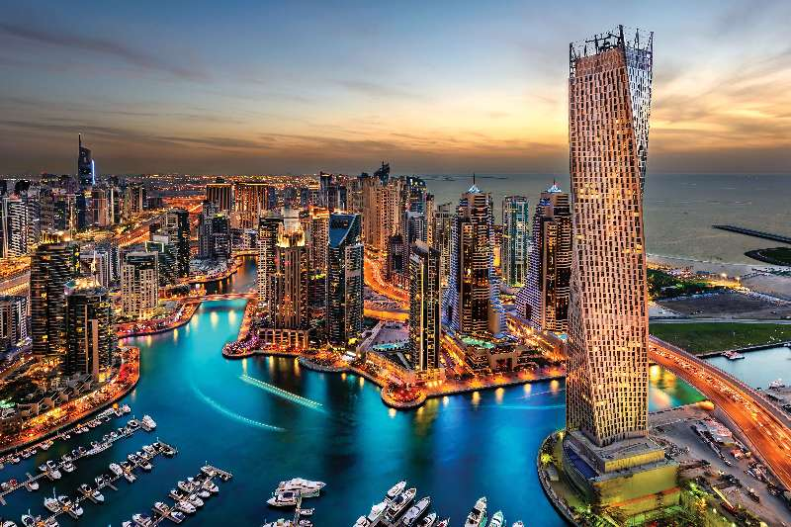
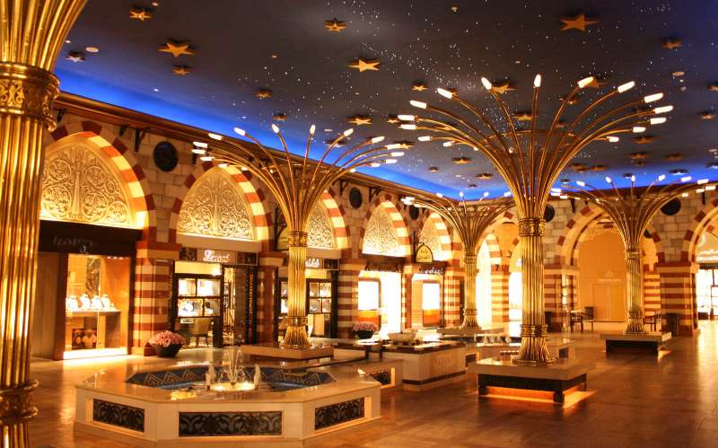




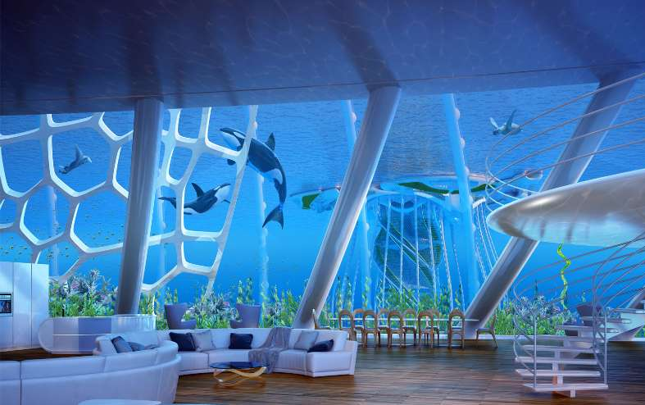

Introduction
Sky Tower
Resort
View
Room
Located in Dubai
All-around Ornamental Ocean View
Hundred Metres Birdview of the Ocean
229 Sky Tower Rooms
162 Resort Rooms
109 Castle Rooms

Slide 6
Introduction
Unparalleled Honor Helicopter Tour
More than 90000 square foot Plaza
Luxury Service
All-around Ornamental Ocean View
Features
Multifunctional Conference Rooms
Free Car Service
Hundred Metres Birdview
Delicate and Delicious Food

Slide 7
03
THE PART
Function

Slide 8
Website Function
A
Customer-oriented System
B
Online Booking
D
Real-time Room Status Check
E
F
Online Payment
Booking History Review
C
Booking Filter

Slide 9
04
THE PART
Approach

Slide 10





Approach
MySQL
Create Tables and Relation
Python
Generate Random Data
Django
Build the Framework
JavaScript
Front-end Implement
HTML
Front-end Design
Connect Front-end with Database

Slide 11
Workflow
Customer Info
Date(check-in/out)
Online Booking System
Booking No.
customer
Booking Info
Room Info
Bill Info
Notes:
!!!
Date !
Booking No. (example)
Bill Info(room type, room no., total price)

Slide 12
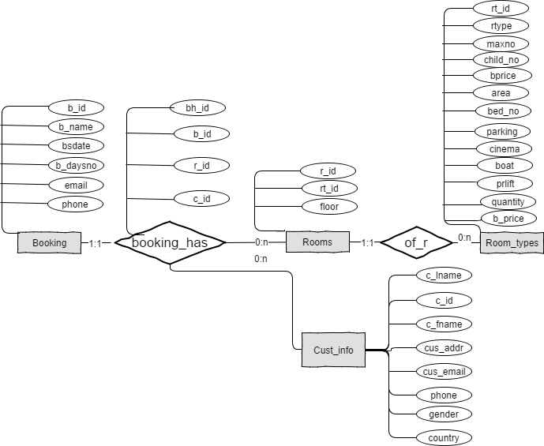
Database
Notes:
Booking has– customer book several times

Slide 13
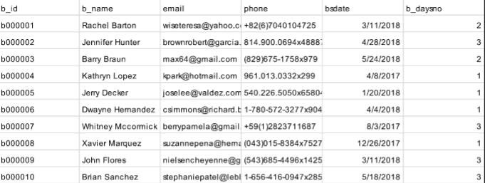
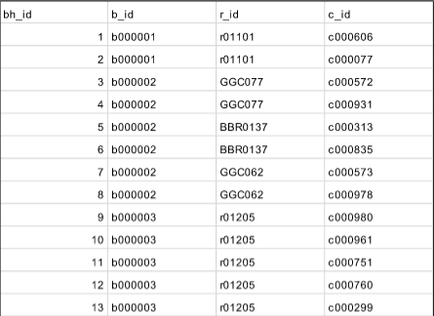
Data

Slide 14
05
THE PART
Website

Slide 15
Any Questions

Slide 16
END
Thank you！
Team 15

