Slide 1








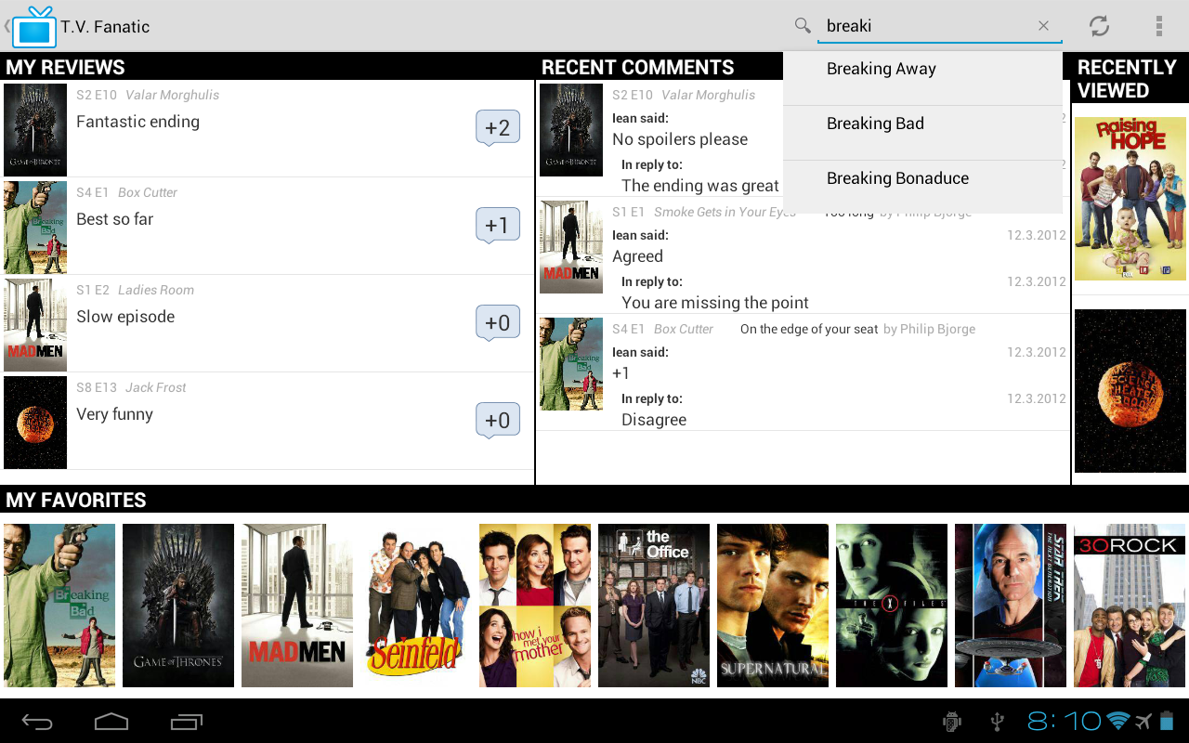
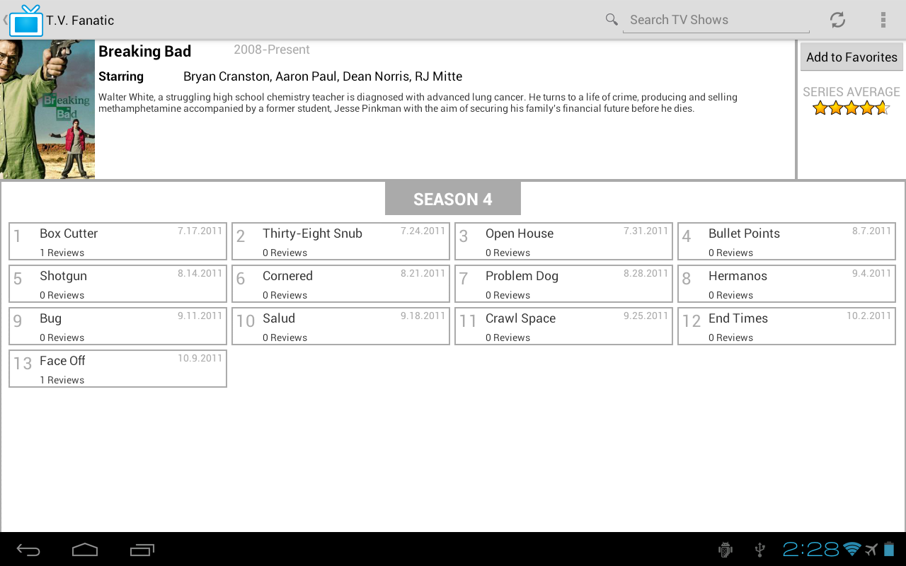
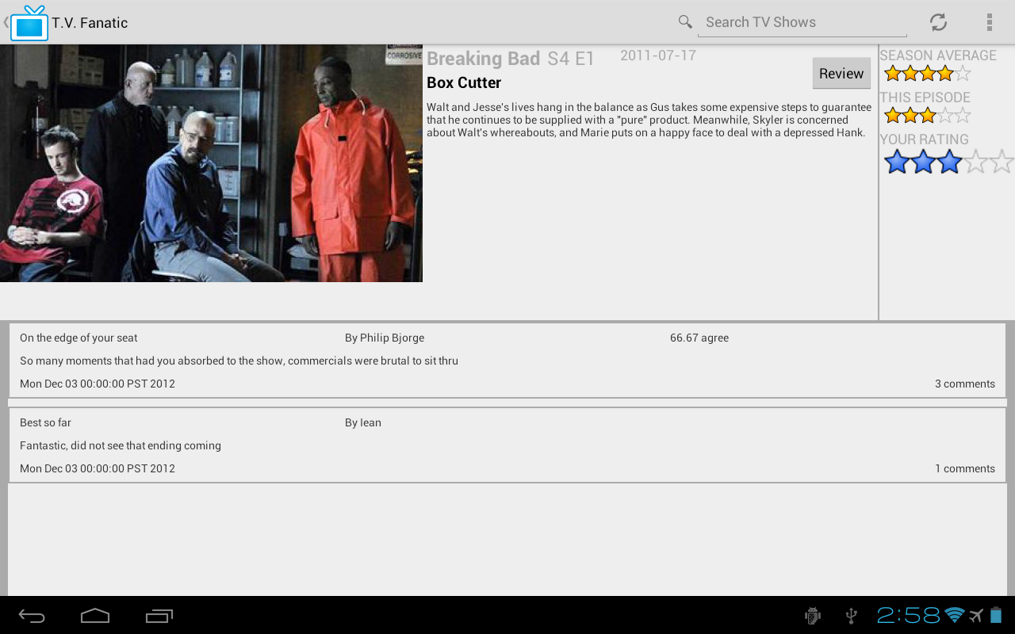
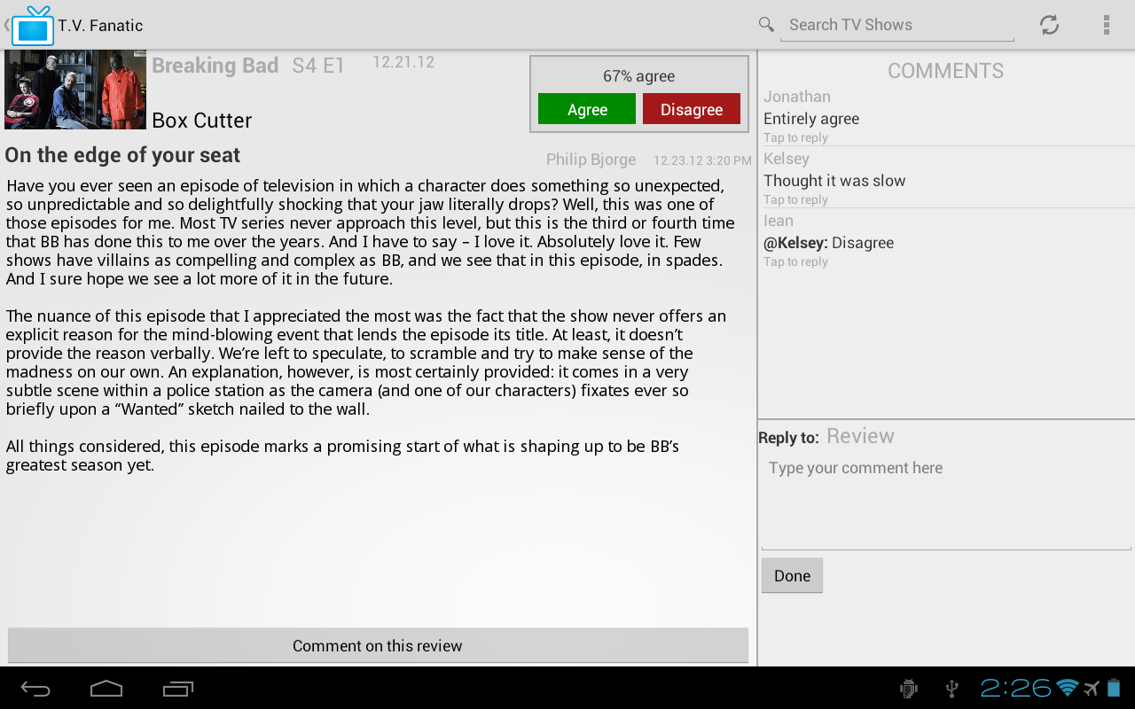
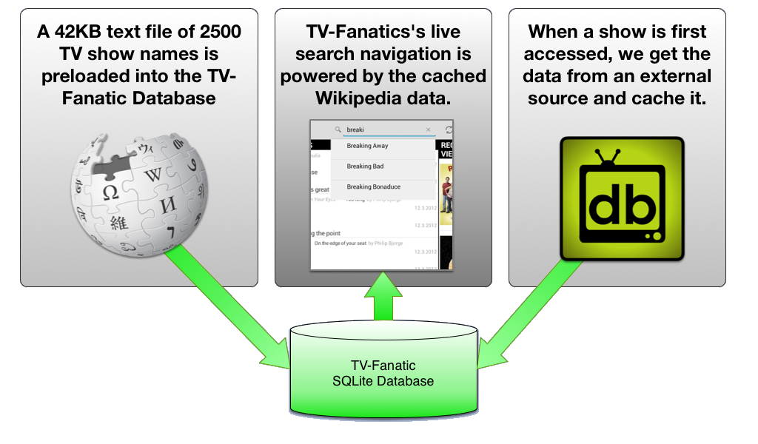

Philip Bjorge
Daniel Prete
Jonathan Roberts
T.V. Fanatic
CSCI 412 - Fall 2012
Mobile Device Programming
OVERVIEW
FEATURES
T.V. Fanatic is an Android app in which users share their opinions of the latest episodes of their favorite television shows and see what others are saying.
We’ve optimized the app for tablets to make the best use of large screens.
Other than an image cache and a few preferences, very little data is kept on your device.
Almost everything comes from our PHP server. Our server was designed according to the elegant yet simple REST protocol.
All that information on TV shows, episodes, as well as reviews and comments from users is kept in a blazingly fast SQLite database on our server.
The first time anyone visits a TV show on our app, we get all the information on that show from the public “TVDB” television database. This takes a little while, but we keep all that info in our database. Next time, the show opens faster for everyone.
We believe this is the first app of its kind for Android, iOS, or even the web!
2500+ TV series: Our database has access to every episode that has ever aired for more than 2,500 titles. T.V. Fanatic provides a photo, summary, and more for each and every episode.
Become the critic: Review any episode of any TV series, and read reviews from users everywhere.
Comment on reviews: Give feedback on reviews. Agree or disagree with a review? Let the author know! T.V. Fanatic strives to facilitate discussion.
Personalized home screen: Your home screen keeps you posted with the latest discussion on your reviews, replies to comments you’ve posted, and more.
Keep track of your favorite shows: Add any show to your list of favorites with the touch of a button. You now have instant access to that show from your home screen.
Rate episodes: Rate an episode on a scale from 1 to 5. Average ratings for episodes, seasons and entire series are instantly updated.
Search
Search our comprehensive database of 2,500 TV series. The closest matches are provided as you type.
Recently Viewed
Go back to the shows you’ve viewed recently, but haven’t favorited yet.
T.V. Series Info
View the official poster, main cast, and description of the T.V. series.
Add to Favorites
Tap to add this T.V. series to your list of favorites. You’ll get quick access to this show from your home screen.
Recent Comments
Scroll through replies to comments you’ve posted.
Series Average
Thinking of starting this show? The average rating of all episodes of this show can help you decide.
My Reviews
See the latest activity within your reviews at a glance. We show you the number of new comments since you last checked.
Home Screen
T.V. Series
Episodes
Click any episode to go to its page and see it’s reviews and ratings.
My Favorites
Instantly jump to any of your favorite shows to check out the latest reviews, write reviews for new episodes, and more.
Seasons
Just swipe left or right to flip between seasons. The latest season is shown first when you open a show.
Back to Home
Just tap the TV icon in any page to jump back to your Home Screen.
T.V. Episode
Review + Comment
Agreeing
Agree or disagree with a review? Just tap the button.
Episode Image
An image straight from the episode itself.
Comments
View what other people have to say about this review. You can reply to a comment by simply tapping on it.
Episode Summary
The summary of the episode may help refresh your memory.
Reviews
View a condensed list of all of the reviews for the episode. Tap one to open up the review.
Write a Review
Click here to start writing a review. Let the world know your opinion!
Rate the Episode
Click on your desired rating to rate the episode.
Review
Read the review here. We also show the author and the episode under review.
Comment on this Review
Tap here to start commenting on the review itself.
Write Comment
Write your comment here, then tap Done to share it with the world.
BEHIND THE SCENES
On-demand database loading
Improving performance
Allows for complete database regeneration without any downtime and it eliminates the need for a test dataset or stub database by allowing all developer’s access to the multi-gigabyte database with just a 42KB download.
The problem: In the early days of the app, the Home Screen took a long time to load.
The Home Screen requires dozens of images all stored on our remote server. The time required to download, decode, and render all of these images was considerable: an active user’s home screen typically required 20-30 seconds to fully load. The Home Screen is the hub of the app, so this was unacceptable!
The solution: A multi-level, LRU image cache:
Android Device
Server
Disk Cache
Memory Cache
Home Screen
If the device does not have the image in either cache, it is downloaded from our TV Fanatic server.
It’s very fast to load an image from the memory cache, but space here is limited.
The image is ready for display, in a fraction of the time!
Once downloaded, the image is saved to the disk cache so that future requests for this image are faster.

