Slide 1

Linux Plus
for
AWS and DevOps

Slide 2

Using Filter

Slide 3
Table of Contents
stdin, stdout, stderr
Filters
Commands:
cat, tee, grep, cut, tr, wc, sort, uniq, comm
Control Operators

Slide 4
stdin, stdout, stderr
1

Slide 5
stdin, stdout, stderr
stdout
stdin
program
stderr
Notes:
stdin, stdout, and stederr are three standard streams that are established when a Linux command is executed.
Data streams, like water streams, have two ends. They have a source and an outflow. Whichever Linux command you’re using provides one end of each stream. The other end is determined by the shell that launched the command. That end will be connected to the terminal window, connected to a pipe, or redirected to a file or other command, according to the command line that launched the command.

Slide 6
Filters
2

Slide 7
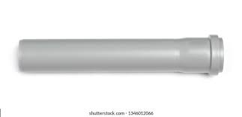

Filters
A filter is a program that takes data from one command, does some processing and gives output. Filter commands generally are used with a pipe.
Pipe ('|') is a mechanism that send the output of one command as input of another command.
output of the command
pipe
filter
cat colors.txt | grep “blue”
Notes:
cat colors.txt
green
blue
red
yellow
black

Slide 8

cat
tee
grep
cut
tr
wc
sort
uniq
comm
Commands
3

Slide 9
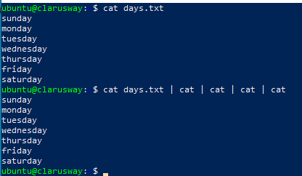
Filters Commands
When between two pipes, the cat command does nothing (except putting stdin on stdout). Displays the text of the file line by line.
cat
Notes:
Days.txt
Monday
Tuesday
Wednesday
Thursday
Friday
Saturday
Sunday
$ cat days.txt | cat | cat | cat | cat

Slide 10
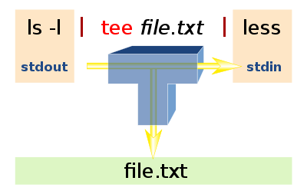
Filters Commands
tee is almost the same as cat, except that it has two identical outputs.
tee
Notes:
count.txt:
one
two
three
four
five
tac count.txt | tee temp.txt | tac
https://americanliterature.com/author/jack-london/short-story/to-build-a-fire
Day had broken cold and grey, exceedingly cold and grey, when the man turned aside from the main Yukon trail and climbed the high earth- bank, where a dim and little-travelled trail led eastward through the fat spruce timberland. It was a steep bank, and he paused for breath at the top, excusing the act to himself by looking at his watch. It was nine o'clock. There was no sun nor hint of sun, though there was not a cloud in the sky. It was a clear day, and yet there seemed an intangible pall over the face of things, a subtle gloom that made the day dark, and that was due to the absence of sun. This fact did not worry the man. He was used to the lack of sun. It had been days since he had seen the sun, and he knew that a few more days must pass before that cheerful orb, due south, would just peep above the sky- line and dip immediately from view.
The man flung a look back along the way he had come. The Yukon lay a mile wide and hidden under three feet of ice. On top of this ice were as many feet of snow. It was all pure white, rolling in gentle undulations where the ice-jams of the freeze-up had formed. North and south, as far as his eye could see, it was unbroken white, save for a dark hair-line that curved and twisted from around the spruce- covered island to the south, and that curved and twisted away into the north, where it disappeared behind another spruce-covered island. This dark hair-line was the trail--the main trail--that led south five hundred miles to the Chilcoot Pass, Dyea, and salt water; and that led north seventy miles to Dawson, and still on to the north a thousand miles to Nulato, and finally to St. Michael on Bering Sea, a thousand miles and half a thousand more.
But all this--the mysterious, far-reaching hairline trail, the absence of sun from the sky, the tremendous cold, and the strangeness and weirdness of it all--made no impression on the man. It was not because he was long used to it. He was a new-comer in the land, a chechaquo, and this was his first winter. The trouble with him was that he was without imagination. He was quick and alert in the things of life, but only in the things, and not in the significances. Fifty degrees below zero meant eighty odd degrees of frost. Such fact impressed him as being cold and uncomfortable, and that was all. It did not lead him to meditate upon his frailty as a creature of temperature, and upon man's frailty in general, able only to live within certain narrow limits of heat and cold; and from there on it did not lead him to the conjectural field of immortality and man's place in the universe. Fifty degrees below zero stood for a bite of frost that hurt and that must be guarded against by the use of mittens, ear-flaps, warm moccasins, and thick socks. Fifty degrees below zero was to him just precisely fifty degrees below zero. That there should be anything more to it than that was a thought that never entered his head.

Slide 11
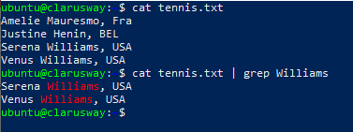
Filters Commands
The most common use of grep is to filter lines of text containing (or not containing) a certain string.
grep
Notes:
Nation Ranking Player_Name Player_Lastname Date_Reached
-------- ----------- ------------------ ------------------------ -------------------
Algeria 114 Lamine Ouahab 21 September 2009
Argentina 2 Guillermo Vilas 30 April 1975
Armenia 38 Sargis Sargsian 12 January 2004
Australia 1 John Newcombe 3 June 1974
Australia 1 Patrick Rafter 26 July 1999
Australia 1 Lleyton Hewitt 19 November 2001
Austria 1 Thomas Muster 12 February 1996
Bahamas 96 Mark Knowles 24 June 1996
Barbados 106 Darian King 8 May 2017
Belarus 18 Max Mirnyi 18 August 2003
Belgium 7 David Goffin 20 November 2017
Bolivia 35 Mario Martinez 12 September 1983
Bosnia 23 Damir Džumhur 2 July 2018
Brazil 1 Gustavo Kuerten 4 December 2000
Bulgaria 3 Grigor Dimitrov 20 November 2017
Canada 3 Milos Raonic 21 November 2016
Chile 1 Marcelo Ríos 30 March 1998
China 136 Zhang Zhizhen 10 February 2020
Taipei 33 Lu Yen-hsun 1 November 2010
Colombia 28 Santiago Giraldo 29 September 2014
Costa_Rica 55 Juan Antonio Marín 11 October 1999
Croatia 2 Goran Ivanišević 4 July 1994
Cyprus 8 Marcos Baghdatis 21 August 2006
Czech_Republic 1 Ivan Lendl 28 February 1983
Denmark 41 Kenneth Carlsen 7 June 1993
Dominican_Rep. 43 Víctor Estrella 13 July 2015
Ecuador 4 Andrés Gómez 11 June 1990
Egypt 34 Ismail El Shafei 8 April 1975
El_Salvador 139 Marcelo Arévalo 2 July 2018
Estonia 71 Jürgen Zopp 10 September 2012
Finland 13 Jarkko Nieminen 10 July 2006
France 3 Yannick Noah 7 July 1986
Georgia 9 Alex Metreveli 3 July 1974
Germany 1 Boris Becker 28 January 1991
Greece 5 Stefanos Tsitsipas 5 August 2019
Guatemala 275 Chris.Díaz Figueroa 30 September 2013
Haiti 22 Ronald Agénor 8 May 1989
Hong_Kong 653 Wong Hong Kit 12 December 2018
Hungary 12 Balázs Taróczy 5 April 1982
Iceland 703 Arnar Sigurdsson 7 May 2007
India 16 Vijay Amritraj 7 July 1980
Indonesia 241 Christopher Rungkat 8 April 2013
Iran 146 Taghi Akbari 3 June 1974
Ireland 129 Conor Niland 6 December 2010
Israel 18 Amos Mansdorf 16 November 1987
Italy 4 Adriano Panatta 24 August 1976
Jamaica 64 Dustin Brown 10 October 2016
Japan 4 Kei Nishikori 2 March 2015
Kazakhstan 33 Andrey Golubev 4 October 2010
Latvia 10 Ernests Gulbis 9 June 2014
Lithuania 50 Ričardas Berankis 23 May 2016
Luxembourg 21 Gilles Müller 31 July 2017
Mexico 4 Raúl Ramírez 7 November 1976
Macedonia 510 Tomislav Jotovski 15 June 2015
Moldova 39 Radu Albot 5 August 2019
Monaco 84 Jean-René Lisnard 27 January 2003
Montenegro 236 Goran Tošić 7 June 2010
Morocco 14 Younes El Aynaoui 11 March 2003
Netherlands 3 Tom Okker 2 March 1974
New_Zealand 19 Chris Lewis 16 April 1984
Nigeria 52 Nduka Odizor 11 June 1984
Norway 34 Casper Ruud 17 February 2020
Pakistan 44 Haroon Rahim 2 July 1977
Paraguay 9 Víctor Pecci 21 April 1980
Peru 18 Jaime Yzaga 30 October 1989
Philippines 72 Cecil Mamiit 11 October 1999
Poland 10 Wojciech Fibak 25 July 1977
Portugal 28 João Sousa 16 May 2016
Romania 1 Ilie Năstase 23 August 1973
Russia 1 Yevgeny Kafelnikov 3 May 1999
Russia 1 Marat Safin 20 November 2000
Senega l74 Yahiya Doumbia 19 September 1988
Serbia 1 Novak Djokovic 4 July 2011
Serbia 63 Novak Djokovic 29 May 2006
Slovakia 4 Miloslav Mečíř 22 February 1988
Slovenia 43 Grega Žemlja 15 July 2013
Slovenia 43 Aljaž Bedene 19 February 2018
South_Africa 5 Kevin Curren 22 July 1985
South_Africa 5 Kevin Anderson 16 July 2018
South_Korea 19 Chung Hyeon 2 April 2018
Spain 1 Carlos Moyà 15 March 1999
Spain 1 Juan Carlos Ferrero 8 September 2003
Spain 1 Rafael Nadal 18 August 2008
Sweden 1 Björn Borg 23 August 1977
Sweden 1 Mats Wilander 12 September 1988
Sweden 1 Stefan Edberg 13 August 1990
Switzerland 1 Roger Federer 2 February 2004
Thailand 9 Paradorn Srichaphan 12 May 2003
Tunisia 46 Malek Jaziri 12 November 2018
Turkey 77 Marsel İlhan 2 March 2015
Ukraine 4 Andriy Medvedev 16 May 1994
United_Kingdom 1 Andy Murray 7 November 2016
United_States 1 Jimmy Connors 29 July 1974
United_States 1 John McEnroe 3 March 1980
United_States 1 Jim Courier 10 February 1992
United_States 1 Pete Sampras 12 April 1993
United_States 1 Andre Agassi 10 April 1995
United_States 1 Andy Roddick 3 November 2003
Uruguay 19 Pablo Cuevas 15 August 2016
Uzbekistan 33 Denis Istomin 13 August 2012
Venezuela 74 Nicolás Pereira 22 July 1996
Vietnam 385 Lý Hoàng Nam 11 November 2018
Yugoslavia 7G oran Ivanišević 28 January 1991
Zimbabwe 22 Byron Black 29 April 1996

Slide 12
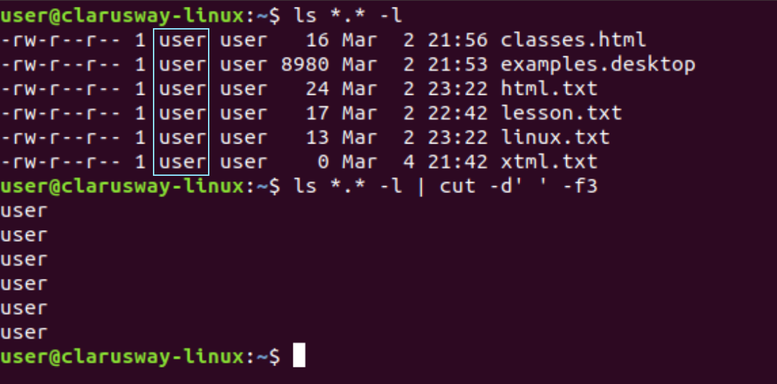
Filters Commands
The cut filter can select columns from files, depending on a delimiter or a count of bytes
cut
cut -d(delimiter) -f(columnNumber) <fileName>
Notes:
cat /etc/passwd; cut -d: -f1-3 /etc/passwd | tail -3; cut -d: -f1,3 /etc/passwd
cat tennis.txt
cut -d’ ‘ -f1 tennis.txt

Slide 13
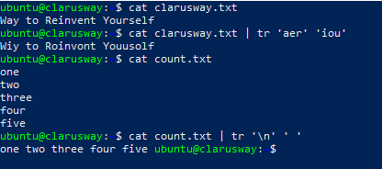
Filters Commands
The command 'tr' stands for 'translate’. It is used to translate, like from lowercase to uppercase and vice versa or new lines into spaces.
tr
Notes:
clarusway.txt:
Clarusway: Way to reinvent yourself.
cat clarusway.txt | tr ‘aer’ ‘QAZ’
count.txt :
one
two
three
four
five
six
seven
eight
nine
ten
cut count.txt | tr ‘\n’ ‘ ‘
To delete the characters: cat clarusway.txt | tr -d e
To convert lower case to upper case: cat clarusway.txt | tr [a-z] [A-Z]
To translate white-space to tabs: cat clarusway.txt | tr ‘ ‘ '\t'

Slide 14
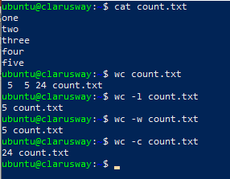
Filters Commands
Counting words, lines and characters is easy with wc.
wc
wc <fileName> (Counts words, lines and characters)
wc -l <fileName> (Counts only lines)
wc -w <fileName> (Counts only words)
wc -c <fileName> (Counts only characters)
Notes:
total user number:
wc -l /etc/passwd

Slide 15
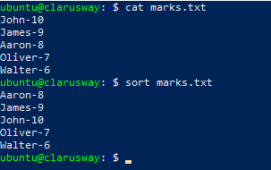
Filters Commands
The sort filter will default to an alphabetical sort.
sort
sort -r | the flag returns the results in reverse order
sort -f | the flag does case insensitive sorting
Notes:
marks.txt:
john-10
victor-5
james-9
aaron-9
oliver-7
walter-8
albert-9
tom-7

Slide 16
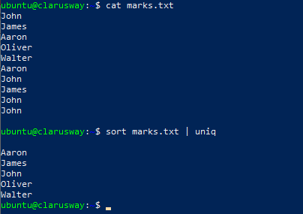
Filters Commands
With the help of uniq command you can form a sorted list in which every word will occur only once.
uniq
Notes:
trainees.txt:
john
james
aaron
oliver
walter
albert
james
john
travis
mike
aaron
tomas
daniel
john
aaron
oliver
mike
john

Slide 17
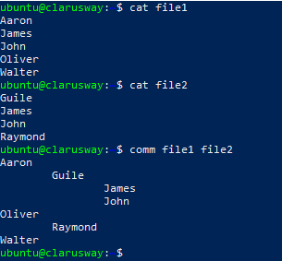
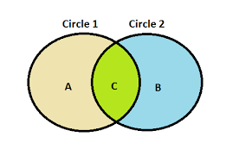
Filters Commands
The 'comm' command compares two files or streams. By default, 'comm' will always display three columns. First column indicates non-matching items of first file, second column indicates non-matching items of second file, and third column indicates matching items of both the files. Both the files has to be in sorted order for 'comm' command to be executed.
comm
Notes:
list1.txt:
Abba
Bowie
Cure
Queen
Sweet
list2.txt:
Abba
Cure
Queen
Turner
comm list1.txt list2.txt
file1:
Aaron
James
John
Oliver
Walter
file2:
Guile
James
John
Raymond

Slide 18
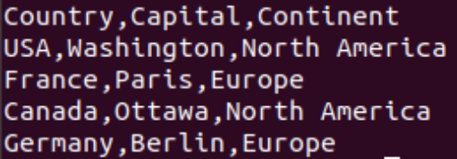
Exercise 1
Create a file named countries.csv with the following content
a. Cut only “Continent” column
b. Remove header
c. Sort the output
d. List distinct values
e. Save final output to “continents.txt” file
Display content of continents.txt file
Notes:
🍐 This is a Pear Deck Text Slide
🍐 To edit the type of question, go back to the "Ask Students a Question" in the Pear Deck sidebar.
countries.csv:
Country, Capital, Continent
USA, Washington, North America
France, Paris, Europe
Canada, Ottawa, North America
Germany, Berlin, Europe
cut -d’,’ -f3 countries.csv
cut -d’,’ -f3 countries.csv | tail -4
cut -d’,’ -f3 countries.csv | tail -4 | sort
cut -d’,’ -f3 countries.csv | tail -4 | sort | uniq
cut -d’,’ -f3 countries.csv | tail -4 | sort | uniq | tee continents.txt
cut -d’,’ -f3 countries.csv | tail -4 | sort | uniq > continents.txt

Slide 19

Using Control Operators
4

Slide 20
Table of Contents
Control Operators
Semicolon (;)
Ampersand (&)
Dollar Question Mark ($?)
Double Ampersand (&&)
Double Vertical Bar (||)
Combining && and ||
Pound Sign (#)
Escaping Special Characters (\)
End of line Backslash

Slide 21
Control Operators
We put more than one command on the command line using control operators.
Control Operator | Usage
; semicolon | More than one command can be used in a single line.
& ampersand | Command ends with & and doesn't wait for the command to finish.
$? dollar question mark | Used to store exit code of the previous command.
&& double ampersand | Used as logical AND.
|| double vertical bar | Used as logical OR.
Combining && and || | Used to write if then else structure in the command line.
# pound sign | Anything was written after # will be ignored.

Slide 22
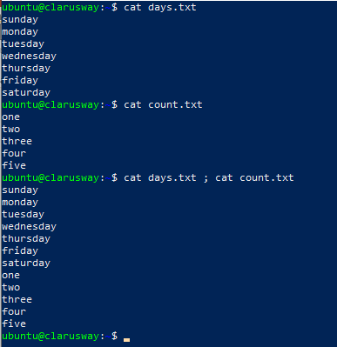
Semicolon (;)
You can put two or more commands on the same line separated by a semicolon (;)
Notes:
echo Hello
echo World
echo Hello ; echo World

Slide 23

Ampersand (&)
When a line ends with an ampersand &, the shell will not wait for the command to finish. You will get your shell prompt back, and the command is executed in background. You will get a message when this command has finished executing in background.
Look at the above snapshot, command "sleep 20 &" has displayed a message after 15 seconds.
Meanwhile, in the shell prompt, we can write any other command.

Slide 24
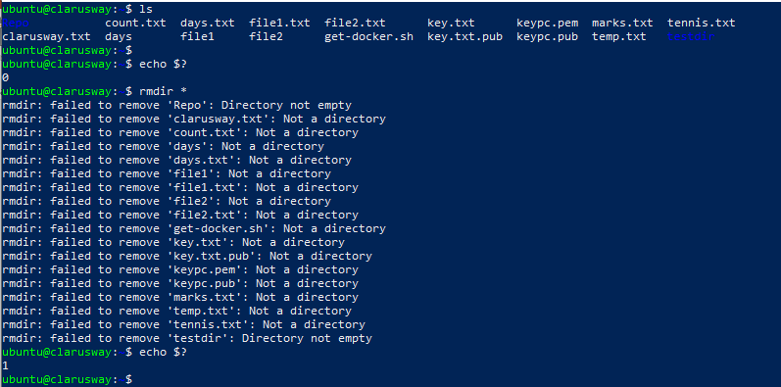
Dollar Question Mark ($?)
This control operator is used to check the status of last executed command. If status shows '0' then command was successfully executed and if shows '1' then command was a failure.
Notes:
user@clarusway~$ touch file1
user@clarusway~$ echo $?
0
user@clarusway~$ rm file1
user@clarusway~$ echo $?
0
user@clarusway~$ rm file1
rm: cannot remove `file1': No such file or directory
user@clarusway~$ echo $?
1

Slide 25
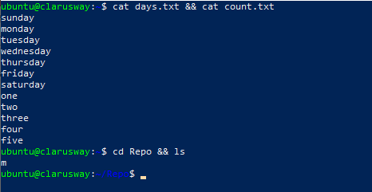
Double Ampersand (&&)
The command shell interprets the && as the logical AND. When using this command, the second command will be executed only when the first one has been successfully executed.
Notes:
user@clarusway:~$ echo first && echo second
first
second
user@clarusway:~$ zecho first && echo second
-bash: zecho: command not found
user@clarusway:~$ cd gen && ls
file1 file3 File55 fileab FileAB fileabc
file2 File4 FileA Fileab fileab2
user@clarusway:/gen$ cd gen && ls
-bash: cd: gen: No such file or directory

Slide 26
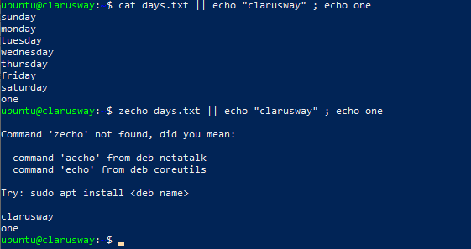
Double Vertical Bar (||)
The command shell interprets the (||) as the logical OR. This is opposite of logical AND. Means second command will execute only when first command will be a failure.
Notes:
user@clarusway:~$ echo first || echo second ; echo third
first
third
user@clarusway:~$ zecho first || echo second ; echo third
-bash: zecho: command not found
second
third

Slide 27
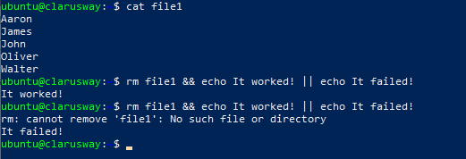
Combining && and ||
You can use this logical AND and logical OR to write an if-then-else structure on the command line. This example uses echo to display whether the rm command was successful.
Notes:
temp_file:
aaron
james
john
oliver
walter
cat temp_file
rm temp_file && echo it worked || echo it failed
rm temp_file && echo it worked || echo it failed
ls nofile.txt && echo “file found” || echo “file not found”
cd abc && echo “in abc folder” || echo “abc folder not found”

Slide 28

Pound Sign (#)
Everything written after a pound sign (#) is ignored by the shell. This is useful to write a shell comment but has no influence on the command execution or shell expansion.

Slide 29
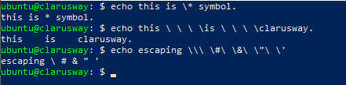
Escaping Special Characters (\)
Escaping characters are used to enable the use of control characters in the shell expansion but without interpreting it by the shell.
Notes:
echo I can use asterisk as a wildcard
echo I can use * as a wildcard
echo I can use \* as a wildcard
echo I can use # as a wildcard
echo I can use \# as a wildcard
user@clarusway:~$ echo hello \; world
hello ; world
user@clarusway:~$ echo hello\ \ \ world
hello world
user@clarusway:~$ echo escaping \\\ \#\ \&\ \"\ \'
escaping \ # & " '
user@clarusway:~$ echo escaping \\\?\*\"\'
escaping \?*"'

Slide 30

End of Line Backslash (\)
Lines ending in a backslash are continued on the next line. The shell does not interpret the newline character and will wait on shell expansion and execution of the command line until a newline without backslash is encountered.
Notes:
user@clarusway:~$ echo This command line \
> is split in three \
> parts
This command line is split in three parts

Slide 31


Slide 32
Exercise
a. Search for “clarusway.txt” in the current directory
b. If it exists display its content
c. If it does not exist print message “Too early!”
Create a file named “clarusway.txt” that contains “Congratulations”
Repeat Step 1
Notes:
🍐 This is a Pear Deck Text Slide
🍐 To edit the type of question, go back to the "Ask Students a Question" in the Pear Deck sidebar.
find -name clarusway.txt
find -name clarusway.txt && cat clarusway.txt
find -name clarusway.txt && cat clarusway.txt || echo “too early\!”
cat > clarusway.txt
Congratultions!
find -name clarusway.txt && cat clarusway.txt || echo “too early\!”
solution
ls clarusway.txt && cat clarusway.txt || echo Too early\!

Slide 33
Exercises
ls -l | cut -d’ ‘ -f3
ls -l | tee output.txt | cut -d’ ‘ -f3
ls -l | cut -d’ ‘ -f3 | tee output.txt
cat file.txt | tr ‘a’ ‘W’ cat file.txt | tr ‘a’ ‘W’ | file.txt
cat /etc/passwd | cut -d’ ‘ -f1 | wc -l
cat tennis_players.txt | sort cat tennis_players.txt | sort -r
info ls | tee ls_exp.txt cat /etc/passwd | cut -d’ ‘ -f3 | uniq | wc -l

Slide 34
Homework
diff
diff (1) - compare files line by line
diff (1p) - compare two files
https://www.geeksforgeeks.org/diff-command-linux-examples/#:~:text=diff%20stands%20for%20difference.,make%20the%20two%20files%20identical.
https://www.linuxtechi.com/diff-command-examples-linux/

Slide 35
THANKS!
Any questions?

