Slide 1

Learning How to Ask: Querying LMs with Mixtures of Soft Prompts
Guanghui Qin and Jason Eisner
Johns Hopkins University

Slide 2
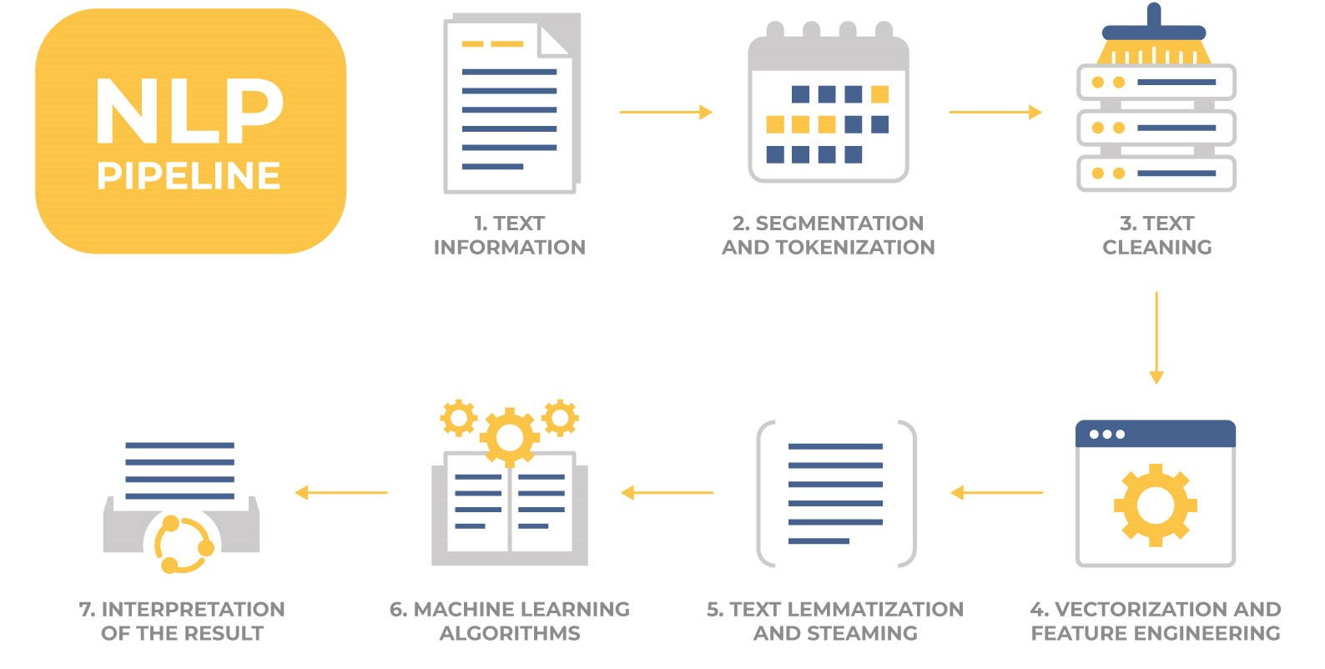



LMs Already Did Your Job
.
Prompt:
died
in
Input
BERT
GPT-3
Task:
What year did Mary Cassatt die?

Slide 3

LMs Already Did Your Job
Output
Mary Cassatt
1926
.
Prompt:
[MASK]
died
in
Input
BERT
GPT-3
Task:
What year did Mary Cassatt die?

Slide 4



The Form of the Question Matters
Should employers be forced to negotiate with unions?
Should unions have the right to negotiate with employers?
We’re prompting LMs!
Opinion Poll
Why can’t we see the moon now?
Where does the moon go during the day?
BERT
GPT-3
Children’s Mind

Slide 5
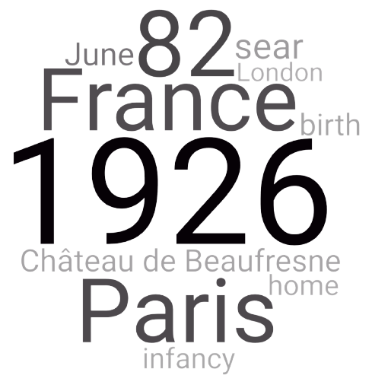






Prompt LMs
Output
Database
X | Y
Cab Calloway | 1994
Mary Cassatt | 1926
… | …
1926
Delaware
Bands
1994
1994
ignored
ignored
ignored
ignored
ignored
Backprop ?
Transformers
Embeddings:
Mary Cassatt
Cab Calloway
died
perished
in
during
[MASK]
.
Prompt:
Simulated
Annealing
Gradient
Descent
Input
Soft Prompts
Task:
Task:
Fact Queries: Year-of-Death
Fact Queries: Year-of-Death

Slide 6

Why Soft Prompts?
Easy to search with backprop.
We have a larger space of prompts.
They can emphasize certain keywords, even particular dimensions.
1926?
Paris?
gender neutral
= {his, her, their}
Longer
More general
[MASK]
.
Cab Calloway
played
until
his
death
in
Mary Cassatt
= {played, painted, worked}
= in_{year} English
profession neutral
More Specific

Slide 7
Deep Perturbation of Prompts
Parameters
More layers…
Layer 2:
#param ratio
soft-prompt 1
deep-perturbation 25
fully-fine-tuning 1e5
Layer 1:
Embeddings:
Mary Cassatt
died
in
[MASK]
.
Prompt:

Slide 8
Ensembling (Mixture of Prompts)
Bigger model: When one prompt is unsure, others can help
Better predictions: Ensembling reduces variance
Better optimization: Explore multiple starting points in parallel
weight =
0.45
died in .
0.33
weight =
0.33
0.15
was the year died .
weight =
0.40
0.33
performed until his death in .

Slide 9

Main Experiments
Predict factual relations from T-REx dataset by prompting BERT-large
About 1000 training examples per relation
Initialize at other researchers' prompts -- huge improvement!
Initialize randomly -- almost as good!
Really close
+12.2%

Slide 10
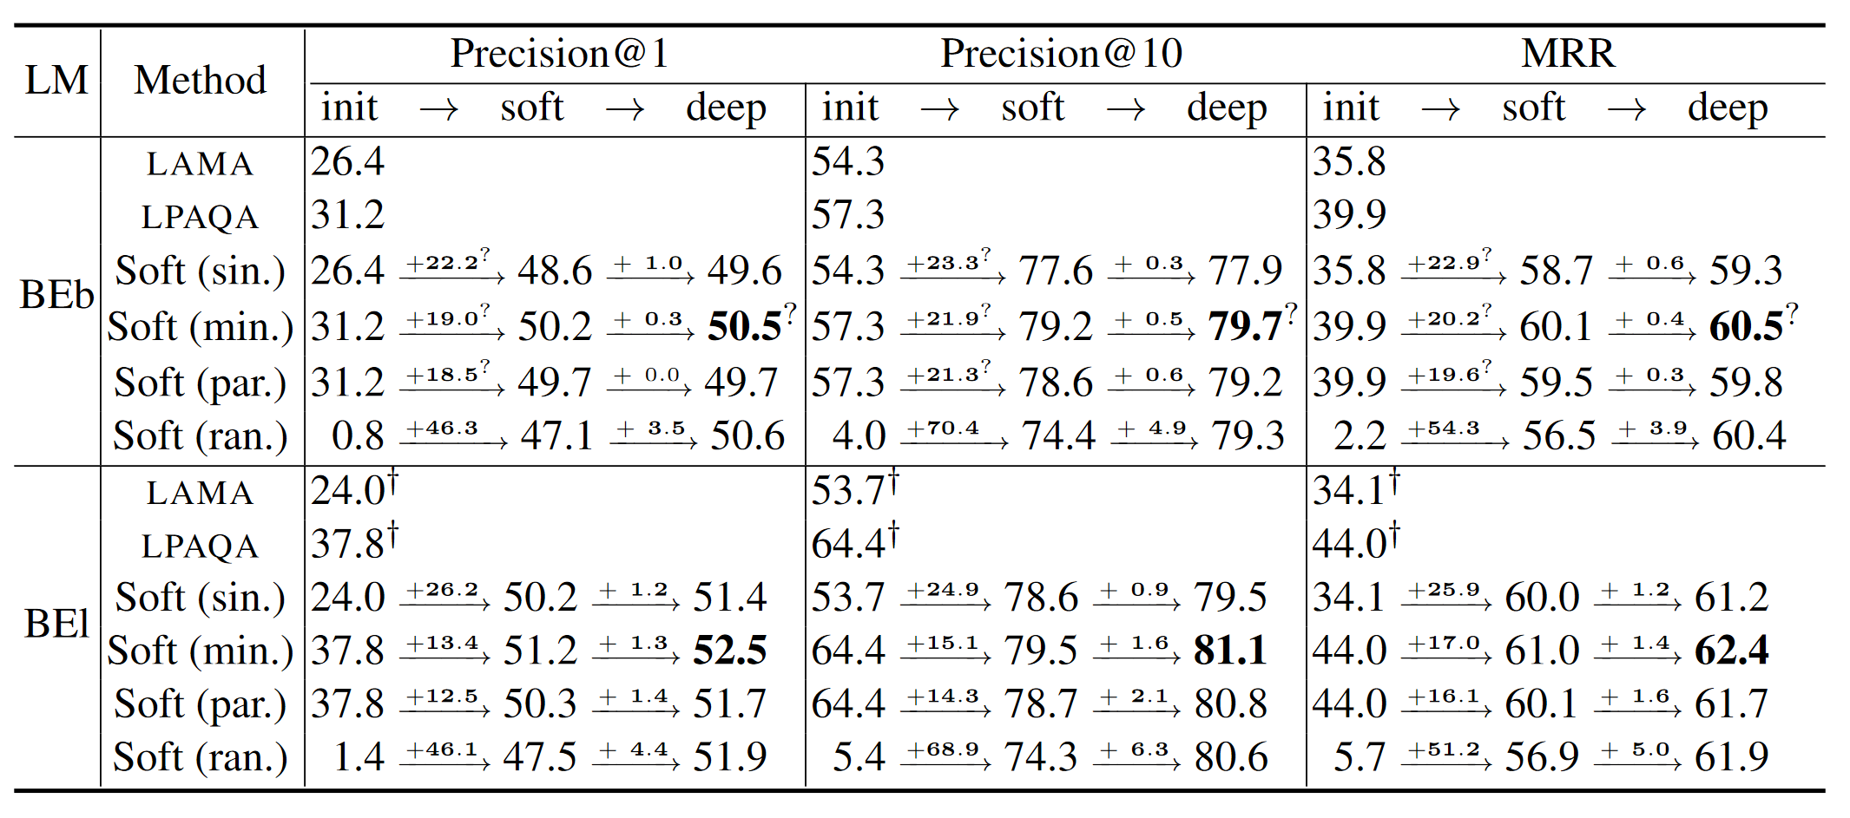
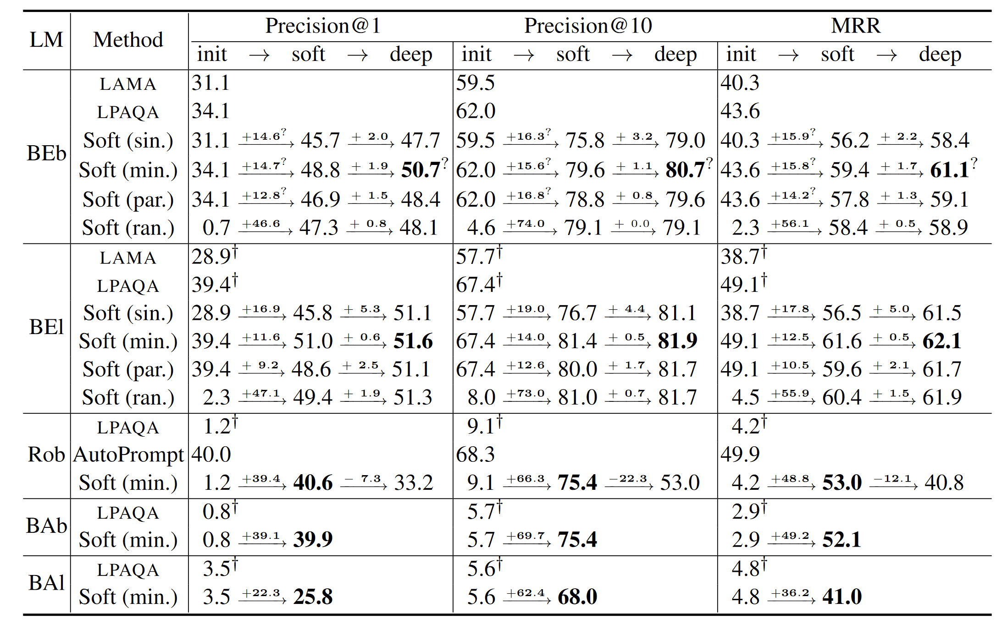
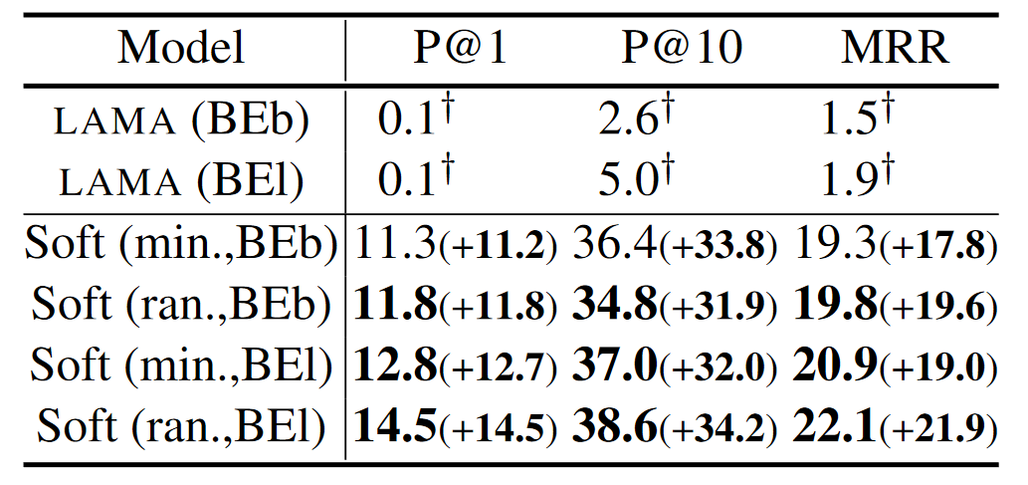
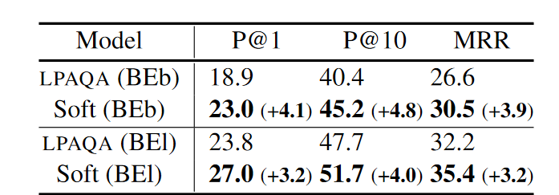
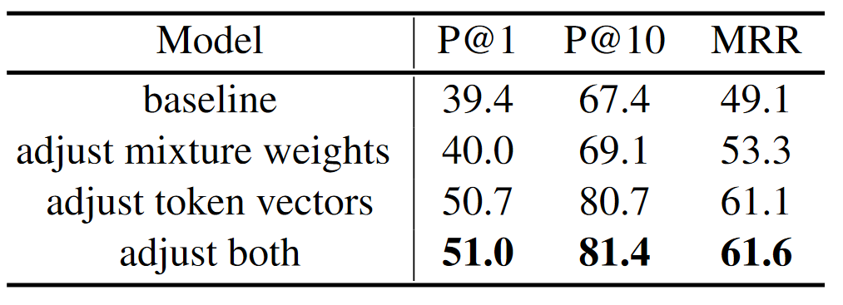
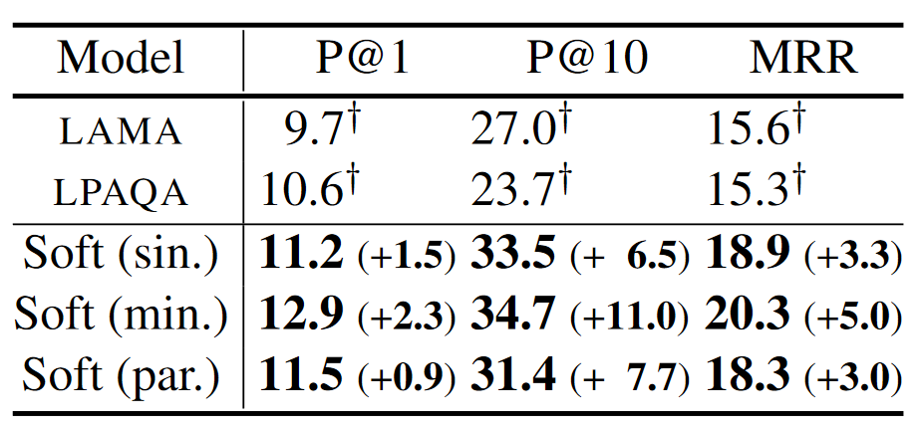
Lots of Experiments

Slide 11
Related Work
Jiang, Zhengbao, et al. "How can we know what language models know?." TACL (2020).
Shin, Taylor, et al. "AutoPrompt: Eliciting knowledge from language models with automatically generated prompts." EMNLP (2020).
Haviv, Adi, Jonathan Berant, and Amir Globerson. "BERTese: Learning to speak to BERT." EACL (2021).
Li, Xiang Lisa, and Percy Liang. "Prefix-Tuning: Optimizing Continuous Prompts for Generation." ACL (2021).
Xiao Liu, Yanan Zheng, Zhengxiao Du, Ming Ding, Yujie Qian, Zhilin Yang, and Jie Tang. GPT understands, too. arXiv (2021).

Slide 12


Takeaways
LMs know more facts than we thought. You just have to learn how to ask.
Prompts are made of vectors, not words! So you can tune them with backprop.
Random initialization works fine. No grad student required.
Prompt tuning is lightweight, and could also be applied to few-shot learning.

Slide 13
Thanks!

