Slide 1
Nugget: Neural Agglomerative Embedding for Text
Guanghui Qin & Benjamin Van Durme

Slide 2
Text representation
You can't cram the meaning of a whole @#$% sentence into a single #$%^ vector!
Ray Mooney

Slide 3
Text representation
passage-level
e.g. SBERT
token-level
e.g. ColBERT
I think , therefore I am .
A balance b/w capacity & space

Slide 4


Nugget
I think, therefore I am .
Encode texts with variable lengths of vectors called “nuggets”
Trained as autoencoder
Nuggets as bottleneck
Residual connection ensures differentiability
End-to-end training
Decoder Layers
+
“nuggets”
Logits
Transformer Encoder
I think, therefore I am .

Slide 5

Selecting nuggets
compression ratio
Select $n∙r$ of tokens
“nuggets”
Logits:
0.1
1.9
4.4
2.3
0.4
0.1
5.2
FFN
Transformer Encoder
I think, therefore I am .

Slide 6
Training nuggets
I think, therefore I am .
我思，故我在。
Autoencoding
Decoding with x-attn to nuggets
Alternatively, machine translation
Nugget selection is not differentiable!
Decoder Layers
“nuggets”
Logits
Transformer Encoder
I think, therefore I am .

Slide 7
Ensuring differentiability
I think, therefore I am .
Residual connection between logits and decoder
Plug in logits to cross attention
Decoder Layers
+
“nuggets”
Logits
logits
Transformer Encoder
cross-attn from target tokens to nuggets
I think, therefore I am .

Slide 8
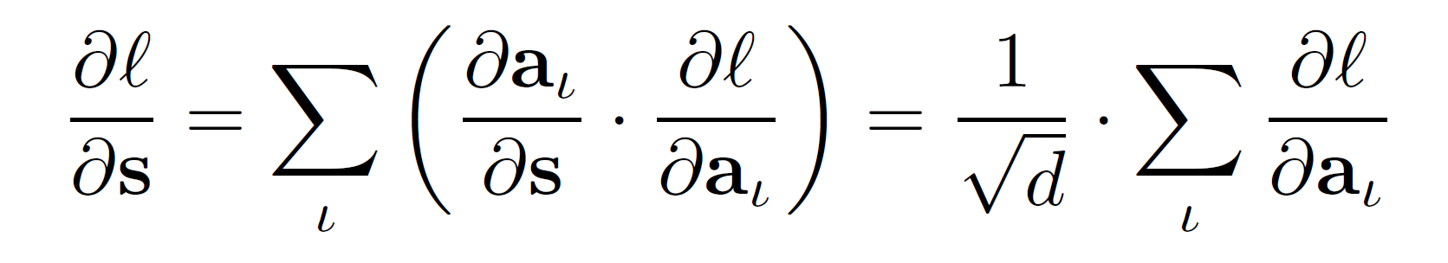
Ensuring differentiability
How does it work?
Gradients on nugget logits
Gradients on x-attn logits
Decoder pays more attention to a nugget
Nugget gets higher logits
Token has a higher chance to be selected

Slide 9
Experiment setup
Architecture: BART (checkpoint: mBART-50)
Dataset: WMT19/zh-en
Concatenate sentences to form documents up to 128 tokens
Training objectives:
Autoencoding (AE)
Machine Translation (MT)

Slide 10

Intrinsic analysis
What tokens are selected as nuggets?
What is a sufficient compression ratio $r$ ?
What is encoded in each nugget?

Slide 11
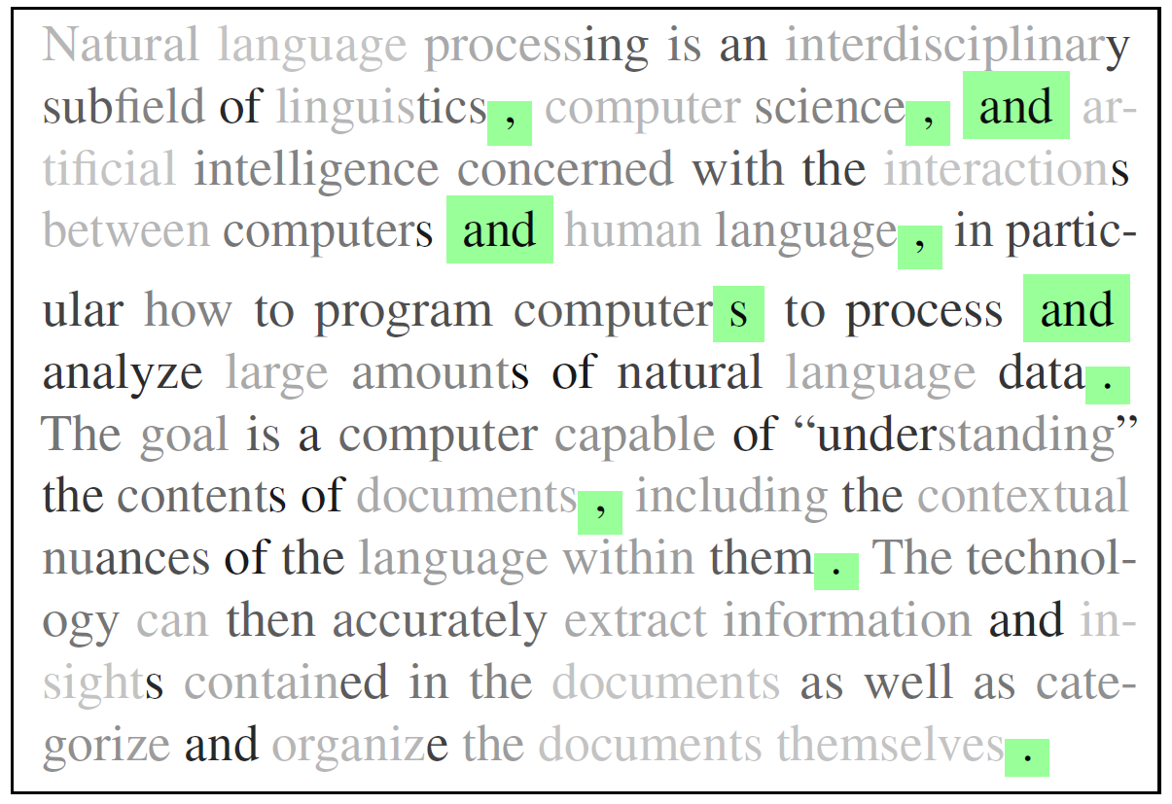
Nugget favors clausal text delimiters
Darker tokens have higher logits
Tokens in green are selected

Slide 12
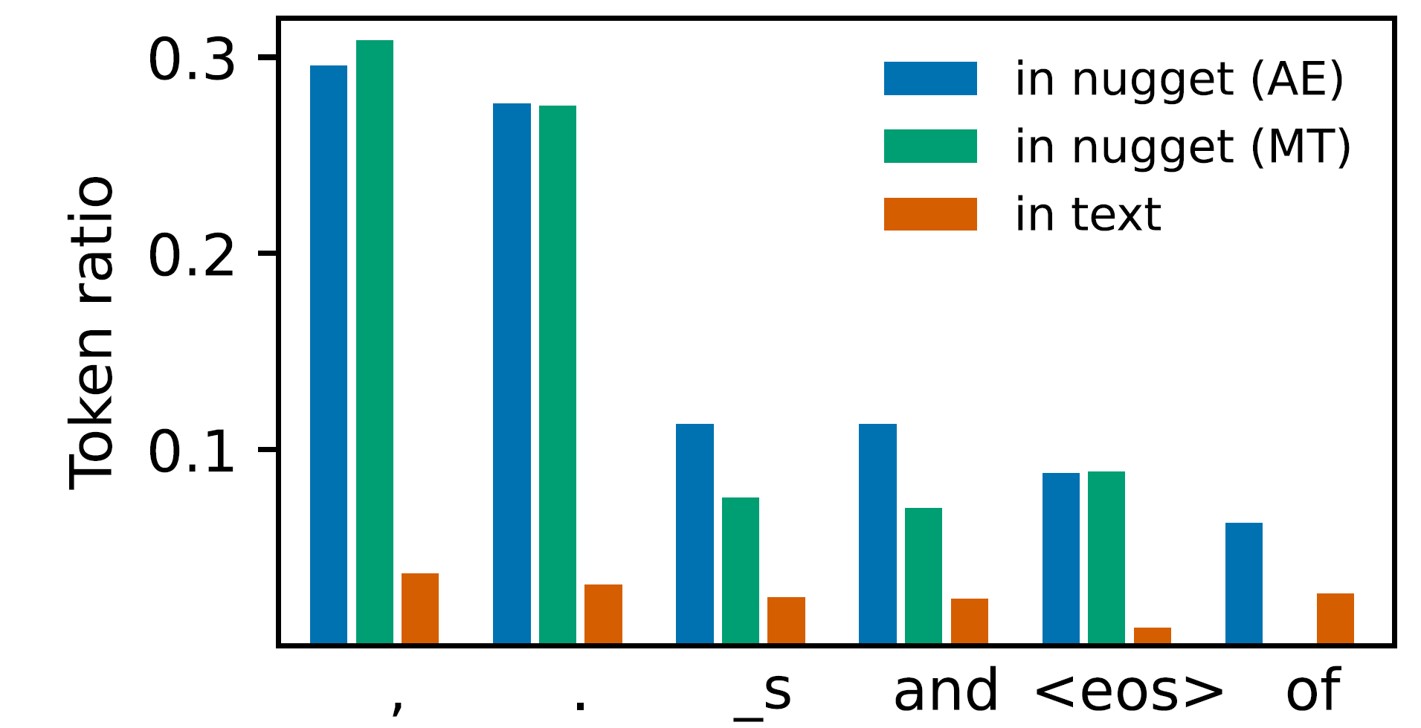
Nugget favors clausal text delimiters
Token frequency in nugget & text
Token “the” is rarely selected.
Summary tokens? Why?
Semantically “light”
Understand the preceding text, then predict the EOS.
punctuations
conjunction

Slide 13
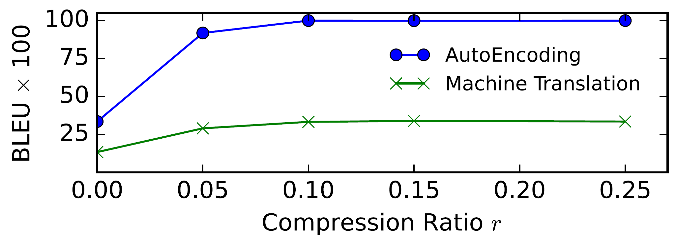
Nearly lossless encoding with 10% tokens
Nearly verbatim
single-
vector
Performance saturated

Slide 14
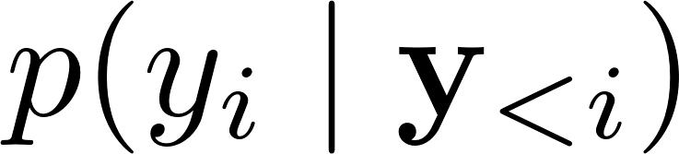
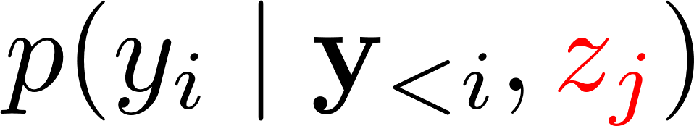


What is encoded in each nugget?
Measure the confidence of decoder on each target token
As an unconditional LM:
Conditioned on one nugget:
Probability gain:
x-attn
$p($“am” | “I think ..” $)$
$,$ $)$
Decoder
“nuggets”
I think, therefore I …

Slide 15
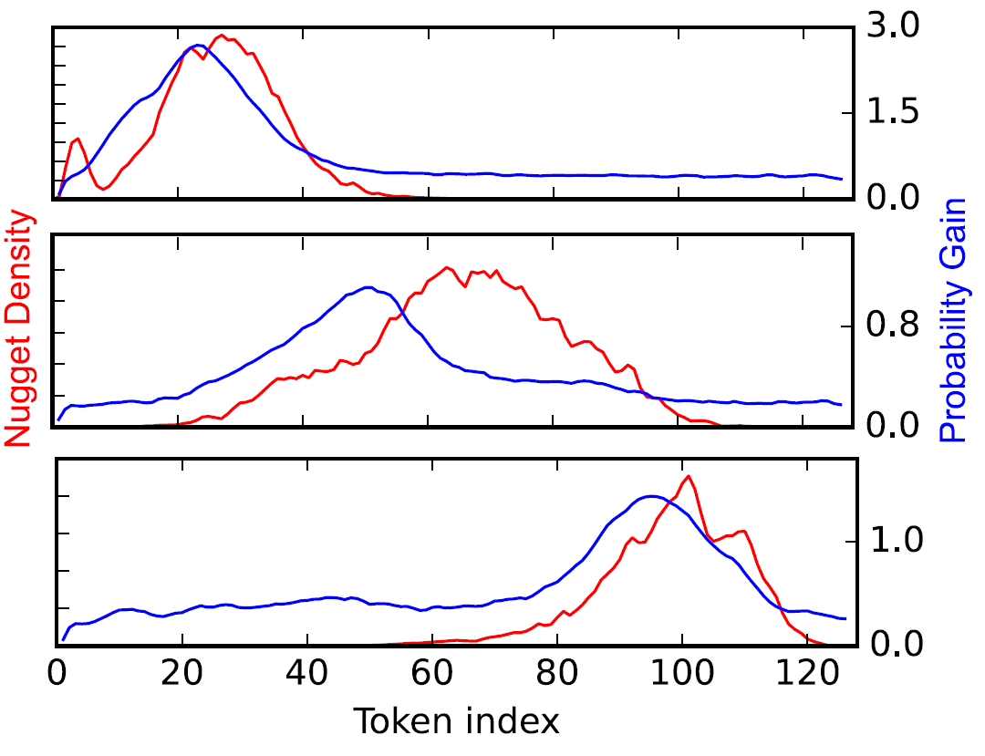
Nugget is encoding its preceding text
Location of encoded text
3rd nugget
~10 tokens behind (r=0.1)
Nugget density
Probability gain
6th nugget
Location of nuggets
9th nugget
Token index

Slide 16
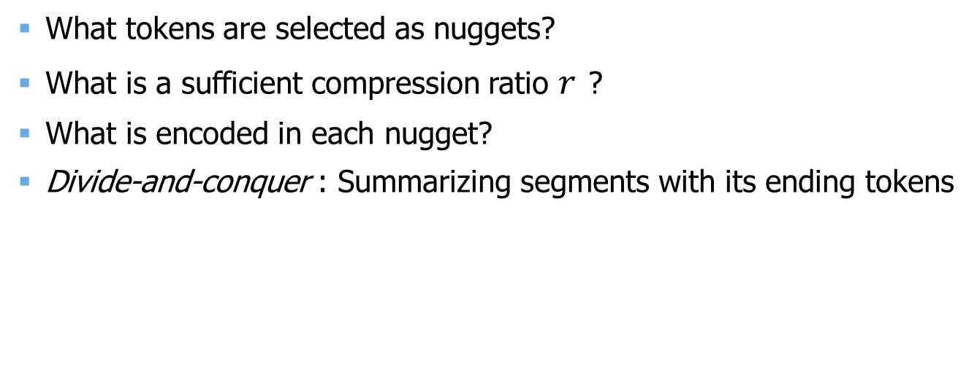
Intrinsic analysis
clausal delimiters
What tokens are selected as nuggets?
What is a sufficient compression ratio $r$ ?
What is encoded in each nugget?
Divide-and-conquer : Summarizing segments with its ending tokens
5% - 10%
preceding texts
I think , therefore I am .

Slide 17


Extrinsic evaluation: What are they good for?
Used alone: Measure similarity between documents
As an auxiliary module: Compress the context
long doc
nugget repr.
downstream

Slide 18
Document similarity test
Existing datasets (e.g. STS) are short sentences.
2 synthetic datasets with up to 256 tokens per document
Paraphrase identification (PI) built on ParaBank
Passage re-ranking (RR) built on WikiText
Task: Rank 20 candidates based on their similarity to the src doc.
src doc
candidates

Slide 19
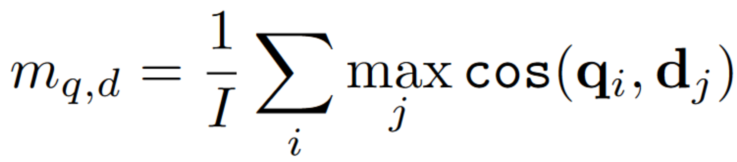
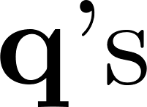
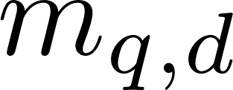

Multi-vector cosine similarity: Mean-max
query
I think , therefore I am .
Nugget
Max
Mean
Max
doc
I think , so I am .
Nugget

Slide 20
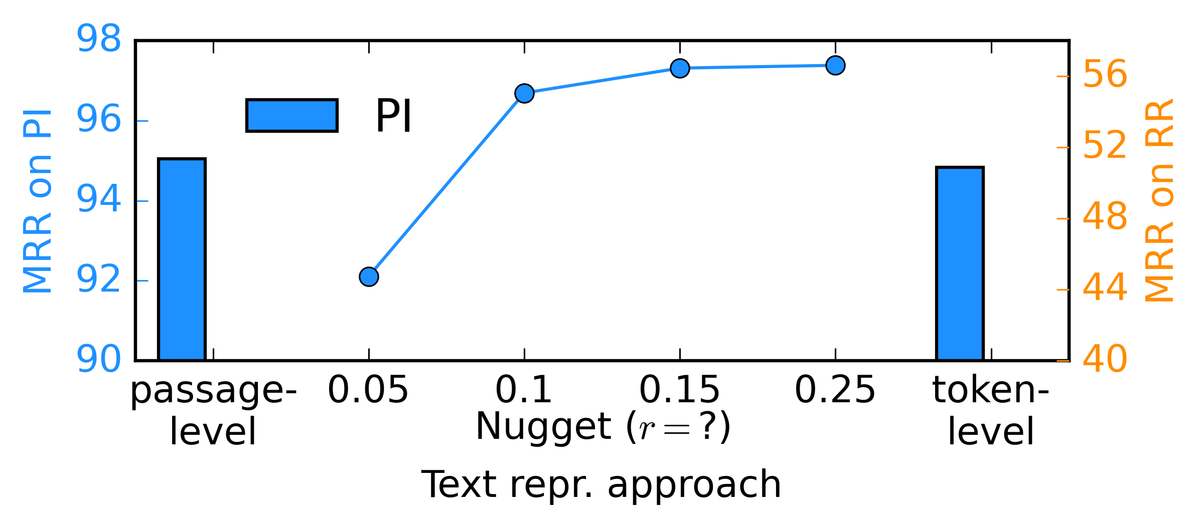
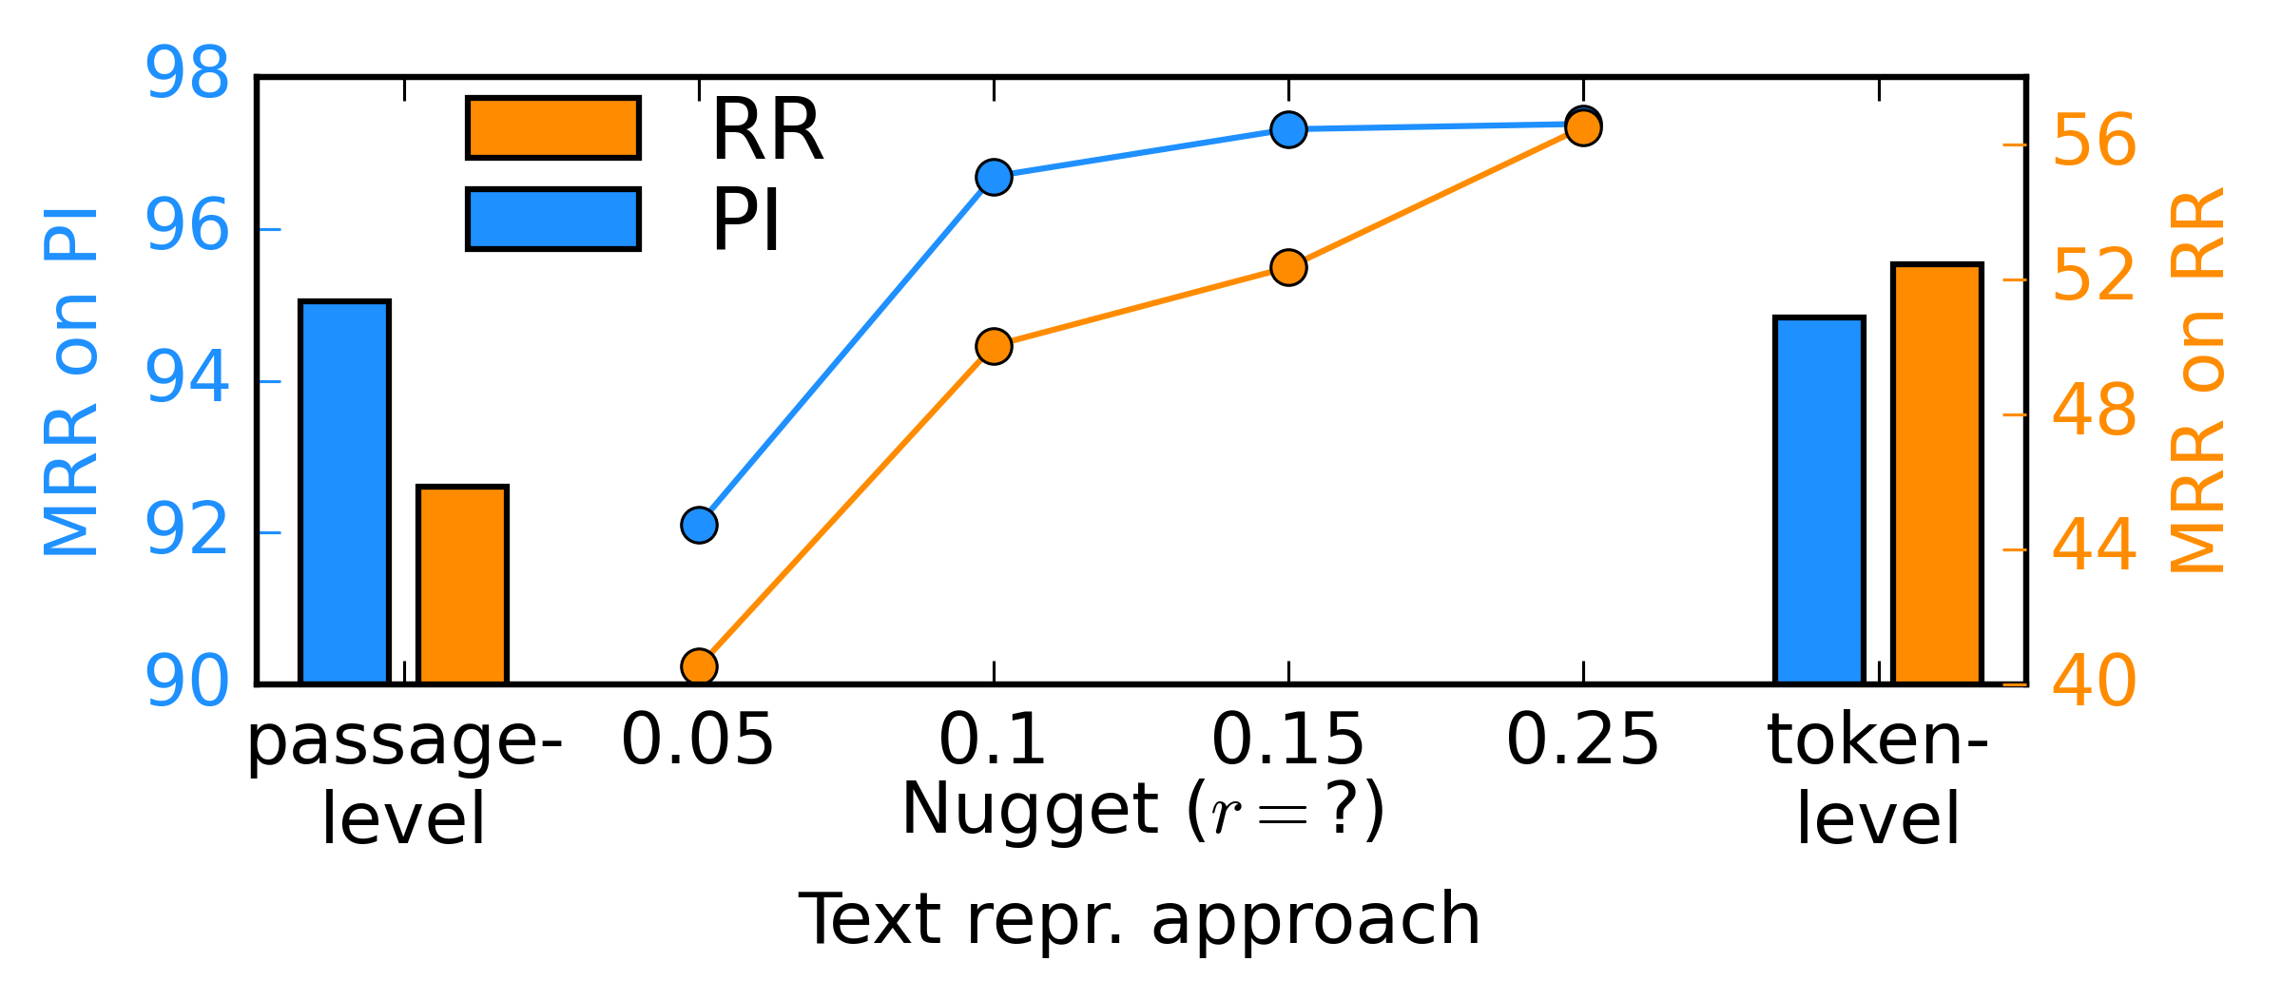
Document similarity test: Results
More nuggets help
better performance
more vectors

Slide 21

Nugget efficiently encode contexts
Transformers suffer from quadratic complexity.
Compress the history with Nugget
Nugget Encoder
Sequence Model
128 tokens
past segments
nuggets
current segment
#past segments: $h$

Slide 22
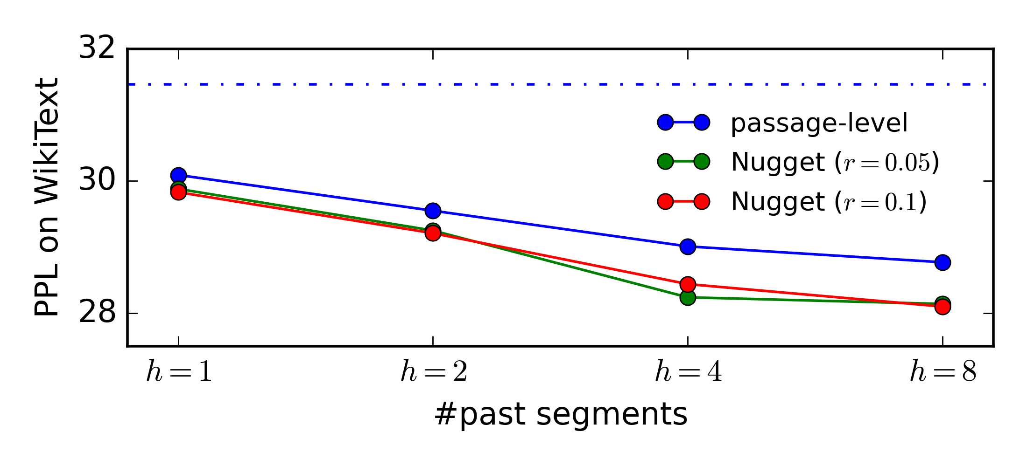

Nugget-assisted LM results
baseline $(h=0)$
better performance
more history

Slide 23
Conclusion & future work
Nugget provides certified minimal information loss with higher compression ratio.
With further training with contrastive objectives, can Nugget make information retrieval more efficient?
In-context learning is constrained by the length of context, which can be compressed by Nugget.
A step further, can LM reason over nuggets instead of natural language? Chain-of-thought with nuggets?

Slide 24
Copyright The Johns Hopkins University 2022. All rights reserved.

