Slide 1



Learning Latent Semantic Annotations for Grounding Natural Language to Structured Data
Guanghui Qin, Jin-Ge Yao, Xuening Wang, Jinpeng Wang, Chin-Yew Lin
4th Nov. 2018, EMNLP
Notes:
Hi Everyone, I’m Guanghui Qin from Peking University. Today I’ll talk about my work on grounding natural language to structured data. This work was done during my internship at Microsoft.

Slide 2
Grounded Language Acquisition
Language grounding: learning the meaning of language in the context of a world state
This work: learning semantic correspondences between texts and structured tables
Team | Wins | Losses | Points in Total | … | The Day of Week
Raptors | 33 | 15 | 120 | … | Tue.
Wizards | 15 | 17 | 116 | …
The Raptors ( 33 - 15 ) edged out the Wizards on Tuesday …
Notes:
The meaning of natural language should always be accompanied with a context.
Language grounding aims at learning the meaning of natural language in the context of a world state.
The world state could be represented by pictures, videos, or structured data.
In this work, we focus on structured tables, which records the statistics of sports games.

Slide 3
From Language to Tables
Team | Wins | Losses | Points in Total | … | The Day of Week
Raptors | 33 | 15 | 120 | … | Tue.
Wizards | 15 | 17 | 116 | …
World:
Text:
The Raptors ( 33 - 15 ) edged out the Wizards on Tuesday …
Notes:
Here we show a table about a basketball game and a few sentences describing this game.
Our goal is to establish the correspondences between natural language, and values from the table.
You may wonder if this could be partially achieved by using some simple heuristics, like number matching.
In many cases, there exist ambiguities. For instance, if there are multiple 15s in the table, then which 15 should be the one used in the sentence?
Moreover, different lexical choices in natural language actually originate from different values in the table.
For instance, the phrase “edge out”… (continued by next page)

Slide 4
From Language to Tables
Team | Wins | Losses | Points in Total | … | The Day of Week
Raptors | 33 | 15 | 120 | … | Tue.
Wizards | 15 | 17 | 116 | …
World:
Text:
The Raptors ( 33 - 15 ) edged out the Wizards on Tuesday …
Notes:
… actually corresponds to the fact that The Raptors only just won the game by a narrow margin of four points.
Therefore, we should align the phrase “edged out” to the points in the table.

Slide 5
Problem Setup
Team | Wins | Losses | Points in Total | … | The Day of Week
Raptors | 33 | 15 | 120 | … | Tue.
Wizards | 15 | 17 | 116 | …
World:
Team_Wins
Points_Delta
Date
Label:
Team_Name
Team_Losses
Team_Name
Text:
The Raptors ( 33 - 15 ) edged out the Wizards on Tuesday …
Notes:
Establishing the correspondence between table cells and text spans could be difficult.
In this preliminary work, we model this process in a sequence labeling framework.
Each label here, corresponds to a certain piece of information in the table.
For example, we define a label called Team_Wins, which represents the total number of previous wins for each team.
This alignment means that the number 33 in the sentence below, corresponds to the number of wins from the table.

Slide 6
Problem Setup
Team_Wins
Points_Delta
Date
Labels:
Team_Name
Team_Losses
Team_Name
Text:
The Raptors ( 33 - 15 ) edged out the Wizards on Tuesday …
NULL
Notes:
Some functional words , such as determiners and prepositions, and also most of the punctuations, do not contain any real contextual meanings.
Also, some sentences might describe information outside the table, because the tables and texts we used here were actually collected from two different sources.
For both cases, text spans should remain unaligned. We define a special NULL tag to label these unaligned words.

Slide 7
Problem Setup
Team | Wins | Losses | Points in Total | … | The Day of Week
Raptors | 33 | 15 | 120 | … | Tue.
Wizards | 15 | 17 | 116 | …
A world: s =
An executable tag:
$$Tag \left( \right)=Result Set$$
Team | Wins | Losses | Points in Total | … | The Day of Week
Raptors | 33 | 15 | 120 | … | Tue.
Wizards | 15 | 17 | 116 | …
Examples:
Team_Name ( S ) = {“Raptors”, “Wizards”}
Points_Delta ( S ) = { 4 }
Notes:
The tags are induced from the table schema. We have a set of tags, and they could be executed on a table and output a result set.
For example, the tag Team_Name could return the name of each team.
We also define a tag Points_Delta, which could output the score difference between two teams, and for this table, the result is a-hundred-and-twenty minus a-hundred-and-sixteen, which is four.

Slide 8
Hidden Semi-Markov Models
observed words
tags
world state: tables
dataset
segmentations
segments
Notes:
To jointly induce word segmentations and latent semantic annotations in a unified framework, we propose a generative model.
We sample world state s and observed words w from dateset D.
For each instance, we sum up all of its possible segmentations and annotations.
Given the segmentation pi, we could use letter c to represent the segments.
We impose the first-order Markovian assumption into our model, which leads to the equation at the bottom.

Slide 9
Hidden Semi-Markov Models
Team_Name
Team_Wins
Team_Losses
Points_Delta
Team_Name
NULL
NULL
NULL
NULL
NULL
NULL
Date
The
Raptors
(
33
-
15
)
edge out
the
Wizards
on
Tuesday
segments
transition probabilities
emission probabilities
tags
Notes:
This formulation resembles a standard HMM. The first term is the transition probabilities and the second term could be regarded as the emission probabilities.
Keep in mind that our model assigns tags to word spans, or the segments, instead of individual words.
So the emission probabilities are modeled from a tag l to a segment c.

Slide 10
Hidden Semi-Markov Models
Executable Tags
Team_Name
Team_City
Player_Name
…
Points_Delta
Team_Wins
Player_Rebounds
…
Sun.
Mon.
…
Sat.
Date
Player_Position
Output Strings (4)
Output Numbers (43)
Output Categorical Values (2)
Texts
The Raptors ( 33 - 15 ) edged out the Wizards in Tuesday …
numbers
strings
Notes:
The tags can be grouped according to the different types of their output.
There are three types of outputs: strings, real numbers, and categorical values.
Categorical values are some discrete values. E.g., the tag Date could output 7 values, from Sun. to Saturday.
The words in the texts are classified into 2 types, strings and numbers.

Slide 11
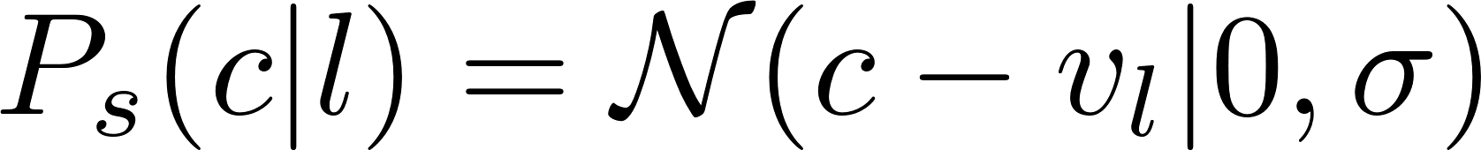
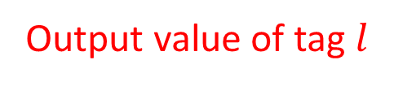
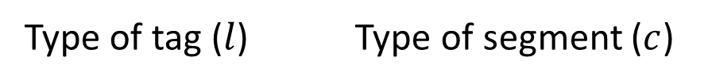
Hidden Semi-Markov Models
Type of tag ($l$) Type of segment ($c$)
Output value of tag $l$
Numbers Numbers
Strings Strings
String Matching
Categorical distribution
Categorical values Strings
Numbers Strings
Gaussian mixture
Notes:
For different types of tags and segments, we use different distributions to model the emission probabilities.
If the tag output and the segment are both numbers, we use a Gaussian distribution with small variance.
If the tag output and the segment are both strings, it is natural to model this with string matching.
If the tag outputs categorical values, we just model it as a categorial (multinomial) distribution as in previous work.
The last case is, when the tag outputs numbers and the segment is strings, we adopt Gaussian mixture model.

Slide 12
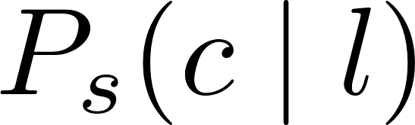
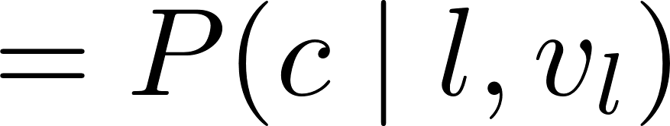

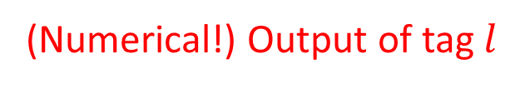
Hidden Semi-Markov Models
Type of tag ($l$) Type of segment ($c$)
Numbers Strings
Bayes rule
(Numerical!) Output of tag $l$
Notes:
To derive the last term, we just revise the emission probability using the Bayes rule.
The first term of the decomposition is modeled as Gaussian, and the second term is modeled by categorical distribution.
The intuition is that people use different lexical terms to describe different numerical values.
For example, if the reporter used the word “routed”, it is more likely that the score difference was 30 rather than 3.

Slide 13
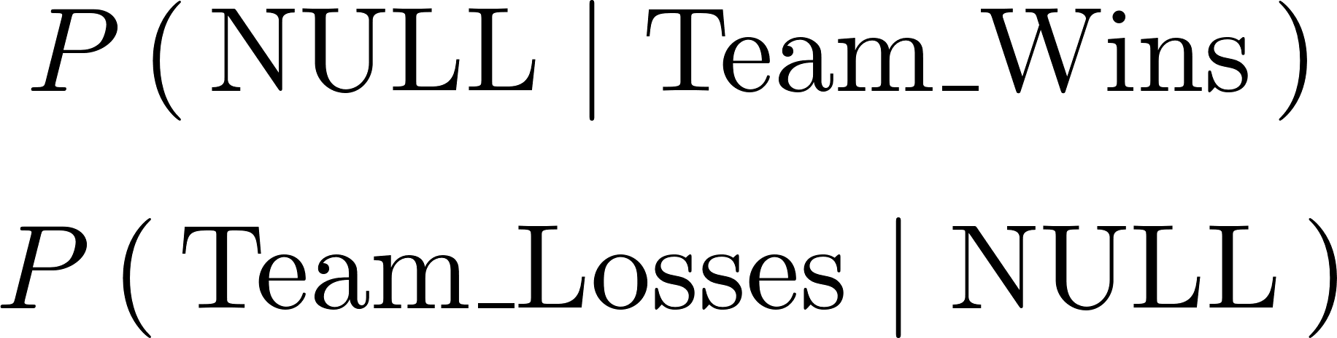
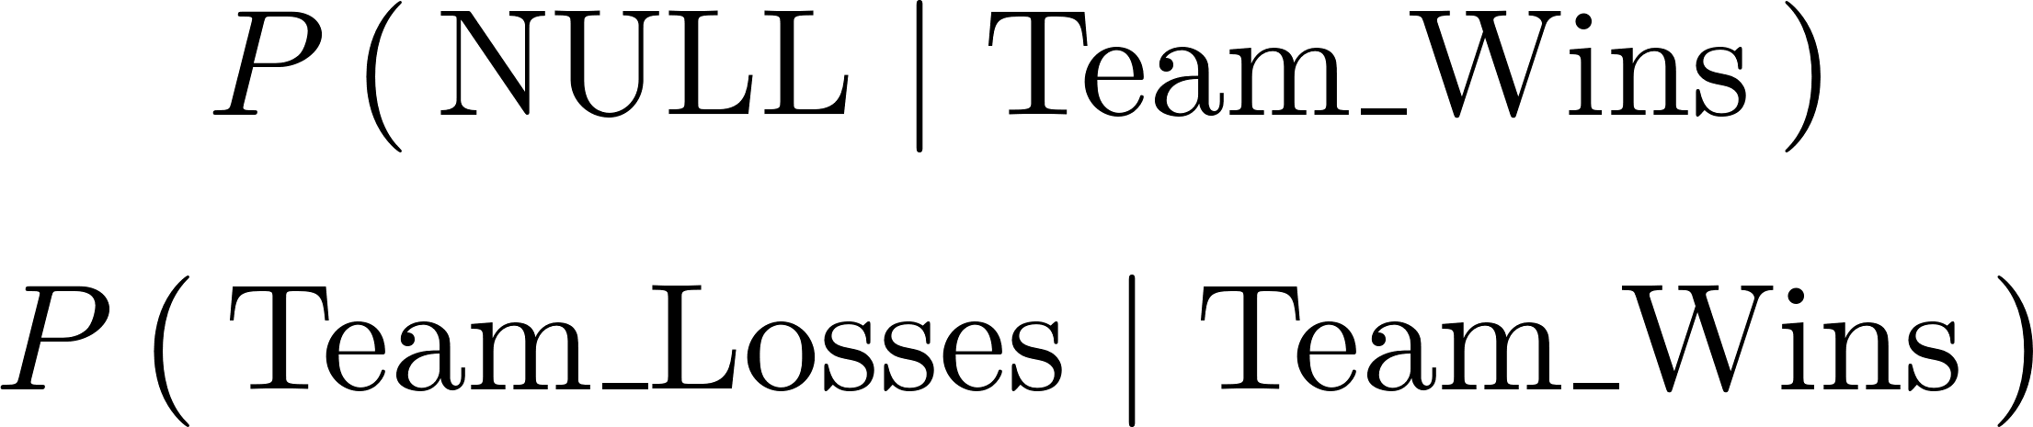
Skipping NULL Tags
Team_Name
Team_Wins
Team_Losses
Points_Delta
Team_Name
NULL
NULL
NULL
NULL
NULL
NULL
Date
The
Raptors
(
33
-
15
)
edge out
the
Wizards
on
Tuesday
Notes:
The NULL tags could be very troublesome, since they could intercept the Markov transition probabilities.
In this case, a dash mark is sandwiched between the team wins and losses.
So we have to calculate the transition probability from NULL tag to team losses.
However, this transition probability might be less informative than that from team losses to team wins. So we make our model skip all the null tags when calculating the transition probabilities.

Slide 14
The Issue of “Garbage Collection”
(
the
Team Win Delta
next game
and
win streak
Team Rebounds Delta
from
)
of
Player Offensive Rebounds
Non-informative words
or
Information outside the table
Tail tags
Notes:
In the ideal case, all those non-informative words should be assigned with NULL tags.
However, we found that in our initial experiments, many words tend to be labels by tail tags rather than NULL tag.
And this is known as garbage collection issue on statistical models for word alignment.

Slide 15
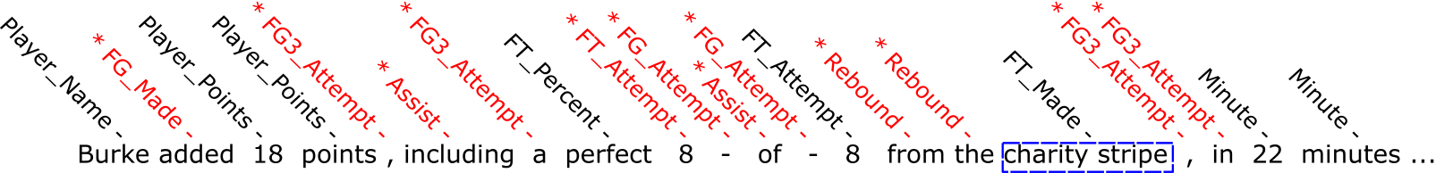
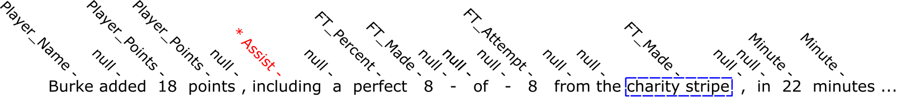
Solution: Injecting Statistical Constraints
Black: Correct! *Red: Wrong!
Notes:
So it’s good to constraint our model. This inequality encourages our model assign at least a certain portion of NULL tags on the text spans. The ratio r_0, is an adjustable variable, and in our experiments, we simply set it as ½.
As we can see, some non-informative words are successfully assigned with NULL tags.
Some other annotations are also benefited. There are two number 8’s in the sentence, but they have different meanings. The first 8 is the free throw the player made, and the second 8 is that he tried.
Before we constraint, our model is unable to distinguish the two 8’s from each other.
However, after the constraint, with the help of transition probabilities calculated by skipping the null tags, our model successfully assign the correct tags on these two numbers.

Slide 16
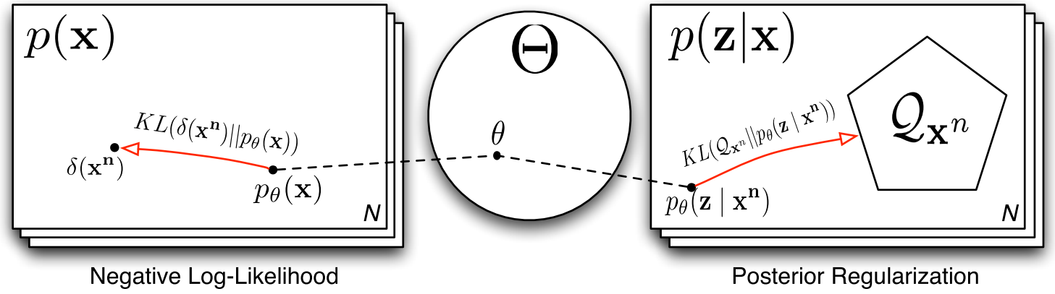
Solution: Injecting Statistical Constraints
Posterior Regularization
Notes:
But how can we apply the constraint to our model?
We adopt a commonly-used method for EM algorithm, that is, posterior regularization.
Due to the time limit, I will not go through the details of this method.
Essentially, this is a framework to introduce certain types of soft statistical constraints to a latent variable model, while keeping the training and inference tractable.

Slide 17
Results
Models | Precision | Recall | F1
Liang 2009 | 0.319 | 0.643 | 0.426
Semi-HMMs | 0.254 | 0.765 | 0.381
Liang 2009 + posterior regularization | 0.397 | 0.640 | 0.490
Semi-HMMs + posterior regularization | 0.504 | 0.786 | 0.614
Notes:
For evaluation, we hire three annotators with familiarity in basketball terms to annotate hundreds of sentences and evaluate our model on these annotated data.
We compare our model to Liang 2009, who originally tries to capture the semantic correspondences between structured data and texts.
Liang 2009 is a hierarchical model, which is different from our method.
Although Liang2009 considers less types of correspondences, that’s the reason they suffer less from GCI and get a higher precision than us.
However, this issue is resolved by adding PR, and we get a big improvement.

Slide 18
Ablation Studies
Models | Precision | Recall | F1
Semi-HMMs + PR | 0.504 | 0.786 | 0.614
- Semi | 0.545 | 0.694 | 0.610
- Transition | 0.468 | 0.633 | 0.538
- NULL-Skipping | 0.454 | 0.737 | 0.562
Team_Name
Team_Wins
Team_Losses
Points_Delta
Team_Name
NULL
NULL
NULL
NULL
NULL
NULL
Date
The
Raptors
(
33
-
15
)
edge out
the
Wizards
on
Tuesday
Notes:
We also conducted ablation studies.
This is our original model, hidden semi Markov model

Slide 19
Ablation Studies
Models | Precision | Recall | F1
Semi-HMMs + PR | 0.504 | 0.786 | 0.614
- Semi | 0.545 | 0.694 | 0.610
- Transition | 0.468 | 0.633 | 0.538
- NULL-Skipping | 0.454 | 0.737 | 0.562
Team_Losses
Points_Delta
Team_Name
Team_Wins
Points_Delta
Team_Name
NULL
NULL
NULL
NULL
NULL
NULL
Date
The
Raptors
(
33
-
15
)
edge out
the
Wizards
on
Tuesday
Notes:
First of all, we try to replace our model with an ordinary HMM.
In this, our model tried to assign tag on individual words, instead of word spans.
As we can see, the precision is boosted and recall is hurt. As a whole result, the F1 score is a little bit hurt.

Slide 20
Ablation Studies
Models | Precision | Recall | F1
Semi-HMMs + PR | 0.504 | 0.786 | 0.614
- Semi | 0.545 | 0.694 | 0.610
- Transition | 0.468 | 0.633 | 0.538
- NULL-Skipping | 0.454 | 0.737 | 0.562
Team_Name
Team_Wins
Team_Losses
Points_Delta
Team_Name
NULL
NULL
NULL
NULL
NULL
NULL
Date
The
Raptors
(
33
-
15
)
edge out
the
Wizards
on
Tuesday
Notes:
For the 2nd study, we tried to remove the transition probabilities. Apparently the result drops dramatically.

Slide 21
Ablation Studies
Models | Precision | Recall | F1
Semi-HMMs + PR | 0.504 | 0.786 | 0.614
- Semi | 0.545 | 0.694 | 0.610
- Transition | 0.468 | 0.633 | 0.538
- NULL-Skipping | 0.454 | 0.737 | 0.562
Team_Name
Team_Wins
Team_Losses
Points_Delta
Team_Name
NULL
NULL
NULL
NULL
NULL
NULL
Date
The
Raptors
(
33
-
15
)
edge out
the
Wizards
on
Tuesday
Notes:
We also tied to get rid of the NULL skipping trick, which also hurts the overall performance

Slide 22
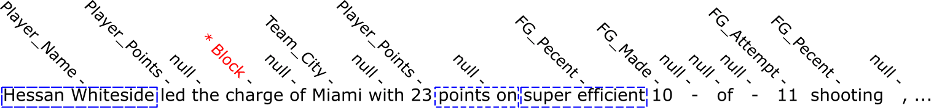
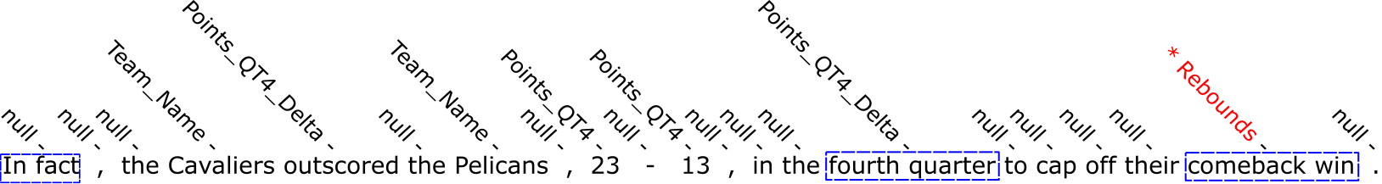
Examples of Tags Assignment
Notes:
Here we show some examples of our tag assignments. In the first case, our model assigns a tag FG percent to the phrase “super efficient”.
The player Hessan is super efficient since his field goal percentage is very high in that game.
In the second instance, the cavaliers outscored the Pelicans in the fourth quarter, and this fact could be derived from the score difference in the fourth quarter, thus our model assign a Points quarter 4 delta to the word outscore.

Slide 23
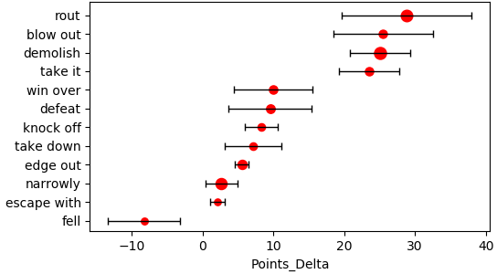
Inducing lexical choices
Top 12 Phrases Aligned to Points_Delta
fell < escape with < narrowly < … < demolish < blow out < rout
Notes:
We also find that the induced alignments could reflect interesting patterns of lexical choices.
Here we list the top twelve word spans aligned to tag Points_Delta.
All these twelve word spans are related to describe the score difference.
Each point here represents a word span, and they are listed along the y axis, and x is the mean and standard deviation of that span estimated by our model.
It’s interesting to find that a reporter tends to use the phrase “demolish”, “blow out” or “rout” to describe the results when the score difference is very large, and use phrases “escape with”, “narrowly” and “edge out” only when the score difference is rather small.

Slide 24




Application: Template Induction
The <STR> got off to a quick start in this one with <NUM> - <NUM>.
Trigger: Quarter_1_Points_Delta $=8.5±3.1$
Slot: Team_Name
Slot: Quarter_1_Points
Given a world $s$
Quarter_1_Points_Delta ($s$) $=10$
Team_Name (s) = {“Raptors”}
Quarter_1_Points (s) = {34, 24}
The Raptors got off to a quick start in this one with 34 – 24 .
See also:
Data2Text Studio: Automated Text Generation from Structured Data, now at Session 9E (Posters and Demos)
Notes:
As an interesting application, we use the outputs of our model to induce the templates for data-to-text generation.
The templates consist of three parts, slots, triggers and other words.
The slots will be filled with strings and numbers, and the triggers decide when to use this template.
In this example, we have three slots and one trigger.
The trigger is derived from the alignment of the phrase quick start and the tag Quarter one points delta, which means the score difference between two team in the first quarter.
The trigger could give a confidence range, which is around 8.5 in this case.
Given our current world, we execute the tag Quarter one points delta in this world, and we get 10, which is within that range.
So the system likes template and fill in the slots.

Slide 25
Summary
Learning executable latent semantic annotations for grounding texts to tables
Framework: semi-HMMs + NULL-skipping + posterior regularization
Can be used to induce templates for data-to-text generation.
Notes:
In summary, our work provides a preliminary study on learning executable latent semantic annotations for grounding text to structured tables.
Our framework is simple and efficient, implemented as a hidden semi-Markov model with constraints from posterior regularization.
As a simple application, our model could be used for template induction and data-to-text generation, with trigger mechanism to guarantee the correctness of our output sentences.

Slide 26
Thanks !
Notes:
So that’s all for my talk.
Thanks for your attention and I’ll be happy to take some questions.

Slide 27
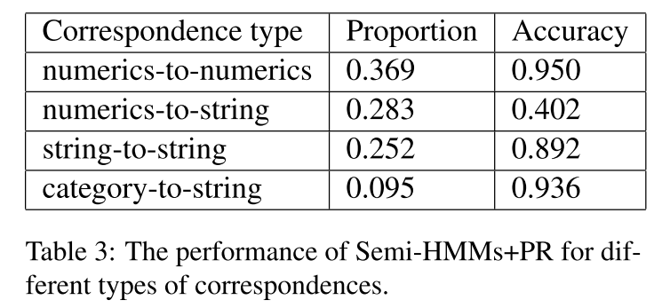

Slide 28
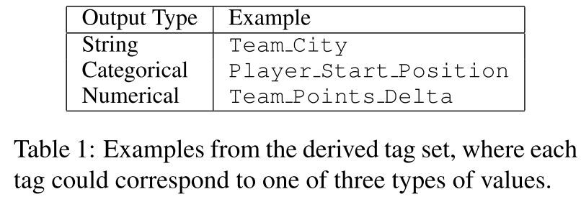

Slide 29
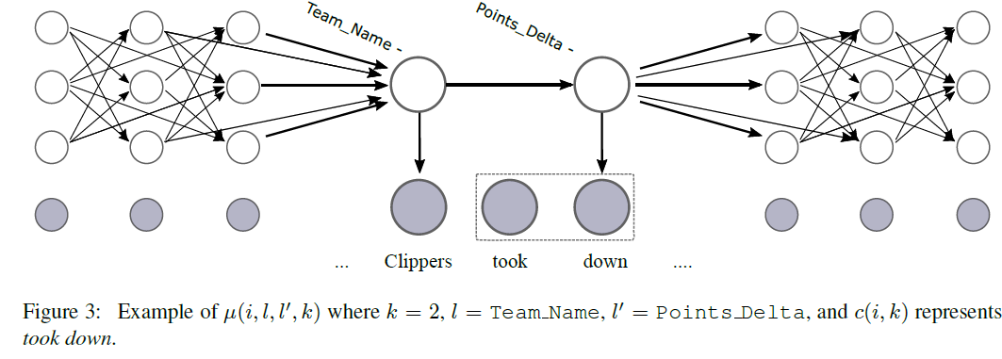

Slide 30
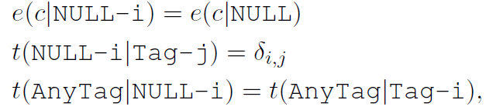

Slide 31
Related Work
Learning semantic correspondences [Liang et al., 2009; Chen and Mooney, 2008; Koncel-Kedziorski et al., 2014; inter alia]
Executable semantic parsing [Zettlemoyer and Collins, 2005; Artizi and Zettlemoyer, 2013; inter alia]
QA over semi-structured tables [Pasupat and Liang, 2015]
Fine-grained NER [Ling and Weld, 2012; Choi et al., 2018; inter alia]
Data-to-Text generation [Angeli et al., 2010; Mei et al., 2016; Wiseman et al. 2017; inter alia]
Notes:
There are plenty of work related to learning semantic correspondences between structured data and texts.
They cover the domains from weather forecasts to event records in sports games.
But as far as we know, our work is the first one trying to capture the relationship between lexical terms and numerical values.
Our work is also highly related to executable semantic parsers under weak supervision, especially for the settings of question answering over semi-structured tables.
Our approach resembles fine-grained named entity recognition, since we are also trying to assign labels over text spans.
Our work is feasible due to the availability of data, which mostly come from those originally collected for data-to-text generation.

Slide 32
Overview
Goals
Learning the explicit latent alignments between structured data and texts
Automatically segment the texts
Approaches
Unsupervised learning: Hidden Semi-Markov models
Trick: NULL-skipping
Soft constraint: posterior regularization
By-product
Induct the template for data-to-text generation
Notes:
Generally speaking, we’re trying to find the latent semantic alignments between structured data and texts in the phrase level.
Especially we’re interested in the correspondence between the numerics in the data and the strings in the texts.
There is no annotations in the raw data, which means unsupervised learning should be conducted.
We adopt a hidden semi-Markov model to address this problem.
We further impose NULL-skipping trick and soft constraint to our model to improve the results.
As a by-product, we use our annotations to induce templates for data-to-texts generation, and get some positive results.

