Slide 1
The NLP Task Effectiveness of Long-Range Transformers
Guanghui Qin, Yukun Feng, Benjamin Van Durme

Slide 2
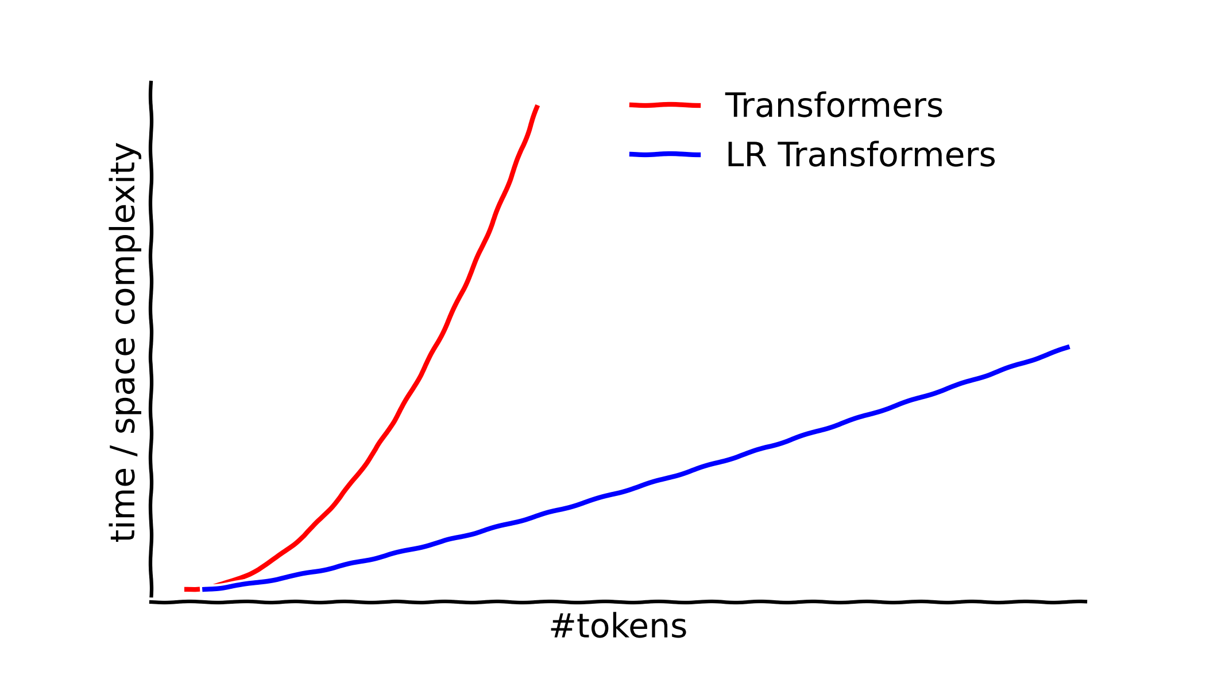
Challenge of long documents
Long doc: Explode
Long range transformers
Short doc: SOTA

Slide 3

Variants of Long-Range Transformers
Recurrence
Attention to previous states
Sparse pattern
Possibly with a global token
Kernel Approximation
Self-attention block

Slide 4



NLP Effectiveness
Recurrence
Pattern
Kernel
3 Variants
Efficiency
Effectiveness
Coreference Resolution
Natural Language Inference
Extractive QA
Abstractive QA
Summarization
Long Range Arena
Language Modeling
Protein Sequence
…
5 Tasks
7 Datasets
Previous: Non-NLP benchmark
Our work: Extensive NLP experiments

Slide 5

Methodology
Cross-model benchmark
We focus on long-range attention
Confounders:
model size / architecture
Ablate long-range attention
Model lacks pretraining
Migrate parameters

Slide 6
Overall Performance
How?
Why?
LR Transformers help when…
They hurt performance for…
Historical states are present.
Explicit query exists.
Task formulated as seq2seq.
Common Token-/span-level tasks.
Sequence classification.
Kernel methods.

Slide 7
Recurrence helps, but can do better
Does it work?
With Recurrence
Does it exploit past hidden states?
Contribution of each segment

Slide 8

Selectivity improved for summarization
Intuitively, a summarizer should skim over the document selectively.
Consistently low entropy
We suppose:
Global Information
Lower Entropy
Greater Selectivity

Slide 9

Global tokens make query more attended
We care queries for QA:
Setting as global tokens
Queries make more contribution with GTs
Being globally visible
More attended

Slide 10
Error accumulation of kernel approximation
Kernel methods failed. Can’t we trust the approximation?
Kernelize n BERT layers
Use f random features
Fewer features work as well
Deep kernel layers cause catastrophic error accumulation

Slide 11
Thanks!

Slide 13
Self-attention block

