Slide 1

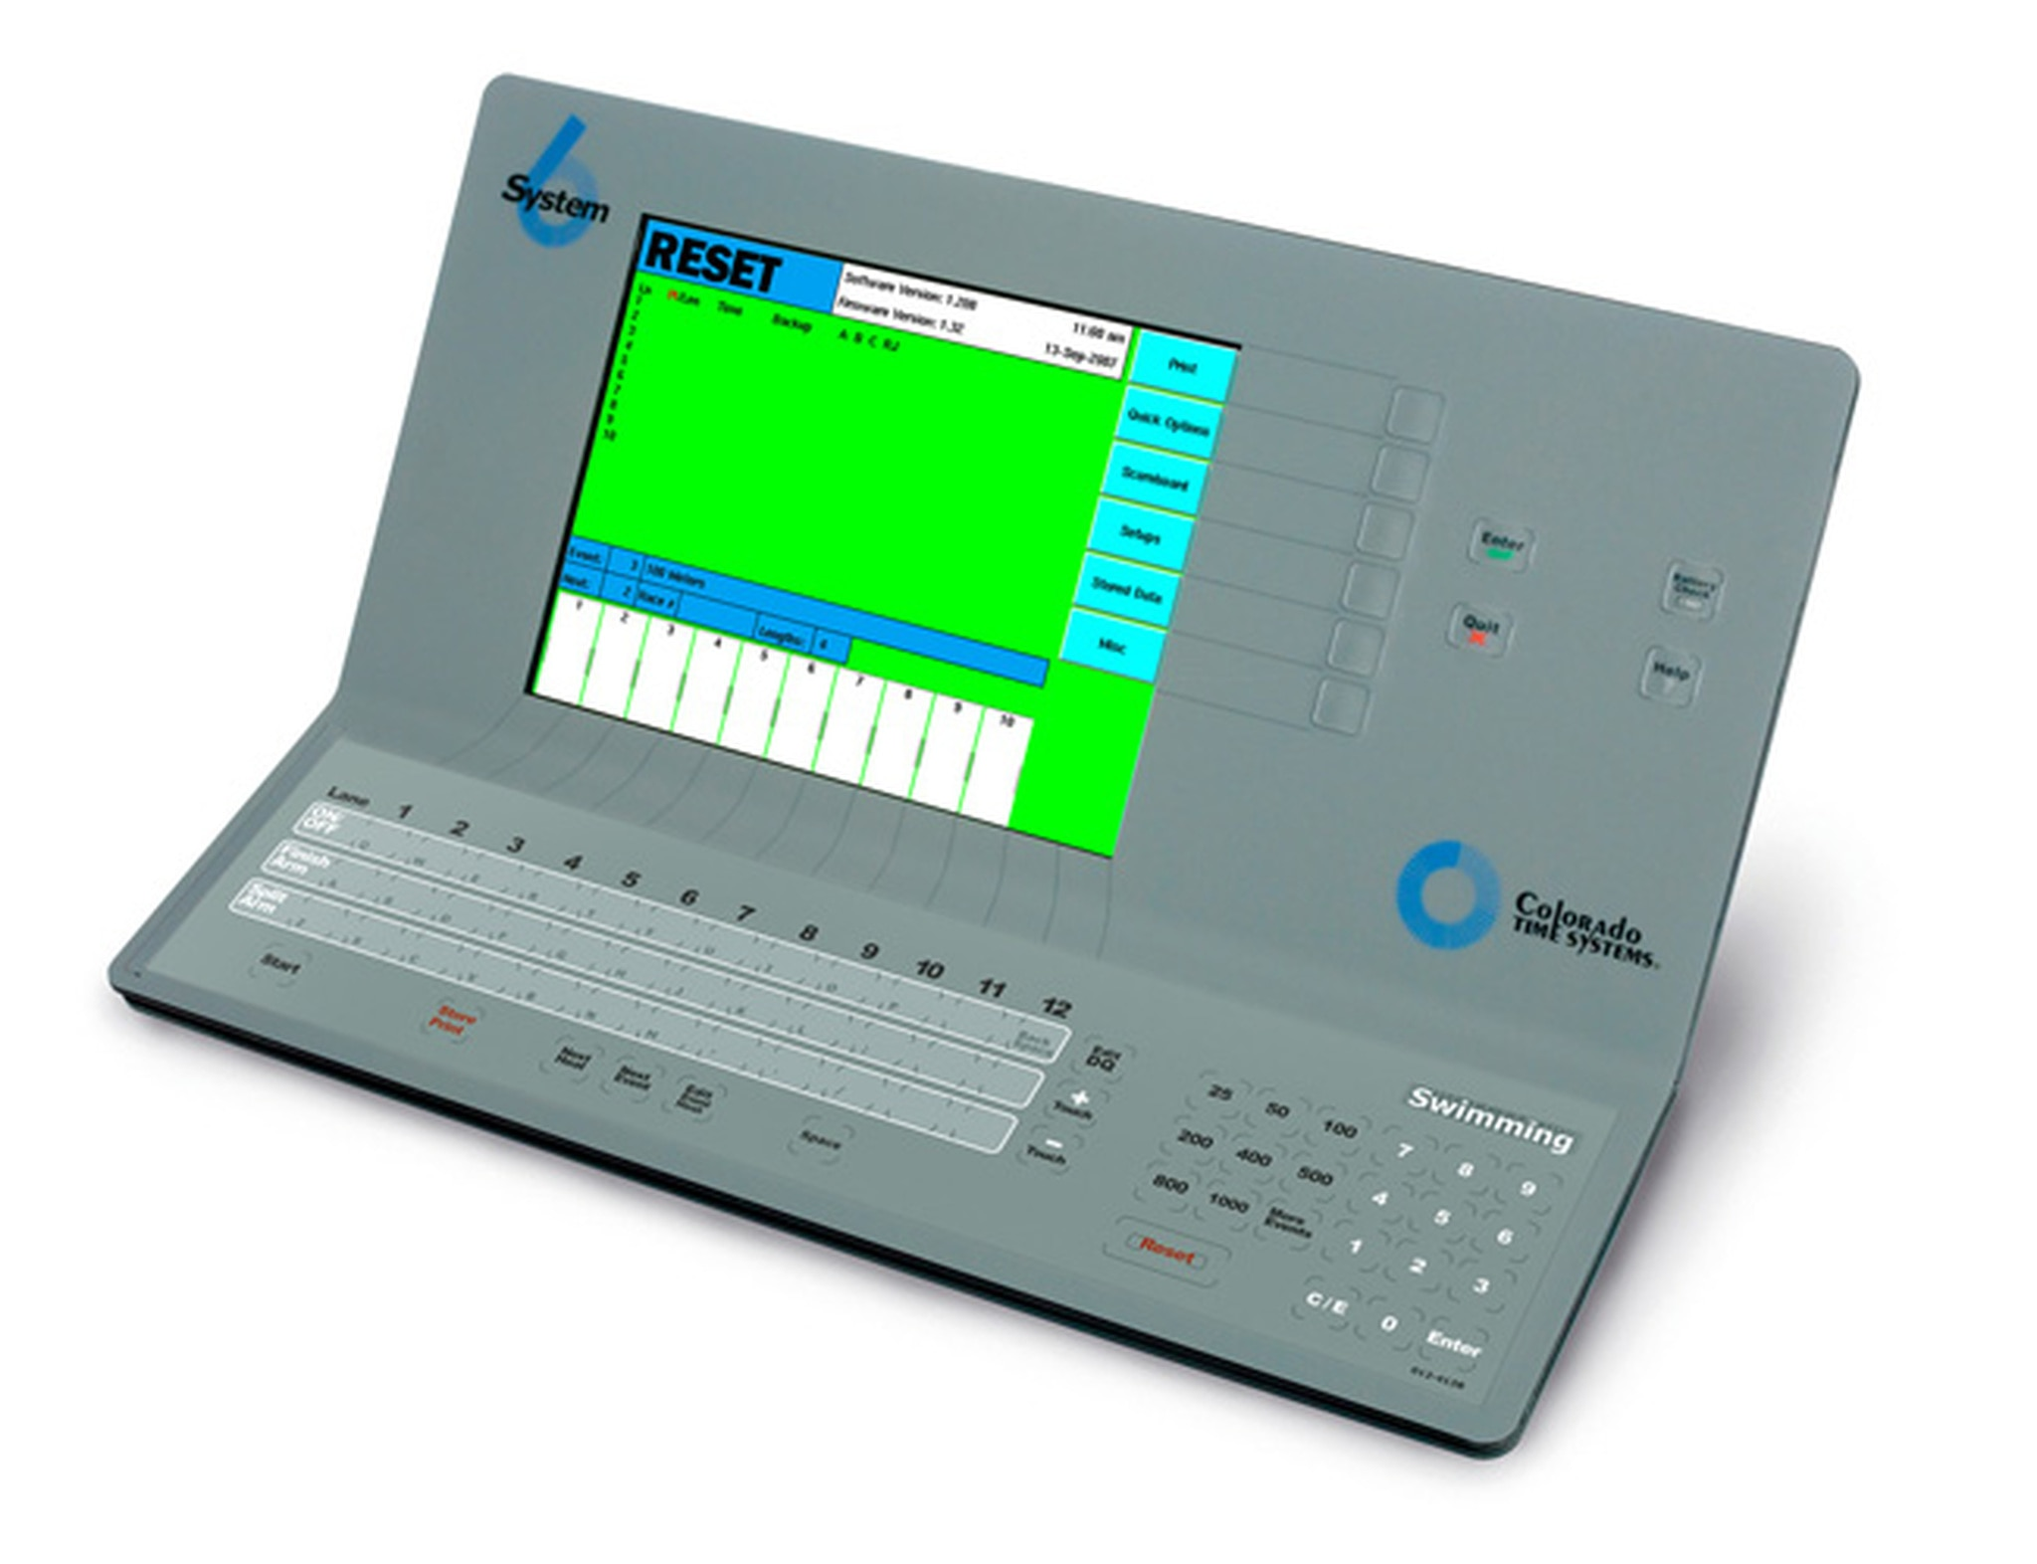





Azure Cloud
App Service
wswebsocket
serial
App Service
frontend
Raspberry
IoT Hub
App Service dathub
Cosmos DB

