Slide 1
Infrastructure as a Service
Jürgen Ratzenböck, Markus Hiesmair, Christoph Stenglein

Slide 2
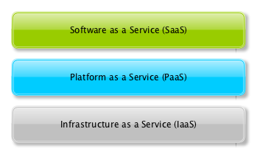
What is Infrastructure as a Service?
Lowest layer of the Cloud Computing architecture
Shared pool of compute, storage and networking resources
Provided on-demand
Pay-as-you-go

Slide 3
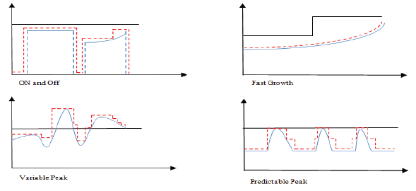
Comparison to Dedicated Hardware
Adapts utilization to current load
No need to buy cost-intensive hardware
No configuration, maintenance, backups, resilience planning
No transparency

Slide 4
Technical Details
Virtualization
Load Balancing
Resilience Planning
Backup Strategies
Monitoring

Slide 5
Security
High need for Security
Different Authentication methods
Advantages and drawbacks

Slide 6


Existing systems

