Slide 1

LS Deviation Log
K-ELECTRIC Database

Slide 2
Introduction of organization:
K-Electric (KE) is a vertically integrated power utility, and a Pakistani electric supply company, based in Karachi, Sindh, Pakistan.
K-Electric supplies power to Pakistan's largest city and economic hub, Karachi, home to around 20 million people. The company has a customer base of 2.2 million, and 11,000 employees. K-Electric Ltd. engages in the generation, transmission, and distribution of electric energy to industrial, commercial, agricultural and residential areas that falls under its network. . In 2018, the utility also initiated the process of distributed generation under a net metering program.

Slide 3
Fact Finding
ANALYZING DATA: Electricity is a widely used entity by each human being though it is divided by different types of consumers. Load dispatch center which is the nerve of our power system is used to perform various functions. Load dispatch center is an important link between generation and transmission, which coordinates the power requirements of consumers of electricity.
SURVEY:
Processes involved in LOAD DISPATCH CENTER:
Generation Transmission Distribution Utilization

Slide 4
Fact Finding
EXAMINATION:
Use of SCADA in LOAD DESPATCH CENTER:
Supervisory Control And Data Acquisition System (SCADA) is a high tech computer system with associated communication network that enables supervision and control of power system network. SCADA is the technology that enables a user to collect data from one or more distant operator to stay or visit frequently to the work locations.

Slide 5
Fact Finding
OBSERVATION:
The direct benefits of a modern SCADA system are:
Constant access to Real Time picture of entire network showing power system voltage, frequency, MW,MVAR, etc.
Supervision, monitoring and control of power in Real Time.
Optimal operation of power system, i.e. generation and associated resources.
Minimum of outage and faster restoration of the system in the event of Grid disturbances.
Improvement in the quality of supply through better control of frequency, voltage and other parameters.
Less dependence on basic telephone system. When it comes into existence.

Slide 6
Fact Finding
RESEARCH:
All the changes, information transfer, fault data, generation and demand side requirement and all other data transfer depends upon the means which were not adequate but somehow it was very difficult to keep the records of all the above said things second to second as in many cases some information may gets lost. Hence a new technique named SCADA originates which helping the power sector alot by taking the form of load dispatch center. The progress so far indicates a hopeful future for a quick and accurate fault restoration support system.

Slide 7
Scenario Of The Project
This is the K-electric Load dispatch centre(ldc) database developed for multi grid stations consisting of block and groups having four different loss categories. The numbers of feeders are provided inconsideration with the load shed in an area. Serial number determining the scheduled and deviated off timings varying according to the loss category. Very High Loss(VHL) having longer time duration of load shed than lower loss(LL).

Slide 8
Normalization
Normalization is the process of reorganizing data in a database so that it meets two basic requirements: (1) There is no redundancy of data (all data is stored in only one place), and (2) data dependencies are logical (all related data items are stored together). Normalization is important for many reasons, but chiefly because it allows databases to take up as little disk space as possible, resulting in increased performance.

Slide 9
Why we have done normalization of our database?
In our database we have performed normalization because all the changes, information transfer, fault data, generation and demand side requirement and all other data transfer depends upon the means which were not adequate but somehow it was very difficult to keep the records of all the above said things second to second as in many cases some information may gets lost.
At this time the LS deviation log has been designed using Microsoft EXCEL but it has following constraints:
Limited relational data management support (You can do look up fields and queries, but it’s not ideal)
Limited programmability support, you can write VBA macros, but they aren’t that great.
No indexing. If you have a massive amount of data across multiple worksheets, a query can take a long time.

Slide 10
Probably the most important drawback, though, is lack of robust multi-user support.
With excel, you can set it so that multiple people can use it, but nothing is locked, so when you save data, if someone else is looking at it and they make a change they could overwrite your data.
If many people need to use the data, you’re best off using a database with a front end as the organization has a demand of intranet communication system.
SQL Queries can be used to retrieve large amounts of
records from a database quickly and efficiently.

Slide 11
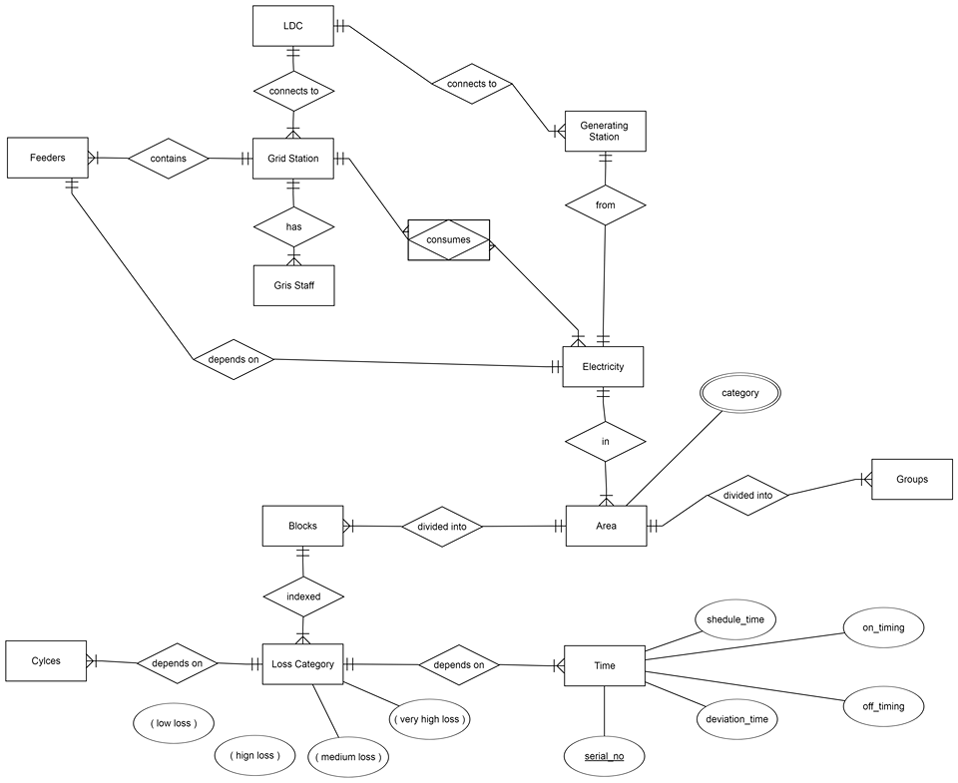
Entity Relationship Diagram

Slide 12
Anomalies in the Database
What is Anomaly ?
Problem that occur in poorly planned and un-normalized database.
3 Types of anomalies.
Insert
Delete
Update

Slide 13
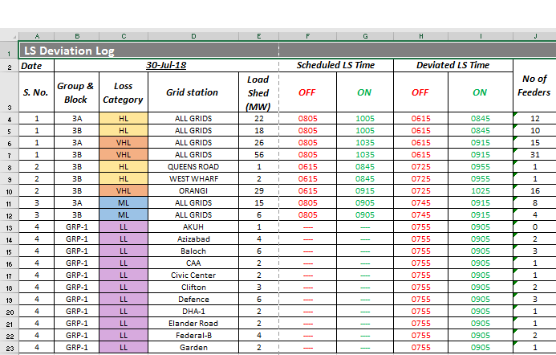
Insert Anomaly
In this database we have insert anomaly like if we have built a new grid station but it has not yet been timetabled for any block .
Delete Anomaly
Here is the deletion anomaly like if we remove the entity block : 3b from the above table, the detail of grid station get deleted.
Update Anomaly
The loss category of Queens road has been improved, now it is on LL. For updating a single entity we have to update all other columns where grid station is Queens road.

Slide 14
Database description
Our database provides the information about the load shedding timings according to the areas and loss categories as shown in table. Further, it shows that how much time of load shedding is deviated from the scheduled time. It also provides the information about feeders depending upon the load shed in an area.

Slide 15
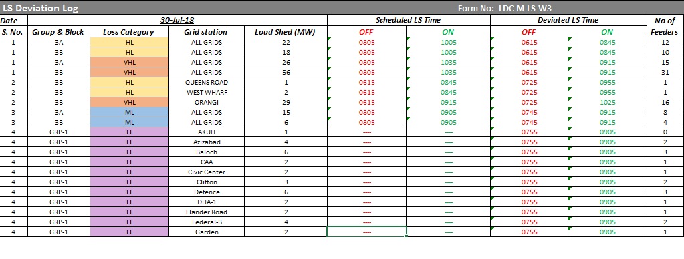
1st Normal Form

Slide 16
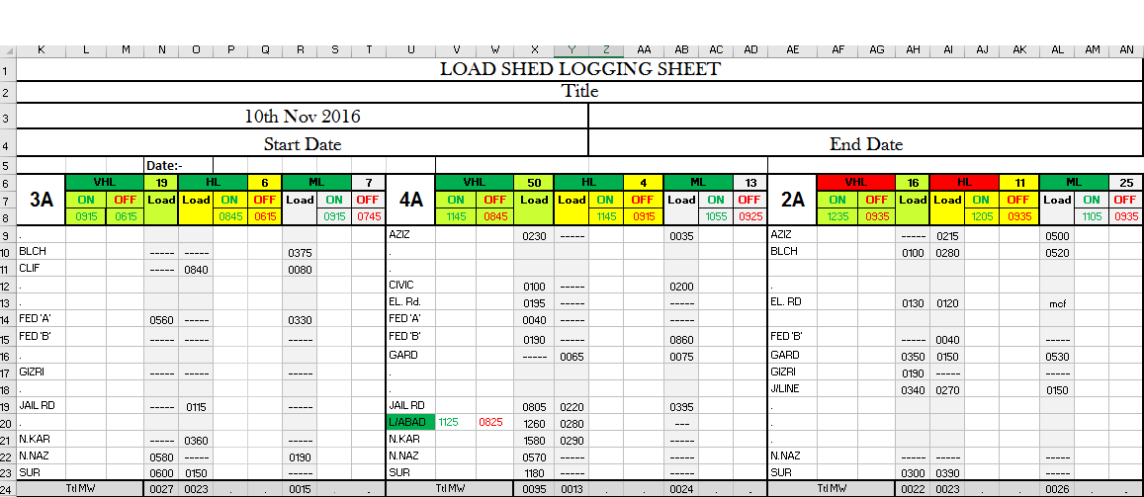
Dependencies in LS database
In LS deviation log the s.no, block and loss category combines to form a composite key in order to provide information about load shed in an area.
Number of feeders depending upon the load shed in an area, if high than will require greater number of feeders.
Off time depending upon serial no and on time depending upon the loss category very high loss(VHL) having larger time duration than low loss(LL).

Slide 17
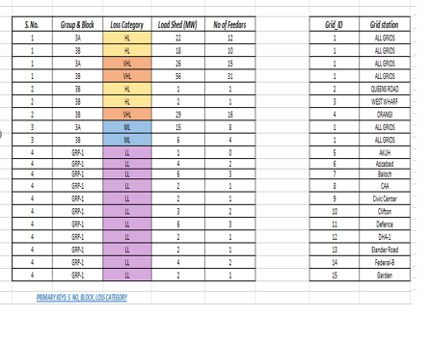
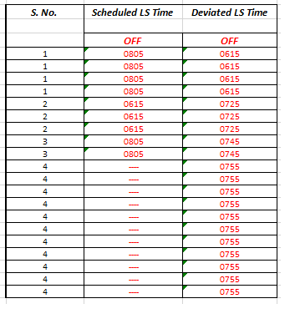
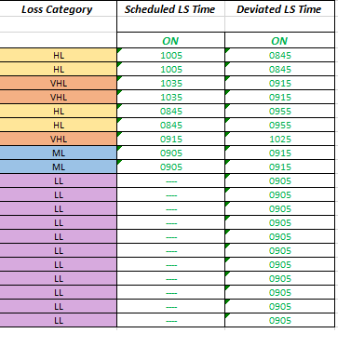
2nd Normal Form

Slide 18
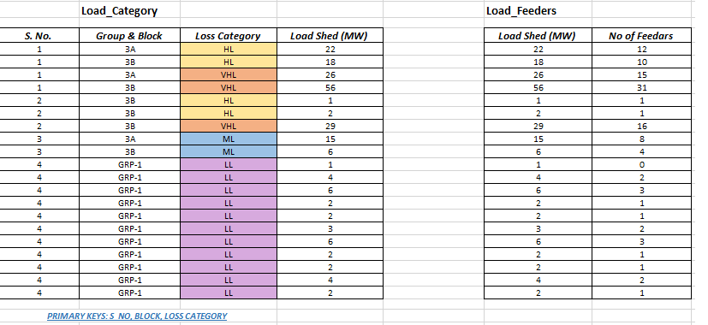
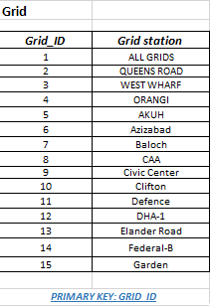
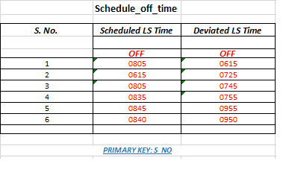
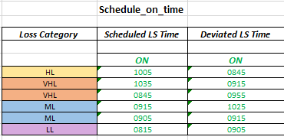
3rd Normal Form

Slide 19
Designing a schema
Table Name | Primary Key(s) | Other Fields
Load_Category | S_No, Block, Loss_category | Load_Shed
Grid | Grid_ID | Grid_name
Scheduled_off_time | S_No | Scheduled off time, Deviated off time
Scheduled_on_time | Loss_category | Scheduled on time, Deviated on time
Load Feeder | Load_Shed | No_of_feeders

Slide 20
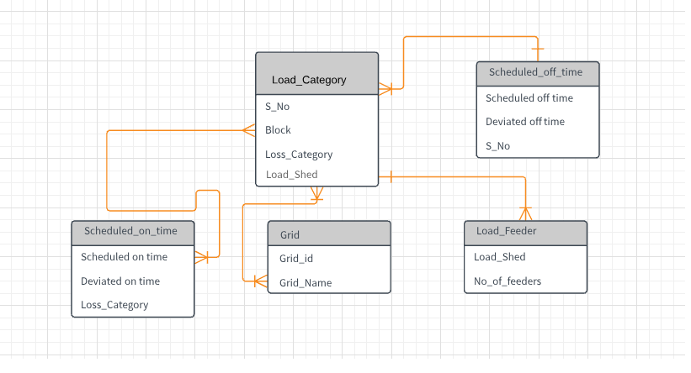
Tables created using following queries:
CREATE TABLE `
Load_Category ` (
`S_No` <type>,
`Block` <type>,
`Loss_Category` <type>,
` Load_Shed` <type>
);
CREATE TABLE `Grid` (
` Grid_id` <type>,
` Grid_Name` <type>
);
CREATE TABLE `Load_Feeder` (
`Load_Shed` <type>,
`No_of_feeders` <type>
);
CREATE TABLE `Scheduled_off_time` (
`Scheduled off time` <type>,
`Deviated off time` <type>,
`S_No` <type>
);
CREATE TABLE `Scheduled_on_time` (
`Scheduled on time` <type>,
`Deviated on time` <type>,
`Loss_Category` <type>
);

Slide 21
Fact findings with the help of queries
The data would be commit which ensures data consistency.
The user would be able to retrieve data using queries such as grid_name using grid_id as primary key.
The user could know the numbers of feeders and the amount of load shed within the specified range.
With the help of serial number and loss category we could easily access the scheduled and deviated on-off timings respectively.
The viewer would not be able to make changes in the database without having privilege to enter in database(not known username and password).
The database we created helps the organization to perform operations in a synchronized way.
The user can create view of any specified part of database.

Slide 22
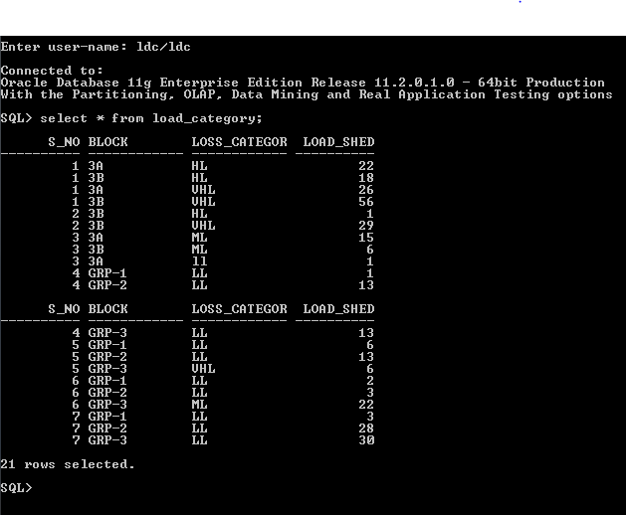
QUERIES RELATED TO FACT FINDING

Slide 23
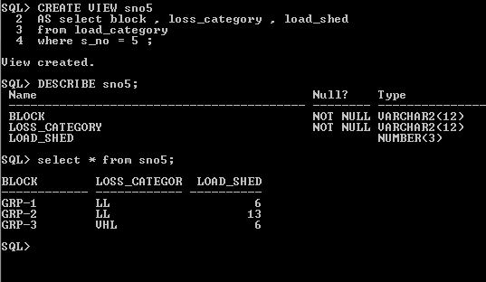

Slide 24
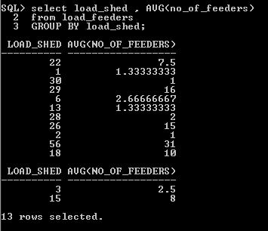


Slide 25
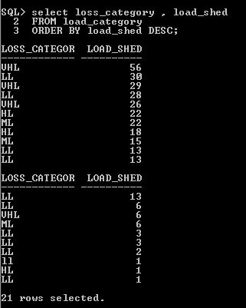

Slide 26
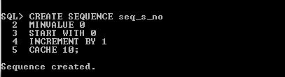

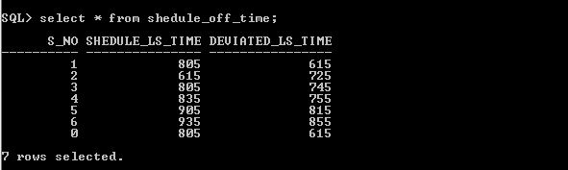

Slide 27
K-ELECTRIC has shown positive response over our database.

