Slide 1
극한직업 크롤링
library(rvest) library(stringr) library(dplyr) library(abind) trim <- function(x) gsub("^\\s+|\\s+$", "", x) base_url <- "https://movie.naver.com" url_sub <- '/movie/bi/mi/point.nhn?code=167651' url <- paste0(base_url,url_sub) html <- read_html(url) url2 <- html %>% html_node('iframe.ifr') %>% html_attr('src') url_add <- "&page=" url_ifr <- paste0(base_url,url2,url_add) pages <- 1:4652 naver_movie <- data.frame(score=c(),review=c(),writer=c(),time=c()) for (n in 1:length(pages)) { url_pages <- paste0(url_ifr,pages[n]) html2 <- read_html(url_pages) lis <- html2 %>% html_node('div.score_result') %>% html_nodes('li') score <- c() review <- c() writer <- c() time <- c() | for (li in lis) { # score score <- c(score,html_node(li,'.star_score') %>% html_text('em') %>% trim()) # review tmp <- li %>% html_node('.score_reple') %>% html_text('p') %>% trim() idx <- str_locate(tmp,'\r') review <- c(review,str_sub(tmp,1,idx[1]-1)) # writer tmp <- trim(str_sub(tmp,idx[1],-1)) idx <- str_locate(tmp,'\r') writer <- c(writer,str_sub(tmp,1,idx[1]-1)) # time tmp <- trim(str_sub(tmp,idx[1],-1)) idx <- str_locate(tmp,'\r') time <- c(time,str_sub(tmp,1,idx[1]-1)) } movie <- data.frame(score=score,review=review,writer=writer,time=time) naver_movie <- rbind.data.frame(naver_movie,movie) } View(naver_movie) naver_movie

Slide 2
극한직업 wordcloud
library(rJava) library(KoNLP) library(wordcloud) library(RColorBrewer) useSejongDic() review <- readLines("D:/Workspace/R-Project/naver_movie_극한직업.txt") words <- sapply(review,extractNoun,USE.NAMES=F) head(unlist(words),50) words <- unlist(words) words <- gsub("에효","",words) words <- gsub("조","",words) words <- gsub("폭","",words) words <- gsub("적","",words) words <- gsub("거","",words) words <- gsub("안난다ㅠ","",words) words <- gsub("리","",words) words <- gsub("집","",words) words <- gsub("반","",words) words <- gsub("보니깐","",words) words <- gsub("돈영화존나재미없는데","",words) | words <- gsub("나오니까한국영화에","",words) words <- gsub("들","",words) words <- gsub("편","",words) words <- gsub("글쓴거야다보고나면","",words) words <- gsub("쓰레기같은영화내용도","",words) words <- gsub("거","",words) words <- gsub("아까워라그냥","",words) words <- gsub("내돈만원","",words) words <- gsub(" ^ㅋ^ㅋ^ㅋ^ㅋ","",words) words <- Filter(function(x) {nchar(x)>=2}, words) wordcount <- table(words) head(sort(wordcount,decreasing=T),50) palete <- brewer.pal(12,"Paired") wordcloud(names(wordcount),freq=wordcount,scale=c(5,0.1),rot.per=0.25,min.freq=30, random.order=F,random.color=T,colors=palete) words <- Filter(function(x) {nchar(x)>=2}, words) wordcount <- table(words) head(sort(wordcount,decreasing=T),50) palete <- brewer.pal(8, "Dark2") wordcloud(names(wordcount), freq=wordcount, scale=c(5,0.3), rot.per=0.1, min.freq=20, random.order=F, random.color=T, colors=palete)

Slide 3
극한직업 wordcloud
words <- unlist(words) words <- gsub("에효","",words) words <- gsub("조","",words) words <- gsub("폭","",words) words <- gsub("적","",words) words <- gsub("거","",words) words <- gsub("안난다ㅠ","",words) words <- gsub("리","",words) words <- gsub("집","",words) words <- gsub("반","",words) words <- gsub("보니깐","",words) words <- gsub("돈영화존나재미없는데","",words) words <- gsub("나오니까한국영화에","",words) words <- gsub("들","",words) words <- gsub("편","",words) words <- gsub("글쓴거야다보고나면","",words) words <- gsub("쓰레기같은영화내용도","",words) words <- gsub("거","",words) words <- gsub("아까워라그냥","",words) words <- gsub("내돈만원","",words) words <- gsub(" ^ㅋ^ㅋ^ㅋ^ㅋ","",words) words <- Filter(function(x) {nchar(x)>=2}, words) wordcount <- table(words) head(sort(wordcount,decreasing=T),50) palete <- brewer.pal(12,"Paired") wordcloud(names(wordcount),freq=wordcount,scale=c(5,0.1),rot.per=0.25,min.freq=30, random.order=F,random.color=T,colors=palete) words <- Filter(function(x) {nchar(x)>=2}, words) wordcount <- table(words) head(sort(wordcount,decreasing=T),50) palete <- brewer.pal(8, "Dark2") wordcloud(names(wordcount), freq=wordcount, scale=c(5,0.3), rot.per=0.1, min.freq=20, random.order=F, random.color=T, colors=palete)

Slide 4
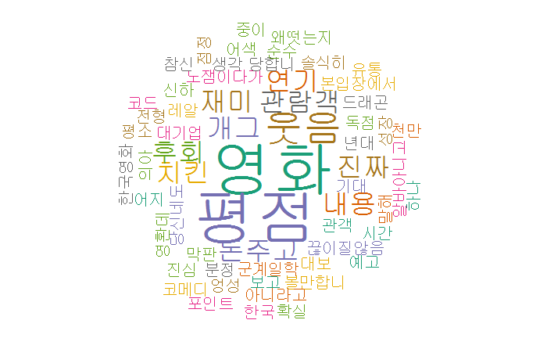
wordcloud

Slide 5
크롤링파일 데이터생성
library(ggplot2) library(gridExtra) naver_movie <- read.csv("D:/Workspace/R-Project/naver_movie_극한직업(일자별 시간별 월별).csv",header=T) str(naver_movie) | 'data.frame': 46520 obs. of 9 variables: $ X : int 1 2 3 4 5 6 7 8 9 10 ... $ score : int 10 8 10 10 10 10 8 10 10 10 ... $ review: Factor w/ 46279 levels "''웃기려는 의도없이 무심히 툭 던지는 드립과 작정하고 웃기려는 드립 그 사이 어디쯤''에 있는 대사들이 적재적소에 "| __truncated__,..: 35696 7103 16322 4193 39299 1457 28745 23752 23943 11666 ... $ writer: Factor w/ 43981 levels "_(chzh****)",..: 29205 37347 19052 29757 24133 173 11962 7347 24636 27126 ... $ day : Factor w/ 164 levels "2019.01.23","2019.01.24",..: 1 1 1 1 1 1 1 1 1 1 ... $ time : int 11 11 12 2 8 2 6 5 9 12 ... $ X.1 : int 45 37 47 48 16 47 0 32 26 48 ... $ X.2 : Factor w/ 2 levels "12:00 AM","12:00 PM": 1 1 2 2 2 2 2 2 1 2 ... $ month : int 1 1 1 1 1 1 1 1 1 1 ...

Slide 6
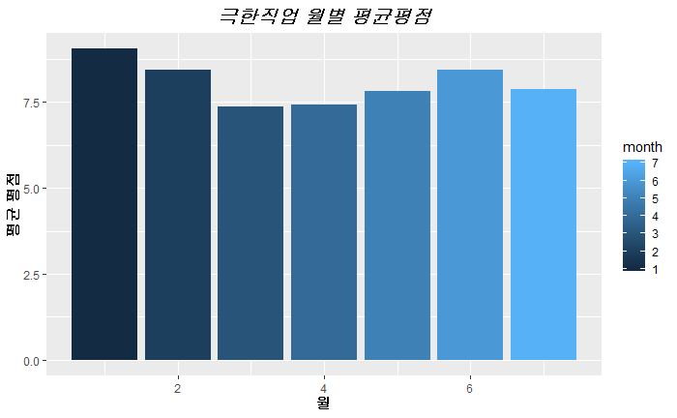
월별 평점 분석
data_movie <- naver_movie %>% select(score, month, day, time) data_movie1 <- data_movie %>% group_by(month) %>% summarise(average=mean(score,na.rm=T)) data_movie1 ggplot(data_movie1,aes(x=month,y=average,fill=month)) + geom_bar(stat="identity") + xlab("월") + ylab("평균 평점") + ggtitle("극한직업 월별 평균평점") + theme(plot.title = element_text(color="black",size=15,face="bold.italic",hjust=0.5), axis.title.x = element_text(color="black",size=10,face="bold"), axis.title.y = element_text(color="black",size=10,face="bold"))

Slide 7
일자별 평점 분석 1-1
data_movie2 <- data_movie %>% group_by(day) %>% summarise(average=mean(score,na.rm=T)) data_movie2 data_movie2_1 <- data_movie2 %>% filter(day %in% c('2019.02.01','2019.02.02','2019.02.03','2019.02.04', '2019.02.05','2019.02.06','2019.02.07','2019.02.08')) data_movie2_2 <- data_movie2 %>% filter(day %in% c('2019.03.01','2019.03.02','2019.03.03','2019.03.04', '2019.03.05','2019.03.06','2019.03.07','2019.03.08')) data_movie2_3 <- data_movie2 %>% filter(day %in% c('2019.04.01','2019.04.02','2019.04.03','2019.04.04', '2019.04.05','2019.04.06','2019.04.07','2019.04.08')) data_movie2_4 <- data_movie2 %>% filter(day %in% c('2019.05.01','2019.05.02','2019.05.03','2019.05.04', '2019.05.05','2019.05.06','2019.05.07','2019.05.08')) | g1 <- ggplot(data_movie2_1,aes(x=day,y=average,fill=day)) + geom_bar(stat="identity") + xlab("일자") + ylab("평균 평점") + ggtitle("극한직업 일자별 평균평점 1") + theme(plot.title = element_text(color="black",size=12,face="bold.italic",hjust=0.5), axis.title.x = element_text(color="black",size=9,face="bold"), axis.title.y = element_text(color="black",size=9,face="bold")) g2 <- ggplot(data_movie2_2,aes(x=day,y=average,fill=day)) + geom_bar(stat="identity") + xlab("일자") + ylab("평균 평점") + ggtitle("극한직업 일자별 평균평점 2") + theme(plot.title = element_text(color="black",size=12,face="bold.italic",hjust=0.5), axis.title.x = element_text(color="black",size=9,face="bold"), axis.title.y = element_text(color="black",size=9,face="bold"))

Slide 8
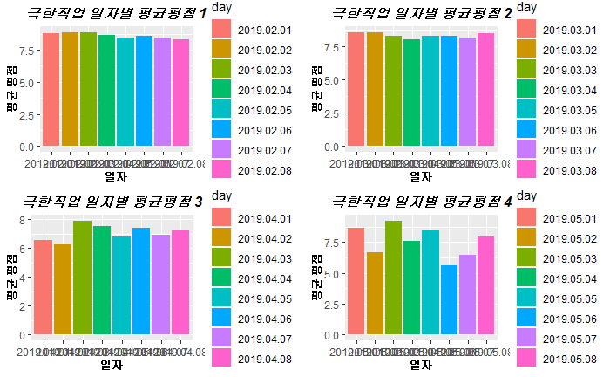
일자별 평점 분석 1-2
g3 <- ggplot(data_movie2_3,aes(x=day,y=average,fill=day)) + geom_bar(stat="identity") + xlab("일자") + ylab("평균 평점") + ggtitle("극한직업 일자별 평균평점 3") + theme(plot.title = element_text(color="black",size=12,face="bold.italic",hjust=0.5), axis.title.x = element_text(color="black",size=9,face="bold"), axis.title.y = element_text(color="black",size=9,face="bold")) g4 <- ggplot(data_movie2_4,aes(x=day,y=average,fill=day)) + geom_bar(stat="identity") + xlab("일자") + ylab("평균 평점") + ggtitle("극한직업 일자별 평균평점 4") + theme(plot.title = element_text(color="black",size=12,face="bold.italic",hjust=0.5), axis.title.x = element_text(color="black",size=9,face="bold"), axis.title.y = element_text(color="black",size=9,face="bold")) grid.arrange(g1,g2,g3,g4,nrow=2,ncol=2)

Slide 9
일자별 평점 분석 1-3

Slide 10
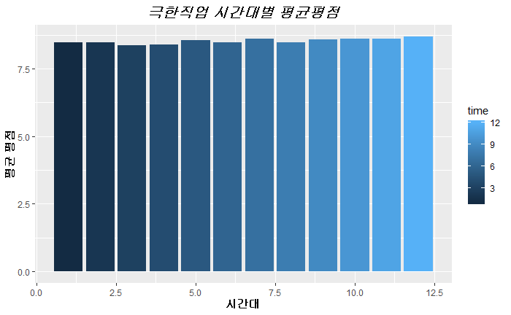
시간대별 평점 분석
data_movie3 <- data_movie %>% group_by(time) %>% summarise(average=mean(score,na.rm=T)) data_movie3 ggplot(data_movie3,aes(x=time,y=average, fill=time)) + geom_bar(stat='identity') + xlab("시간대") + ylab("평균 평점") + ggtitle("극한직업 시간대별 평균평점") + theme(plot.title = element_text(color="black",size=15,face="bold.italic",hjust=0.5), axis.title.x = element_text(color="black",size=10,face="bold"), axis.title.y = element_text(color="black",size=10,face="bold"))

