Slide 1
빅데이터를 활용한 스마트데이터
전문가 양성과정
19.08.21
- 미니프로젝트 CIFAR10, 100 데이터 셋 -
오진영

Slide 2
CIFAR10
출처 : https://andrewkruger.github.io/projects/2017-08-05-keras-convolutional-neural-network-for-cifar-100
출처 : https://datascienceschool.net/view-notebook/8fc58d2c1ffc420dac44eafee7b28cea/
Padding = same
Padding = same
X1 ----- Xn
학습데이터 50,000개
32 x 32
Convolution1
Mask – 128
Size – 3 x 3
Relu
Convolution2
Mask – 128
Size – 3 x 3
relu
Max_pooling
Drop Out
10%
Padding = same
Padding = same
Convolution3
Mask – 256
Size – 3 x 3
relu
Convolution4
Mask – 256
Size – 3 x 3
relu
Max_pooling
Drop Out
25%
Padding = same
Padding = same
Convolution5
Mask – 512
Size – 3 x 3
relu
Convolution6
Mask – 512
Size – 3 x 3
relu
Max_pooling
Drop Out
50%
Flatten
Dense 128
Drop Out
50%
출력 10개
Softmax
Adam

Slide 3
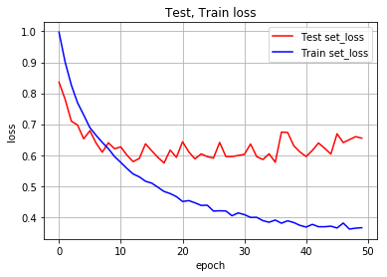
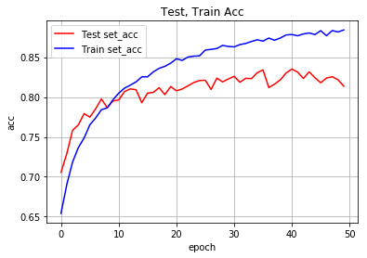
CIFAR10
result
# CIFAR10 데이터 로딩 및 확인
(X_train, y_train0), (X_test, y_test0) = cifar10.load_data()
# 자료형 변환
X_train = X_train.astype('float32') / 255.0 X_test = X_test.astype('float32') / 255.0
# one - hot - encoding Y_train = np_utils.to_categorical(y_train0, 10) Y_test = np_utils.to_categorical(y_test0, 10)
#모델 설정
model = Sequential() model.add(Conv2D(128,(3,3), activation='relu', input_shape=(32, 32, 3), padding='same')) model.add(Conv2D(128,(3,3), activation='relu', padding='same')) model.add(MaxPooling2D()) model.add(Dropout(0.1))
model.add(Conv2D(256,(3,3), activation='relu', padding='same')) model.add(Conv2D(256,(3,3), activation='relu', padding='same')) model.add(MaxPooling2D()) model.add(Dropout(0.25))
model.add(Conv2D(512,(3,3), activation='relu', padding='same')) model.add(Conv2D(512,(3,3), activation='relu', padding='same')) model.add(MaxPooling2D()) model.add(Dropout(0.5))
model.add(Flatten()) model.add(Dense(128, activation='relu')) model.add(Dropout(0.5)) model.add(Dense(10, activation='softmax'))
model.compile(loss='categorical_crossentropy', optimizer='adam', metrics=['accuracy'])

Slide 4
CIFAR100
출처 : https://andrewkruger.github.io/projects/2017-08-05-keras-convolutional-neural-network-for-cifar-100
출처 : https://datascienceschool.net/view-notebook/8fc58d2c1ffc420dac44eafee7b28cea/
Padding = same
Padding = same
X1 ----- Xn
학습데이터 50,000개
32 x 32
Convolution1
Mask – 128
Size – 3 x 3
Relu
Convolution2
Mask – 128
Size – 3 x 3
relu
Max_pooling
Drop Out
10%
Padding = same
Padding = same
Convolution3
Mask – 256
Size – 3 x 3
relu
Convolution4
Mask – 256
Size – 3 x 3
relu
Max_pooling
Drop Out
25%
Padding = same
Padding = same
Convolution5
Mask – 512
Size – 3 x 3
relu
Convolution6
Mask – 512
Size – 3 x 3
relu
Max_pooling
Drop Out
50%
Flatten
Dense 128
Drop Out
50%
출력 100개
Softmax
Adam

Slide 5
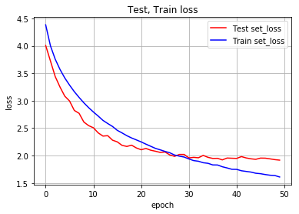
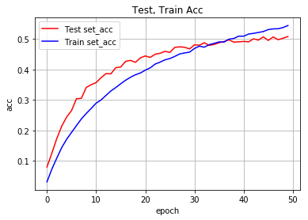
CIFAR100
result
# CIFAR10 데이터 로딩 및 확인
(X_train, y_train0), (X_test, y_test0) = cifar100.load_data()
# 자료형 변환
X_train = X_train.astype('float32') / 255.0 X_test = X_test.astype('float32') / 255.0
# one - hot - encoding Y_train = np_utils.to_categorical(y_train0, 100) Y_test = np_utils.to_categorical(y_test0, 100)
#모델 설정 model = Sequential() model.add(Conv2D(128,(3,3), activation='relu', input_shape=(32, 32, 3), padding='same')) model.add(Conv2D(128,(3,3), activation='relu', padding='same')) model.add(MaxPooling2D()) model.add(Dropout(0.1))
model.add(Conv2D(256,(3,3), activation='relu', padding='same')) model.add(Conv2D(256,(3,3), activation='relu', padding='same')) model.add(MaxPooling2D()) model.add(Dropout(0.25))
model.add(Conv2D(512,(3,3), activation='relu', padding='same')) model.add(Conv2D(512,(3,3), activation='relu', padding='same')) model.add(MaxPooling2D()) model.add(Dropout(0.5))
model.add(Flatten()) model.add(Dense(128, activation='relu')) model.add(Dropout(0.5)) model.add(Dense(10, activation='softmax'))
model.compile(loss='categorical_crossentropy', optimizer='adam', metrics=['accuracy'])

Slide 6
감사합니다

