Slide 1





Image Processing Using Python
Submitted in the partial fulfillment for the award of the degree of
Bachelor of Engineering
in
Computer Science with Specialization in
Artificial Intelligence and Machine Learning
Under supervision of:
NIKITA MA’AM
Submitted by:
Meenakshy - 22BAI71194
Gouri B J - 22BAI70485
Hiba Saudha - 22BAI70005
Saeed Fahim - 22BAI70391

Slide 2
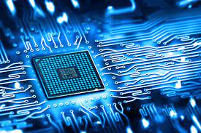
Outline
Introduction
Objectives
Problem Formulation
Methodology
Timeline
Future Scope
References

Slide 3
Introduction
Image processing using Python is to leverage the language's versatile libraries and tools to:
Analyze
Manipulate
Enhance Digital Images
Image processing is a powerful technique for improving the visual quality.
By employing libraries such as OpenCV, NumPy, and Pillow, to develop efficient algorithms for tasks like image filtering, segmentation, object recognition, and feature extraction.

Slide 4

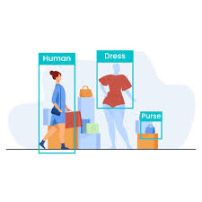



Objectives
Image Generation
Creating 3D,Animated and High Quality Images.
Object Detection
Detecting Objects in the reference Image(3D Image)
Enhancing Quality
Quality enhancement of images using Stable Diffusion.
Image Enhancement
Implement algorithms for sharpening, blurring, and color correction.

Slide 5





Problem Formulation
Create Algorithms
To enhance the quality of digital images by tackling problems such as color correction and noise reduction.
.
Create an Intuitive Interface
For users to leverage Python's power without extensive programming knowledge.
Explore seamless integration
By using external tools and libraries to enhance functionality.
Ensure efficient handling
Handling of large datasets and high-resolution images without compromising speed.

Slide 6
Methodology
Integration with Tools
User Interface Design
Documentation
Define Problem
Literature Review
Data Collection
Algorithm Selection
Testing and Validation
Performance Optimization
Reporting and Visualization
Continuous Improvement

Slide 7
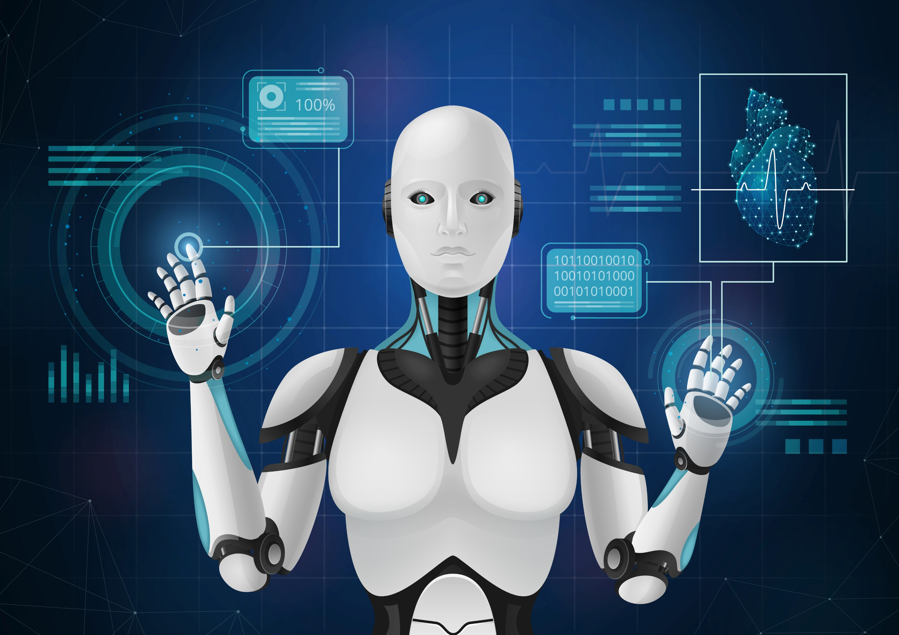
TIMELINE
01
04
DEFINING THE PROBLEM
DATA COLLECTION
02
ANALYSING PREVIOS SOLUTION
05
DRAFTING THE PROPOSED SYSTEM
03
DETECTING DRAWBACKS
06
IMPLEMENTATION OF SYSTEM

Slide 8
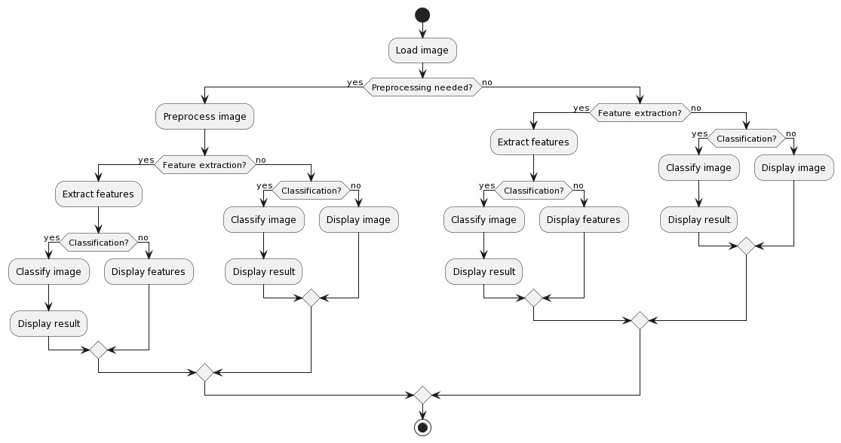
PRELIMINARY DESIGN

Slide 9
ANALYSIS OF FEATURE
FEATURE
EXTRACTION
MACHINE LEARNING
INTEGRATION
Extracting key points and descriptors for image matching.
Histogram-based features for color distribution analysis.
Integrate machine learning models for image classification or regression tasks.
Use libraries like scikit-learn or TensorFlow for model implementation.

Slide 10
Future Scope
Integration of Deep Learning
Applications of Augmented Reality
Advanced Recognition of Objects
Processing in the Cloud
Semantic Division
Processing 3D Images
Combining IOT Device Integration
Multimodal Image Interpretation
Automated Extraction of Features
Interpretability and Explainability
Interaction between humans and computers
Processing videos in Real Time

Slide 11
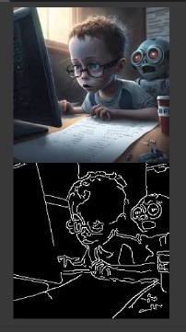
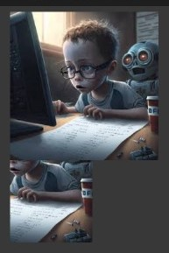
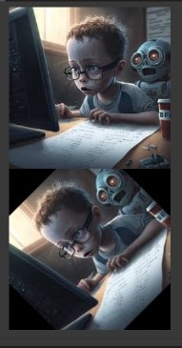
Feature Identification
Feature identification is the process of detecting and extracting the most important features of an image . Here are some techniques we used for feature identification
01
02
03
Edge Detection
Crop
Rotate
Edge detection is a technique used to identify the boundaries of objects in an image
Crop is a technique used to crop the images
Rotate is a technique used to rotate the images

Slide 12
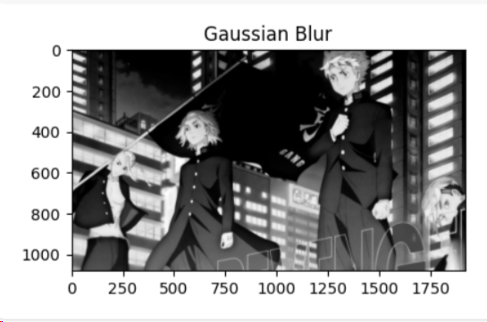
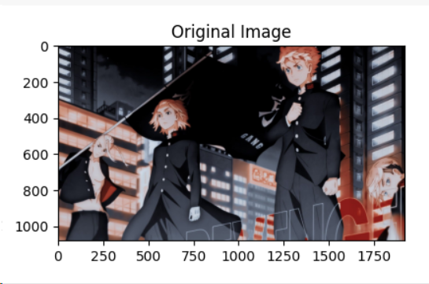
Constraint Identification
Constraint identification is the process of identifying the limitations and constraints of an image processing task. Here we are providing our constraints in image processing
Noise Reduction
Noise reduction is the process of removing unwanted noise from an image .Here’s an example of noise production.

Slide 13
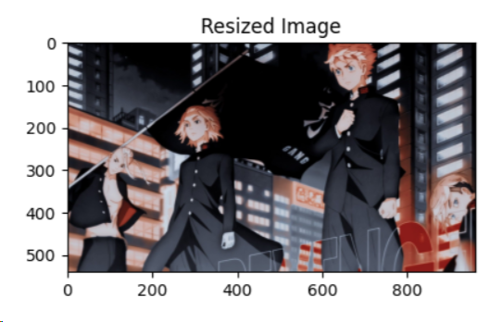
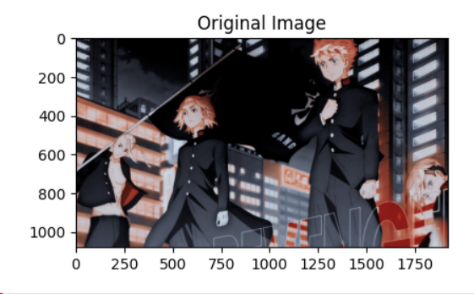
Image Resizing
Image resizing is the process of changing the size of an image. Here’s an example of image resizing.

Slide 14
Design Selection
The methodologies we used to determine the most suitable approach for solving the problem.
Accuracy
We use skiicit library, tensor flow ,csv for better accuracy.
Efficiency
We uses so many techniques for efficient processing like edge detection, crop and rotate.
Robustness
We used methods for enhancing or denoising images using filters like Gaussian.

Slide 15
THANK YOU
Submitted by:
Meenakshy - 22BAI71194
Gouri B J - 22BAI70485
Hiba Saudha - 22BAI70005
Fahim Saeed - 22BAI70391

