Slide 1

Fraud Detection for Banking

Slide 2

The Team
Anjum Sultana
Computer Science Graduate
Zarnigor Kholikova
Financial Auditor
Hiba Bashir
Systems Engineer

Slide 3
Problem Definition
In this project, our team identifies fraudulent transaction from Banksim dataset.
The source of the data: https://www.kaggle.com/code/vmeh23/general-data-analysis-for-banksim-data-set/data

Slide 4
Machine Learning Process
Get Data
EDA and Feature Engineering
Choosing a Machine Learning Model
Data Cleaning
Training
Evaluation

Slide 5
Columns:
Step
Customer
Age
ZipcodeOri
Gender
Merchant
ZipMerchant
Category
Amount
Fraud
Features
Label

Slide 6
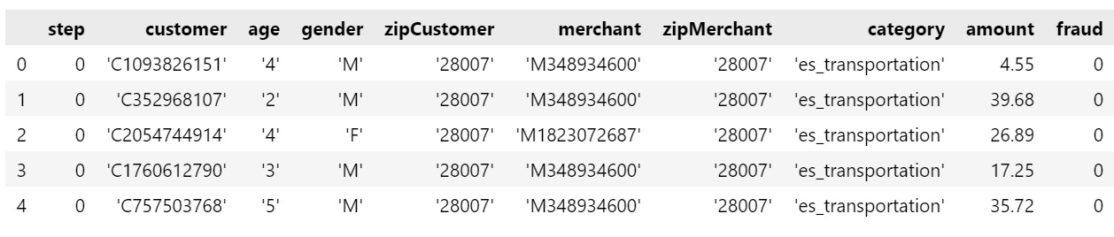
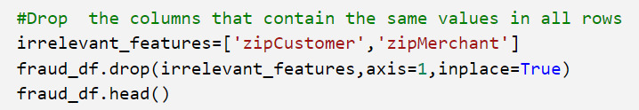

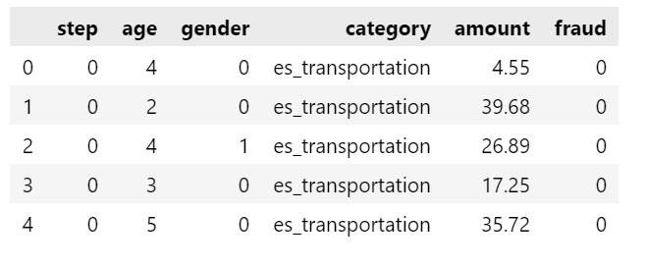
Data Cleaning
Data cleaning
Cleaned data

Slide 7
2. Exploratory Data Analysis and Feature Engineering

Slide 8
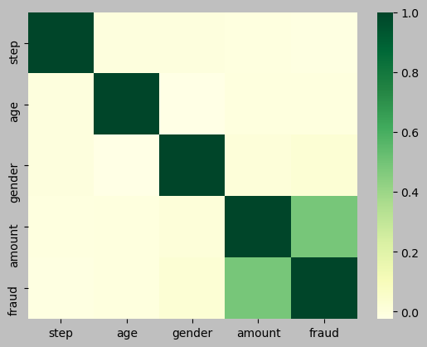
Correlation matrix between numerical columns
 | Step | Age | Gender | Amount | Fraud
Step | 1 | 0.001 | 0 | -0.008 | -0.012
Age | 0.001 | 1 | -0.025 | -0.004 | -0.004
Gender | 0 | -0.025 | 1 | 0.013 | 0.025
Amount | -0.008 | -0.004 | 0.013 | 1 | 0.49
Fraud | -0.012 | -0.004 | 0.025 | 0.49 | 1

Slide 9
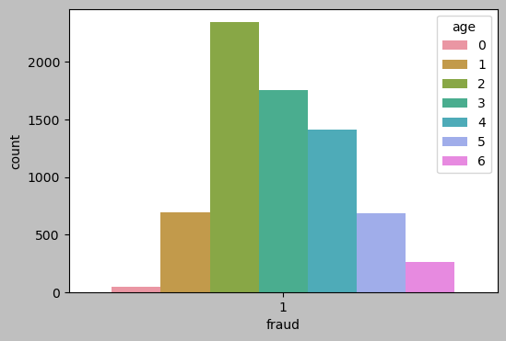
Fraud analysis by Age
Age | Number of frauds
0 | 48
1 | 689
2 | 2344
3 | 1755
4 | 1410
5 | 686
6 | 261

Slide 10
Fraud analysis by Amount
Descriptive Statistics
count | 592,950
mean | 38
std | 112
min | 0
25% | 14
50% | 27
75% | 43
max | 8,330
Frequency Table for the Amount variable
Amount | Frequency
-8 : 833 | 592,070
833 : 1666 | 482
1666 : 2499 | 118
2499 : 3332 | 87
3332 : 4165 | 72
4165 : 4998 | 62
4998 : 5831 | 34
5831 : 6664 | 16
6664 : 7497 | 6
7497 : 8330 | 3
880

Slide 11
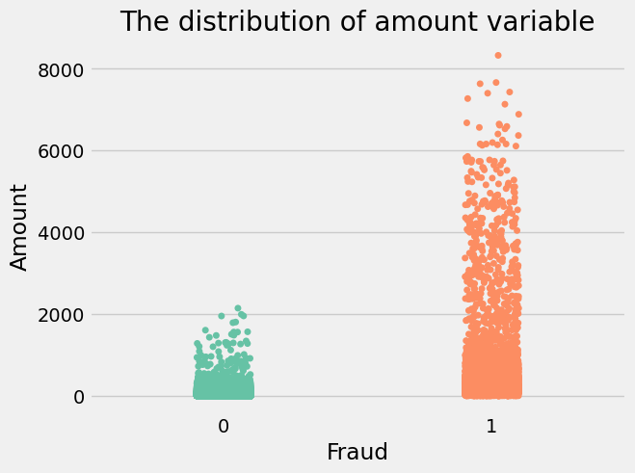
Fraud Analysis by Amount
Outliers

Slide 12
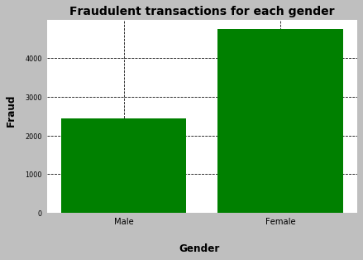
Fraud analysis by Gender
Gender | Number of fraudulent transactions | Total | Percentage of fraudulent transactions
Male | 2,435 | 268,385 | 0.91%
Female | 4,758 | 324,565 | 1.47%

Slide 13
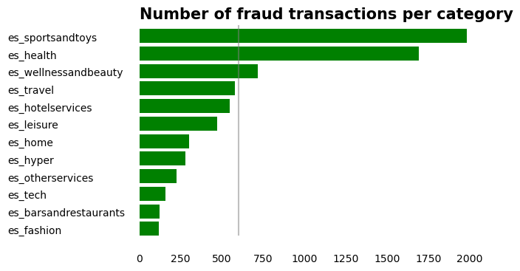
Fraud analysis by Category

Slide 14
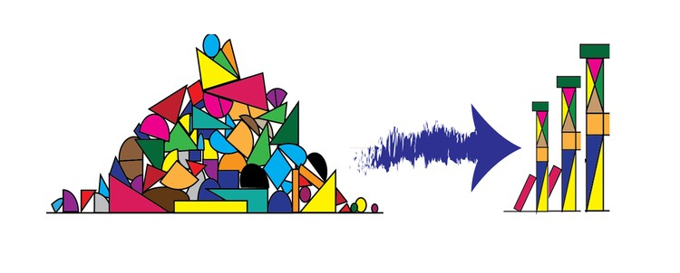
Feature Engineering

Slide 15
Feature Engineering Steps
Drop irrelevant columns
One-Hot Encoding
Under sampling
Normalization of data
Train-Test split

Slide 16
One Hot encoding – converting categorical data into binary value, to ensure that machine learning does not assume that higher numbers are more important.
Category
es_transportation
es_food
es_health
es_wellnessandbeauty
es_fashion
es_barsandrestaurants
es_hyper
es_sportsandtoys
es_tech
es_home
es_hotelservices
es_otherservices
es_contents
es_travel
es_leisure
es_transportation | es_food | es_health | . . . . | es_leisure
0 | 1 | 0 | . . . . | 0
1 | 0 | 0 | . . . . | 0
0 | 0 | 0 | . . . . | 0
0 | 0 | 1 | . . . . | 0
0 | 0 | 0 | . . . . | 0
0 | 0 | 0 | . . . . | 0
0 | 0 | 0 | . . . . | 0
0 | 0 | 0 | . . . . | 0
0 | 0 | 0 | . . . . | 0
0 | 0 | 0 | . . . . | 0
0 | 0 | 0 | . . . . | 1
0 | 0 | 0 | . . . . | 0
0 | 0 | 0 | . . . . | 0
0 | 0 | 0 | . . . . | 0
0 | 0 | 0 | . . . . | 0

Slide 17
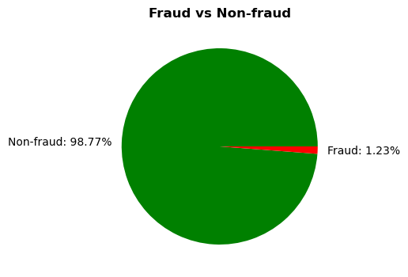
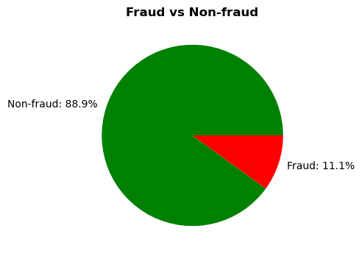
Undersampling the labels
Undersampling
The number of non-fraud data was decreased to keep the balance between fraud and non-fraud data. The ratio of two became 1:9

Slide 18
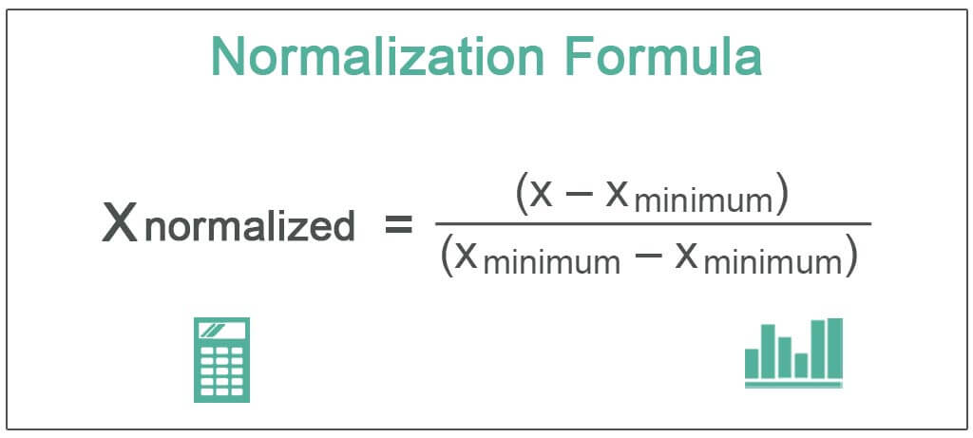
Normalization of Dataset
The goal of normalization is to change the values of numeric columns in the dataset to a common scale, without distorting differences in the ranges of values. For machine learning, every dataset does not require normalization. It is required only when features have different ranges.
Normalized columns in our dataset: Step, age, amount

Slide 19
Before Feature Engineering Before Feature Engineering
step | customer | age | gender | zipcodeOri | merchant | zipMerchant | category | amount | fraud
0 | 'C1093826151' | ‘4’ | M | '28007' | 'M348934600' | '28007' | es_transportation | 4.55 | 0
179 | 'C352968107' | ‘2’ | F | '28007' | 'M348934600' | '28007' | es_transportation | 39.68 | 0
150 | 'C2054744914' | ‘2’ | F | '28007' | 'M1823072687' | '28007' | es_transportation | 26.89 | 0
30 | 'C1760612790' | ‘3’ | M | '28007' | 'M348934600' | '28007' | es_transportation | 17.25 | 0
24 | 'C757503768' | ‘5’ | M | '28007' | 'M348934600' | '28007' | es_transportation | 35.72 | 0

Slide 20
After Feature Engineering
step | age | gender | amount | category_es_barsandrestaurants | category_es_contents | category_es_fashion | category_es_food | category_es_health | . . .
0.35 | 0.66 | 0 | 0.01 | 0 | 0 | 1 | 0 | 0 | . . .
0.55 | 0.66 | 0 | 0.01 | 1 | 0 | 0 | 0 | 0 | . . .
0.68 | 0.33 | 1 | 0.00 | 0 | 1 | 0 | 0 | 0 | . . .
0.11 | 0.50 | 0 | 0.10 | 0 | 0 | 0 | 0 | 1 | . . .
0.64 | 0.33 | 1 | 0.45 | 0 | 0 | 0 | 1 | 0 | . . .

Slide 21
The problems with Data
Highly Uneven amount of Fraud and Non-fraud data
Huge variation in variable values (Amount, Step)
Insufficient number of features to evaluate Fraudulent transactions

Slide 22
3. The Machine Learning Model

Slide 23
3. The Machine Learning Model
Supervised Learning
Classification

Slide 24
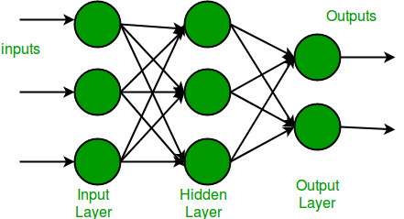
3. The Machine Learning Model
Neural Network MLP Classifier
Advantages of Multi-layer Perceptron:
Capability to learn non-linear models.
Capability to learn models in real-time

Slide 25
3. The Machine Learning Model
step
age
gender
amount
category_es_barsandrestaurants
category_es_contents
category_es_fashion
category_es_food
category_es_health
category_es_home
category_es_hotelservices
category_es_hyper
category_es_leisure
category_es_otherservices
category_es_sportsandtoys
category_es_tech
category_es_transportation
category_es_travel
category_es_wellnessandbeauty
Features
Fraud
Label

Slide 26
4. Machine Learning Analysis

Slide 27


4. Machine Learning Analysis
Model Training :
Split data to train and test
Used predict function to predict the labels for training data and test data

Slide 28
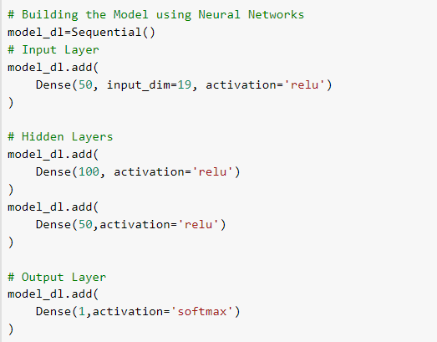
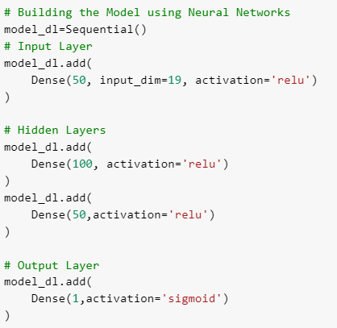
4. Machine Learning Analysis
Used Hyperparameters
Tried 2 different activation functions in the output layer for testing:
SoftMax
Sigmoid

Slide 29
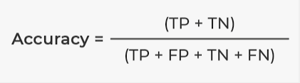
4. Machine Learning Analysis
Calculated the metrics for each model
Metrics used:
Loss : The difference between the predicted value by your model and the true value.
Loss function used :Binary Cross Entropy
(Used when there is a classification between 2 categories only)
Accuracy: Used to tell the percentage of accurate predictions. We calculate it by dividing the number of correct predictions by the total number of predictions.

Slide 30
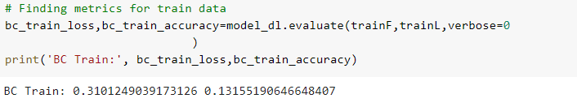
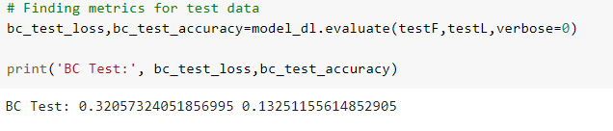
4. Machine Learning Analysis
Loss and Accuracy results for train and test data using Softmax Activation function
Loss
Accuracy
Loss
Accuracy

Slide 31
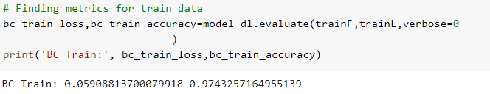
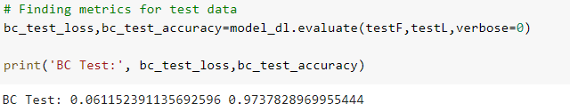
4. Machine Learning Analysis
Loss and Accuracy results for train and test data using Sigmoid Activation function
Loss
Accuracy
Loss
Accuracy

Slide 32
4. Machine Learning Analysis
After comparing themetrics for both activation functions we found that sigmoid was doing a better performance .
Multi-classification Binary classification
SoftMax
Sigmoid

Slide 33
4. Machine Learning Analysis
Suggested improvements:
Fine-tuning of the hyperparameters
Try different machine learning models (Ex: Random Forest , Gradient Booster Tree)

Slide 34
5. Conclusion

Slide 35
5. Conclusion
Challenges we faced :
Only 1.23 % of the initially provided data was classified as fraud
Model was predicting wrong values for the label because of a non-suitable activation function for the output layer

Slide 36
5. Conclusion
Lessons learned:
Graphical representation of data can give good insights of our data and it helps with detecting patterns and outliers.
There is always a room for improvement

Slide 37
5. Conclusion
Next steps for your data science career
This DataScience BootCamp is just the start !

Slide 38

Questions

