Slide 1

Popular Democratic Republic of Algeria
Ministry of Higher Education and Sientific Research
University of Sience and Technology Houari Boumedie
Computer Sience Faculty
Work presented to :
Hariz Soumia
Keteb Yousra
Hiba Tebani
Nadir Manel
Beddai Yakoub Abdallah

Slide 2


INFORMATIQUE & COMMUNICATION TECHNOLOGIES PRESENTATION

Slide 3
Content table :
SLIDE | TOPIC
4 | Introduction about ICT
5 | Types of ICT
6 | Negatives & Positives of ICT
7 | Microsoft Tools
8 | Google Services
9 | Latex
10 | GIT & GITHUB

Slide 4

Introduction in ict :
Information and communications technology (ICT) is an extensional term for information technology (IT) that stresses the role of unified communications and the integration of telecommunications (telephone lines and wireless signals) and computers, as well as necessary enterprise software, middleware, storage and audiovisual, that enable users to access, store, transmit, understand and manipulate information.

Slide 5
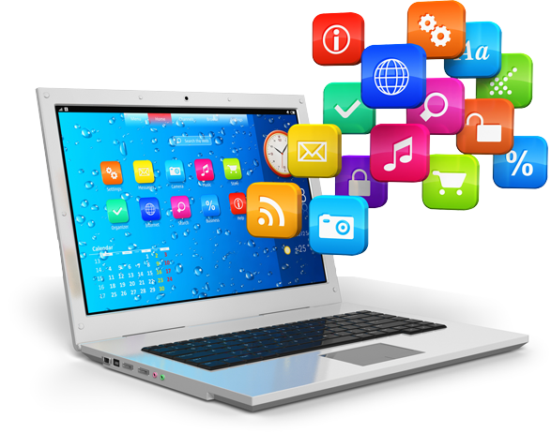
NEGATIVES & POSITIVES OF ICT :
NEGATIVES | POSITIVES
1. Speed and easiness of traveling 2. Education (EdTech) 3. Makes shopping hassle-free, affordable, and quick 4. Safer Management of Money 5. Equal opportunities | 1. Depression and Other Mental Health Issues 2. Technology leaves us feeling isolated 3. Technology is addictive 4. Privacy and securityTechnology promotes a shorter attention span

Slide 6
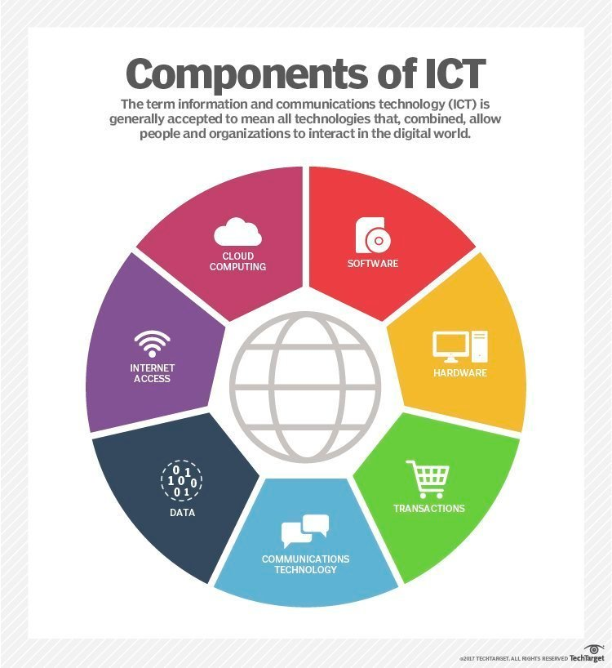
types of ict :
Computing and Information Technology:Computing and information technology mainly refers to designing and building computers. It also refers to maintaining and troubleshooting the computer system. It also ensures that the computer runs smoothly.
Broadcasting:Broadcasting is the transfer of audio and video visuals through any electronic mass communication to various audiences all over the world. It mainly uses the electromagnetic spectrum to transfer the data.
Telecommunications:Telecommunications are the transfer of electronic information over several distances. This information may be in the form of voice, data, text, images or any video.
Internet:The Internet is a global system that provides a variety of information and other communicational services by the use of interconnected networks. It uses the Internet Protocol (IP) to communicate with others.

Slide 7


Microsoft tools
Microsoft provides a diverse range of tools that cater to different aspects
of computing and productivity. Here are some key Microsoft tools :
tool | explanation
. Microsoft Office Suite | A cloud computing platform offering services such as virtual machines, databases, and AI, enabling businesses to build
. Microsoft Edge | A web browser developed by Microsoft, known for its integration with Windows and compatibility with web standards
Windows Operating System | Microsoft’s flagship operating system used on personal computers, laptops, and servers
Visual Studio: | An integrated development environment (IDE) for software development, supporting a variety of programming languages
Microsoft Teams | - A collaboration platform that integrates chat, video conferencing, file storage, and application integration to facilitate teamwork
OneDrive | A cloud storage service that allows users to store and share files securely

Slide 8






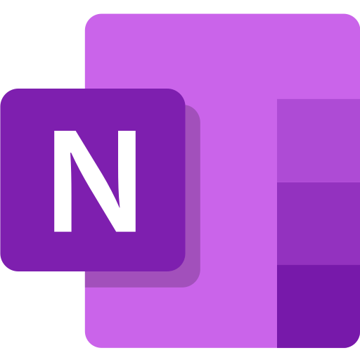


MICROSOFT OFFICE PLAN :
These tools collectively contribute to various aspects of computing, from software development and collaboration to data analysis and cloud computing. They play a crucial role in enhancing productivity, communication, and overall efficiency in both personal and professional computing environments.
MICROSOFT
TOOLS

Slide 9
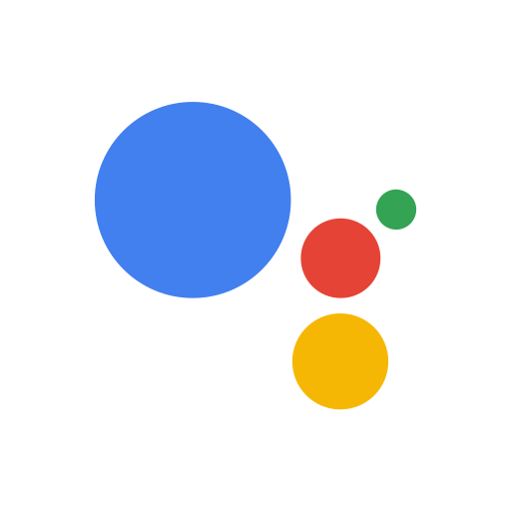









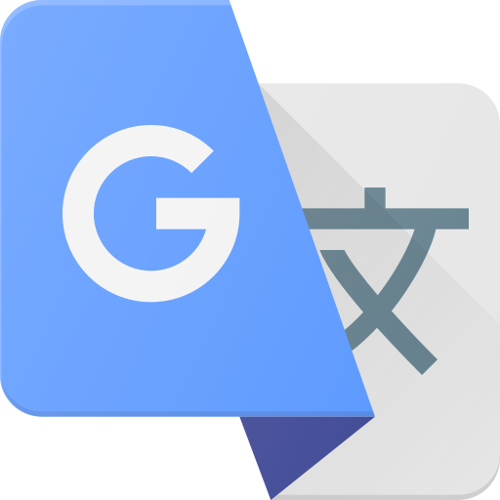
GOOGLE SERVICES :
Google services encompass a suite of applications and tools provided by Google, playing realm of Information and Communications Technology (ICT). Here’s an overview of some key Google services and their connection to ICT :
Google Search
Gmail
Google Maps
Google Drive
YouTube
Google Calendar
Google Photos:
Google Translate
Google Chrome
Google Play Store
Google Assistant
GOOGLE APPS

Slide 10

LATEX :
LaTeX is a document preparation system widely used in scientific and academic publishing. Here’s an explanation of LaTeX and how it works:
Document Formatting: - LaTeX excels in handling complex document structures. It allows users to focus on content creation while taking care of formatting automatically. This is particularly beneficial for academic papers, research articles, and other documents with intricate layouts.
Version Control: - LaTeX integrates well with version control systems like Git. This is particularly advantageous for collaborative writing and managing changes in large documents
Programming Language: - LaTeX is not a regular word processor; it’s a document preparation system based on a programming language. It uses programming-like commands to specify the format of the document and its various elements.
Mathematical Typesetting: - LaTeX is widely known for its excellent support for mathematical typesetting. It provides a comprehensive set of tools for creating and formatting mathematical equations and expressionsPortability and Stability: - LaTeX documents are plain text files, making them portable and easy to share. Additionally, LaTeX provides stability and consistency across different platforms, ensuring that documents look the same regardless of the operating system
Cross-Referencing: - One of LaTeX’s strengths is its robust cross-referencing system. It automates the numbering of sections, figures, and equations, ensuring consistency throughout the document. When changes are made, LaTeX automatically updates the references

Slide 11




Git & github
GIT :
- Git is a distributed version control system that enables developers to track changes in their project files. It allows developers to create local copies (repositories) of their projects and records changes at different stages, facilitating collaboration and change management.
GITHUB :
- GitHub is an online platform that provides hosting services for Git projects. Developers use GitHub to upload (push) their projects (repositories) to the cloud, allowing for better collaboration. GitHub offers a graphical user interface for project management and displays changes, providing a platform for developers to work together. ⦁ In summary, Git is the system that controls changes and allows for the creation of local copies, while GitHub is the place where developers can share and improve their projects online using Git.

