Slide 1
What happens after
you choose a program?
Earnings, AI exposure & employment outcomes across college programs.
A visual story of where graduates go next.
DATA-DRIVEN ANALYSIS
[Brooke Crichlow] • [Personal Project] • [August 2026]

Slide 2
OVERVIEW
01
TLDR; What should a prospective student take away?
Evaluating college major outcomes by earnings, employment, and AI exposure
EARNINGS
ARTIFICIAL INTELLIGENCE
EMPLOYMENT
Technical and applied programs Engineering, Computer Science, and skilled trades deliver the strongest earnings outcomes, both in absolute terms and relative to tuition cost
AI and expert-system exposure is heavily concentrated in Computer Science and a handful of STEM-adjacent fields; most other programs see minimal AI exposure in their linked occupations
People-facing and service-oriented programs show the highest "not working" activity, while technical and hard-science programs show the lowest.
OVERALL MESSAGE
[Institutional selectivity is a surprisingly weak predictor of future earnings, what you study matters far more than where you study. Prospective students may be better served by evaluating specific programs based on career growth, earning potential, and AI exposure to align their program choice with their personal goals. ]

Slide 3
Earnings
1
How much do graduates earn, and how does that compare
with the cost and selectivity of the program?
PROGRAM OUTCOMES • EARNINGS • AI • EMPLOYMENT

Slide 4
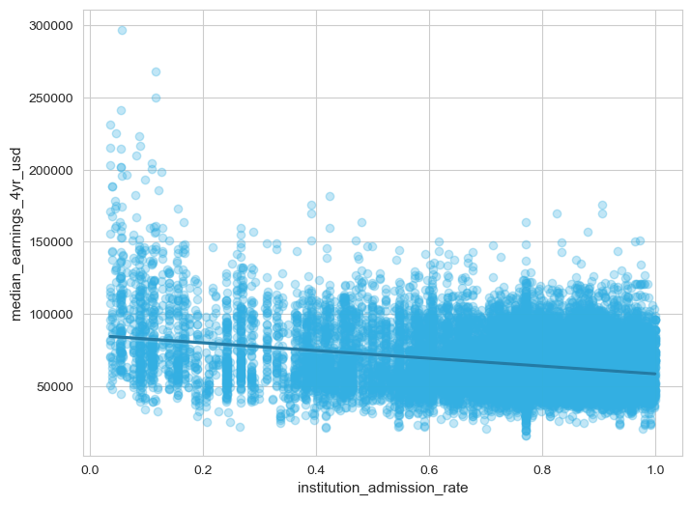
EARNINGS
03
Does school selectivity affect post-graduate earnings?
The correlation between the admission rate and 4-year earnings across all programs
GENERAL-LEVEL CHART
Selectivity matters but only weakly overall
The correlation between admission rate and 4-year earnings is -0.274
Graduates from more selective schools' trend towards higher earnings, but with a very loose relationship
Source: Lab, M. (2026, August 1). College majors 2026: Earnings, Debt, jobs, AI. Kaggle. https://www.kaggle.com/datasets/kylefengkfeng209/college-majors-2026-earnings-debt-jobs-ai

Slide 5
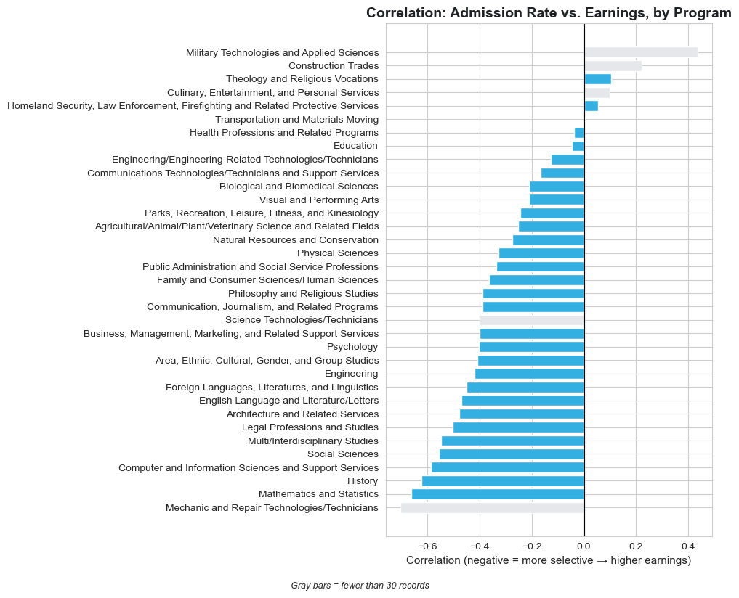
EARNINGS
04
Does school selectivity affect post-graduate earnings?
Comparing the correlation between admission rate and 4-year earnings across all programs
PROGRAM-LEVEL CHART
It matters a lot more in some programs than others
Mathematics & Statistics, History, Computer/Info Sciences, and Social Sciences show the strongest link between selectivity and earnings
Programs like Military Technologies and Construction Trades show the opposite direction. However, these programs also have smaller samples
Source: Lab, M. (2026, August 1). College majors 2026: Earnings, Debt, jobs, AI. Kaggle. https://www.kaggle.com/datasets/kylefengkfeng209/college-majors-2026-earnings-debt-jobs-ai

Slide 6
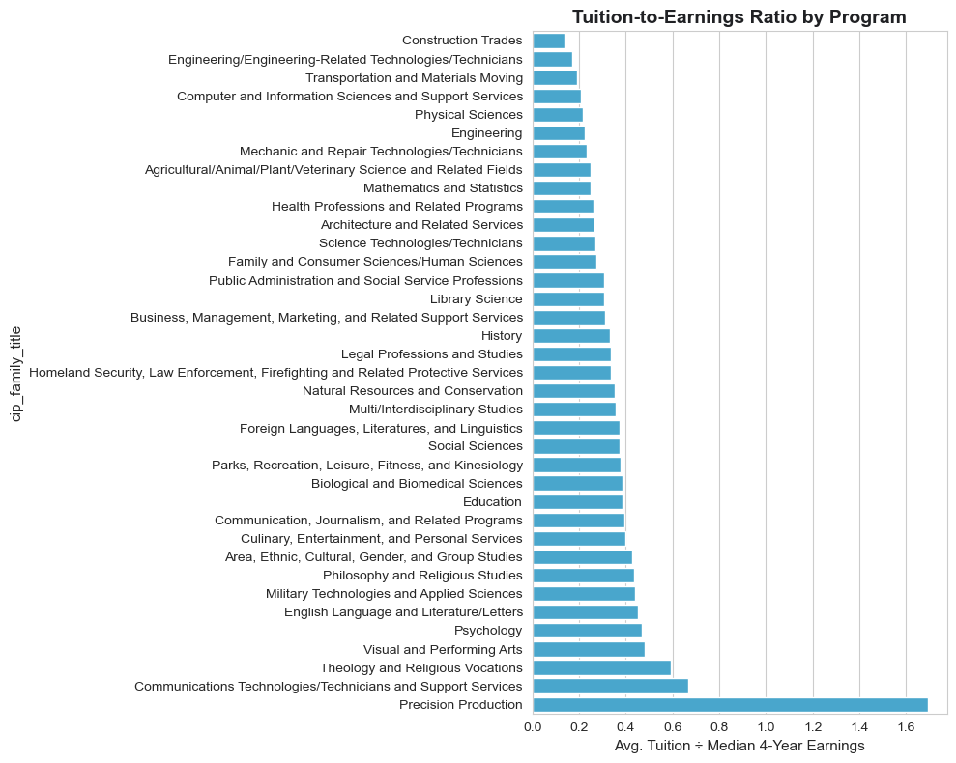
EARNINGS
05
Which programs offer the strongest tuition-to-earnings value?
Comparing the cost of attendance with post-graduate earnings.
TUITION TO EARNINGS RANKED BAR CHART
Technical and applied programs deliver the strongest return on tuition spend
Construction Trades (~0.15), Engineering-related Technologies (~0.17), Transportation (~0.18), Computer/Info Sciences (~0.20), and Engineering (~0.22) all have lower tuition in comparison to earnings, offering better return per dollar of tuition compared to most university programs
Precision Production (~1.7) (small sample size), Communications Technologies (~0.65) Theology and Religious Vocations (~0.58, and Visual and Performing Arts (~0.48) all have relatively weaker tuition-to-earnings value
Source: Lab, M. (2026, August 1). College majors 2026: Earnings, Debt, jobs, AI. Kaggle. https://www.kaggle.com/datasets/kylefengkfeng209/college-majors-2026-earnings-debt-jobs-ai
Define exactly how the tuition-to-earnings ratio is calculated.

Slide 7
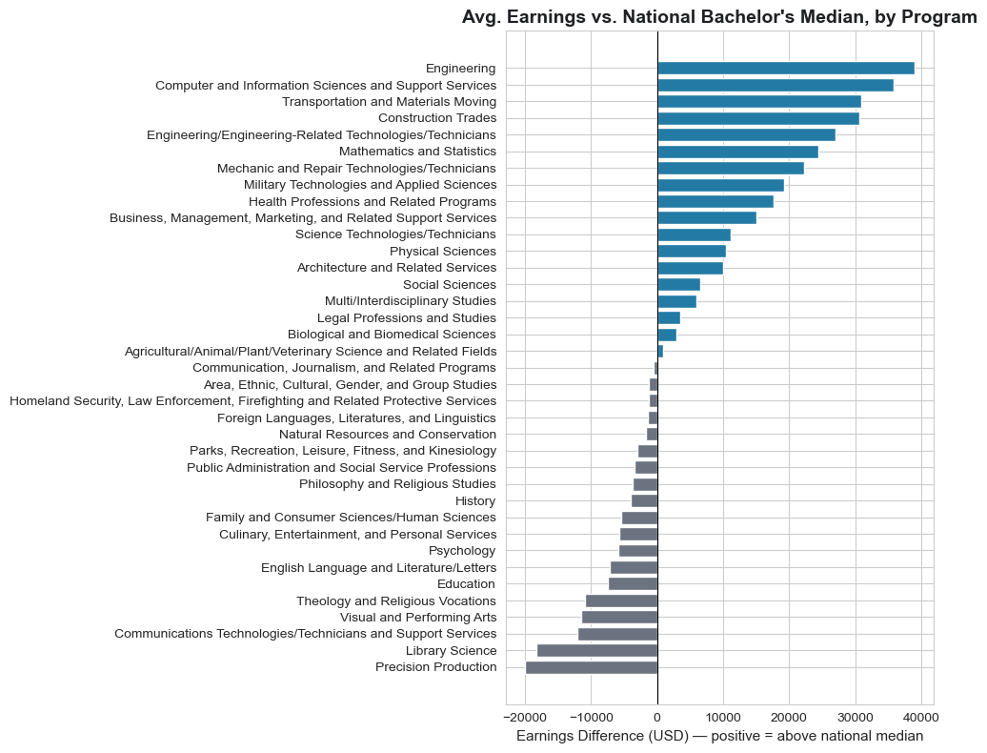
EARNINGS
06
How does each program compare with the typical bachelor’s degree earner?
Each program’s four-year earnings relative to the median four-year earnings benchmark
BENCHMARKED BAR CHART
BENCHMARK
$57,000
Median 4-year earnings of a Bachelor’s degree holder in the USA²
STEM and technical graduates outperform the national 4-year earnings benchmark, while arts, communications, and theology trail behind.
Highest Earners: Engineering (+$39K), Computer Science (+$36K), Transportation (+$31K), Construction (+$30K), and Engineering Tech (+$27K)
Lowest Earners: Precision Production (-$19K) (small sample size), Library Science (-$15K), Communications Tech (-$12K), Arts (-$11K), and Theology (-$11K).
Sources:
Lab, M. (2026, August 1). College majors 2026: Earnings, Debt, jobs, AI. Kaggle. https://www.kaggle.com/datasets/kylefengkfeng209/college-majors-2026-earnings-debt-jobs-ai
Picchi, A. (n.d.). College majors have a big impact on income. here are the highest- and lowest-earning fields. CBS News. https://www.cbsnews.com/news/college-major-top-and-lowest-earning-majors-impact-on-income-pay/

Slide 8
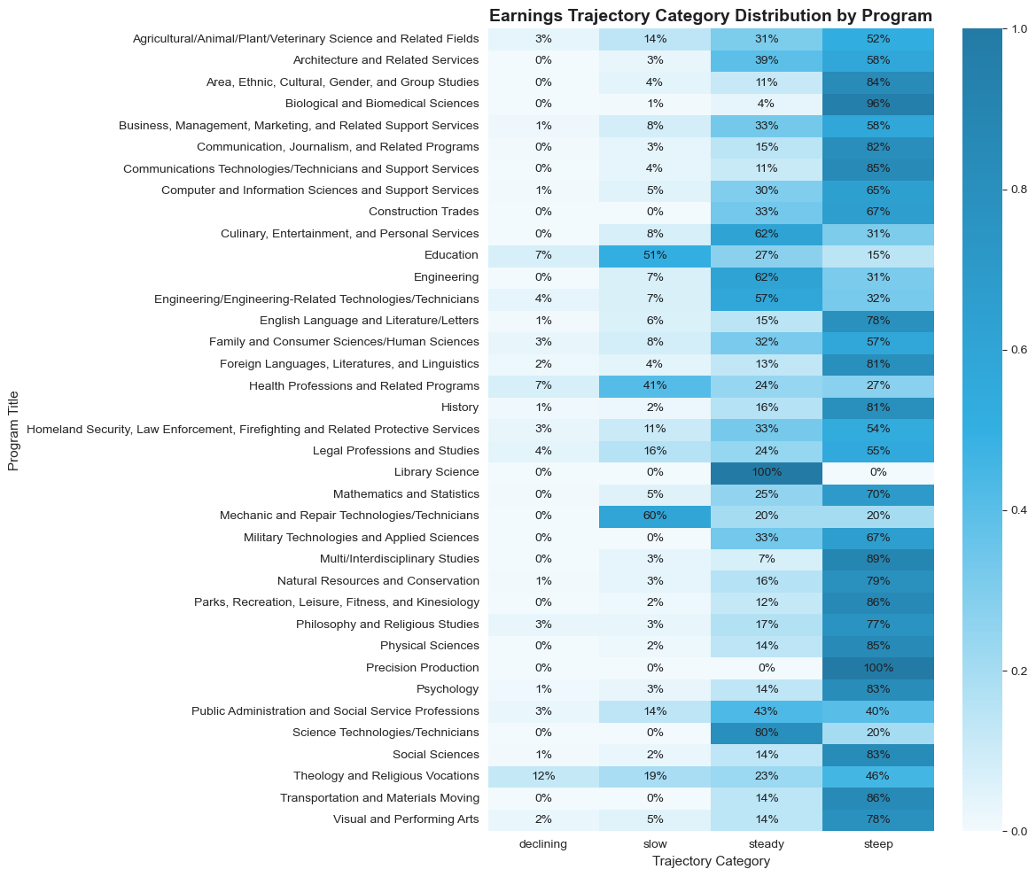
EARNINGS
07
What can graduates expect across a career?
The earnings trajectory associated with each program
HOW TO READ THIS CHART
CAREER TRAJECTORY CHART
Row = Program: Shows 100% distribution of graduate earnings trajectories
Color = Concentration: Darker blue indicates a higher percentage in that category
U.S. bachelor’s earnings growth is steep overall, with exceptions in Education and Healthcare.
Most programs trend "steep" growth (earnings climb dramatically from year 1 to year 5)
Education (51% "slow") and Health Professions (41% "slow") are outliers from this trend. Graduates in these fields see much flatter earnings growth over their career compared to others.
Source: Lab, M. (2026, August 1). College majors 2026: Earnings, Debt, jobs, AI. Kaggle. https://www.kaggle.com/datasets/kylefengkfeng209/college-majors-2026-earnings-debt-jobs-ai

Slide 9
Artificial Intelligence
2
How much of the work associated with each program is
changing because of AI?
PROGRAM OUTCOMES • EARNINGS • AI • EMPLOYMENT

Slide 10
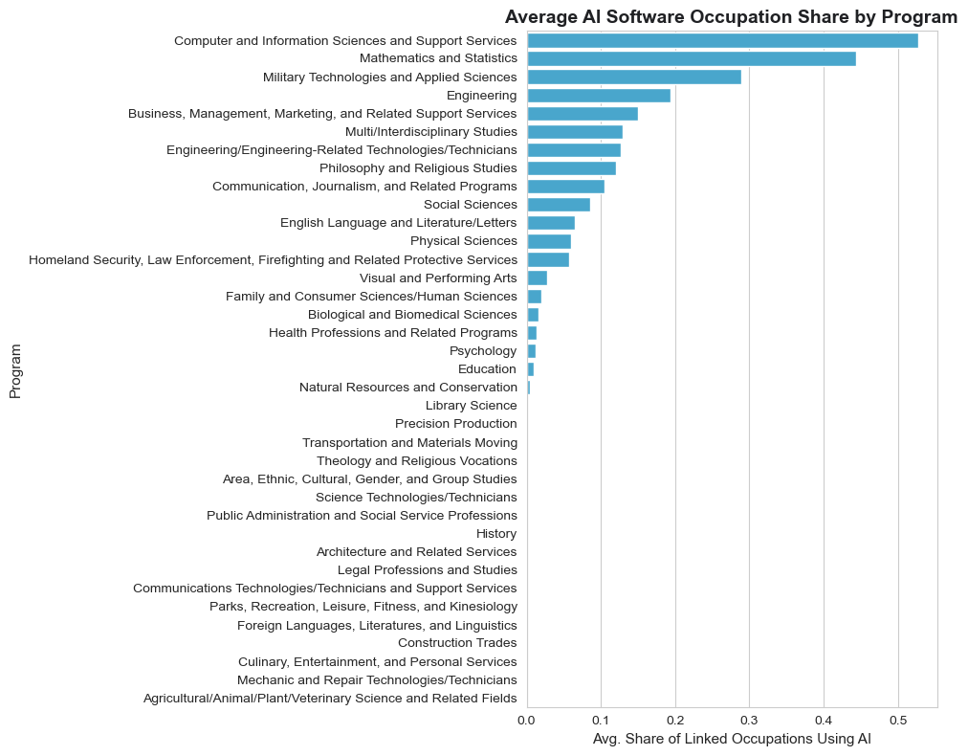
ARTIFICIAL INTELLIGENCE
09
Which programs’ graduates can expect to work most alongside AI?
Measuring the proportion of program-linked occupations that use AI
AI EXPOSURE BY PROGRAM
AI tool exposure is concentrated almost entirely in tech and quantitative fields
Computer and Information Sciences leads by a wide margin (~53% of linked occupations use AI software), followed by Mathematics and Statistics (~45%) and Military Technologies (~29%)
Nearly every other program including most humanities, arts, and service-oriented fields, sit below 15%, with many close to 0%.
Source: Lab, M. (2026, August 1). College majors 2026: Earnings, Debt, jobs, AI. Kaggle. https://www.kaggle.com/datasets/kylefengkfeng209/college-majors-2026-earnings-debt-jobs-ai

Slide 11
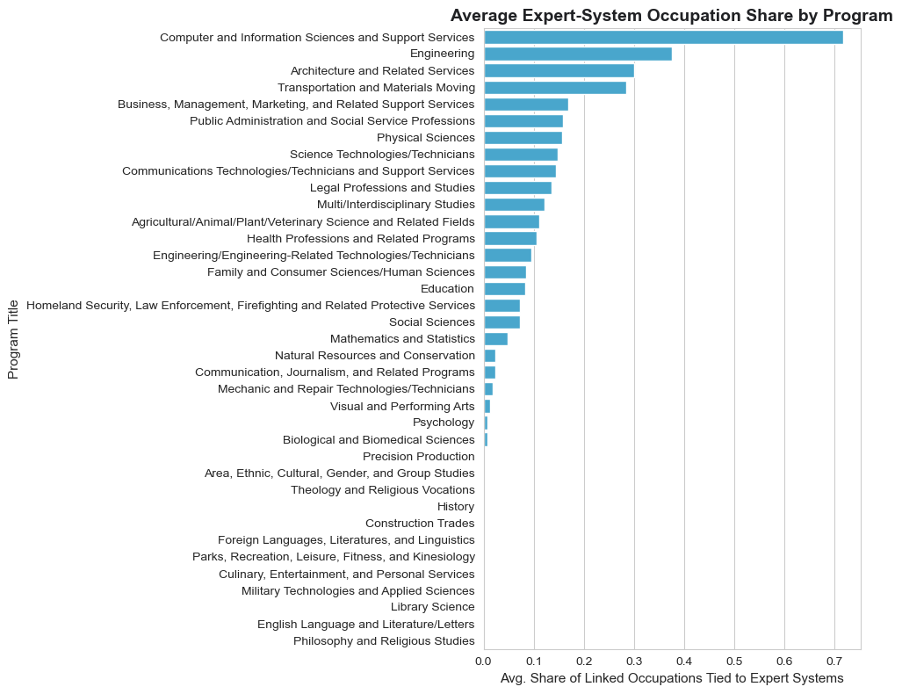
ARTIFICIAL INTELLIGENCE
10
Where are tasks most likely to be replaced by AI?
Measuring the proportion of program-linked occupations exposed to expert-systems
EXPERT-SYSTEM EXPOSURE
DEFINITION
Expert-system exposure
[The proportion of occupations linked to a college program that utilize AI expert systems designed to emulate specialized human decision-making]
Expert-system exposure is heavily concentrated in Computer Science, and also in other STEM related roles
Computer and Information Sciences leads in expert-system exposure by a wide margin (~72% of linked occupations tied to expert-system technology), with Engineering (~38%), Architecture (~30%), and Transportation and Materials Moving (~29%) form a distinct second tier
Beyond these four programs, exposure drops off with the majority of remaining programs falling under 15%
Source: Lab, M. (2026, August 1). College majors 2026: Earnings, Debt, jobs, AI. Kaggle. https://www.kaggle.com/datasets/kylefengkfeng209/college-majors-2026-earnings-debt-jobs-ai

Slide 12
Employment
3
Where do graduates go, and which programs have the
highest share of students not working?
PROGRAM OUTCOMES • EARNINGS • AI • EMPLOYMENT

Slide 13
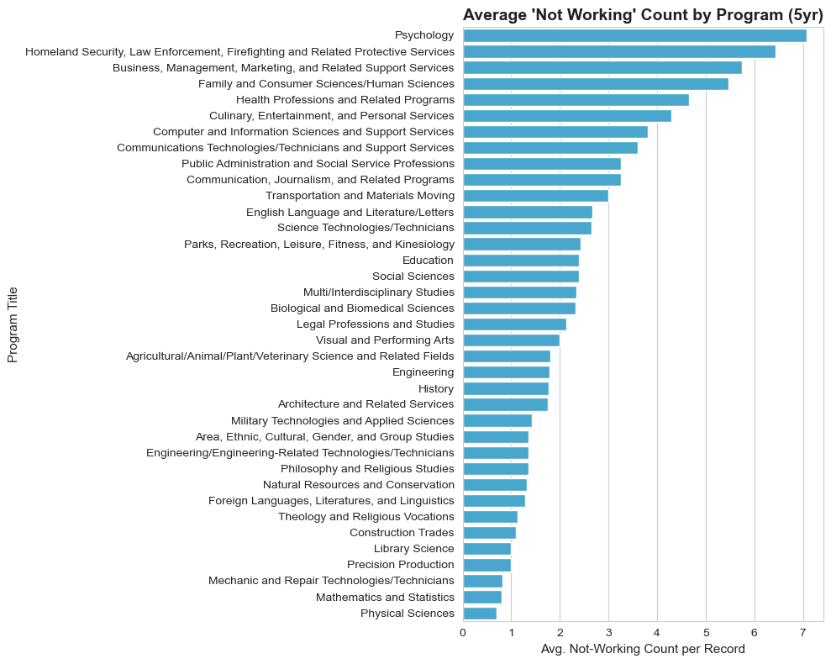
EMPLOYMENT
12
Which programs have the highest percentage of students not working?¹
Identifying each programs' post-graduation employment outcomes
NOT-WORKING COUNT BY PROGRAM
"Not working" activity is highest in people-facing and service-oriented programs, lowest in technical and hard-science fields.
Psychology has the highest average not-working count (~7.1 per record), followed by Homeland Security/Law Enforcement (~6.4) and Business, Management, and Marketing (~5.7
Physical Sciences sits lowest (~0.6), alongside Mathematics and Statistics (~0.7) and Mechanic and Repair Technologies (~0.8)
1: (Note: this is a raw count, not a true percentage, since there's no total-graduates column to normalize by. Please treat it as a relative comparison between programs, not an absolute rate.)
Source: Lab, M. (2026, August 1). College majors 2026: Earnings, Debt, jobs, AI. Kaggle. https://www.kaggle.com/datasets/kylefengkfeng209/college-majors-2026-earnings-debt-jobs-ai

Slide 14
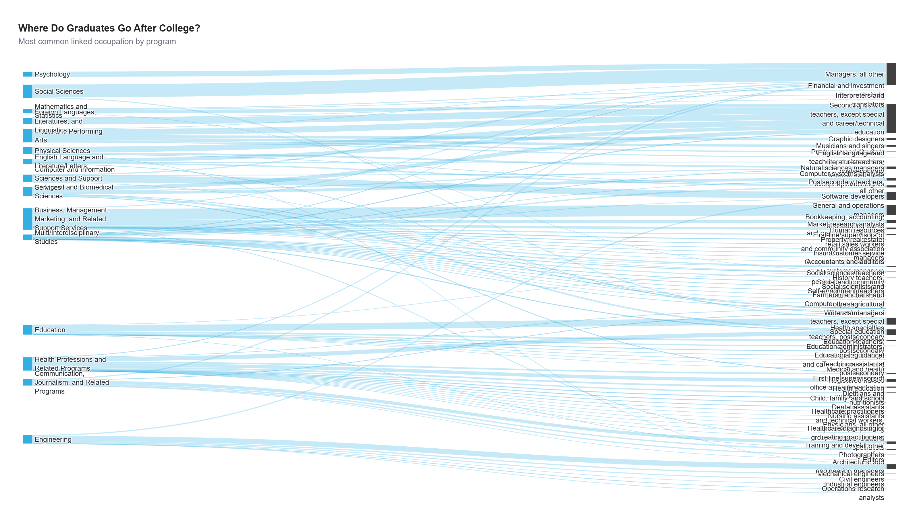
EMPLOYMENT
13
Where do graduates go after completing each program?
Each program and its most common linked occupations
Career outcomes split along two primary paths: management roles driven by business and social sciences grads, and teaching roles led by humanities and physical sciences grads
General & Operations Managers: Business, Management, & Marketing (4,002 records)
Managers, All Other: Social Sciences (4,666 records)
Software Developers: Computer & Information Sciences (2,409 records)
Elementary School Teachers: Education (2,355 records)
Secondary School Teachers: Foreign Languages (2,415), Visual & Performing Arts (2,165), and Physical Sciences (2,057)
OCCUPATION PATHWAY VISUAL
Source: Lab, M. (2026, August 1). College majors 2026: Earnings, Debt, jobs, AI. Kaggle. https://www.kaggle.com/datasets/kylefengkfeng209/college-majors-2026-earnings-debt-jobs-ai

Slide 15
APPENDIX
14
Definitions & methodology
Use this slide to make the analysis transparent and reproducible.
MEASURES
LIMITATIONS
Program: CIP (Classification of Instructional Programs) family grouping, aggregating related degree programs (e.g., all Engineering disciplines) into one category for comparison.
Earnings: Median earnings 4 years after graduation, in USD
Tuition: In-state, published tuition rate; does not account for financial aid, scholarships, or net price after aid
Selectivity: Institution's undergraduate admission rate; a lower rate indicates a more selective school
AI-linked occupation: An occupation classified as using AI software tools in its day-to-day work
Expert-system exposure: Share of program-associated roles exposed to AI-driven expert decision-making systems
Not working: Count of graduates not reporting employment 5 years after completion; a raw count, not normalized by total program size
Linked occupation: The occupation(s) most commonly held by graduates of a given program
Correlation does not imply causation, thus selectivity and earnings may both be driven by other underlying factors
Occupation linkage reflects common outcomes for a program nationally, not any individual graduate's actual job
Earnings vary by geography, experience, industry, and economic conditions not captured in this dataset
AI and expert-system exposure measures indicate occupational exposure to these technologies, not confirmed or guaranteed job displacement
Some programs have small underlying sample sizes; these are flagged where relevant and should be interpreted with caution
Appendix

