Slide 1
Hybrid Quantum–Classical
Term Deposit Campaign
Nov 11th, 2026
Atomiq Hackathon
Hibiki Matsuyama
Notes:
We designed and verified a three-stage hybrid pipeline: probability ranking, constrained quantum optimization, and quantum probability estimation.

Slide 2
Our three-stage pipeline
Stage 1
Stage 2
Stage 3
Prediction
Optimization
Uncertainty
300 labelled → 100 test
Rank by calibrated p
Top 10 → choose 6
Budget ≤25, capacity ≤22
6-qubit Bernoulli circuit
P(3 or more subscribe)
One consistent probability model connects all three stages.
Notes:
Stage 1 predicts customer subscriptions. Stage 2 selects exactly six customers based on expected net value. Stage 3 estimates the chance that at least three subscribe.

Slide 3
Stage 1: N17 + Friend Hybrid
Calibrated probabilities from training data only
N17
Friend LR
Quantum
History-aware
classification
Compact classical
baseline
Kernel + VQC
components
N17 + Friend Hybrid
100 test probabilities
All preprocessing and calibration must be fitted within training folds.
Notes:
The final prediction pipeline combines N17 with classical and quantum components provided by our team. We also report classical and hybrid baselines on aligned folds.

Slide 4
Stage 1: aligned cross-validation
Model
PR-AUC ↑
ROC-AUC ↑
Brier ↓
N16
0.3553
0.7257
0.09157
N17 + Friend LR
0.3557
0.7319
0.09136
N17 + Friend Hybrid
0.3572
0.7344
0.09111
Protocol: aligned 3-fold CV, seed 42; 300 training customers
Hybrid model improves PR-AUC and ROC-AUC within this protocol.
Notes:
These scores are comparable because they were computed with the aligned three-fold procedure. The result is a modest improvement, not proof of a statistically significant gain.

Slide 5
Stage 1: top 10 selected customers
Rank
Customer
Predicted p
Stage 2 selected
1
C0081
0.8494
YES
2
C0079
0.7296
YES
3
C0031
0.7017
YES
4
C0327
0.2641
YES
5
C0183
0.2583
—
6
C0208
0.2304
—
7
C0374
0.2269
YES
8
C0193
0.1899
—
9
C0222
0.1827
YES
10
C0318
0.1762
—
Notes:
Our final stage-one ranking selects exactly ten customers. The six highlighted customers are selected by Stage 2.

Slide 6
Stage 2: constrained optimization
Choose exactly 6 of the top 10 customers
Maximise Σ (pᵢ × deposit_valueᵢ − contact_costᵢ) xᵢ
Σ xᵢ = 6
Σ contact_costᵢ xᵢ ≤ 25
Σ capacity_unitsᵢ xᵢ ≤ 22
Exact classical optimum = 43.183204 | Cost = 14 | Capacity = 11
Notes:
The objective is expected net value. We enumerate all 210 six-person sets to obtain an exact classical reference.

Slide 7
Stage 2: why Dicke + XY mixer?
|D₁₀⁶⟩ = equal superposition over all 210 six-customer choices
Dicke initial state
XY mixer
Every bitstring begins
with exactly six 1s
Moves amplitudes among
six-selection bitstrings
6 selected in every ideal measurement → 100% feasible
Here, all 210 six-subsets also satisfy budget and capacity limits.
Notes:
The XY mixer commutes with total excitation number. Importantly, all 210 six-customer combinations happen to be within budget and capacity for this instance. This is not true for arbitrary instances.

Slide 8
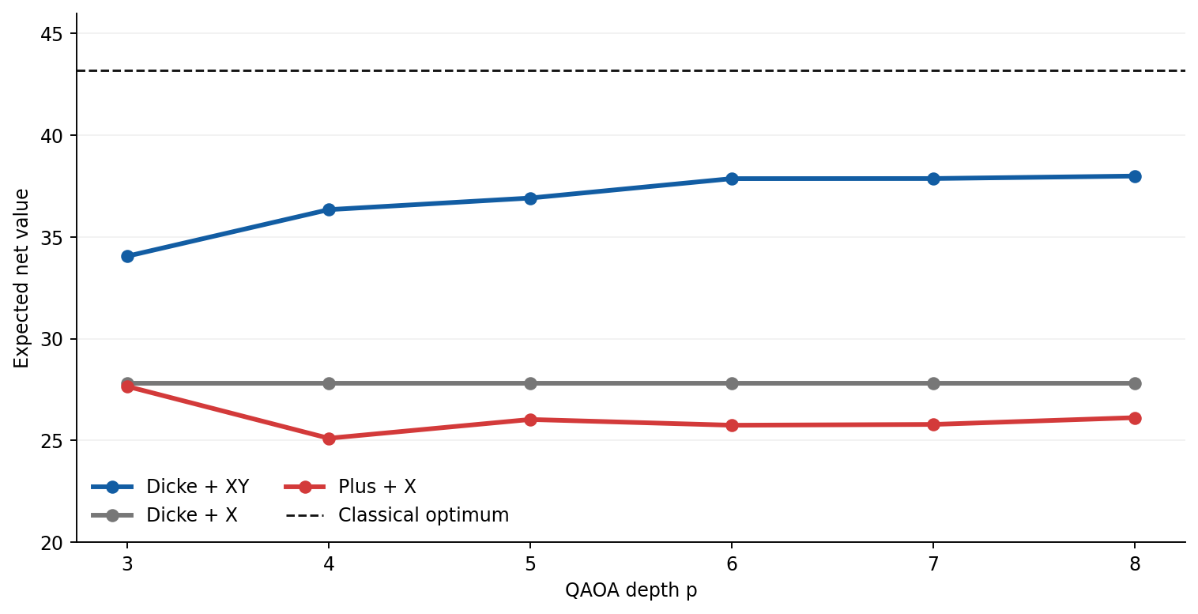
Stage 2: expected net value, p=3–8
Dicke + XY achieves the highest expected net value in this benchmark.
Notes:
These are ideal state expectation values evaluated at parameters whose circuits were checked against Qiskit Aer. p equals eight has the highest expected net value, 37.995.

Slide 9
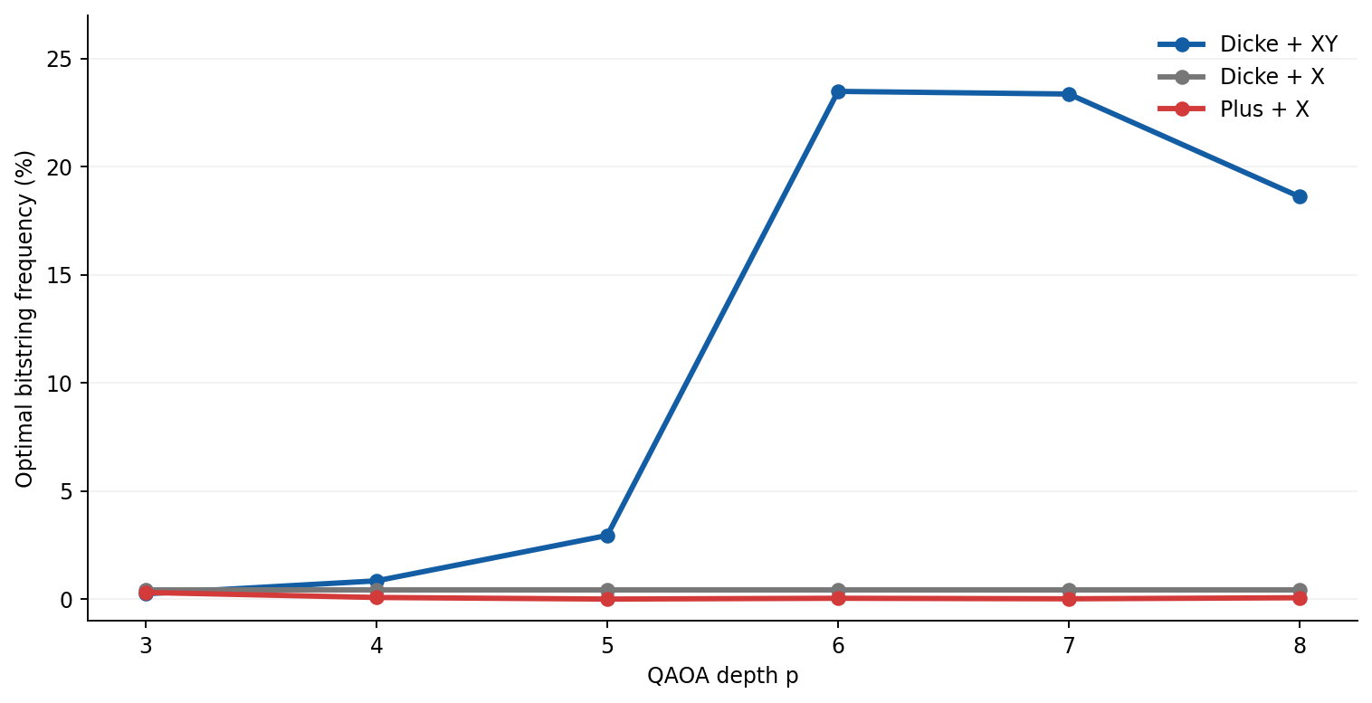
Stage 2: chance of observing the optimum
p = 6: 1,923 / 8,192 shots
Notes:
Our most frequent optimal outcome among Dicke XY circuits was at p equals six. The target bitstring was observed 1923 times in 8192 Aer shots.

Slide 10
Stage 2: constraint-preserving vs standard QAOA
Model
Initial state
Mixer
Feasible shots (p=6)
Dicke + XY
Dicke
XY
8,192 / 8,192
Dicke + X
Dicke
X
8,192 / 8,192
Plus + X
|+⟩¹⁰
X
5,330 / 8,192
X mixing does not conserve the number of selected customers.
Feasibility is enforced structurally by Dicke + XY, not by luck.
Notes:
Dicke X can also remain feasible if optimized beta parameters are nearly zero. Therefore, the sample outcome does not imply that X mixing preserves cardinality in general. p=6 Plus X feasibility was 5330 of 8192.

Slide 11
Stage 3: six-qubit probability encoding
Each qubit encodes one customer’s Bernoulli probability
q0: C0081
Ry(2.344)
M
p=0.849
q1: C0079
Ry(2.048)
M
p=0.730
q2: C0031
Ry(1.986)
M
p=0.702
q3: C0327
Ry(1.079)
M
p=0.264
q4: C0374
Ry(0.993)
M
p=0.227
q5: C0222
Ry(0.883)
M
p=0.183
Count measured 1s: success if at least 3 of 6 subscribe.
Notes:
The angle equals two arcsine of square root p. Six independent single-qubit rotations prepare the Bernoulli product state; no entangling gates are needed for direct Monte Carlo sampling.

Slide 12
Stage 3: Qiskit Aer vs exact probability
Exact
Ideal Aer
Noisy Aer
67.7951%
67.3218%
65.8203%
Poisson-binomial calculation
5,515 / 8,192 shots
5,392 / 8,192 shots
Ideal Aer differs from the exact answer by only 0.473 percentage points.
Noise results are illustrative, not from a calibrated quantum device.
Notes:
The exact result is 0.67795147. Ideal Aer gave 5515 successful outcomes in 8192 shots. Noisy Aer gave 5392. The noise model is illustrative, not hardware calibration.

Slide 13
Stage 3: amplitude estimation extension
Maximum-Likelihood Amplitude Estimation (MLAE)
Method
Shots
Estimate
Absolute error
Direct sampling
8,192
67.3218%
0.4734 pp
MLAE, k=0,1,2,4,8
2,560
67.7125%
0.0826 pp
MLAE, k=0,1,2,4,8
10,240
67.8683%
0.0732 pp
MLAE uses repeated Grover operations — shots are not the full cost.
Lower error here does not establish a quantum speedup.
Notes:
The amplitude estimation circuits were executed in ideal Aer. They require higher circuit depth and more Grover operator applications. Comparing just measurement shots is not a fair hardware cost comparison.

Slide 14
Technical limitations and reproducibility
Strength
Limitation
Stage 1: held-out predictions for all 100
Full retraining needs exact dependencies / seeds
Stage 2: 18 Aer circuits + classical optimum
Dicke initialize is expensive on native gates
Stage 3: direct samples + MLAE
Independent Bernoulli model; illustrative noise
No hardware demonstration or quantum advantage claim
Notes:
An important limitation is Dicke state preparation. When expanded using generic gates, its depth is much higher than the logical depth reported by Aer. Our task is small and classically tractable.

Slide 15
Summary
Goal: reliable hybrid campaign decisions
✓ Stage 1 — N17 + Friend Hybrid ranks 100 customers
✓ Stage 2 — best six identified; classical optimum 43.183204
✓ Stage 2 — Dicke + XY preserves feasibility in Aer
✓ Stage 3 — P(≥3) = 67.7951%; Aer and MLAE verified
Thank you!
Notes:
We built an end-to-end hybrid solution with measured Qiskit Aer evidence, exact classical benchmarks, and reproducible reports. Thank you.

