Slide 1


Lagopus: High-performance Software OpenFlow Switch for Wide-area Network
June 2014
NTT Network Innovation Laboratories

Slide 2


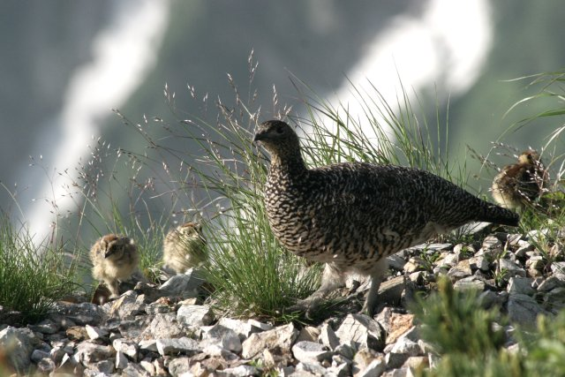
Agenda
Motivation and Target
Development Status
Evaluation
Conformance
Performance
Future Development Plan
A bird in cloud

Slide 3
Motivation
Agile and flexible networking
Full automation in provisioning, operation and management
Seamless networking for customers
Server virtualization and NFV needs a high-performance software switch
Small latency
Wire-rate with short packet (64B)
NO high-performance OpenFlow 1.3 software switch for wide-area networks
1M flow rules
10Gbps-wire-rate
Management protocol

Slide 4
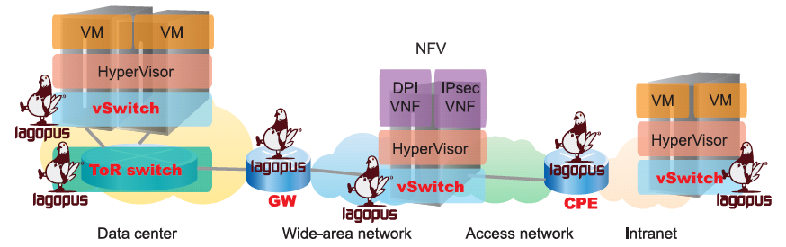
Target of Lagopus
High performance software-based OpenFlow switch
10Gbps wire-rate packet processing
1M flow rules
Expands the application to wide-area networks
Not only for data centers
WAN protocols, e.g. MPLS and PBB
Various management/configuration interfaces
Open Innovation
To be released as OSS

Slide 5
Specific Implementation Target
ONF standard specification support
OpenFlow Switch Specification 1.3.4
Multi tables, Group tables support
MPLS, PBB, QinQ, support
OF-CONFIG 1.1
Multiple data-plane configuration
High performance software data-plane on Intel x86 bare-metal server
Leverages commodity server architecture
Bare metal switch
Utilizing switch ASIC
Various management/configuration interfaces
OF-CONFIG, OVSDB, CLI
SNMP, Ethernet-OAM functionality

Slide 6

Agenda
Motivation and Target
Development Status
Evaluation
Conformance
Performance
Future Development Plan

Slide 7
Development status
Performance
10 GbE wire-rate
1M flow rules
Function:
OpenFlow 1.3 agent: well-tested
OpenFlow 1.3 software data plane: well-tested
OpenFlow 1.3 switch ASIC data plane: research
Management Interface / protocol:
CLI: prototype
SNMP: prototype
OF-CONFIG: prototype
OVSDB: research

Slide 8
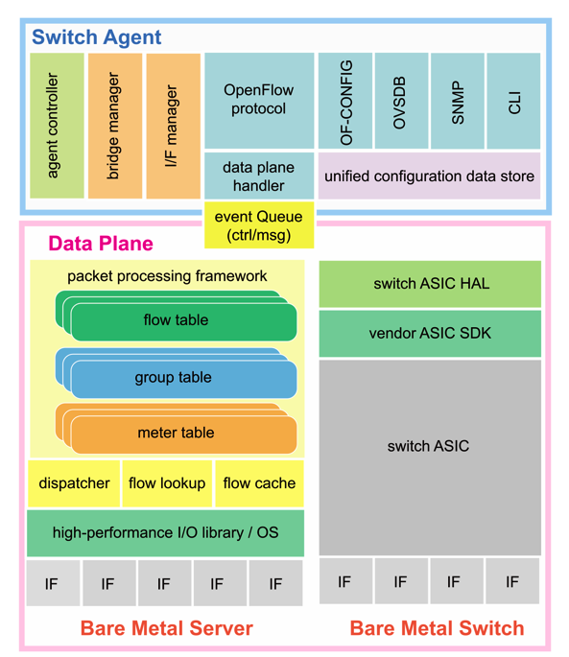

Design
Switch agent and data plane component
Connected via event queue
Supports multiple data plane implementations
Switch agent
Modular architecture
Easy to add configuration and management protocols
Software data plane
User space implementation using Intel DPDK
Easy deployment
OpenFlow controller
OpenFlow 1.3

Slide 9
Software data plane implementation
OpenFlow data plane processing
Must lookup and modify various protocol header
Performance limitation of single CPU core processing
Exploit many core CPUs
Pipelining: dividing I/O and packet processing
Parallelizing each processing
Improves performance and reduces I/O overhead
Ring buffer
NIC RX buffer
Ring buffer
NIC TX buffer
Flow lookup packet processing
CPU2
NIC 1
RX
NIC 1
TX
I/O RX
CPU0
I/O TX
CPU6
NIC 2 RX
Flow lookup packet processing
CPU3
NIC 2 TX
NIC 3
RX
NIC 3
TX
I/O RX CPU1
Flow lookup packet processing
CPU4
I/O TX
CPU7
NIC 4 RX
NIC 4 TX
Flow lookup packet processing
CPU5

Slide 10
Agenda
Motivation and Target
Development Status
Evaluation
Conformance
Performance
Future Development Plan

Slide 11
OpenFlow 1.3 Conformance Status
Conformance test results by Ryu Certification
http://osrg.github.io/ryu/certification.html
 | OpenFlow Switch | Action (56) | Set Field (170) | Match (702) | Total (928)
Software | OVS (netdev) | 27 | 71 | 433 | 531
 | OVS (kernel) | 17 | 65 | 433 | 515
 | Indigo Virtual Switch | 17 | 46 | 362 | 425
 | ofswitch13 | 41 | 69 | 419 | 529
 | LINC | 24 | 71 | 472 | 567
 | Trema | 49 | 129 | 612 | 790
 | Lagopus vswitch | 56 | 162 | 702 | 920
Hardware | Centec V350 | 6 | 11 | 196 | 213
 | HP 2920 | 0 | 0 | 20 | 20
 | NoviFLow NoviKit200 | 31 | 71 | 399 | 501
 | Pica8 P-3290 | 10 | 27 | 386 | 423

Slide 12
Performance Evaluation
Summary
Throughput: 10Gbps wire-rate
Flow rules: 1M flow rules
Evaluation models
WAN-DC gateway
MPLS-VLAN mapping
MPLS P router
MPLS label switching

Slide 13
Performance Evaluation
Evaluation setup
Server spec.
CPU: Dual Intel Xeon E5-2660
8 core(16 thread), 20M Cache, 2.2 GHz, 8.00GT/s QPI, Sandy bridge
Memory: DDR3-1600 ECC 64GB
Quad-channel 8x8GB
Chipset: Intel C602
NIC: Intel Ethernet Converged Network Adapter X520-DA2
Intel 82599ES, PCIe v2.0
Network
tester
Packet size
Flows
Server
Lagopus
Flow
rules
Flow
cache
(on/off)
Flow table
Throughput

Slide 14
WAN-DC Gateway Throughput vs packet size, 1 flow, no flow-cache

Slide 15
WAN-DC Gateway Throughput vs packet size, 1 flow, flow-cache

Slide 16
WAN-DC Gateway Throughput vs flows, 1518 bytes packet

Slide 17
MPLS P router Throughput vs packet size, 1 flow, no flow-cache

Slide 18
MPLS P router Throughput vs packet size, 1 flow, flow-cache

Slide 19
MPLS P router Throughput vs flows, 1518 bytes packet

Slide 20
Agenda
Motivation and Target
Development Status
Evaluation
Conformance
Performance
Future Development Plan

Slide 21
Future Development Plan
40Gbps-wirerate high-performance switch
Hypervisor integration
Tunnel processing
High availability
Open source activity

Slide 22

Thank you for your attention
This research is a part of the project for “Research and Development of Network Virtualization Technology” supported by the Ministry of Internal Affairs and Communications.

