Slide 1
Application Layer
Infrastructure Layer
Integration
System
Connector
Controller
O/R Mapper
use
use
テスト対象
use
Helper
use
RepositoryImpl
use
Domain Layer
use
Service
ServiceImpl
Repository
instantiate
use
DomainObject

Slide 2
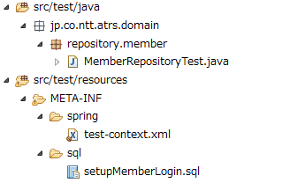

Slide 3
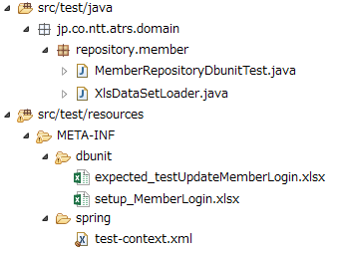


Slide 4
テスト対象
Application Layer
Infrastructure Layer
Integration
System
Connector
Controller
O/R Mapper
use
use
use
Helper
use
RepositoryImpl
use
Domain Layer
use
Service
ServiceImpl
Repository
instantiate
use
DomainObject

Slide 5
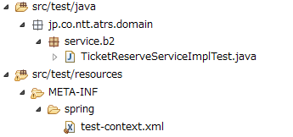

Slide 6
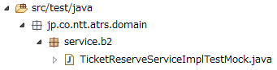

Slide 7
Application Layer
Infrastructure Layer
Integration
System
Connector
Controller
O/R Mapper
use
use
use
Helper
use
RepositoryImpl
use
テスト対象
Domain Layer
use
Service
ServiceImpl
Repository
instantiate
use
DomainObject

Slide 8
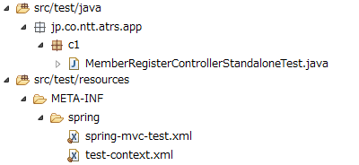

Slide 9
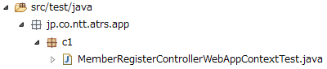

Slide 10


