Slide 1
Crane Damping Applied Robotics - FRTF20 HT-2020 Group10
Hicham Mohamad
Ola Nilsson

Slide 2
Crane Damping Project
System Overview
Model Description
Control Design Approach
Angle Estimation using IMU
Network Connection

Slide 3
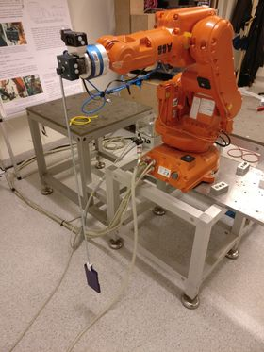
System Overview
System consists of a robot arm that is driven by:
An ABB IRB140 robot with 6 joints/links
A free swinging pendulum attached to the pivot point
IRC5: Embedded main-computer + PID controller
Dc motors at the 6 joints
Mobile phone tracker added to the system
IMU app called IMU+GPS-Stream to gather information

Slide 4
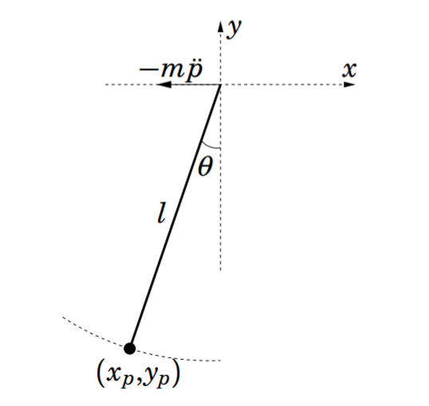
Project Objective
Damping the load swinging in a planar orbit:
The main task of our project is to control ABB140 robot arm such that it will be able to damp the oscillations of the swinging pendulum
using the ABB controller IRC5 and the LTH-made sensor software interface ExtCtrl
Alternative: Circular swinging process

Slide 5
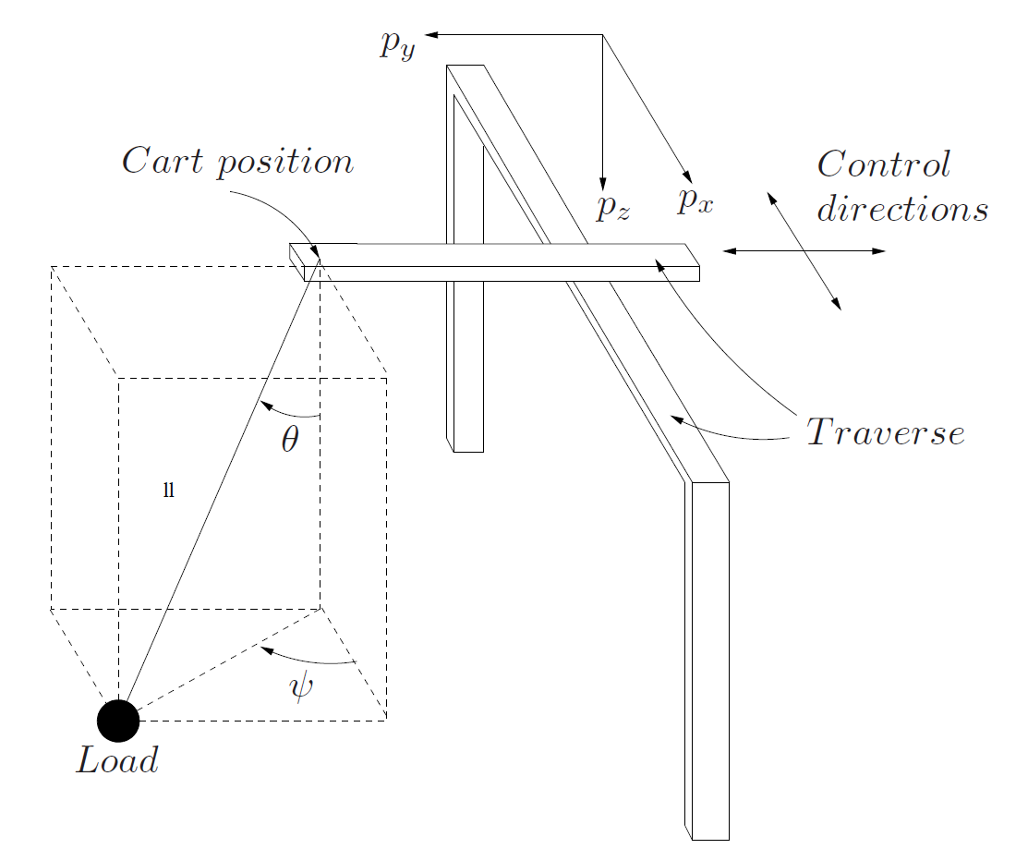
Modeling of the Crane Process
The Cart-pendulum model
Our process can be modelled as a Pendulum mounted to a motorized cart.
The cart motion tries to keep the leaning angle, θ, at a small level and damp the swinging pendulum.
The model should be close to the real process behaviour.

Slide 6
Characteristics of The Physical System
Pendulum is oscillatory without control.
Dynamics of the pendulum system is nonlinear.
Pendulm oscillates back and forth and can be damped by a controller, i.e. The acceleration of the DC motors tries to keep it at the downward vertical position at zero degree by acting on the tilt-angle ɵ

Slide 7
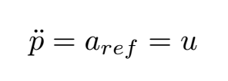
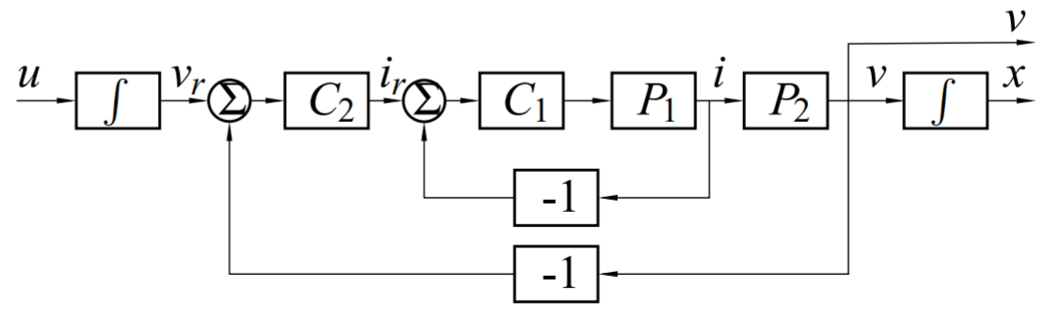
Modelling the Cart / Cascaded structure
DC-motor is controlled in a cascaded structure
Cart dynamics can be modeled as a double integrator from acceleration reference u to the position p of the robot arm: Inner loop & Outer loop
Double integrator

Slide 8
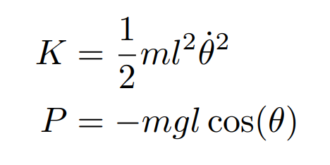

Kinetic and Potential Energy - Pendulum System
Kinetic and potential energy in the generalized coordinate
Lagrangian

Slide 9
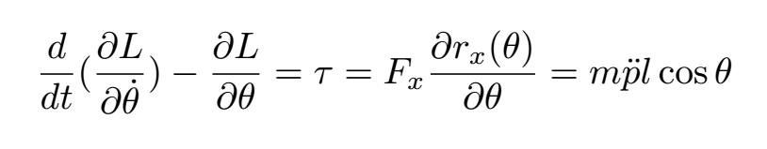
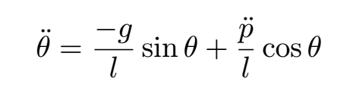
Dynamic Equations of Pendulum System
Euler-Lagrange ‘s Law gives the dynamic equation for the pendulum

Slide 10
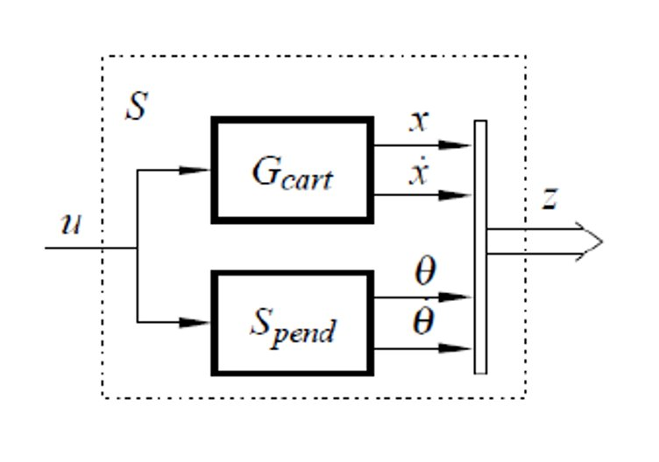
Resulting Nonlinear Model – Complete System
The two governing equations for the cart-pendulum system

Slide 11
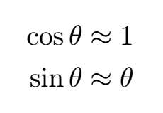
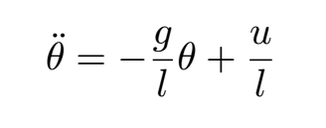
Linearized Pendulum equation of motion
Linearization: The model can be linearized by substituting the approximations in the downward position, around
Validation: This assumption can be reasonably valid if we design the controller such that the pendulum do not deviate too much from the vertically downward equilibrium position.

Slide 12

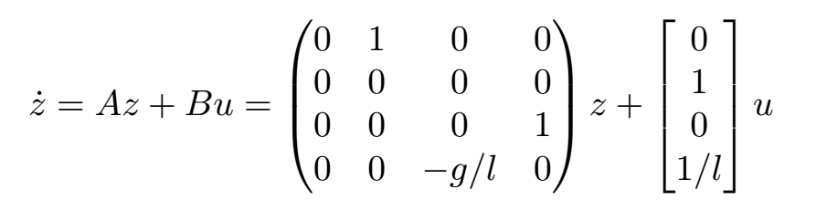
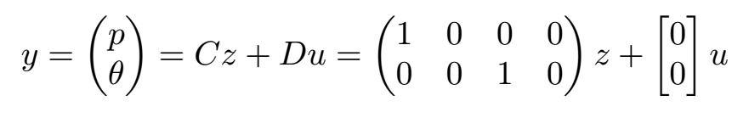
The Full State Space System
Linearization of the system dynamics, results in the following state space model

Slide 13
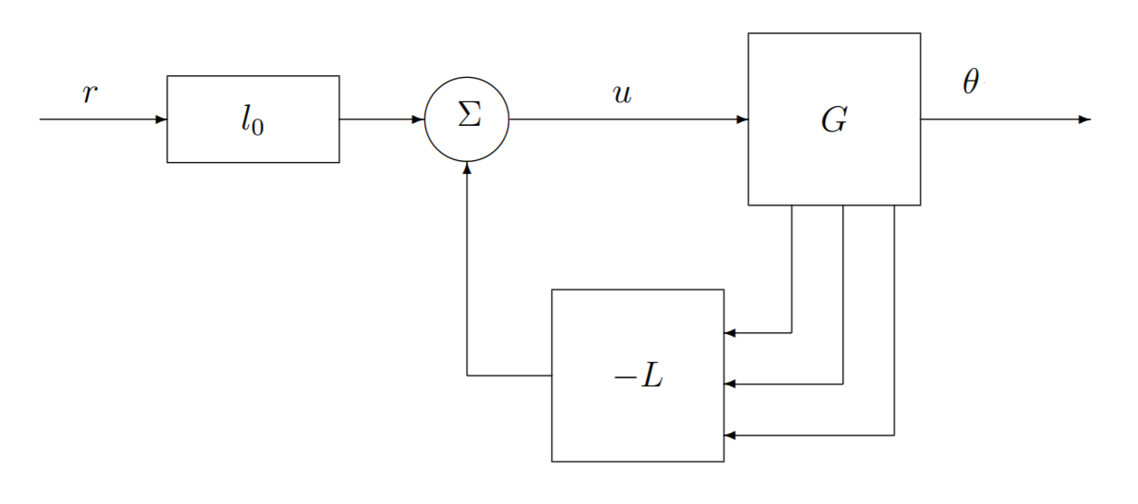
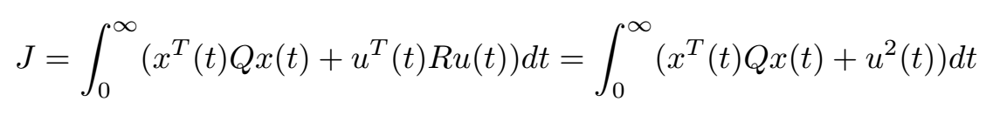
Linear State Feedback Design – LQ Control
Optimal Feedback Law u = - L x
Our control design is based on the linear model
LQR design: computing the optimal gain vector L that minimizes the cost function J given the weights Q and R:

Slide 14
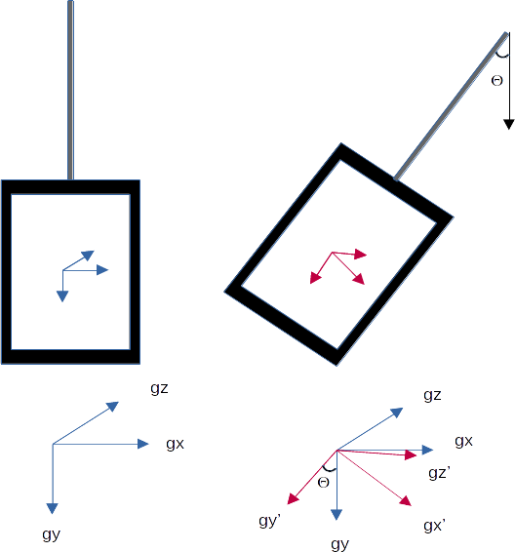
Angle Estimation using IMU
By extracting information from both the accelerometers and the gyro
Sensor fusion: Combining these using low-pass and high-pass filters, we will create a better estimate of the angle of the pendulum, compared to a naive approach of using only the gyro, or only the accelerometer.

Slide 15
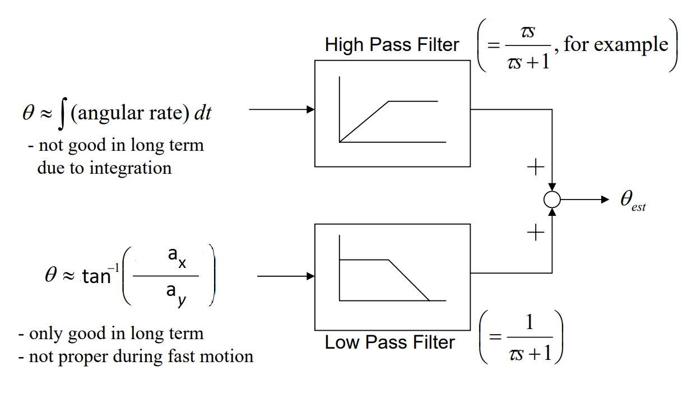
Angle Estimation IMU - Complimentary Filter
Better estimate by using sensor fusion with Complementary Filter

Slide 16
Simulink, Python, C and Orca/EXTCTRL
Network communication to the robot control system
The model and the optimization problem are described in Maltlab/Simulink
Problem solved by a third-party LTH-made Simulink ExtCtrl
Python and C is the interface that let us communicate to ExtCtrl and plot the result

Slide 17
Communication setup / Network Connection
Three parts necessary in order to set up a proper communication to the robot:
*.lc-file to define the variables to send and recieve on network
Matlab/Simulink model sets up the connection between Orca and ExtCtrl
*.c-file to manipulate signals or introduce measurments devices

Slide 18
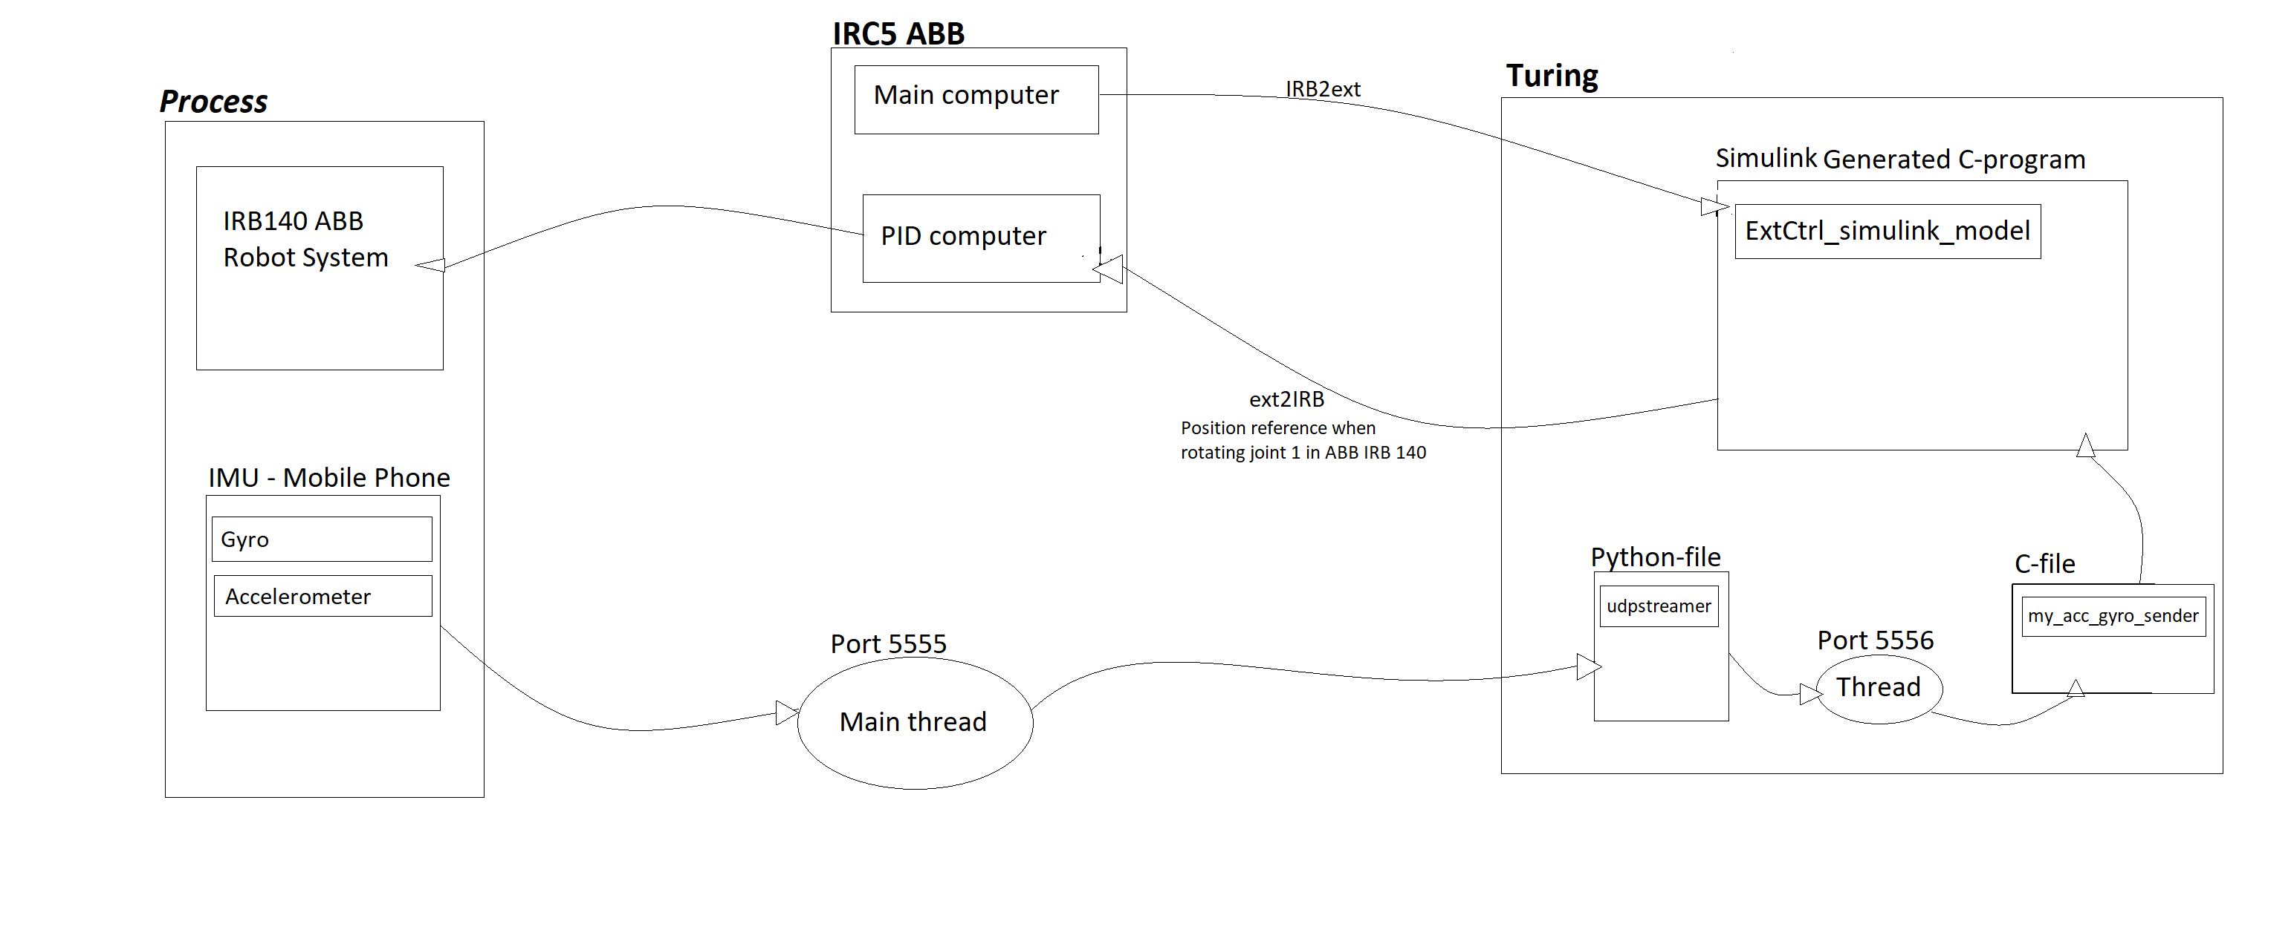
Communication setup with the robot

Slide 19
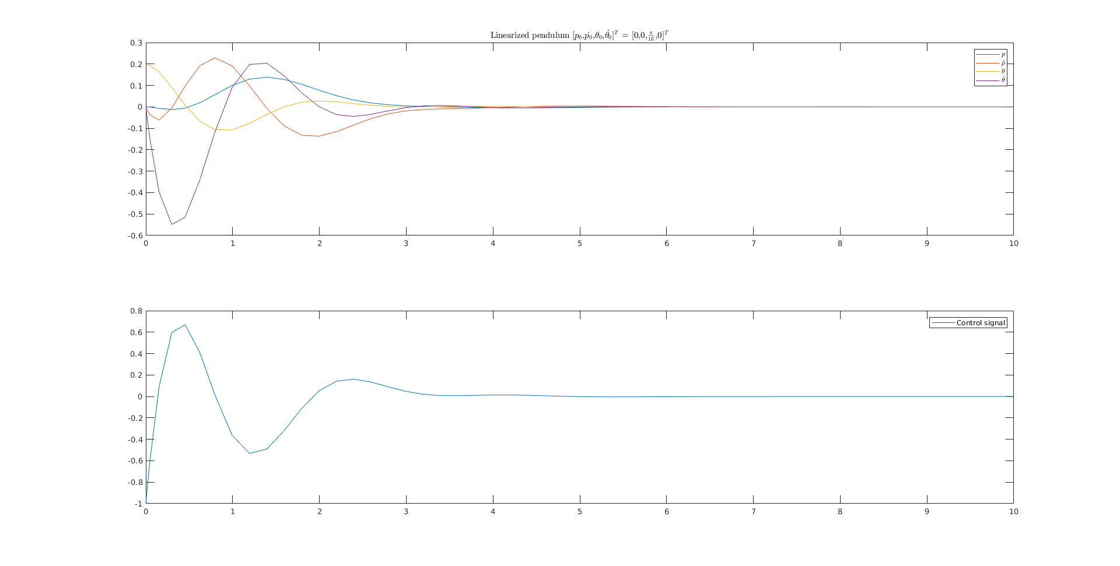
Linear simulation

Slide 20

Nonlinear simulation​

Slide 21
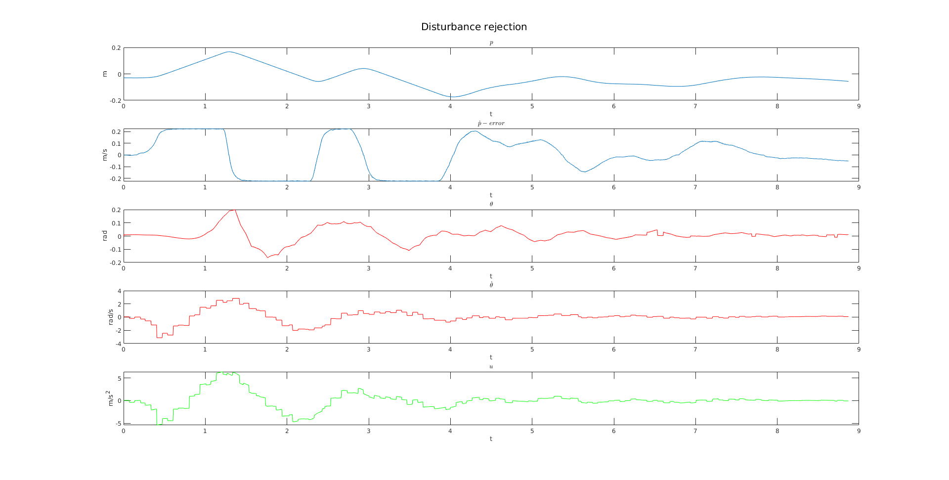
Distubance Rejection​

Slide 22
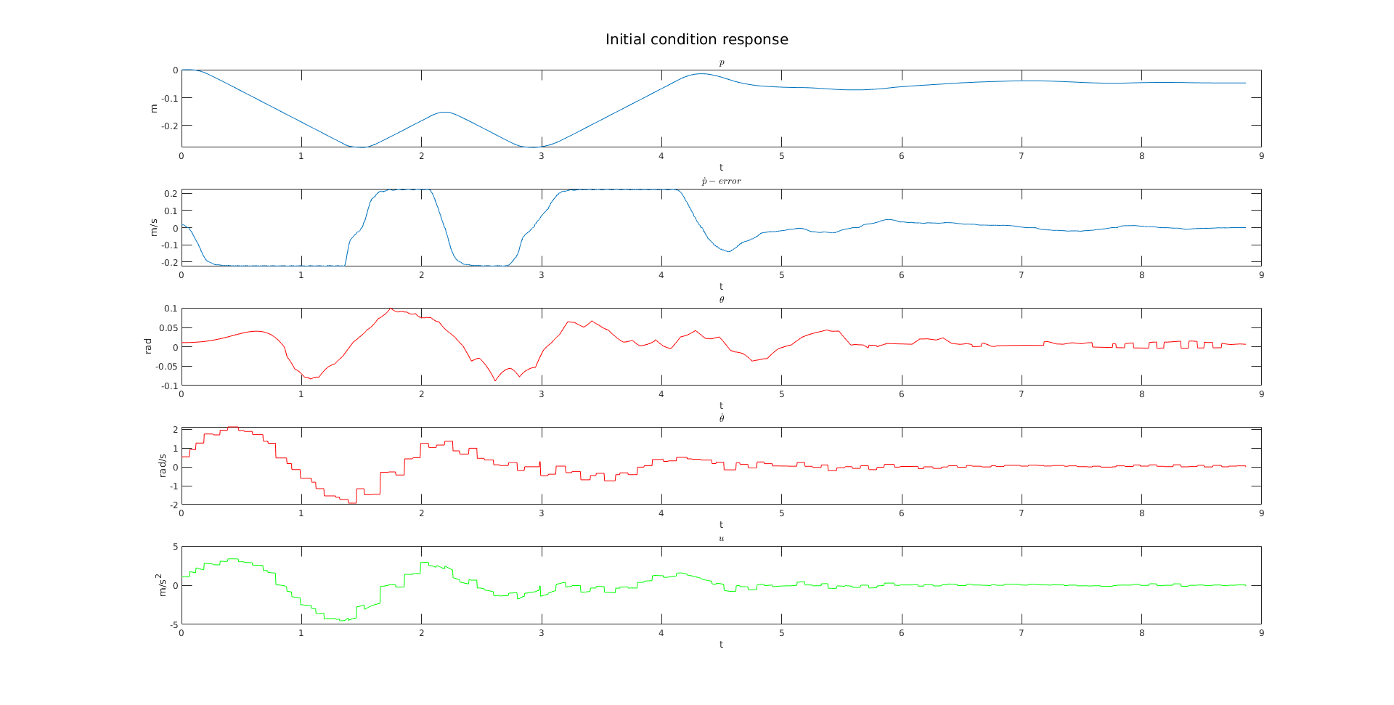
Initial value response​

Slide 23
Questions?
Crane Damping – Group 10

