Slide 1
Pattern Classification using Convolutional Neural Networks
Hichem Belhocine Dominik Söllinger Yansel Gonzalez Tejeda
Project conducted in the context of the course „Pattern Recognition II“ at the Computer Science Department, University of Salzburg.
Winter Term 2017/2018

Slide 2
Introduction
Is a machine able to „recognize“ Handwritten digits? -> Problem statement.
Classifying image using Neuronal Networks
Convolutional Neural Networks (CNN) as Classifiers. -> Focus of our approach.
How can we test this approach? -> Semeion Dataset, Software, Experiments.
Project plan overview.

Slide 3
Is a machine able to „recognize“ handwritten digits?

Slide 4
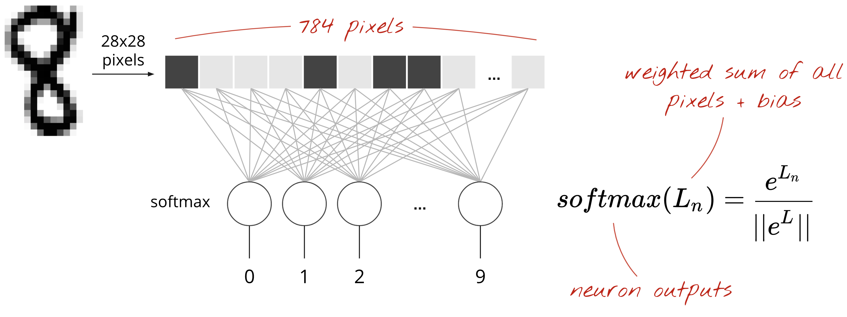
The most simple Neuronal Network

Slide 5
The most simple Neuronal Network
BAD CLASSIFICATION ACCURACY
92% with MNIST dataset

Slide 6
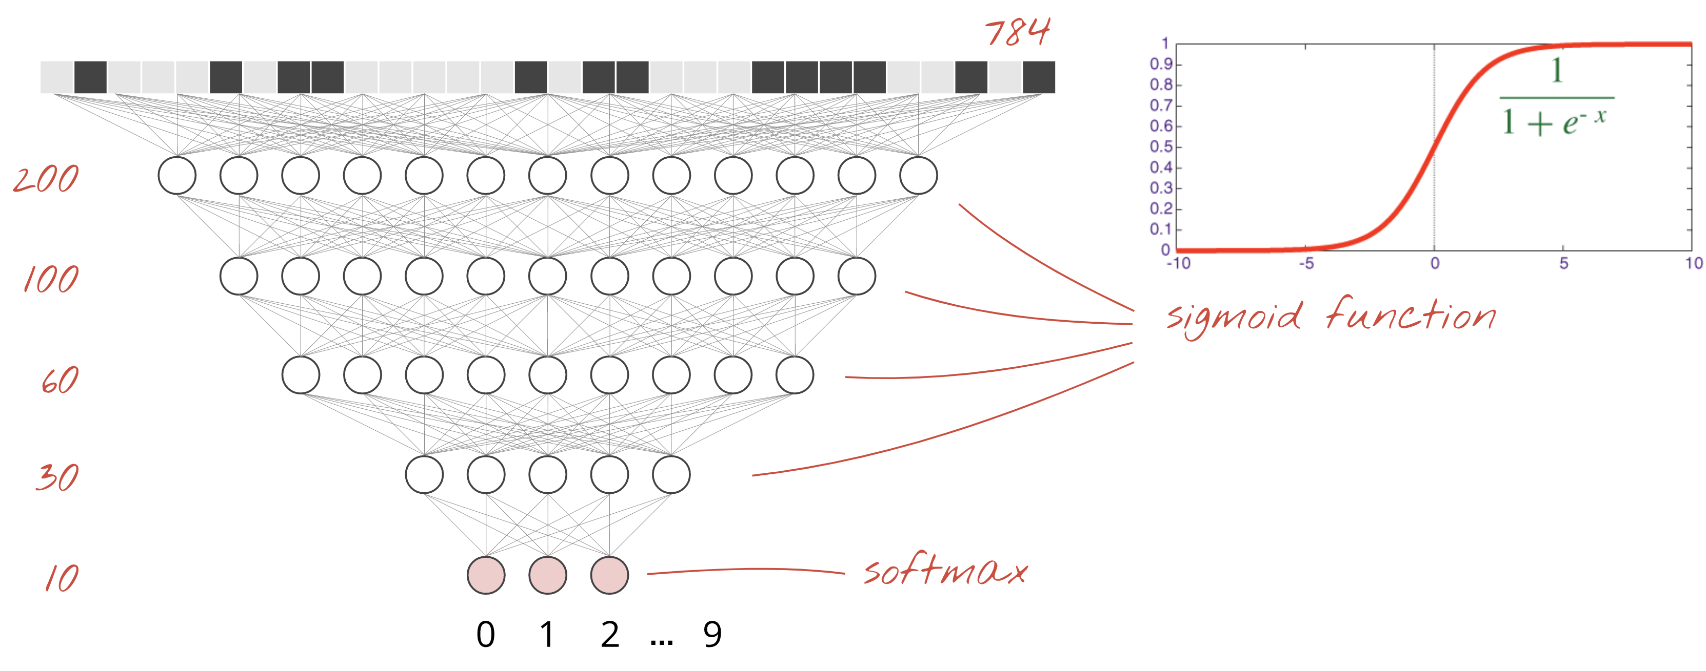
... Ok, we can still add more layers

Slide 7
... Ok, we can still add more layers
INCREASES ACCURACY
98% with MNIST dataset
-> BUT WE CAN DO BETTER

Slide 8
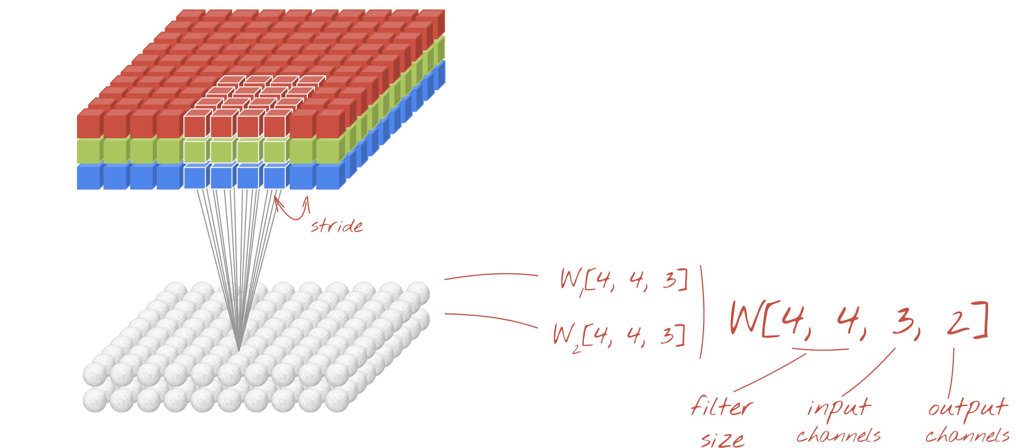
Convolutional Neural Networks (CNN) as Classifiers.

Slide 9
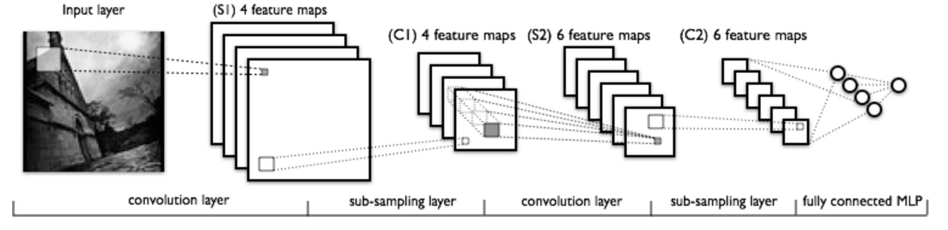
Convolutional Neural Networks (CNN) as Classifiers.

Slide 10


How can we test this approach?
SEMEION Dataset

Slide 11

Semeion Dataset
1593 handwritten digits from around 80 persons
1 2 3 . . . 16
1 2 3 . . . 16

Slide 12

Semeion Dataset
Transformed into a binary picture
1 2 3 . . . 16
1 2 3 . . . 16

Slide 13
Finding the best framework
Tensorflow
scikit-learn
Google
Not for Neuronal Networks
Pytorch

Slide 14
Tensorflow or Pytorch
Tensorflow
Well-established
Static Graph Computation
Visualization
A lot of content on the web
…
Pytorch
Still Beta
Dynamic Graph Computation
Simple debugging without standard python debugger
Nice syntax / Easy to use for beginners
…

Slide 15
Tensorflow or Pytorch
Tensorflow
Well-established
Static Graph Computation
Visualization
A lot of content on the web
…
Pytorch
Still Beta
Dynamic Graph Computation
Simple debugging without standard python debugger
Nice syntax / Easy to use for beginners
…

Slide 16
Project Plan Overview
Date | Work step | Assigned to | Status
03.10.2017 | Definition of scope, topic, goals and members | HB, DS, YGT | Completed
10.10.2017 | First group meeting to defined member‘s work areas and responsabilities. | HB, DS, YGT | Completed
16.10.2017 | Literature review and theory on CNN. | HB | Completed
16.10.2017 | Software evaluation and acquisition. | DS | Completed
16.10.2017 | Data collection and basic research. | YGT | Completed

Slide 17
Date | Work step | Assigned to | Status
25.10.2017 | Presentation of Project Plan. | DS | Completed
Beg. of Nov | Implement POC | DS | In Progress
Beg. of Nov | Second group meeting Def. experiments and results presentation strategy | HB, DS, YGT | TBD
Nov - Dec | Experiments | DS, YGT | TBD
Nov - Dec | Project report / Theory | HB | TBD
19.12.2017 | Presentation of project status | HB | TBD
xx.01.2018 | Presentation of project results | YGT | TBD
16.02.2018 | Submit project report | DS | TBD

