Slide 1
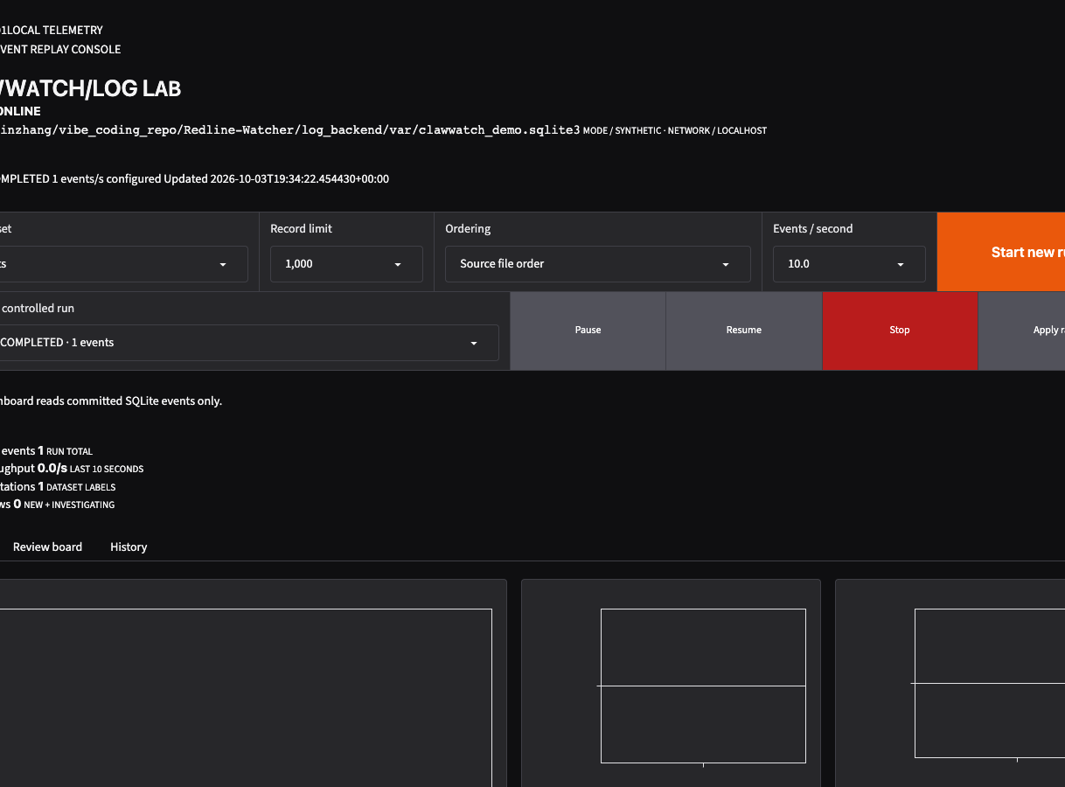
SYS / CLW-01
CLAWWATCH
/ LOG LAB
Live SIEM investigation workflow
Verified ingestion, controlled replay, persistent review, and audited Slack delivery.
100,000
SYNTHETIC SECURITY EVENTS
PYTHON 3.12 SQLITE PANDAS GRADIO
SYNTHETIC SIEM DATASET / PROTOTYPE MEASUREMENTS
Notes:
I built ClawWatch to turn a security dataset into something an engineer can operate. The same event remains traceable from its original JSON record, through replay and investigation, to a team notification. The current prototype runs locally and does not depend on a hosted database or model API.
Source: log_backend/docs/clawwatch-slide-content.md and repository implementation.

Slide 2
PROBLEM
02
Static SIEM data lacks replay and review state
EVENTS AT REST
01
No live timing
{
event_id: evt-1842
severity: critical
type: auth
actor: user-17
source_ip: 192.0.2.10
}
Historical records cannot reproduce the pace and ordering of an incident.
02
No durable review
Notes and decisions drift away from the event evidence.
03
No tested handoff
Restart, concurrency, and notification failures remain hidden.
A record shows what happened. It does not preserve the operating response.
SYNTHETIC SIEM DATASET / PROTOTYPE MEASUREMENTS
Notes:
Rendering JSON addresses only the display layer. A useful security demo needs verified input, controllable event timing, durable state, a human decision point, and a reliable path to the team. These capabilities let the system reproduce and explain what happened.
Source: log_backend/docs/clawwatch-slide-content.md and repository implementation.

Slide 3
SYSTEM
03
Local system architecture
SQLITE
EVIDENCE STORE
Durable replay
controller
Hugging Face
SIEM dataset
Revision +
SHA-256 gate
Pandas
batch importer
PINNED INPUT
10,000 ROW BATCHES
Monitoring queries
+ Gradio console
Review cards
+ activity history
Critical review
notifier
SLACK
SYNTHETIC SIEM DATASET / PROTOTYPE MEASUREMENTS
Notes:
SQLite is the source of truth for imported events and operating state. The replay controller writes each emitted event and its cursor in one transaction. The dashboard reads bounded snapshots from the same store. Review cards, notes, stage changes, and successful Slack sends return to the activity history.
Source: log_backend/docs/clawwatch-slide-content.md and repository implementation.

Slide 4
INVESTIGATION WORKFLOW
04
One event from replay to team action
Replay
Observe
Inspect
Review
Notify
1
2
3
4
5
Rate, limit, severity, type, and ordering
Live counters, trends, and searchable events
Normalized fields, raw log, and original JSON
New, Investigating, Resolved, or Dismissed
Critical cards still under active review
Human boundary: an engineer creates the review card before the notifier can act.
The server checks every 30 seconds. Resolved, Dismissed, noncritical, and previously sent cards are skipped.
SYNTHETIC SIEM DATASET / PROTOTYPE MEASUREMENTS
Notes:
The review boundary is deliberate. An engineer selects an event and creates a card before the critical review notifier can act on it. The server checks every 30 seconds even if the browser is closed. The same check is available from a dashboard button or CLI script. Only critical cards in New or Investigating qualify.
Source: log_backend/docs/clawwatch-slide-content.md and repository implementation.

Slide 5
RELIABILITY
05
Recovery and state integrity
DATASET
Pinned revision and checksum verification
KNOWN DELIVERY BOUNDARY
AT-LEAST-ONCE
IMPORT
Resumable batches with accepted, rejected, and duplicate counts
REPLAY
Event and cursor commit atomically, with one active run
A crash after Slack accepts a message but before the local audit commit can produce a duplicate on retry.
RESTART
Unfinished runs become Interrupted and resume explicitly
REVIEW
Revision checks prevent silent concurrent overwrites
PROTOTYPE LIMIT
SLACK
Serialized dispatch and persistent successful send audit
SYNTHETIC SIEM DATASET / PROTOTYPE MEASUREMENTS
Notes:
A partial import resumes from its last committed batch. A replay cannot advance its cursor without storing the event. A stale browser cannot overwrite a newer review revision. Slack checks share one lock, and successful delivery is recorded for future checks. The narrow crash boundary means the prototype provides at-least-once delivery.
Source: log_backend/docs/clawwatch-slide-content.md and repository implementation.

Slide 6
EVIDENCE
06
Measured prototype results
100,000
99.9/s
45
EVENTS IMPORTED
REAL-TIME REPLAY
TESTS PASSING
0 rejected / 0 duplicates
1,000-event run
Ruff lint and format clean
Recorded check | Measurement
Local clean import | 4.04 seconds / about 24,778 rows per second
Dell server clean import | 5.28 seconds
Full-run dashboard snapshot | 0.250–0.259 seconds
Full corpus persistence | 100,000 unique sequences / controllable clock
Dataset size 93,724,615 bytes. Severity, risk, and threat values are source annotations.
SYNTHETIC SIEM DATASET / PROTOTYPE MEASUREMENTS
Notes:
The full corpus replay persisted 100,000 unique sequences using a controllable test clock. The 99.9 events per second figure comes from a separate real-time 1,000-event run. The dataset is synthetic, and its severity, risk, and threat fields are source annotations rather than ClawWatch detections.
Source: log_backend/docs/clawwatch-slide-content.md and repository implementation.

Slide 7
NEXT PHASE
07
Planned NemoClaw investigation loop
PLANNED ROUND TRIP
CLAWWATCH
BACKEND
Evidence selection
Request state
Validation + audit
INVESTIGATION REQUEST
NEMOCLAW SANDBOX
VALIDATED RESULT
HUMAN
REVIEW
OPENCLAW
+ LOCAL GB10 MODEL
SLACK
STRUCTURED ASSESSMENT
Isolated execution boundary
CONNECTION CONTRACT
IDEMPOTENCY
BOUNDED CONTEXT
STRUCTURED RESULT
BACKEND CONTROL
Request ID + card revision
Stored evidence IDs only
Verdict + rationale + confidence
Validate, persist, then notify
CURRENT BRIDGE: ONE-WAY CRITICAL JSON SENDER / PLANNED: VALIDATED INVESTIGATION ROUND TRIP
Notes:
The current remote script is a one-way bridge that passes a complete critical JSON record through NemoClaw and OpenClaw to Slack. The planned connection makes ClawWatch the coordinator and system of record. The backend sends a bounded request to the redline-watcher-3 sandbox, receives a structured assessment, verifies every cited event ID against the request, stores the result beside the review card, and keeps human approval before Slack delivery. NemoClaw owns isolated execution. ClawWatch owns evidence selection, request state, validation, retries, audit, and routing.
Source: log_backend/docs/clawwatch-slide-content.md and repository implementation.

