Slide 1
Fraud Detection in Financial Transactions Using Machine Learning
Lee Hickey | Emma Reen | Sarah O'Hanlon Dublin City University

Slide 2
Agenda
• Introduction & Research Questions
• Dataset Overview & Exploratory Analysis
• Critical Finding: Data Leakage Prevention
• RQ1: Algorithm Comparison
• RQ2: Feature Importance Analysis
• RQ3: Class Imbalance Handling
• Key Findings & Conclusions

Slide 3
Introduction
• Financial fraud costs billions annually worldwide
• Traditional rule-based systems cannot adapt to evolving fraud patterns
• Machine learning offers flexible pattern detection from data
• Challenge: Extreme class imbalance (0.13% fraud rate)
• Challenge: Avoiding data leakage for realistic results

Slide 4
Research Questions
•
•
•

Slide 5
Dataset Overview

Slide 6
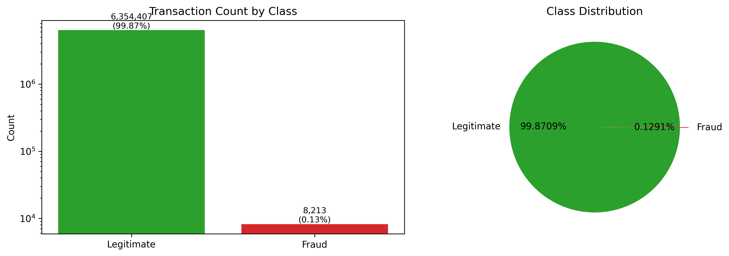
PaySim Dataset
• 6,362,620 total transactions
• 8,213 fraudulent cases (0.13%)
• 5 transaction types:
• CASH_IN, CASH_OUT, DEBIT,
• PAYMENT, TRANSFER
• Fraud only in TRANSFER & CASH_OUT
• Class imbalance ratio: 773:1

Slide 7
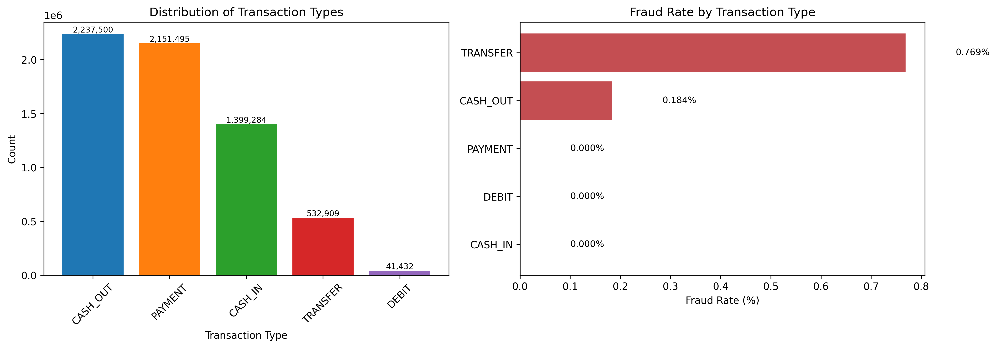
Fraud by Transaction Type

Slide 8
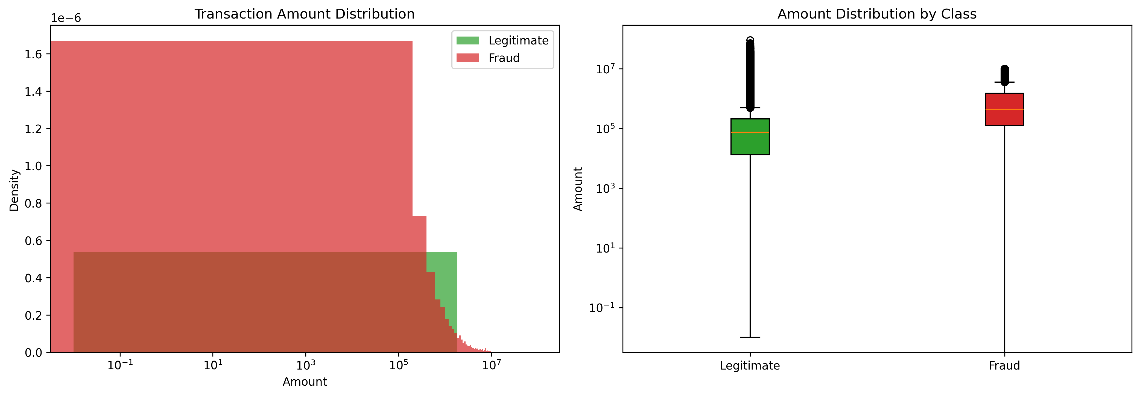
Transaction Amount Distribution
• Fraudulent transactions have:
• - Larger average amounts
• - Different distribution pattern
•
• Average Amount:
• Legitimate: $178,197
• Fraudulent: $1,467,967
•
• Frauds are 8.2x larger on average

Slide 9
Critical Finding: Data Leakage Prevention

Slide 10
Data Leakage Discovery
• Initial models achieved >99% accuracy across all metrics
•
• Investigation revealed: full_drain feature had +0.987 correlation with fraud
• - 100% of full_drain=1 transactions were fraudulent
• - 97.5% of all frauds had full_drain=1
•
• Problem: full_drain requires POST-transaction data
• Real systems must predict BEFORE transaction completes
•
• This feature encodes the fraud definition itself!

Slide 11
Resolution: Pre-Transaction Features Only
• Safe Features (10 total):
• - step, hour_of_day, day (temporal)
• - type_encoded (transaction type)
• - amount (transaction amount)
• - oldbalanceOrg, oldbalanceDest (pre-transaction balances)
• - amount_to_orig_balance, amount_to_dest_balance (ratios)
• - dest_zero_balance_before (recipient zero balance flag)
•
• Excluded Features (Data Leakage):
• - full_drain, newbalanceOrig, newbalanceDest
• - balance_change_orig, balance_change_dest, orig_balance_error

Slide 12
RQ1: Algorithm Comparison

Slide 13
Algorithms Evaluated
• Logistic Regression
• - Linear baseline model
•
• Decision Tree
• - Simple tree-based classifier
•
• Random Forest
• - Ensemble of decision trees
•
• Gradient Boosting
• - Sequential boosting approach
•
• XGBoost
• - Optimized gradient boosting

Slide 14
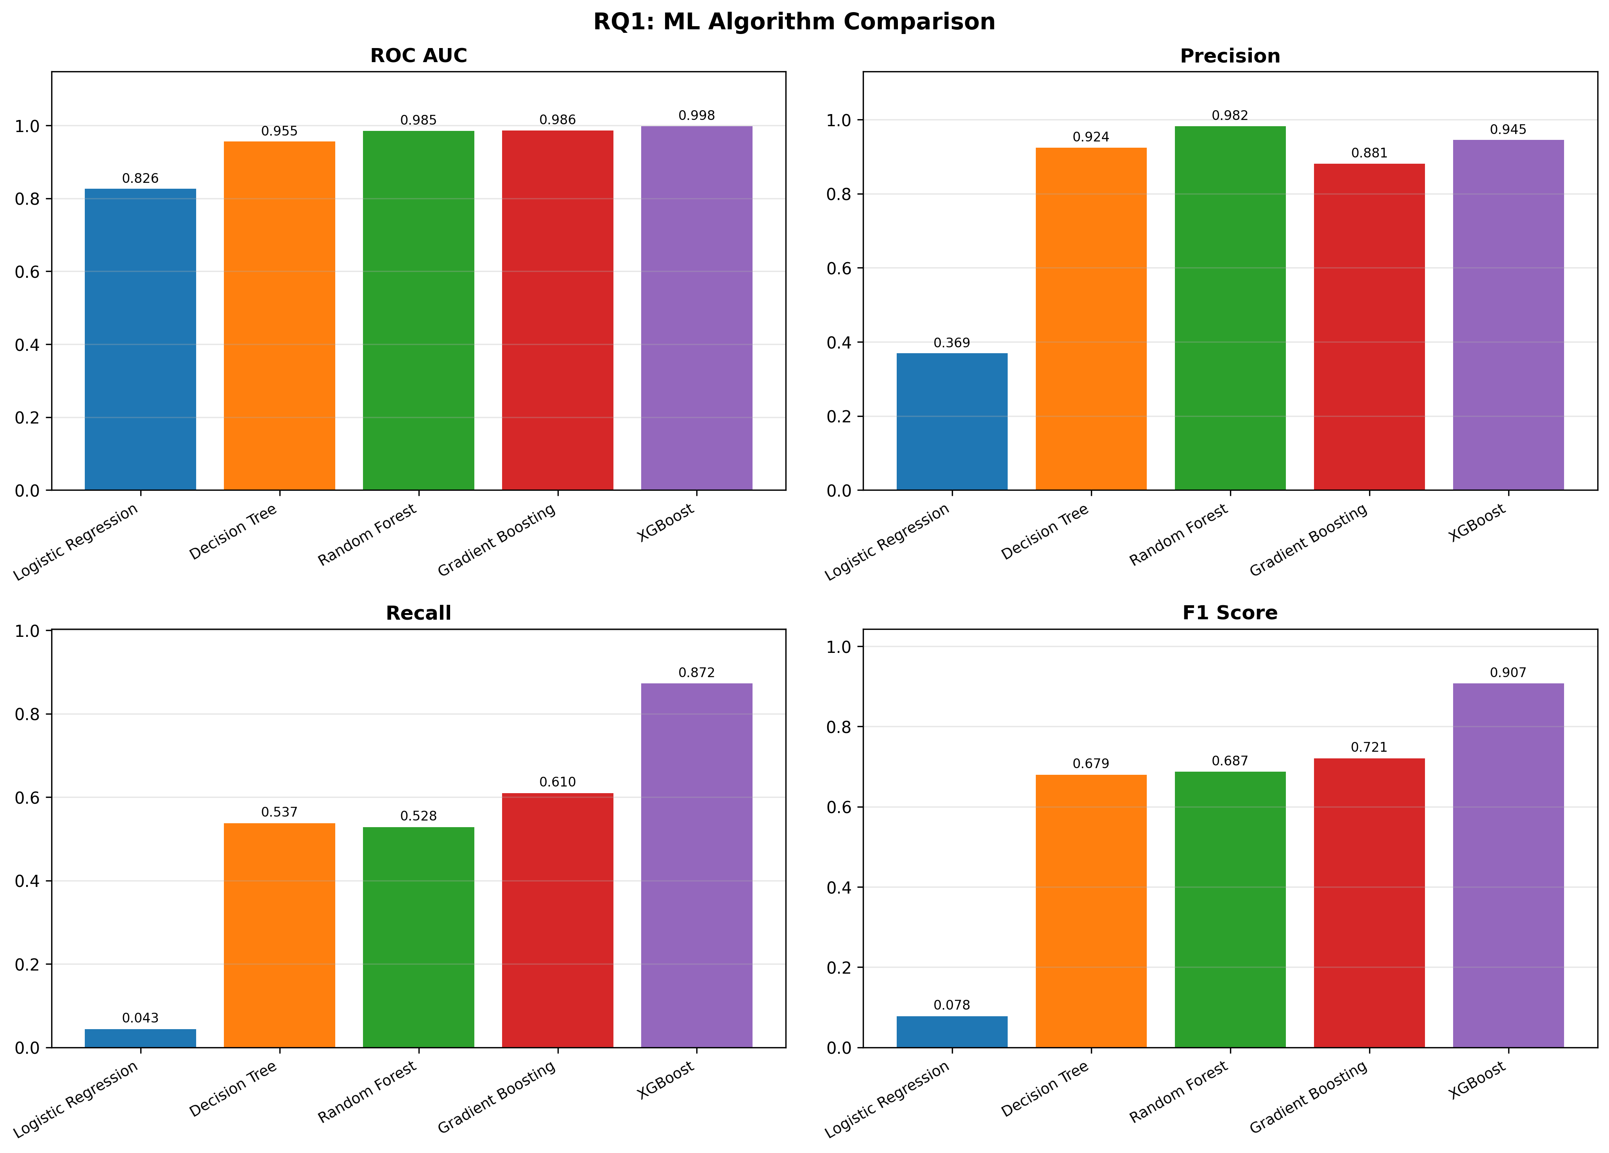
Algorithm Performance (Safe Features)
• XGBoost: Best performer
• AUC: 0.9977, Recall: 87.2%
•
• Gradient Boosting:
• AUC: 0.9861, Recall: 61.0%
•
• Random Forest:
• AUC: 0.9847, Recall: 52.8%
•
• Decision Tree:
• AUC: 0.9554, Recall: 53.7%
•
• Logistic Regression:
• AUC: 0.8258, Recall: 4.3%

Slide 15
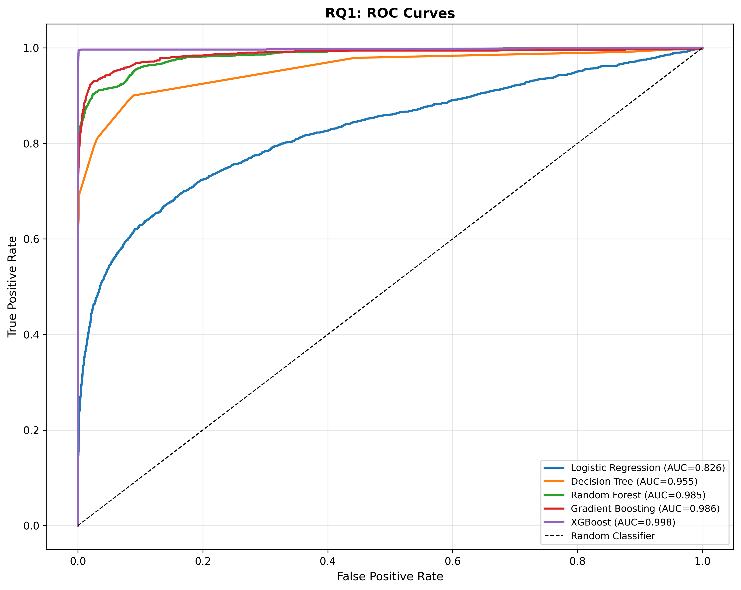
ROC Curves Comparison

Slide 16
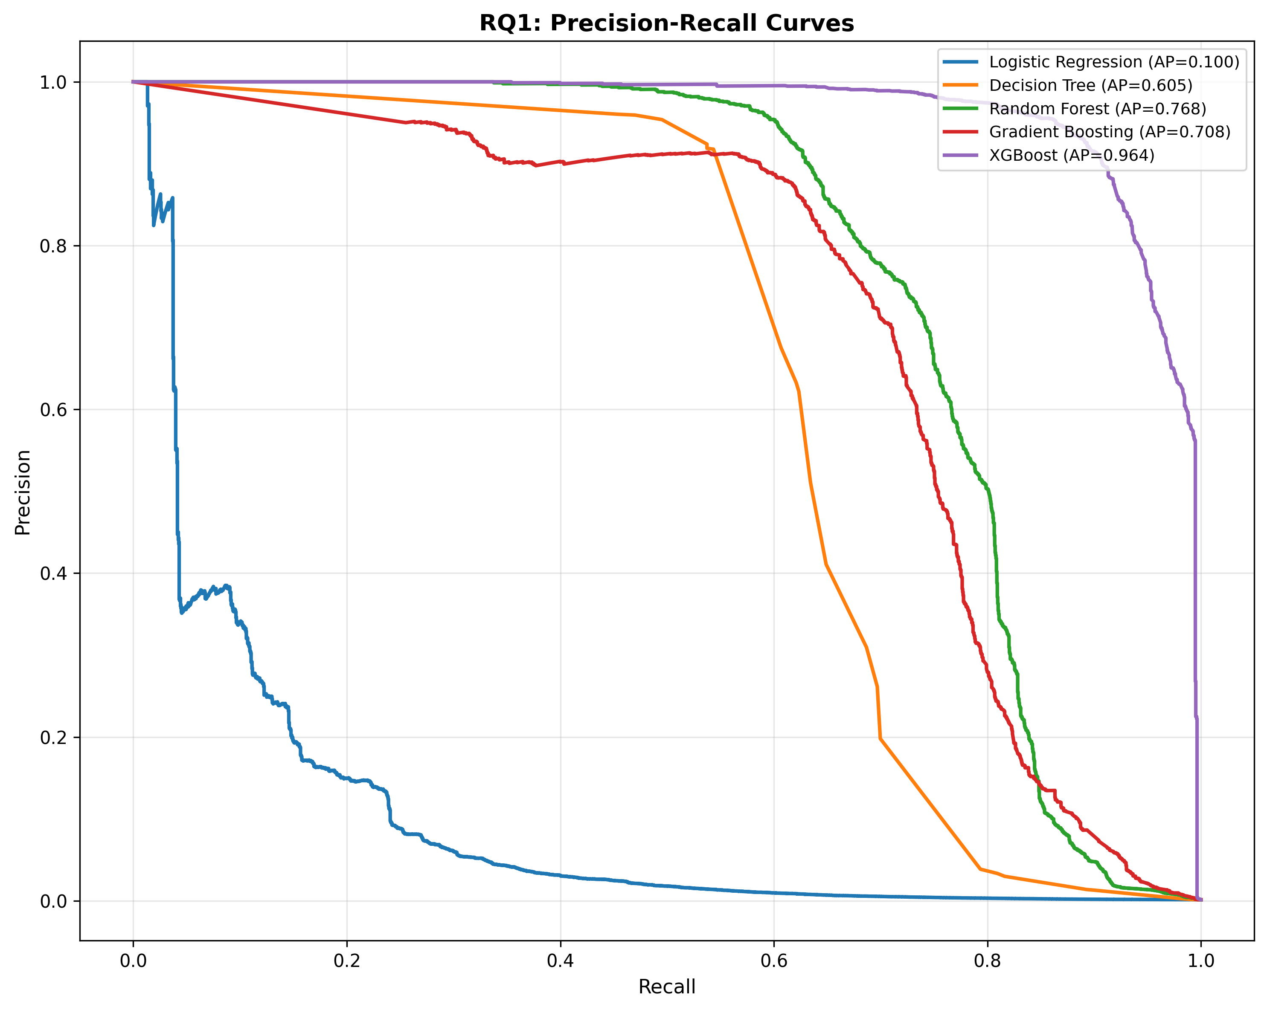
Precision-Recall Curves

Slide 17
RQ1 Key Findings
• XGBoost significantly outperforms all other algorithms
•
• Tree-based ensemble methods dominate:
• - Can capture non-linear fraud patterns
• - Handle feature interactions effectively
•
• Linear models (Logistic Regression) fail:
• - Only 4.3% recall - nearly useless
• - Fraud patterns are highly non-linear
•
• Recommendation: XGBoost for production deployment

Slide 18
RQ2: Feature Importance

Slide 19
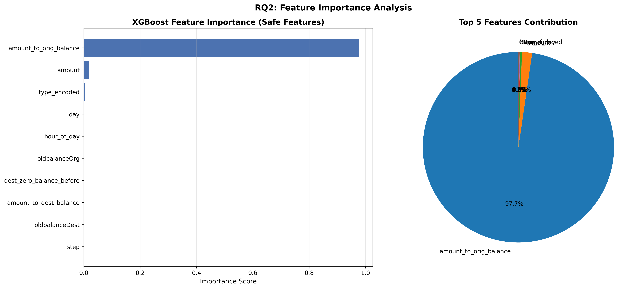
Feature Importance Analysis
• Top Features:
•
• 1. amount_to_orig_balance: 97.7%
• Ratio of amount to sender balance
•
• 2. amount: 1.7%
• Transaction amount
•
• 3. type_encoded: 0.3%
• Transaction type
•
• Dominant predictor: amount ratio

Slide 20
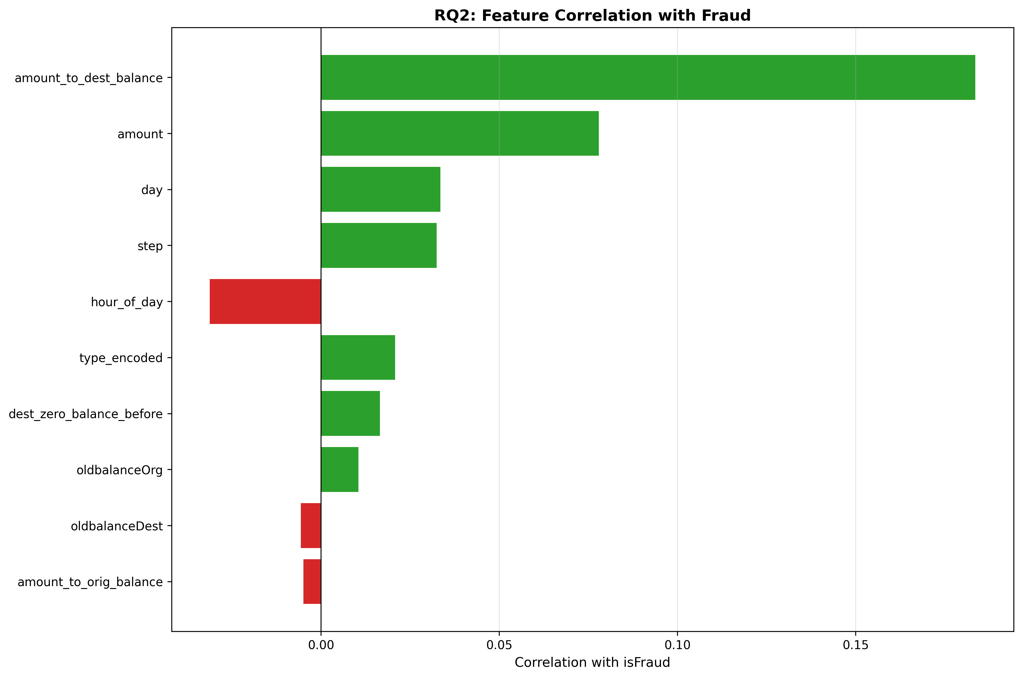
Feature Correlation with Fraud

Slide 21
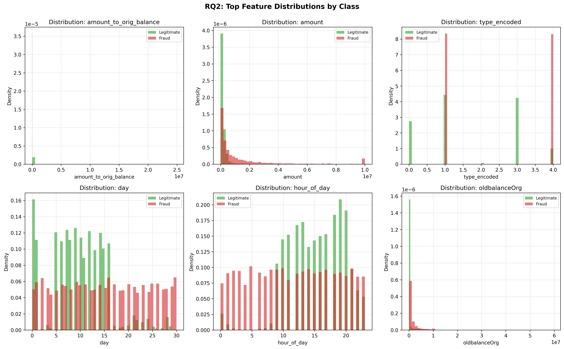
Top Feature Distributions by Class

Slide 22
RQ2 Key Findings
• amount_to_orig_balance dominates (97.7% importance)
• - Fraudsters transfer large proportions of account balances
• - High ratios indicate account draining attempts
•
• Transaction amount is secondary indicator
• - Fraudulent transactions are ~8x larger on average
•
• Transaction type provides context
• - TRANSFER and CASH_OUT are fraud-associated types
•
• Key Insight: Amount ratios are more predictive than absolute amounts

Slide 23
RQ3: Class Imbalance Handling

Slide 24
The Class Imbalance Challenge
• Dataset Distribution:
• - Legitimate: 6,354,407 (99.87%)
• - Fraudulent: 8,213 (0.13%)
• - Imbalance ratio: 773:1
•
• Without handling, models:
• - Predict everything as legitimate
• - Miss most fraudulent transactions
• - High accuracy but useless for fraud detection

Slide 25
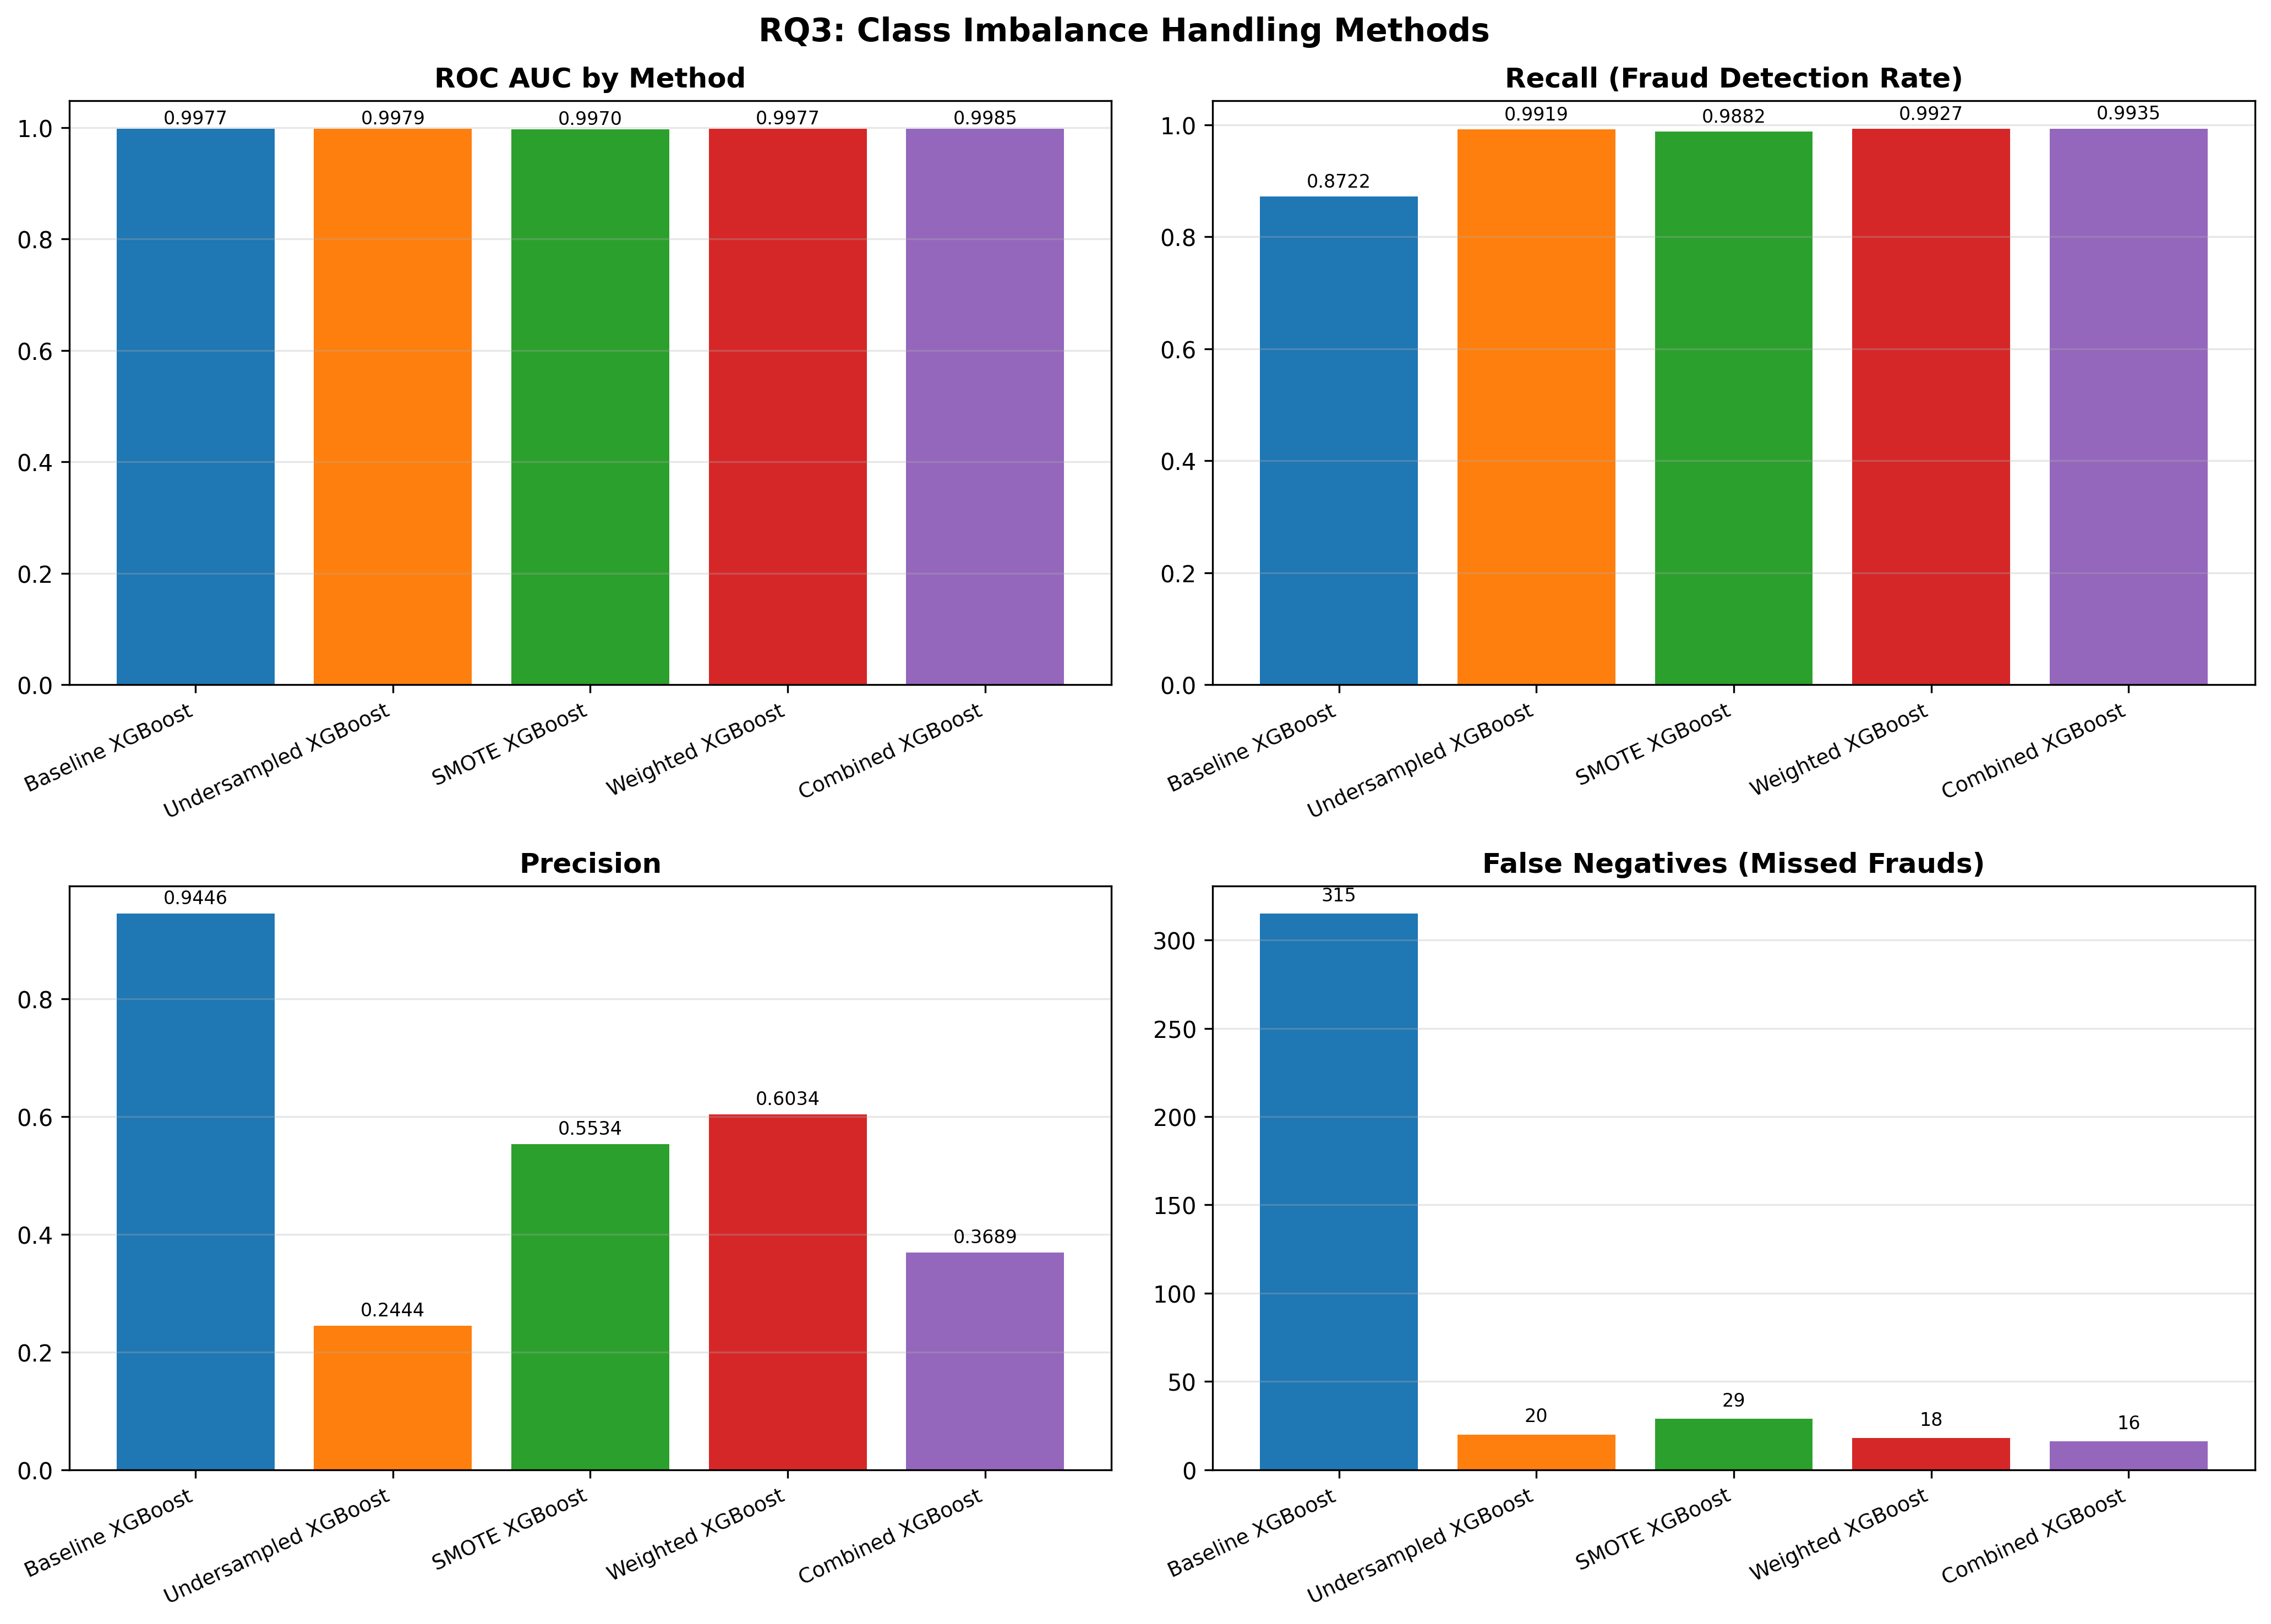
Imbalance Handling Methods Evaluated
• 1. Baseline (no handling)
• Standard XGBoost
•
• 2. Random Undersampling
• Reduce majority class
•
• 3. SMOTE (Synthetic Oversampling)
• Generate synthetic minority samples
•
• 4. Class Weighting (scale_pos_weight)
• Weight fraud samples higher
•
• 5. Combined Approach
• Undersampling + weighting

Slide 26
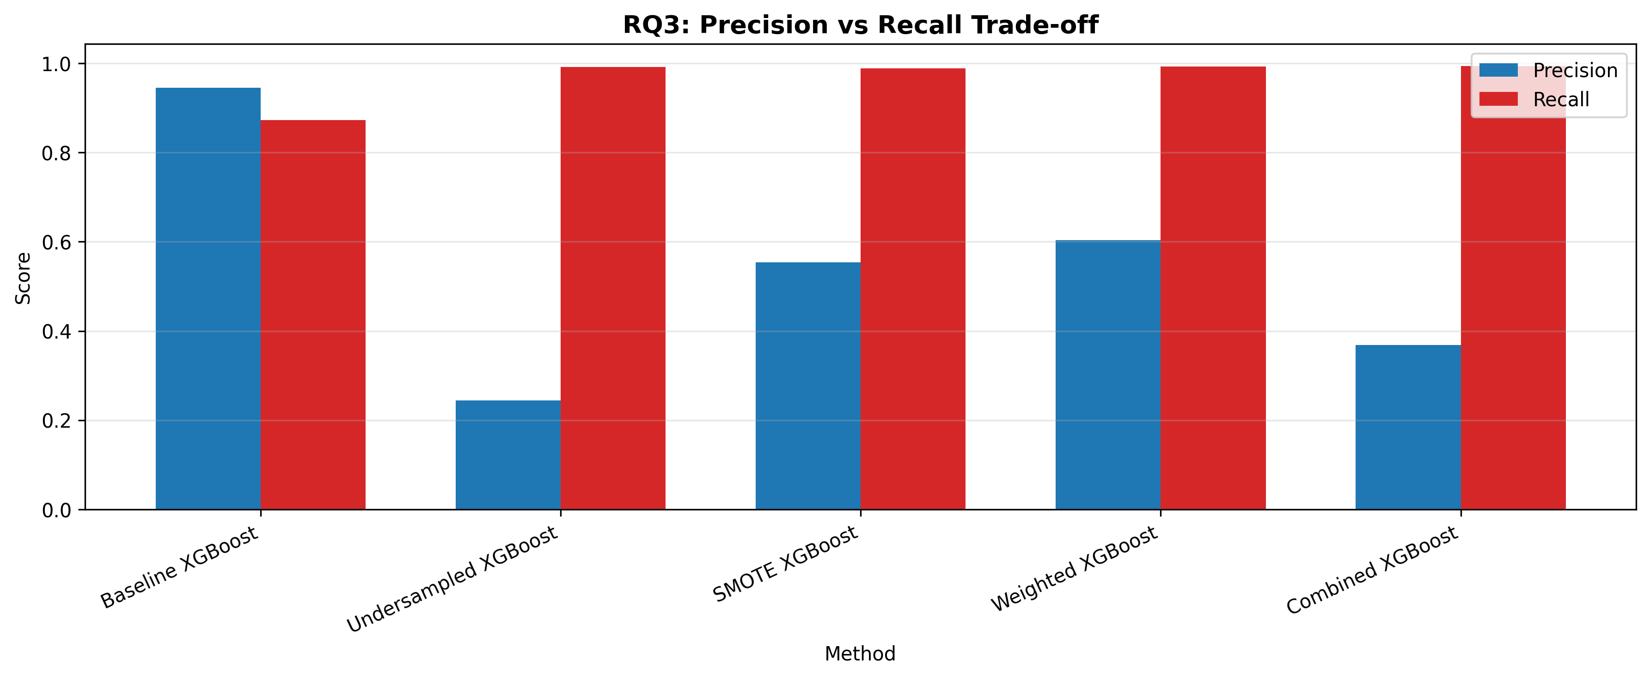
Precision vs Recall Trade-off

Slide 27
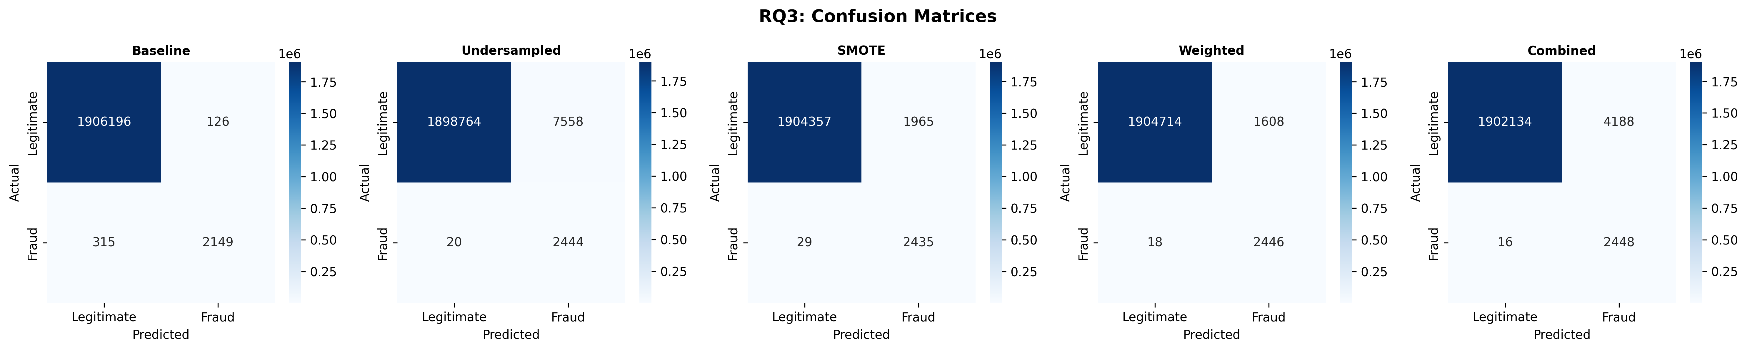
Confusion Matrices by Method

Slide 28
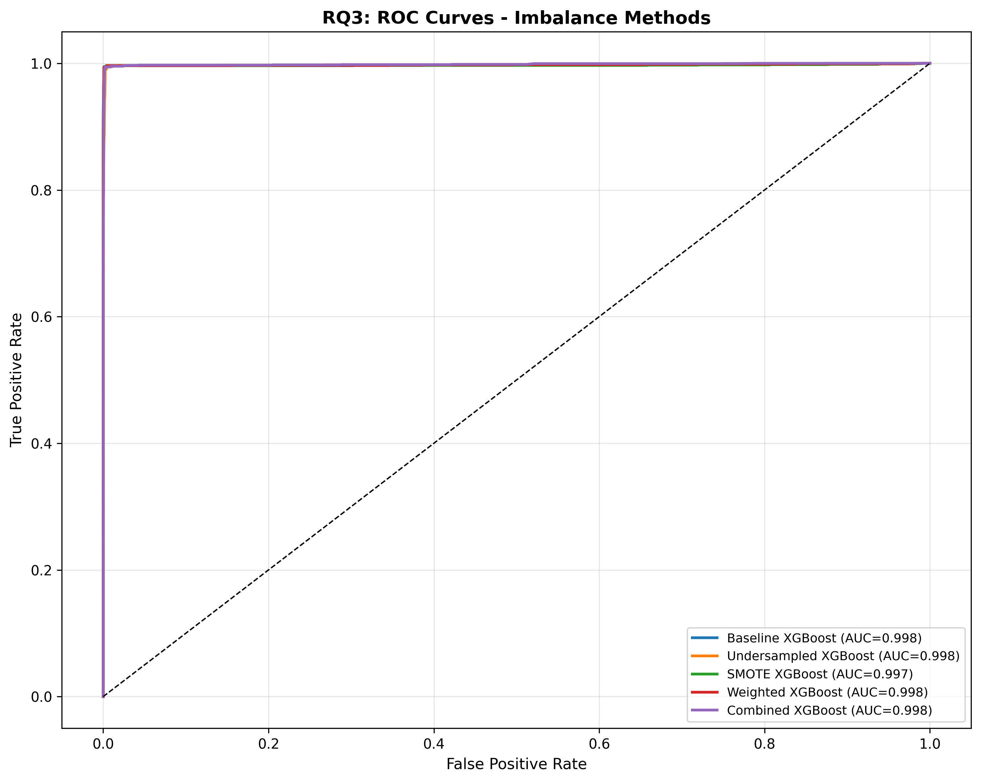
ROC Curves - Imbalance Methods

Slide 29
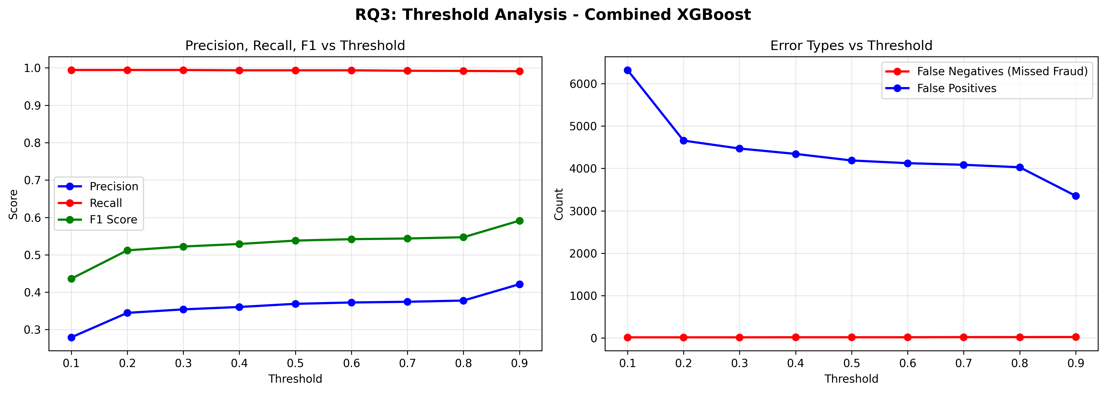
Threshold Analysis

Slide 30
RQ3 Results Summary
• Method Recall Precision Missed Frauds
• -------------------------------------------------------
• Baseline XGBoost 87.2% 94.5% 315
• Undersampled 99.2% 24.4% 20
• SMOTE 98.8% 55.3% 29
• Weighted XGBoost 99.3% 60.3% 18
• Combined XGBoost 99.4% 36.9% 16
•
• Best Recall: Combined XGBoost (99.4%)
• Best Balance: Weighted XGBoost (99.3% recall, 60.3% precision)

Slide 31
Conclusions

Slide 32
Key Findings
• RQ1: XGBoost achieves best performance (AUC 0.9977)
• Tree-based ensembles outperform linear models
•
• RQ2: amount_to_orig_balance is dominant predictor (97.7%)
• Fraudsters drain large proportions of account balances
•
• RQ3: Class weighting provides best precision-recall balance
• 99.3% recall with 60.3% precision using Weighted XGBoost
•
• Critical: Data leakage identification ensures realistic expectations

Slide 33
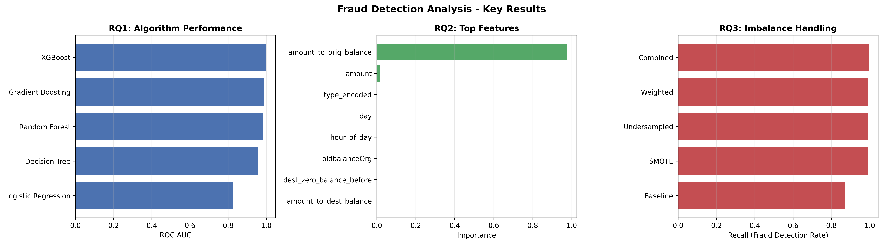
Summary Visualization

Slide 34
Practical Recommendations
• For Production Deployment:
•
• 1. Use XGBoost with class weighting (scale_pos_weight)
•
• 2. Monitor amount_to_orig_balance as primary risk indicator
•
• 3. Lower decision threshold (0.3-0.4) to catch more fraud
• Accept higher false positives to minimize missed frauds
•
• 4. Focus on TRANSFER and CASH_OUT transaction types
•
• 5. Real-time monitoring of pre-transaction features only

Slide 35
Limitations & Future Work
• Limitations:
• - Synthetic dataset may not fully reflect real fraud patterns
• - Limited feature engineering due to data leakage constraints
• - No temporal pattern analysis across user history
•
• Future Directions:
• - Real-world dataset validation
• - Deep learning approaches (LSTM for sequences)
• - Graph neural networks for transaction networks
• - Online learning for adapting to new fraud patterns
• - Cost-sensitive learning based on transaction amounts

Slide 36
Thank You
Questions?

