Slide 1
Who’s Who
April 2023

Slide 2
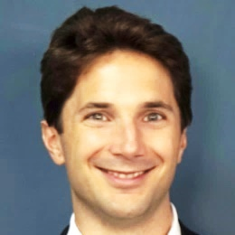
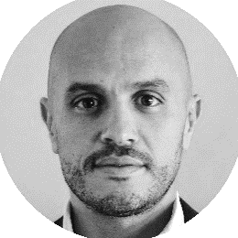
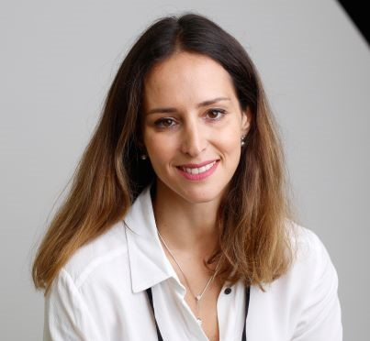
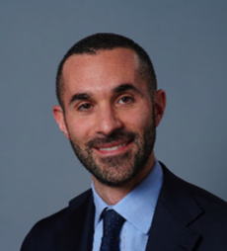


Infomineo Executive Committee
Infomineo Executive Committee
Managing Partners
Martin Tronquit
Dubai
Hamza Laraichi
Casablanca
Chief Human Capital Officer
Chief Growth
Officer
Chief Operating Officer
Finance Director
Dounia Boutaleb
Barcelona
Matteo
Gamberale
Dubai
Faizel Logday
Barcelona
Romain
Murigneux
Barcelona

Slide 3

Business Research
Graphic Design
Business Translation
Data Analytics
Finance
Human Capital
Information Technology
Operations
Office Admin
Marketing
Delivery
Business Lines
Service
Infomineo teams are split into different service lines
Business Development
Business Development (sales)

Slide 4

Business Development Team
Who are they?
What do they do?
Identifying business opportunities
Vice Presidents
Mapping key stakeholders & defining the appropriate action plan
Senior Vice Presidents
Coordinating proposals and contracting processes
Associate Vice Presidents
BD Lead
Maintaining an updated CRM
Providing clients with necessary collaterals
Senior Account Executives
Account Executives
Developing an Account Management & planning for each key account

Slide 5
Service Team (1/2)
Finance
Human Capital
Operations

Slide 6
Service Team(2/2)
IT
Marketing
Office Admin

Slide 7
Finance
Finance Strategic Topics
Country Finance Topics
Managing the company’s finances
Provide strategic recommendations
Forecast, Budget and other reports
Transfer Pricing
Review vendor’s contracts
Define travel expenses and PO policy
Calculate and process pay slips
Process all payments
Invoice the customers
Check due diligence for suppliers
Process and check bills
Legal and tax compliance
Financial statements
Budget controlling
Ensure travel expenses and PO policy
Business Controller Topics, supporting BD team
Customer contracting processes (incl. due diligence)
Cleaning & controlling of BD CRM
Collections, accounts receivables
Provide reports and dashboards for BD team
Calculate VP commissions
Support the local admin tasks for the Dubai company (e.g. Health insurance)

Slide 8
Human Capital
Human Capital Strategic Topics
Professional Development Topics
Overall steering of the Human Capital Function
Defining and implementing Infomineo HR policies across the offices
Overseeing Professional Development Initiatives
Overseeing Talent Recruitment and Retention strategies
Contributing to the overall company strategy
Staffing Committee
Training & E- Learning (Onboarding and Ongoing)
Performance Evaluation & Career Development
Consultancy and coaching for managers and their teams
Mobility programs
Recruitment Topics
HR Administration & Compensation & Benefits
Attracting new talents
Application processes and interviews management
Recruitment event planning
Talent pool cultivation
Candidates Referrals
Attrition analysis
Labor law and compliance
Company policies & procedures
Payroll & Leave administration, incl. Social insurance
Compensation and benefit programs, incl. Health & life insurance
Administrative requests
Employees Issues, and complains
Onboarding/offboarding process

Slide 9
Operations
Operations
Chief Operating Officer
Director of Delivery Excellence
Country Managers
Define recruitment targets to make sure capacity meets demand
Team staffing coordination to maximize utilization levels
Develop and maintain an operations dashboard
Define knowledge capitalization & strategies
Leadership of service quality across global delivery teams
Assessment and launch of new services and Business Lines
Creation, improvement, and control of key processes impacting delivery
Collaborate with service teams on different matters
Ensure a good local value proposition to attract the best talent.
Acts as interface with local administrations
Continuous contributions to the office's profitability with Operations team
Digital Transformation Manager
Operations’ Team Members
Lead infomineo's digital transformation projects
Focus on process improvement across departments, from support to delivery
Leverage technology to improve service quality for internal & external customers
Implement lean & continuous improvement practices
Data preparation for periodic reports for COO and managers
Assist the COO in setting and managing Operations metrics and goals
Manage incidents related to Odoo system
Managing deliverables
Reporting

Slide 10
Information Technology
Who are they?
What do they do?
Implementing and Managing IT Systems and Networks
Providing IT Support for all business units
System Administration and Application/Accounts Management
Ensuring IT Systems security and defining IT Policies
IT Asset Management and Purchasing
IT Onboarding/Offboarding

Slide 11
Marketing
Who are they?
What do they do?
Managing and improving lead generation campaigns
Developing Infomineo’s Marketing Strategy
Monitoring new content.
Overseeing the development of marketing materials
Overseeing Infomineo’s web strategy
Infomineo’s sector and region content development

Slide 12
Office Admin - Management & Logistics
Who are they?
What do they do?
Office life events planning
General services management (e.g. clean desk, maintenance, management of cleaning force)
Security & Safety
Room & VC booking
Courier planning
Catering and every-day lunch orders
Pick-up & transfer management
Administrative procedures support (e.g. taxes, VISA, work permit, mobility program).
AXA enrollment & contribution retrieval (Casa)
Travel perk booking
Gifts purchases (work anniversaries and events etc)

Slide 13
Business Research (1/4) – More info about team assignment on slides 15 to 17
Head Of Business Research
Senior Managers
Managers
Team Leads

Slide 14
Business Research (2/4) – More info about team assignment on slides 15 to 17
Senior Associates
Associates

Slide 15
Business Research (3/4) – More info about team assignment on Slides 15 to 17
Sarah Nafie Cairo
Senior Business Analysts

Slide 16
Business Research (4/4) – More info about team assignment on Slides 15 to 17
Sarah Nafie Cairo
Analysts

Slide 17
Composed of generalists' profiles working with the different MCK offices all around the world
Align the staffing based on the sectors covered (Finance, Public sector, Energy, etc. )
Support the client both on short and long requests
Main clients / users are from:
- The Middle East (UAE, KSA, and Egypt),
-Europe (France, Iberia, Benelux, UK, Poland, etc.),
-Africa (Morocco, South Africa, Kenya, Nigeria, Angola, ..)
-ROW (USA, Canada, India, Pakistan)
Comprised of 3 different sub-teams focusing on different geographies (Europe & Africa, Middle East, and KT Global)
Each Team member having 30+ databases at their disposal incl. big names such as Euromonitor, Oxford Economics, BMI, Global Data, etc.
Working as a full off-site extension of the client research team capabilities with access to a big portion of BCG tools incl. email addresses & slack communication
Researchers work directly with the case teams with no intermediaries, mainly on short engagements (4-8 hours) although long engagements lasting weeks are becoming more regular
Offers sectorial specialization in different topics incl. (Industrial goods, Technology, Public Sector, Healthcare, Consumer products, etc.)
MCK Team
BCG
Team
Infomineo Research Teams
Insight Knowledge Team
Serves all of Infomineo’s clients that are not engaged in a big retainer
Execute complex projects that require strong analytical skills and creativity
Deliver high value-added insights
Build diversified expertise to support a large number of clients with different needs

Slide 18
Insights & Knowledge Team (IKT) (1/2)
Senior Managers
Managers
Team Leads
Senior Associates
Associates

Slide 19
Insights & Knowledge Team (IKT) (2/2)
Senior Business Analysts
Analysts

Slide 20
MCK Team (1/2)
Senior Managers
Managers
Senior Associates
Team Leads
Associates

Slide 21
MCK Team (2/2)
Senior Business Analysts
Business Analysts

Slide 22
BCG Team : EUR / ME / Africa / Pilot (1/2)
Senior Managers
Managers
Senior Associates
Team Leads
Associates

Slide 23
BCG Team : EUR / ME / Africa / Pilot (2/2)
Senior Business Analysts
Business Analysts

Slide 24
Business Translation
Business translation

Slide 25
Graphic Design
Graphic Design Manager
Graphic Design Managers
Creative Lead
Senior Graphic Designers
Graphic Designers
Project Coordinator
Junior Graphic Designers

Slide 26
Data Analytics
Data Analytics

