Slide 1
RESTful(ish) APIs
Representational
State
Transfer

Slide 2
RESTful(ish) APIs
kein Protokoll im engeren Sinne
Übertragung über HTTP
jede Ressource ist unter
bestimmter URI erreichbar
z.B.: http://example.com/api/articles/23

Slide 3
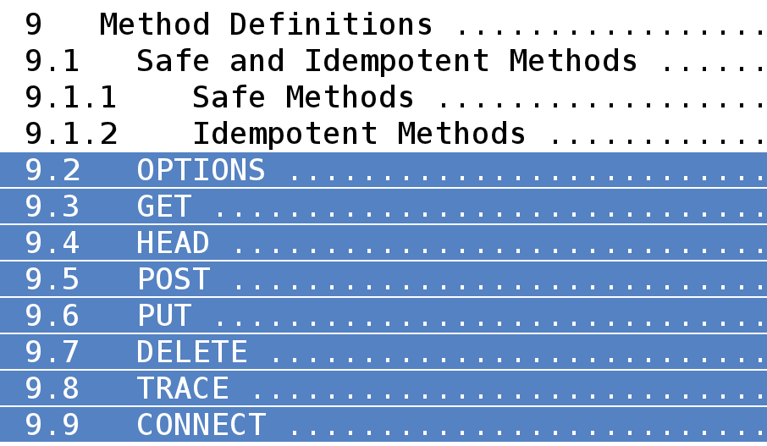
RESTful(ish) APIs
Auszug aus der RFC 2616 (HTTP/1.1):
http://www.ietf.org/rfc/rfc2616.txt

Slide 4
RESTful(ish) APIs
verschiedene Repräsentationen
  plain text
  JSON
  XML
  …
stateless – zustandslos
keine Beschreibungssprache (wie WSDL)
stattdessen lockere Vereinbarungen

Slide 5
RESTful(ish) APIs
Best Practices:
Ressourcen sollten immer
Nomen sein
Versionen/Repräsentationen
nicht mit in URI
http://example.com/v2/articles/3.json
  beides lieber in den Accept-Header:
Accept: application/vnd.hickerspace-v2+json
  (Stichwort: Vendor MIME Type)

Slide 6
RESTful(ish) APIs
Authentifzierung
  API-Key als Parameter (SSL!)
  Basic Auth (SSL!)
  OAuth

Slide 7
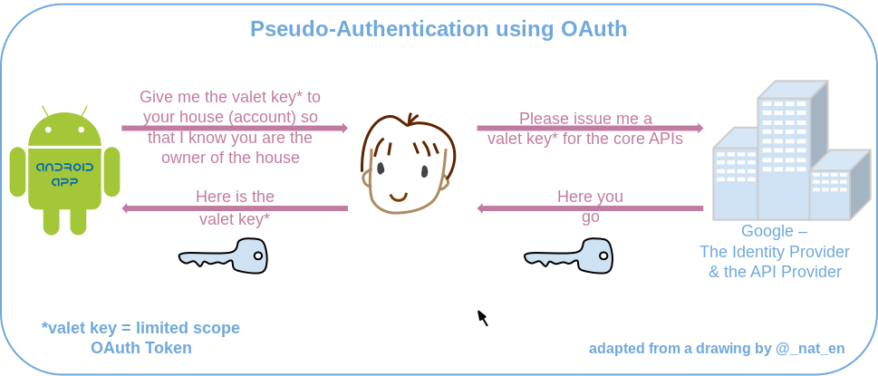
RESTful(ish) APIs
http://en.wikipedia.org/wiki/File:OpenIDvs.Pseudo-AuthenticationusingOAuth.svg

Slide 8
RESTful(ish) APIs
Wo werden RESTful APIs benutzt?
  OSM (Clients/Bots)
  Twitter
  Facebook
  Wetter-Services
  automatische Google-Suchen
  eBay
  Amazon Web Services
  ...

Slide 9
RESTful(ish) APIs
..und bei uns?
  Retweet-Bot (Twitter)
  MensaHildesheim (Twitter)
  Twitterdrucker
  Raumstatus
  LED-Ticker
  Audio-Announces
  Ampel
  ...
Notes:
Fooo!

Slide 10

RESTful(ish) APIs
”Flask is a microframework for Python based on Werkzeug, Jinja 2 and good intentions.”
http://flask.pocoo.org/
Notes:
Fooo!

Slide 11
RESTful(ish) APIs
Minimales Beispiel:
1
2
3
4
5
6
7
8
9
10
11
12
from flask import Flask
app = Flask(__name__)
@app.route('/<name>')
def api_hello(name):
return 'Hallo %s!' % name
if __name__ == '__main__':
app.run(debug=True)
Notes:
Fooo!

Slide 12
RESTful(ish) APIs
Minimales Beispiel:
1
2
3
4
5
6
7
8
9
10
11
12
from flask import Flask
app = Flask(__name__)
@app.route('/<name>')
def api_hello(name):
return 'Hallo %s!' % name
if __name__ == '__main__':
app.run(debug=True)
Notes:
Fooo!

Slide 13
RESTful(ish) APIs
Minimales Beispiel:
1
2
3
4
5
6
7
8
9
10
11
12
from flask import Flask
app = Flask(__name__)
@app.route('/<name>')
def api_hello(name):
return 'Hallo %s!' % name
if __name__ == '__main__':
app.run(debug=True)
Notes:
Fooo!

Slide 14
RESTful(ish) APIs
Minimales Beispiel:
1
2
3
4
5
6
7
8
9
10
11
12
from flask import Flask
app = Flask(__name__)
@app.route('/<name>')
def api_hello(name):
return 'Hallo %s!' % name
if __name__ == '__main__':
app.run(debug=True)
Notes:
Fooo!

Slide 15
RESTful(ish) APIs
Minimales Beispiel:
1
2
3
4
5
6
7
8
9
10
11
12
from flask import Flask
app = Flask(__name__)
@app.route('/<name>')
def api_hello(name):
return 'Hallo %s!' % name
if __name__ == '__main__':
app.run(debug=True)
Notes:
Fooo!

Slide 16
RESTful(ish) APIs
1
2
3
4
5
6
7
8
9
10
11
12
13
14
15
16
17
18
19
20
21
22
from flask import Flask, request
app = Flask(__name__)
waren = ['Shirt', 'Schuhe', 'Hose']
@app.route('/waren', methods=['GET', 'POST'])
def api_waren():
if request.method == 'GET':
return "Waren: %s" % waren
elif request.method == 'POST':
neueWare = request.form['name']
waren.append(neueWare)
index = len(waren) - 1
return 'Abgelegt unter id %d.' % index
@app.route('/waren/<index>')
def api_waren_nummer(index):
return waren[int(index)]
if __name__ == '__main__':
app.run(debug=True)
Notes:
Fooo!

Slide 17
RESTful(ish) APIs
1
2
3
4
5
6
7
8
9
10
11
12
13
14
15
16
17
18
19
20
21
22
from flask import Flask, request
app = Flask(__name__)
waren = ['Shirt', 'Schuhe', 'Hose']
@app.route('/waren', methods=['GET', 'POST'])
def api_waren():
if request.method == 'GET':
return "Waren: %s" % waren
elif request.method == 'POST':
neueWare = request.form['name']
waren.append(neueWare)
index = len(waren) - 1
return 'Abgelegt unter id %d.' % index
@app.route('/waren/<index>')
def api_waren_nummer(index):
return waren[int(index)]
if __name__ == '__main__':
app.run(debug=True)
Notes:
Fooo!

Slide 18
RESTful(ish) APIs
1
2
3
4
5
6
7
8
9
10
11
12
13
14
15
16
17
18
19
20
21
22
from flask import Flask, request
app = Flask(__name__)
waren = ['Shirt', 'Schuhe', 'Hose']
@app.route('/waren', methods=['GET', 'POST'])
def api_waren():
if request.method == 'GET':
return "Waren: %s" % waren
elif request.method == 'POST':
neueWare = request.form['name']
waren.append(neueWare)
index = len(waren) - 1
return 'Abgelegt unter id %d.' % index
@app.route('/waren/<index>')
def api_waren_nummer(index):
return waren[int(index)]
if __name__ == '__main__':
app.run(debug=True)
Notes:
Fooo!

Slide 19
RESTful(ish) APIs
1
2
3
4
5
6
7
8
9
10
11
12
13
14
15
16
17
18
19
20
21
22
from flask import Flask, request
app = Flask(__name__)
waren = ['Shirt', 'Schuhe', 'Hose']
@app.route('/waren', methods=['GET', 'POST'])
def api_waren():
if request.method == 'GET':
return "Waren: %s" % waren
elif request.method == 'POST':
neueWare = request.form['name']
waren.append(neueWare)
index = len(waren) - 1
return 'Abgelegt unter id %d.' % index
@app.route('/waren/<index>')
def api_waren_nummer(index):
return waren[int(index)]
if __name__ == '__main__':
app.run(debug=True)
Notes:
Fooo!

Slide 20
RESTful(ish) APIs
1
2
3
4
5
6
7
8
9
10
11
12
13
14
15
16
17
18
19
20
21
22
from flask import Flask, request
app = Flask(__name__)
waren = ['Shirt', 'Schuhe', 'Hose']
@app.route('/waren', methods=['GET', 'POST'])
def api_waren():
if request.method == 'GET':
return "Waren: %s" % waren
elif request.method == 'POST':
neueWare = request.form['name']
waren.append(neueWare)
index = len(waren) - 1
return 'Abgelegt unter id %d.' % index
@app.route('/waren/<index>')
def api_waren_nummer(index):
return waren[int(index)]
if __name__ == '__main__':
app.run(debug=True)
Notes:
Fooo!

Slide 21
RESTful(ish) APIs
1
2
3
4
5
6
7
8
9
10
11
12
13
14
15
16
17
18
19
20
21
22
from flask import Flask, request
app = Flask(__name__)
waren = ['Shirt', 'Schuhe', 'Hose']
@app.route('/waren', methods=['GET', 'POST'])
def api_waren():
if request.method == 'GET':
return "Waren: %s" % waren
elif request.method == 'POST':
neueWare = request.form['name']
waren.append(neueWare)
index = len(waren) - 1
return 'Abgelegt unter id %d.' % index
@app.route('/waren/<index>')
def api_waren_nummer(index):
return waren[int(index)]
if __name__ == '__main__':
app.run(debug=True)
Notes:
Fooo!

Slide 22
RESTful(ish) APIs
1
2
3
4
5
6
7
8
9
10
11
12
13
14
15
16
17
18
19
20
21
22
from flask import Flask, request
app = Flask(__name__)
waren = ['Shirt', 'Schuhe', 'Hose']
@app.route('/waren', methods=['GET', 'POST'])
def api_waren():
if request.method == 'GET':
return "Waren: %s" % waren
elif request.method == 'POST':
neueWare = request.form['name']
waren.append(neueWare)
index = len(waren) - 1
return 'Abgelegt unter id %d.' % index
@app.route('/waren/<index>')
def api_waren_nummer(index):
return waren[int(index)]
if __name__ == '__main__':
app.run(debug=True)
Notes:
Fooo!

Slide 23
RESTful(ish) APIs
1
2
3
4
5
6
7
8
9
10
11
12
13
14
15
16
17
18
19
20
21
22
from flask import Flask, request
app = Flask(__name__)
waren = ['Shirt', 'Schuhe', 'Hose']
@app.route('/waren', methods=['GET', 'POST'])
def api_waren():
if request.method == 'GET':
return "Waren: %s" % waren
elif request.method == 'POST':
neueWare = request.form['name']
waren.append(neueWare)
index = len(waren) - 1
return 'Abgelegt unter id %d.' % index
@app.route('/waren/<index>')
def api_waren_nummer(index):
return waren[int(index)]
if __name__ == '__main__':
app.run(debug=True)
Notes:
Fooo!

Slide 24
RESTful(ish) APIs
Decorators
1
2
3
4
5
@app.route('/secret-page')
@requires_auth
def secret_page():
return 'Geheim!'
Notes:
Fooo!

Slide 25
RESTful(ish) APIs
Decorator: @requires_auth
1
2
3
4
5
6
7
8
9
10
11
12
13
14
def requires_auth(f):
@wraps(f)
def decorated(*args, **kwargs):
auth = request.authorization
if not auth or not
check_auth(auth.user, auth.pw):
# returns 401 + text
return authenticate()
return f(*args, **kwargs)
return decorated
Notes:
Fooo!

Slide 26
RESTful(ish) APIs
Decorator: @requires_auth
1
2
3
4
5
6
7
8
9
10
11
12
13
14
def requires_auth(f):
@wraps(f)
def decorated(*args, **kwargs):
auth = request.authorization
if not auth or not
check_auth(auth.user, auth.pw):
# returns 401 + text
return authenticate()
return f(*args, **kwargs)
return decorated
Notes:
Fooo!

Slide 27
RESTful(ish) APIs
Decorator: @requires_auth
1
2
3
4
5
6
7
8
9
10
11
12
13
14
def requires_auth(f):
@wraps(f)
def decorated(*args, **kwargs):
auth = request.authorization
if not auth or not
check_auth(auth.user, auth.pw):
# returns 401 + text
return authenticate()
return f(*args, **kwargs)
return decorated
Notes:
Fooo!

Slide 28
RESTful(ish) APIs
jsonify & Status Codes
1
2
3
4
5
6
7
8
from flask import Flask, jsonify
@app.route('/articles')
def api_articles():
resp = jsonify({'success': False,
'status': 'Method not allowed.'})
resp.status_code = 405
return resp
Notes:
Fooo!

Slide 29
RESTful(ish) APIs
zurück zur Hickerspace-API:
Rewrite in Flask (Python)..
..mit gevent..
..läuft auf gunicorn

Slide 30
RESTful(ish) APIs
zurück zur Hickerspace-API:
/ledticker (Schreiben*)
/ampel (Schreiben*, Lesen)
/announce (Schreiben*)
/room (Schreiben*, Lesen)
/info (Lesen) [Space-API-konform]
/muc (Schreiben*, Lesen)
/mate-o-meter (to do)
        * = Authentifizierung nötig

Slide 31
RESTful(ish) APIs
zurück zur Hickerspace-API:
/wiki/new
/wiki/userspace
/wiki/updated
/poll/announce (Polling nur authentifiziert)
/poll/ledticker (Polling nur authentifiziert)
/poll/ampel

Slide 32
RESTful(ish) APIs
SpaceAPI
hackerspaces.nl schlugen Specs vor
Hackerspaces können API implementieren und werden im SpaceStatusDirectory aufgenommen
Anwendungen
  Firefox-Extension
  Smartphone App
  Global Hackerspaces Status Wall
  http://hackerspaces.me

Slide 33
RESTful(ish) APIs
Los, schreibt coole APIs!
Weitermachen.
              (Ende)
Veröffentlicht unter CC BY-SA 2.0.

