Slide 1
PHY 245L: Modern Physics Lab Dr. Daniel Hickox-Young (hickoxyoung@roanoke.edu)
9/5/2023
Lecture Topic(s) - Introductions, Syllabus, Practicing Professionalism, The Command Line
Reading for Next Class: Assigned on Moodle
Logistics:
- Reflection 1 due Monday, 9/11 at midnight
- Lab Activity 1 due Friday, 9/8 at 5pm

Slide 2
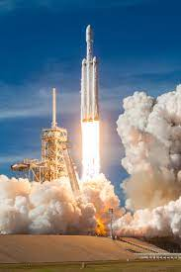
Announcements
Ever wanted to fly a rocket?
A student team(s) from Augsburg will be building and launching a rocket this semester!
Kick-off: Saturday 9/9 at North Branch (transportation can be arranged)
Building materials will be provided
Weekly remote lessons + weekly building sessions
Team(s) will launch their rocket on 10/28
Interested? Talk to me after class or send me an email (hickoxyo@augsburg.edu)
No engineering/physics background necessary!

Slide 3
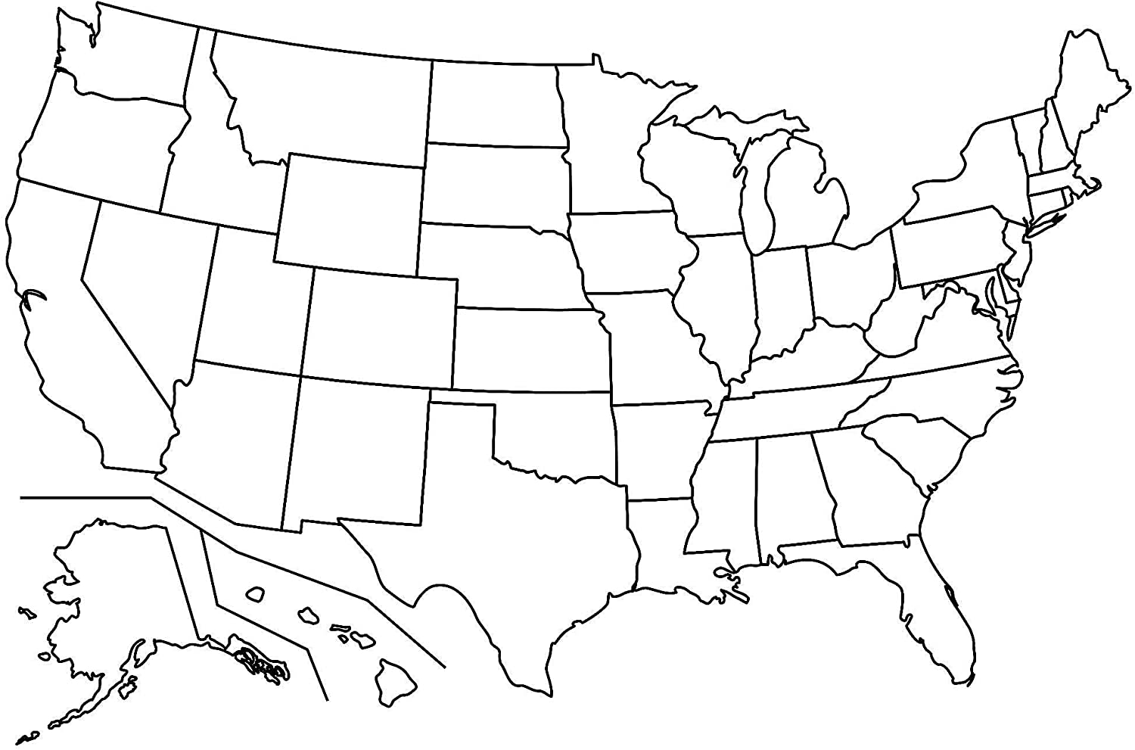
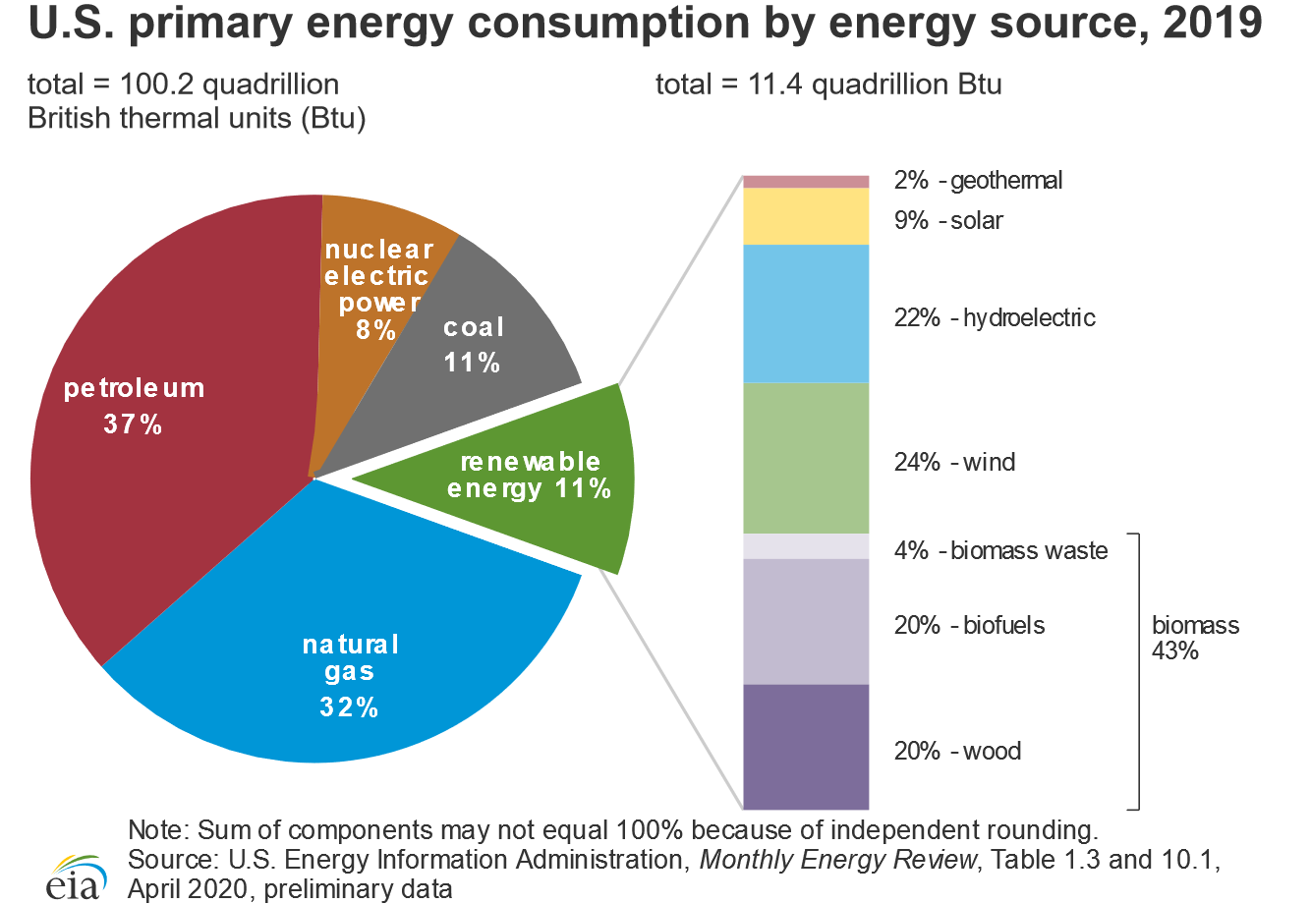
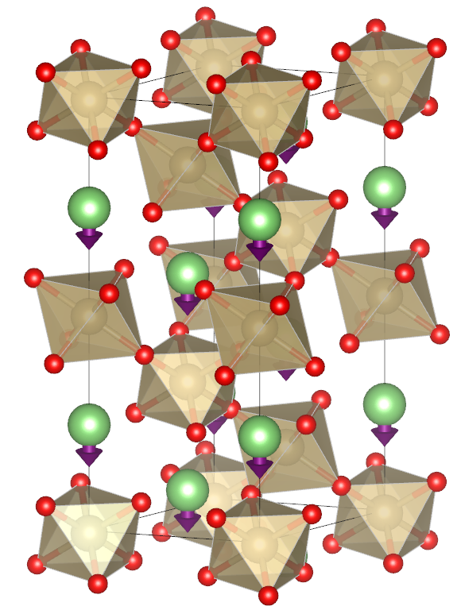
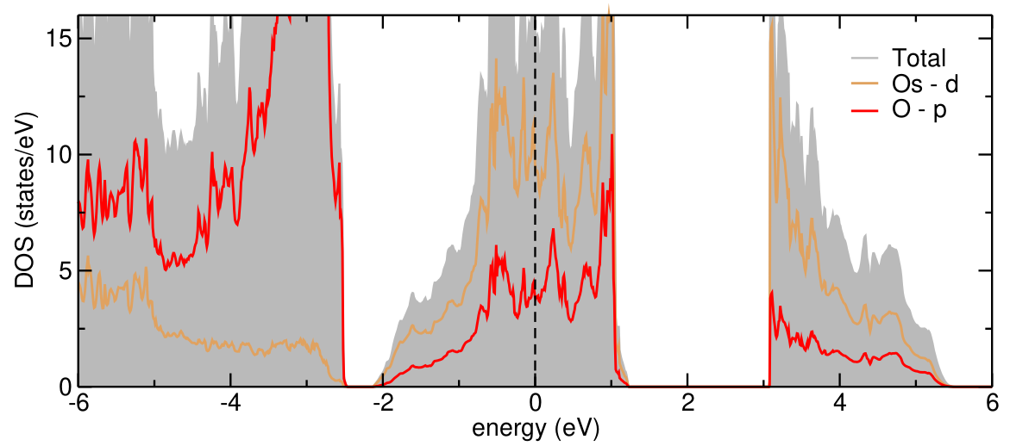
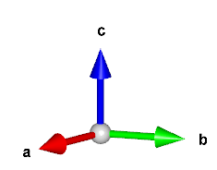
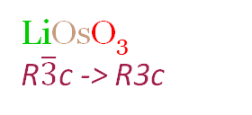
Introductions
Dr. Daniel Hickox-Young (Dr. H-Y)
Pronouns: he/him/his
Assistant Professor – Physics
Office: Hagfors 135
Office Hours: TuW 3-5pm
OR schedule with calendly: https://calendly.com/hickoxyoung
Also available by appt via zoom: https://augsburg.zoom.us/my/hickoxyo
Email: hickoxyo@augsburg.edu
Background
BA in Physics and Mathematics – St. Olaf College (Northfield, MN)
PhD in Materials Science and Engineering – Northwestern University (Evanston, IL)
Research
Materials for energy conversion and storage
First principles (i.e. quantum mechanics) simulations
Conducting and semiconducting polar oxides
LiOsO₃
R$\overline{3}$c -> R3c

Slide 4
Introductions
Please share the following:
Name (First and Last)
What you prefer to be called
Pronouns (if you’d like)
Your favorite science movie (can include sci-fi)

Slide 5
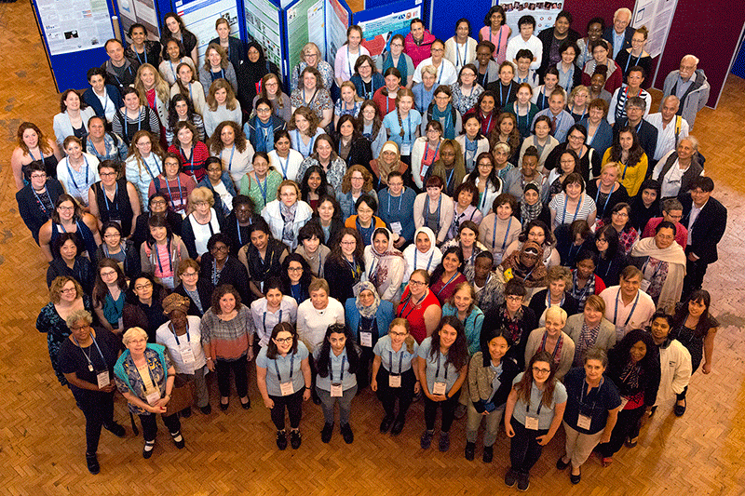
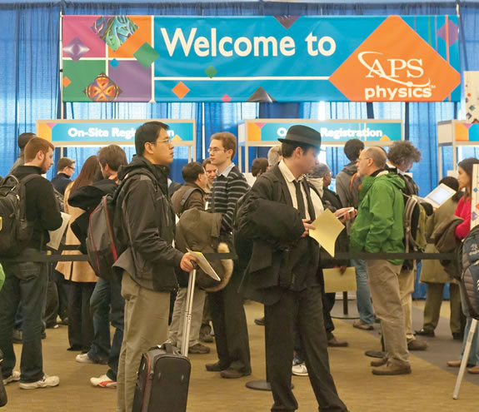
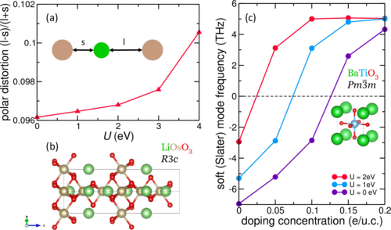
Practicing Professionalism
Goal: Provide a hands-on, professional-style experience of “doing physics.”
Why:
Develop transferrable skills
Prepare you for internships/research opportunities
Demystify the practice of science
Welcome you into the community of scientists
How:
Authentic research experience (computational physics)
Discussions about topics that matter to the modern physics community

Slide 6
What, Specifically?
See the Syllabus, Available on Moodle

Slide 7
Small Group Activity: Community Agreements
From the syllabus: “To help create a space in which the diverse backgrounds, perspectives, and approaches will enrich our discussion without causing harm, we will spend some time on our first day of class crafting community agreements to unpack what that means to us.”
Split into groups (3-4 people) and together develop 2-3 guidelines that you would like to see implemented:
Make sure that everyone is on the same page, working together helps everyone involved
Invite people to work with you, especially if they appear to be on their own
Respect one another: use respectful language
Work with each other, not over each other
Remember that not everyone knows what you know
Critique ideas, not individuals

Slide 8
What do Physicists Care About?
Initial Thoughts:
Nuclear bombs
Expanding the boundaries of our knowledge
Family
Re-learning forgotten math
The understanding of how things interact with one another
Avoiding eye contact
Reproducible experiment
The Earth’s magnetic field
Systems

Slide 9
APS News Activity
Receive a number/letter assignment (e.g. 2C)
Look through your assigned copy of APS News, making note of the types of articles being written in this newsletter by and for physicists.
Group together by number (i.e. all 1’s sit together, all 2’s, etc.) and come up with a list of topics covered by your issue.
Re-group, this time by letter (i.e. all A’s, all B’s, etc.). Compare topic lists and consider the following:
Is there overlap in your lists? Are there consistent topics?
Which topics appear most frequently?
Any other patterns? (i.e. what’s on the front page, what tends to get a longer article, etc.)

Slide 10
What do Physicists Care About?
Considered Thoughts:
Exciting Ideas About The Boundaries of Our Knowledge
Connecting Physics to Current Events
Public Policy
Diversity Equity and Inclusion
Application to Daily Life
Physics Education
Biographies/Obituaries
History
Awards
Units
Space
China
AI

Slide 11
Coding Advice
Remember, the computer is only as smart as the person pushing the buttons
Related, the computer only does EXACTLY what you tell it to
Google is your best friend (websites with names like “stack exchange” are generally reliable, offer good advice)
When you see “<words>”, usually you should replace everything from < to > with your own filename
E.g. if you see “mkdir <YourName>”, type “mkdir DanielHickox-Young”
Don’t put spaces in filenames!

Slide 12
The Terminal
For Windows users, you’ll need the Windows Subsystem for Linux (https://learn.microsoft.com/en-us/windows/wsl/install)
Follow the instructions for install (default settings/distribution will be fine)
Set your new Linux password and username
For Apple users, simply open the terminal

Slide 13
The Command Line: Bash
What is Bash?
“Bash” is the command interpreter, as well as a programming language.
Stands for “Bourne again shell”, named for Stephen Bourne, author of an earlier version of the shell
Default tool for navigating the command line
What is a shell?
Primary purpose: execute commands
Secondary purpose: a programming language capable of executing complex operations

Slide 14
Basic Commands
Navigating the filesystem
pwd – prints your working directory, i.e. your current location or filepath
ls – prints (lists) all the content of your current directory
cd <directory> – change directory to one named “filename”
cd .. – Change directory by moving up one level in the file tree
Creating and editing files
mkdir <directory> – creates a new directory (i.e. a folder)
mv <filename> <filename2> – rename a file or directory
mv <filename> <filepath> – move a file to a new location
rm <filename> – delete (i.e. remove) a file
rm -r <directory> – delete a directory and all of its contents
Quickly access information from a file
head <filename> – print the first 10 lines of a file
tail <filename> – print the last 10 liens of a file
grep <string> <filename> – find the series of characters “string” and print every line containing it

Slide 15
Basic Commands, Editing
Get comfortable with the basic commands by following this tutorial, moving through sections 3-6:
https://ubuntu.com/tutorials/command-line-for-beginners#3-opening-a-terminal
Then complete the (brief) Lab 01 assignment on Moodle

