Slide 1
PHY 245L: Modern Physics Lab Dr. Daniel Hickox-Young (hickoxyo@augsburg.edu)
9/12/2023
Lecture Topic(s) - Materials Science, Crystal Structure, VESTA, Command Line Text Editing
Reading for Next Class: Assigned on Moodle - Milliken
Logistics:
- Reflection 2 due Monday, 9/18 at midnight
- Lab Activity 2 due Friday, 9/15 at 5pm

Slide 2
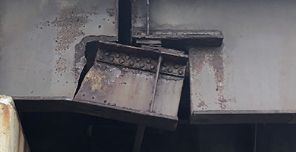

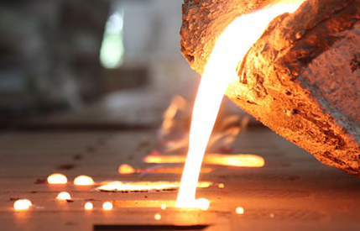
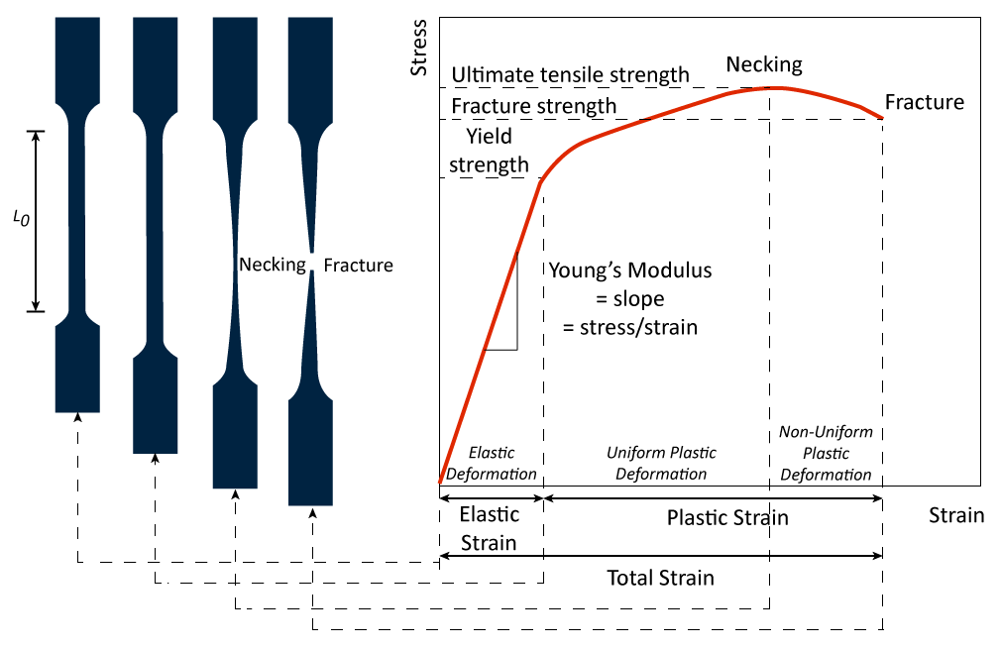
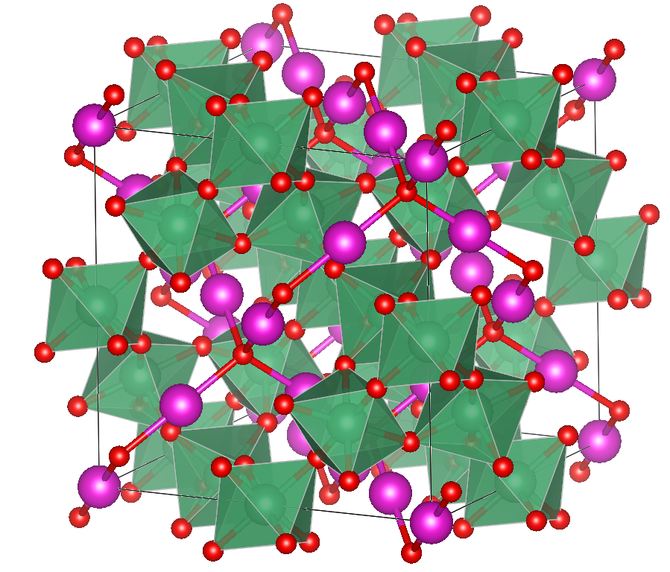
Materials Paradigm
performance
properties
structure
processing

Slide 3
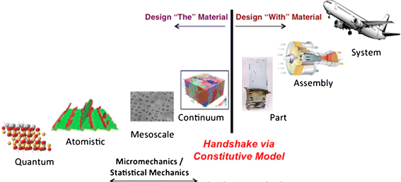
Structure-Property Relationships
Macro-scale properties:
Aerodynamics
Maximum load
Microscopic-scale properties:
Strength
Toughness
Durability
Fundamental properties:
Optical Absorption
Stability
Magnetism
Conductivity
Arnold, S.M. et al. Integrating Materials 4, 37–62 (2015).

Slide 4

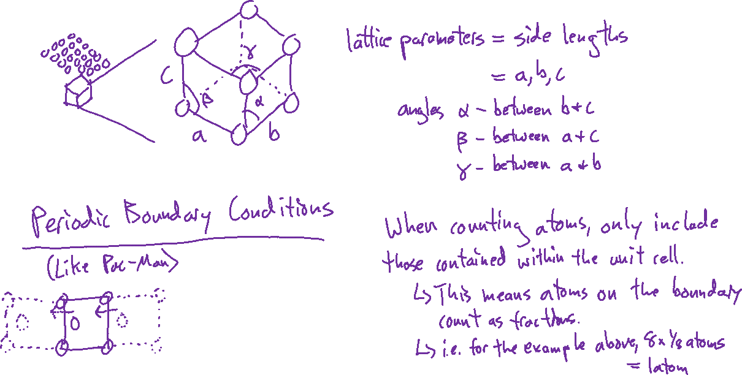
Unit Cell

Slide 5
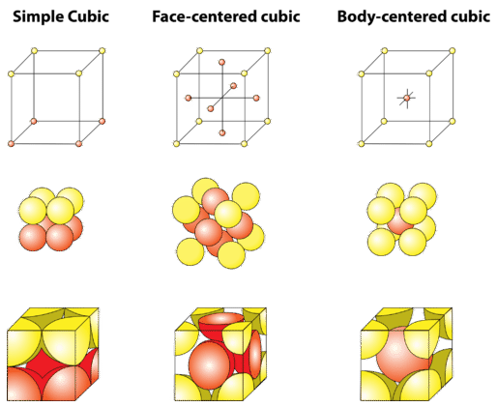
Common Crystal Structures

Slide 6
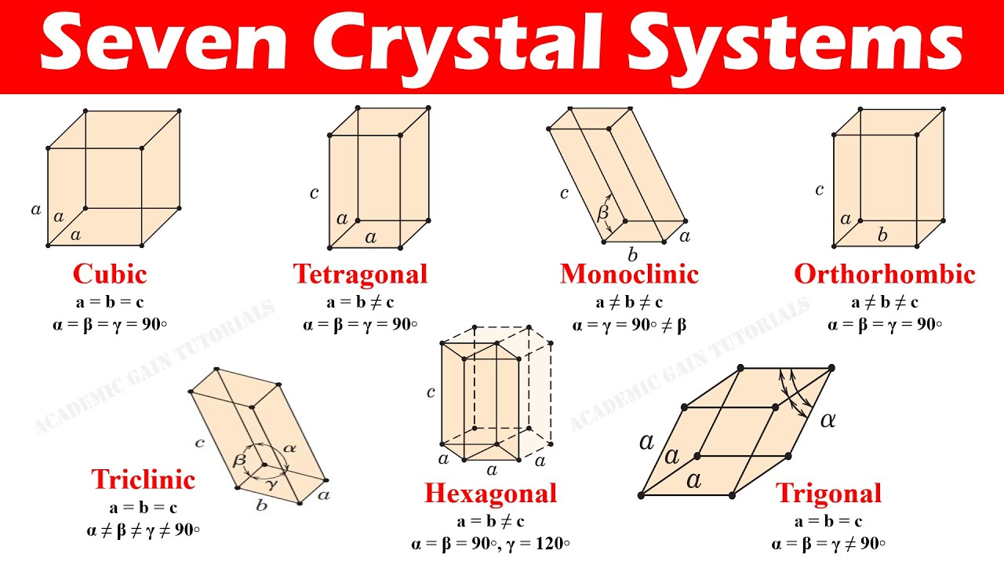
The 7 Crystal Systems

Slide 7
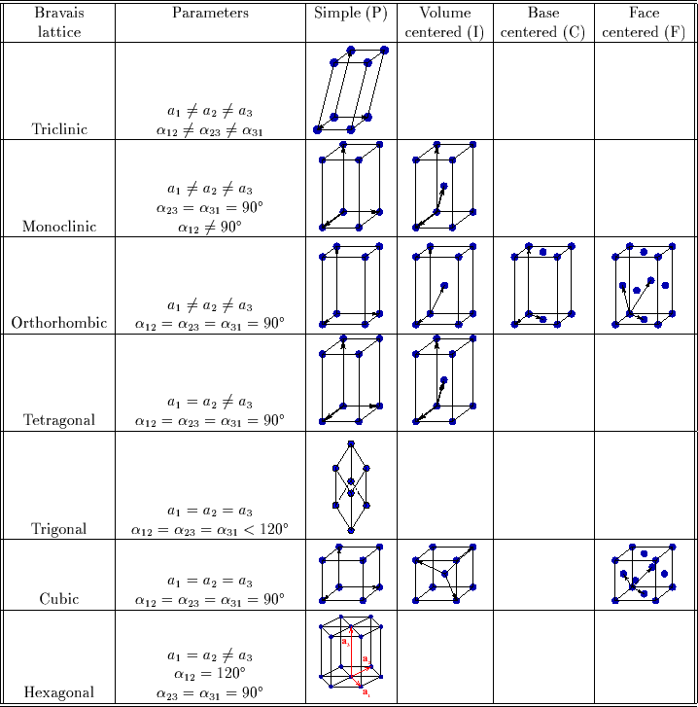
14 Bravais Lattices

Slide 8
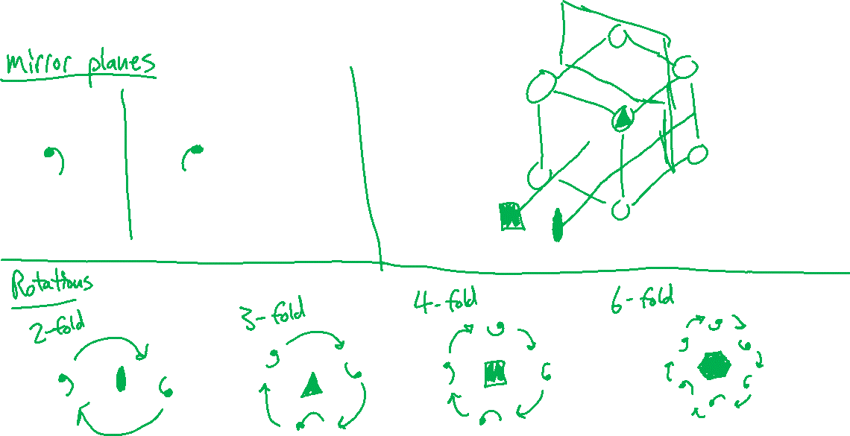
Symmetry Operations

Slide 9
VESTA
For windows, WSL (i.e. windows command line users) you need the following:
apt install mesa-utils libglu1-mesa-dev freeglut3-dev mesa-common-dev
sudo apt install libgtk-3-dev
sudo apt-get install libgomp1
Then to run, execute ./VESTA from the directory
For Mac, or if WSL is proving impossible, download, extract, and run windows or Macintosh version by double-clicking “VESTA” in the extracted folder

Slide 10
Vi
Vi is a command line text editor.
It is what we will routinely use to view and edit input/output files when we perform materials simulations.
There is nothing to install, simply type “vi <filename>” and the editor will open.
Key commands
i – “insert” mode, you must be in insert mode to type
Esc – “command” mode, you can use command mode to navigate quickly and to save
ZZ – save and close
GG – jump to the end of the document
gg – jump to the beginning of the document
For more helpful commands (and a good guide) see https://ryanstutorials.net/linuxtutorial/vi.php

